Slide 1
AI-Based Drone Delivery System
Conflict-Aware Path Recommendation for Urban India
Presented By:
Aditya Acharya | Harphool Singh | Pradeep Kumar | Vishvendra
Presented To:
Dr. Vipul Kumar Mishra
Gati Shakti Vishwavidyalaya, Vadodara
AI&DS
Department of Artificial Intelligence & Data Science

Slide 2
Presentation Outline
Part I: Foundation
Part II: Application
1. Problem Statement & Motivation
6. Single Drone Dashboard (Step 6)
2. Literature Review
7. Fleet Optimization (Step 7)
3. System Architecture
8. Fleet Dashboard (Step 8)
4. Data Pipeline (Steps 1-4)
9. Results & Algorithm Comparison
5. A* Pathfinding Engine (Step 5)
10. Deployment & Future Work
Total: 8-Stage Pipeline | 5 Algorithms | Deployed on HuggingFace

Slide 3
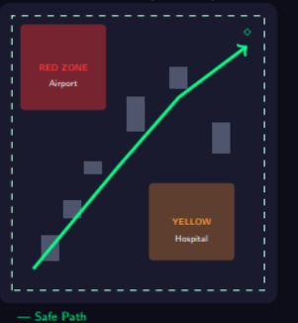
Problem Statement & Motivation
Why Drone Delivery in India?
RED ZONE - No Fly
• 1.4 billion people: massive last-mile delivery demand
• Rural India: poor road connectivity, medical supply gaps
• Urban India: traffic congestion, time-critical deliveries
• DGCA Drone Rules 2021: regulatory framework ready
Airports, military bases
Key Challenges
YELLOW - Conditional
• No-fly zones: airports, military, government buildings
• Conditional zones: hospitals, schools require permission
• Dense building clusters create narrow aerial corridors
• Multi-drone coordination under battery constraints
Hospitals, schools
GREEN - Safe
Open airspace
Operational Area: Jaipur 20×20 km 26.757°-26.937°N, 75.701°-75.901°E

Slide 4
Project Objectives
1
2
Build Airspace Map
A* Pathfinder
India-compliant map with Red/Yellow/Green zones for Jaipur region
Altitude-aware obstacle avoidance with string-pulling smoothing
→
3
4
Fleet Optimizer
Interactive Dashboard
Multi-drone VRP using Google OR-Tools with capacity + battery constraints
2D/3D visualization with Streamlit, deployed on HuggingFace Spaces
→

Slide 5
Literature Review
Approach | Strengths | Weaknesses | References
Potential Fields | Simple, real-time | Local minima | Khatib, 1986
A* Search | Optimal, complete, fast | Grid-dependent | Hart et al., 1968
RRT* | High-dim, any space | Non-deterministic | Karaman, 2011
Theta* | Any-angle smooth paths | More node exploration | Nash et al., 2007
VRP Solvers | Fleet optimization | NP-hard scaling | Dantzig, 1959
Research Gap
No existing work combines India-specific regulatory zones + altitude-aware building avoidance + multi-drone fleet optimization in a single deployable system.

Slide 6
System Architecture — 8-Stage Pipeline
Step 1 Map Analysis
Step 2 Fetch Buildings
Step 3 Simulate Buildings
Step 4 Merge Master Map
→
→
→
Step 5 Multi-Algo Pathfinder
Step 6 Single Drone Dashboard
Step 7 Fleet Optimizer (OR-Tools)
Step 8 Fleet Dashboard
→
→
→
Data Layer
Engine Layer
Fleet Layer
GeoJSON zones + OSMnx buildings + Gaussian simulation
Multi-algorithm pathfinding with string-pulling smoothing
OR-Tools VRP with capacity + battery constraints

Slide 7
Technology Stack
Component | Technology
Language | Python 3.11
GIS Processing | GeoPandas, Shapely
Building Data | OSMnx (OpenStreetMap)
Pathfinding | Custom A*, BFS, Best-First, Theta*, RRT*
Fleet Optimization | Google OR-Tools 9.10
Dashboard | Streamlit 1.55
2D Visualization | Folium
3D Visualization | PyDeck
Hosting | HuggingFace Spaces
HuggingFace Spaces
Streamlit Dashboard
Folium + PyDeck
OR-Tools (Fleet)
A* Pathfinder
GeoPandas + OSMnx
Python 3.11
Technology Stack (Top to Bottom)

Slide 8
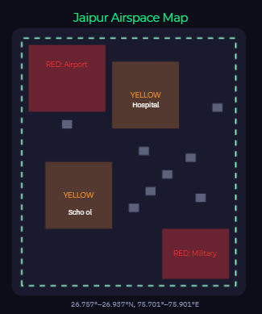
Steps 1-2: Map Analysis & Building Fetch
Step 1: Airspace Classification
Airspace Map
• 12 Red Zones: No-fly (airports, military) — Height: 500m
• 20 Yellow Zones: Conditional (hospitals, schools)
• Boundary: 20×20 km operational area over Jaipur
RED: Airport (No-Fly)
RED: Military Base
Step 2: OSMnx Building Fetch
YELLOW: Hospital
• Query OpenStreetMap for Jaipur building footprints
• Extract polygon geometries + metadata
• Assign realistic heights where data is missing
YELLOW: School Zone
GREEN: Safe Corridor

Slide 9
Steps 3-4: Building Simulation & Master Map
Step 3: Gaussian Building Generation
• 1,079 buildings procedurally generated
• Gaussian cluster density model with 8 centers
• Heights: N(45, 10) truncated to [30, 60] m
• Minimum gap: 18m between buildings
Step 4: Master Map Merge
• Merge zones + buildings → master_map.geojson
• Each feature has height attribute
• Red zones: 500m, Yellow: 400m height encoding
μ = 45m | σ = 10m | n = 1,079 buildings Min gap = 18m | 8 cluster centers

Slide 10
Step 5: Multi-Algorithm Pathfinding Engine
Grid Discretization
Cell Blocking Rule
• 401 × 400 grid = 160,400 cells
• Resolution: ~50m per cell
• 8-directional movement supported
blocked(c) = TRUE if: • c ∈ Red Zone or unpermitted Yellow Zone • height(c) ≥ drone_altitude - safety_margin blocked(c) = FALSE otherwise
A* Formula: f(n) = g(n) + h(n)
Octile Heuristic (admissible + consistent): h(n) = Dmax + (√2 - 1) · Dmin
5 Algorithms Implemented
String-Pulling Smoothing
• A*: Optimal + complete, recommended default
• Best-First Search: Fastest, greedy heuristic only
• BFS: Level-order, no heuristic guidance
• Theta*: Any-angle paths via line-of-sight checks
• RRT*: Sampling-based, asymptotically optimal
96% waypoint reduction on average 156 raw waypoints → 6 smooth flight vectors Process: 1. Start from first waypoint 2. Try line to farthest visible point 3. Skip intermediates if obstacle-free 4. Advance and repeat

Slide 11
Altitude-Aware Obstacle Avoidance
Key Insight: Not all buildings are obstacles!
Altitude Profile
A drone at 60m altitude with 10m safety margin: → Threshold = 50m → Buildings < 50m are IGNORED → Buildings ≥ 50m are AVOIDED
60m
55m
Drone: 60m
Altitude | Safety Margin | Threshold | Buildings Blocked
40m | 10m | 30m | 1,079
60m | 10m | 50m | 412
80m | 10m | 70m | 0
60m | 0m | 60m | 89
45m
Threshold: 50m
30m
25m

Slide 12
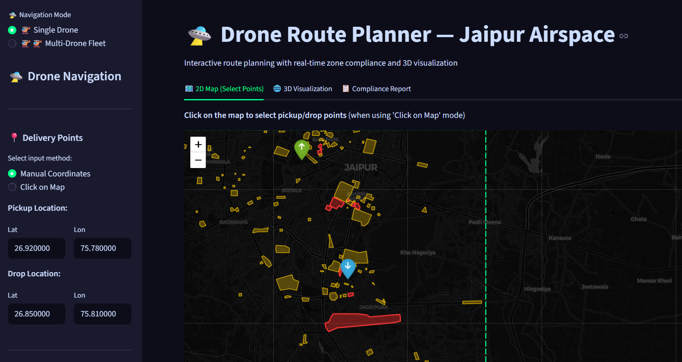
Step 6: Single Drone Dashboard
Dashboard Features
• Point & Click: set pickup/drop on interactive map
• Manual Entry: lat/lon coordinate input
• Yellow Zone Selector: permit/deny per zone
• 2D Map: Folium with zones + buildings + path
• 3D Map: PyDeck with extruded buildings
• Metrics: distance, time, battery, compliance
Sample Results
Mission | Distance | Time | Compute
N→S | 9.47 km | 11.4 min | 47 ms
Cross-city | 15.83 km | 19.0 min | 89 ms

Slide 13
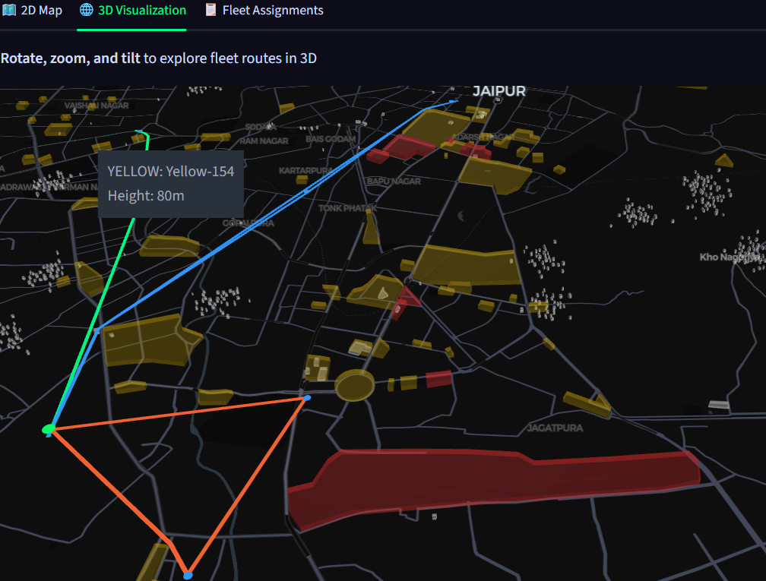
3D Visualization — Fleet Routes over Jaipur
3D Features
• Extruded building geometries (gold)
• Red zones rendered as obstacles
• Color-coded drone flight paths
• Interactive rotate/zoom/tilt
• PyDeck + Mapbox dark basemap
• Real-time fleet route overlay

Slide 14
Step 7: Fleet Optimization with Google OR-Tools
Vehicle Routing Problem (VRP)
Route Assignment Example
Minimize: Σ total fleet distance across all drones
Subject To:
D1
D2
• Weight per drone ≤ capacity (2.5 kg default)
• Distance per drone ≤ battery range (300 km)
• Each drop visited exactly once
• All routes start/end at warehouse
WH
D6
D3
Cost Matrix
Cij = A*-safe distance between locations i, j Requires C(N,2) A* computations Distances are safe-path (not Euclidean)!
Solver: PATH_CHEAPEST_ARC + GUIDED_LOCAL_SEARCH
D5
D4

Slide 15
Fleet Optimization Results
Scenario: 1 Warehouse, 5 Drops, 3 Drones
Drone | Drops | Distance | Weight | Battery Used
Drone 1 | D2, D5 | 22.31 km | 2.3 kg | 7.4%
Drone 2 | D1, D3 | 28.14 km | 2.1 kg | 9.4%
Drone 3 | D4 | 16.71 km | 0.5 kg | 5.6%
Total | 5/5 | 67.16 km | 4.9 kg | —
Key Metrics
• All 5 drops served ✓
• Max battery: 9.4% (of 300 km range) ✓
• OR-Tools converged in < 10s ✓
• All paths avoid Red zones ✓

Slide 16
Algorithm Comparison — Performance Analysis
Algorithm | Success Rate | Avg Distance (m) | Avg Time (s) | Nodes Explored
A* (Recommended) | 5/5 (100%) | 8,438 | 0.051 | 151
Best-First Search | 5/5 (100%) | 8,510 | 0.019 | 154
BFS | 5/5 (100%) | 8,473 | 0.296 | 151
Theta* | 5/5 (100%) | 8,459 | 0.173 | 1,066
RRT* | 3/5 (60%) | 10,736 | 48.84 | 13,997

Slide 17
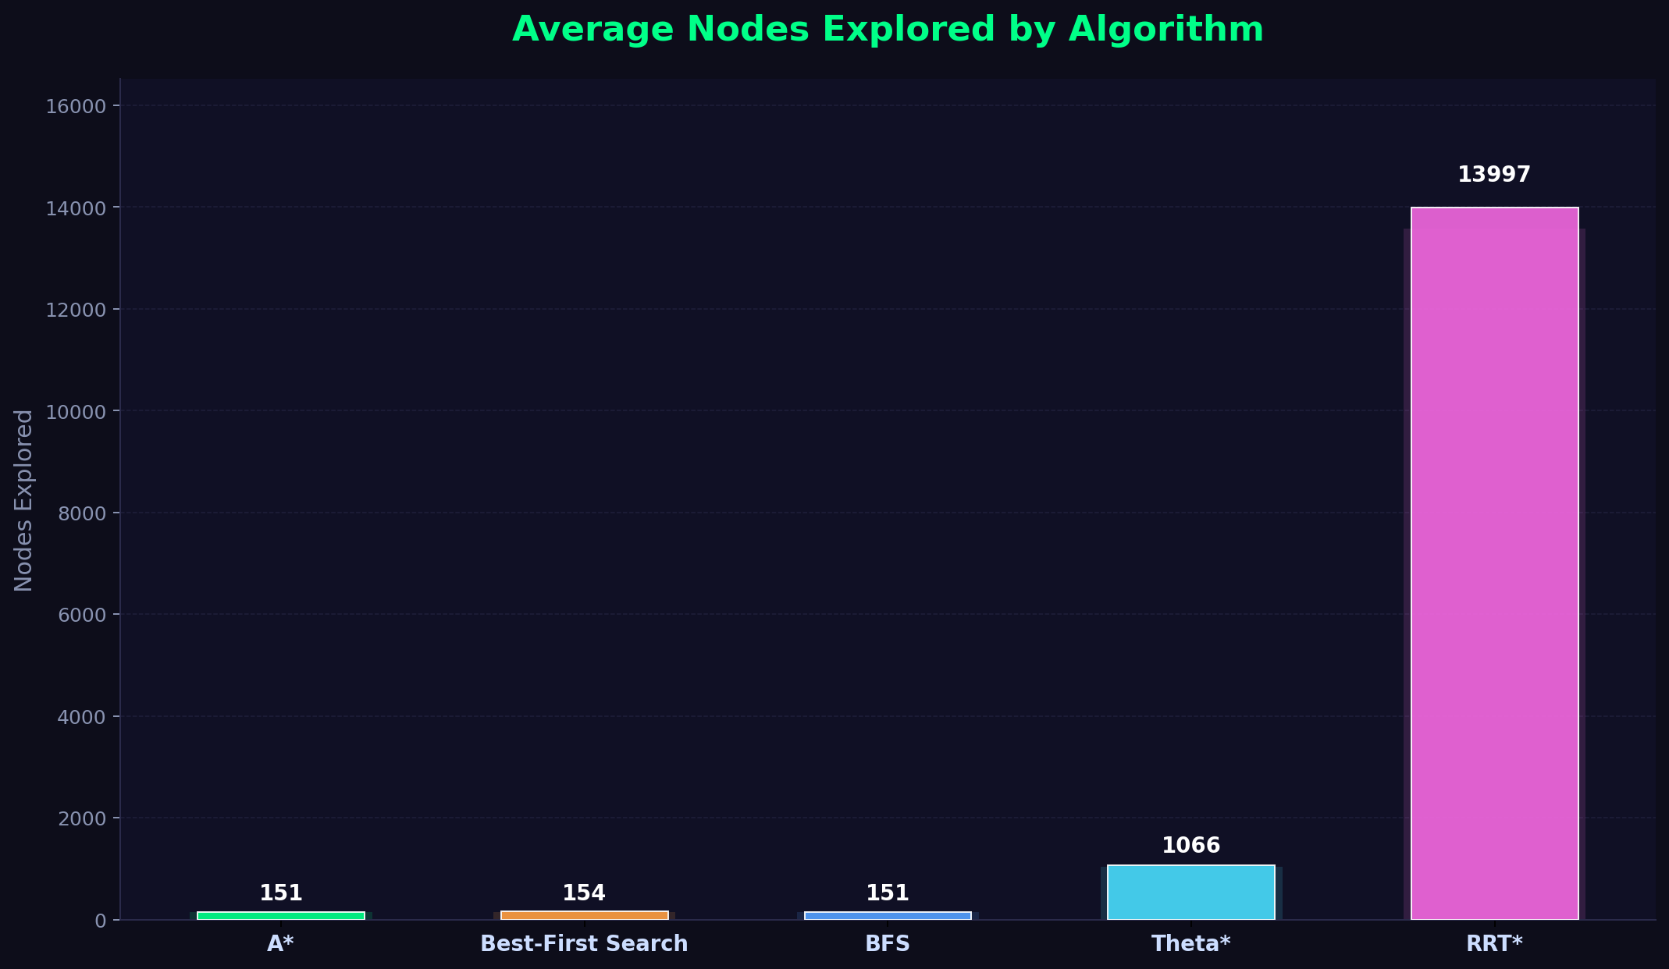
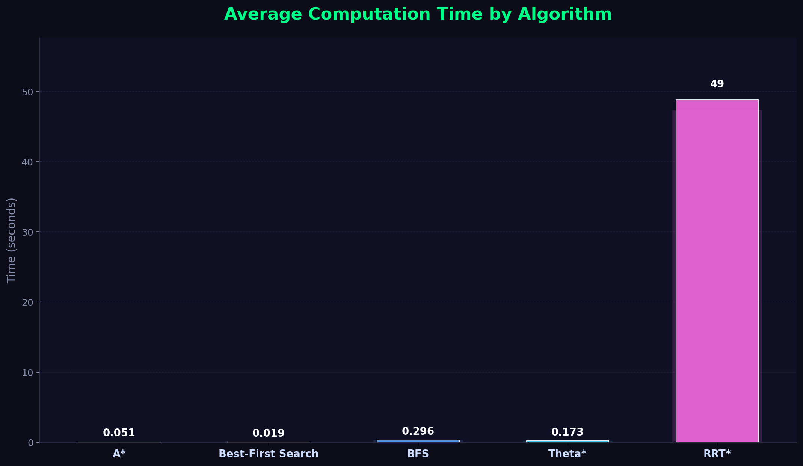
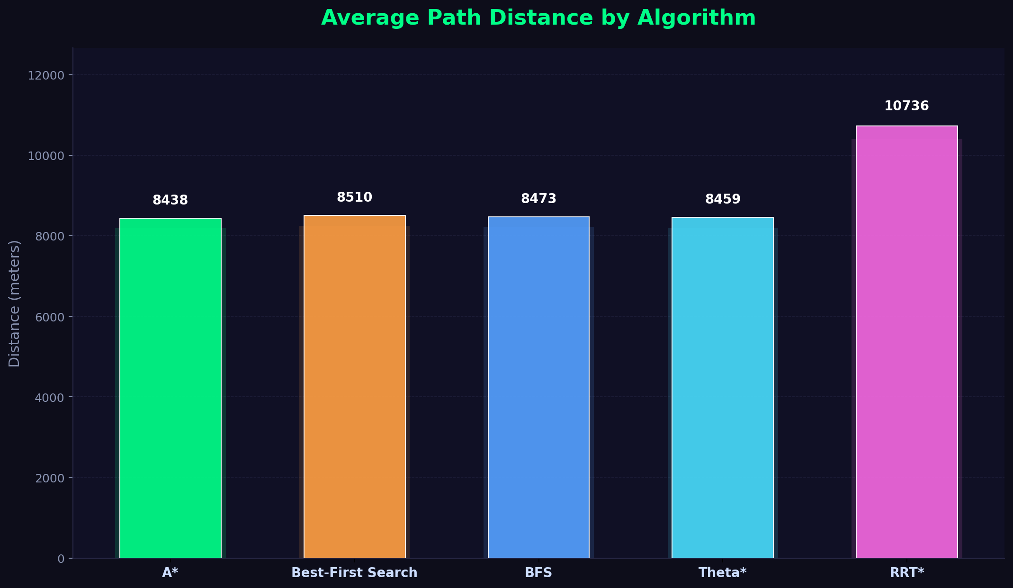
Average Nodes Explored & Computation Time by Algorithm

Slide 18
Deployment on HuggingFace Spaces
Live Public Application
Deployment Flow
• Hosted on HuggingFace Spaces (free tier)
• Streamlit SDK, containerized deployment
• No installation required — browser only
• Dual-mode: Single Drone + Fleet Planner
1
Push Code to Git
2
Build Container
Access URL:
huggingface.co/spaces/harphool17/drone-route-planner
3
Install Dependencies
Deployment Stack:
• app.py → unified entry point
• requirements.txt → auto-install
• data/ + output/ → pre-computed maps
• Git push → auto-build & deploy
4
Run Streamlit
5
Public URL Live!

Slide 19
Future Work
Short-Term
Long-Term
• Dynamic Obstacles: ADS-B data for moving drones/aircraft
• Weather Integration: Wind speed → battery adjustment
• 3D Path Planning: Altitude-varying paths with layered grids
• Multi-Depot VRP: Multiple warehouse locations
• GPU Acceleration: NVIDIA cuOpt for 500+ drops
• ML Heuristics: Neural network-trained A* heuristic
Limitations
Static environment (no dynamic obstacles) • Constant altitude flight • No wind/weather modeling • 50m grid resolution may miss narrow gaps

Slide 20
Conclusion
✓
⚡
🌐
Safe Paths
Fleet Optimized
Deployed
A* with string-pulling < 100ms computation 1.24× detour ratio 100% success rate
OR-Tools VRP solver Capacity + battery constraints All drops served < 10s convergence
HuggingFace Spaces Public browser access Zero installation Dual-mode dashboard
Built a complete, deployable drone delivery system specific to Indian regulations, integrating multi-algorithm pathfinding (A*, Best-First, BFS, Theta*, RRT*), OR-Tools fleet optimization, and interactive 2D/3D visualization — accessible to anyone via a public URL.

Slide 21
Thank You!
Live Demo:
huggingface.co/spaces/harphool17/drone-route-planner
Dr. Vipul Sharma • Aditya Acharya • Harphool Singh • Pradeep Kumar • Vishvendra
Gati Shakti Vishwavidyalaya, Vadodara • B.Tech (AI & DS )

