Slide 1
Re-Engineering the
Registration of Marriages
Registrar Generals Department

Slide 2
Objectives
Streamline General and Kandyan Marriages to simplify process and prevent Fraud
  Same day marriages can still be allowed with special permission, and during office hours
Separation of information held electronically from the signed documents that are scanned and archived
Keep complexities of the marriages out of the re-engineering process, and make minimal changes to the existing forms used

Slide 3
General & Kandyan Marriages
Visiting the Registrar allocated to the place of residence of party can be ineffective
  People maybe born in once place, work at another, and temporarily reside elsewhere
  In the past this was not the case, and the Registrar would have known about the party, or have a record about a previous marriage or a notice issued
  Publication of notices can be ineffective in preventing fraud, due to lack of exposure
Same information will be written/entered twice where parties reside in different divisions

Slide 4
With effective use of technology
Prevent fraud
Ensure notices of marriages are duly publicized
Persons entering marriages are of legal age and status, and not in a prohibited relationship
Retain electronic records of the key information for easy retrieval
Issue extracts of marriage in official and English language
Eliminate the duplication of effort

Slide 5
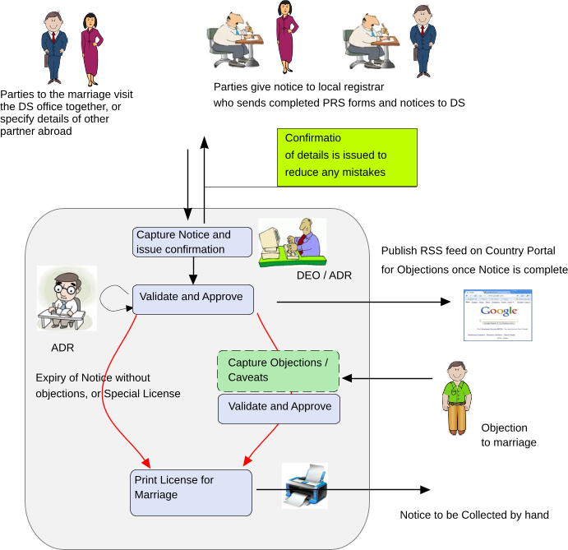
Processing Notices of Marriage for the issuance of the License

Slide 6
Issue of a License for Marriage
Parties must visit the DS office to give notice
  Where both parties are resident in Sri Lanka, they should both visit together
    Ensure that there is no duplication of effort, or clerical errors in a record of marriage
    Can confirm spellings and other details as correct
  DS office registers persons into PRS if required
  Verifies there are no impediments to marriage
    Age, prohibited relationships, previous marriages
When a Sri Lankan is required to present such a license to marry abroad, this same document is used
Where parties cannot come to a DS office, there is provision to submit notices to Registrars to be forwarded to the DS

Slide 7
Items dropped from the Notice
District, DS and Reg. Division of each party
  Unless getting married to a foreigner, both parties visit the same DS (where the marriage is to take place?)
Duration of stay at address
  Should we enforce this with the above amendment?
Fathers rank or profession
  Is this required? How can it be proved anyway?
Consent details, signature/document
  Not required as age must be 18 or more

Slide 8
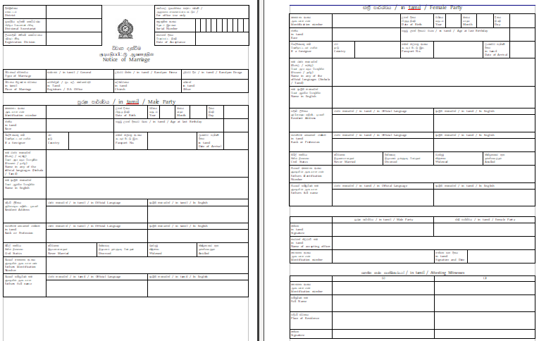

Slide 9
License for Marriage
Once notice is accepted at the DS office, the parties are issued a copy for confirmation of spellings and all information.
  Confirmation maybe posted to the Female party if required, where parties submit notices through Registrars
The notice is published in the RGD Web Site during the notice period after confirmation
Once the notice period ends, the License for Marriage is issued with a unique serial number
  License is to be collected at the DS office, after manually signing a register
If special permission is granted, may bypass notice period to marry within a shorter period of time
Note: License states that according to “details known” to the system, the persons are eligible for marriage

Slide 10
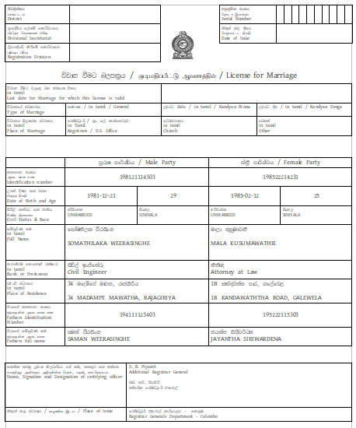
Registrar conducting marriage
Can copy names without
Any mistakes

Slide 11
Solemnization of Marriage
Registrar retains the license, and includes the serial number it in the Marriage Register
  This makes the recording of a marriage simple and quick after the marriage register arrives at the DS for data entry
  DS Office staff must only enter date of marriage, Registrar PIN etc and location of solemnization

Slide 12
Extract Certificate of Marriage
The “signed” copy of the marriage certificate is scanned and archived
Copies of this “original” maybe issued as per current policy
eCivil Registration System issues an “Extract Certificate of Marriage”
  This does not include witnesses, rank or profession etc.
    Rank or profession not proved at marriage, becomes included into documents issued by the Registrar General as true and correct
  This will be the same for all citizens irrespective of the marriage law
  Use of this document as the certificate of marriage is encouraged with the scanned copy only to be used for legal purposes where/if required
The extract is posted to the female party by the issuing DS

Slide 13
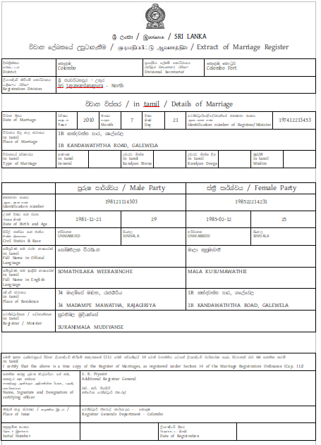
- Internationalized
- Contains only information about the marriage

Slide 14
Muslim Marriages
Notice to Quazis and declarations before marriage takes place outside of the system
After the marriage is solemnized and registered, the DS office captures information to record the event and generate extracts
Note: The extract of a marriage for Muslims does not state Mahr, Kaikuli, Wali and/or relationship to guardian, date/time or person conducting Nikah, details of previous divorces etc

Slide 15
Registration of a Divorce
Irrespective of the Marriage law, when a Divorce is notified, the corresponding Marriage entry is searched and canceled by an ADR or above
The court order, DS / Quazi order details are captured
The system will not generate certificates of divorce

Slide 16
Advantages
Minimizes fraud, and marriages of minors or those within a prohibited relationship or state
Can ensure that a person married under one marriage law cannot marry under another marriage law
Ensures better publicity for notices of marriage

