Slide 1
intruduction to birth registration
Registrars General Department

Slide 2
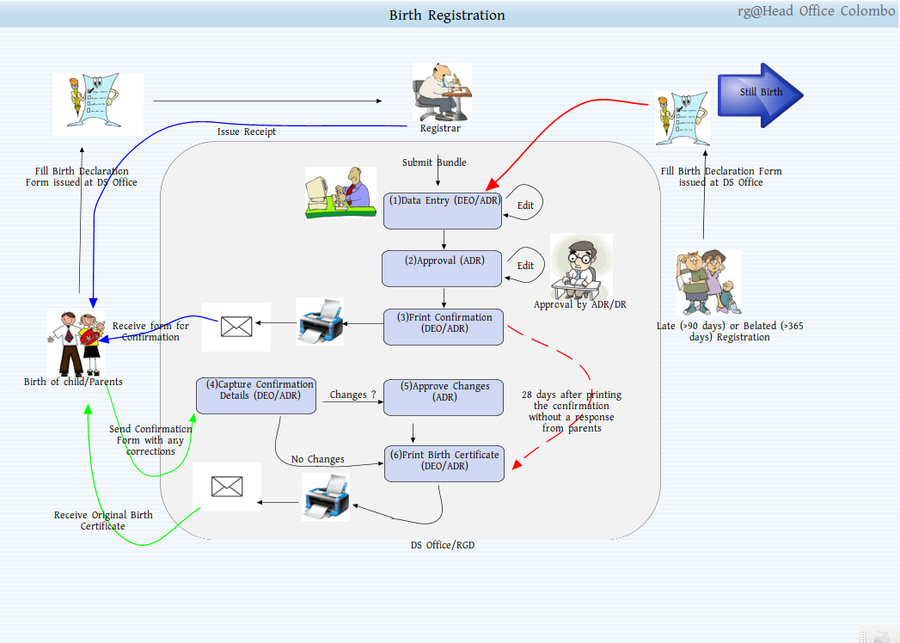
Birth Registration Home

Slide 3
Normal Birth Registration
Registrations that use form number 'CR 1' goes here.
Any user can enter registration details.
User can enter registration that has occured in user assigned divisions.

Slide 4
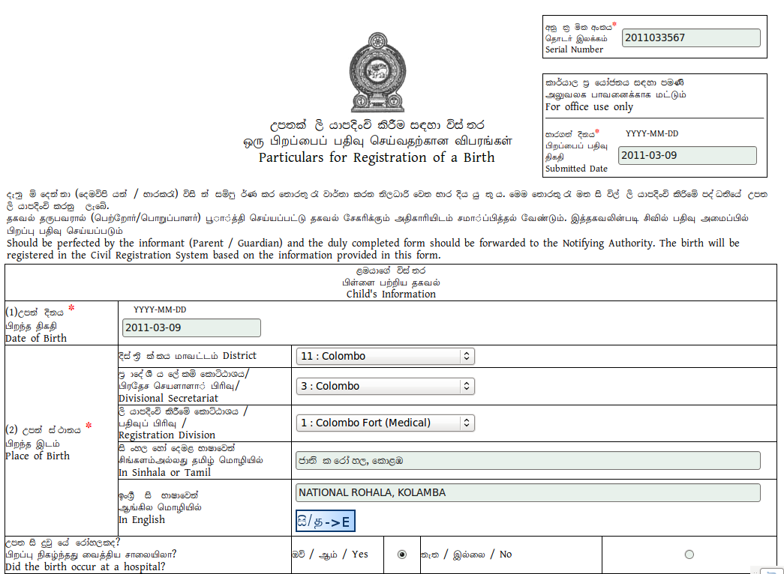
Sample registration form

Slide 5
Notes about filling data
Fill all red labeled data.
Use transiterator button for translate sinhala or tamil text in to English .
But keep in mind this transiteration is not perfect so check the translated check.
You can skip some validation by clicking skip validation button.
Click Next to go next page .

Slide 6
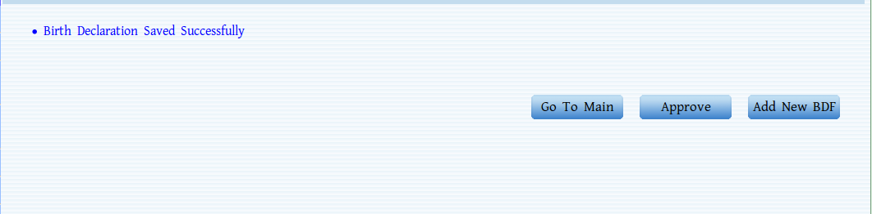
Filling form cont...
After filling all required fields now you can add the birth registration to the system.
Make sure that you have seen following message after successfull add.

Slide 7
What can you do after add .
Add a new normal birth decleration.(click Add new BDF button)
Go to birth registration home page(click Go to Main button).
Approve added birth registration.(click Approve button)
In above case user must have the permission to approve.If user does not have permission button won't display.

Slide 8
cont..
Follow data are auto filled if we lookuped
  In page 2
    Enter father identification number to auto populate father details.
    Enter mother identification number to auto populate mother details.

Slide 9
Adding a still birth
Process is simillar to normal birth registration but still birth registration form has one change and here it is.
Any user can add still birth register but only ADR or higer user's can approve the registration.

Slide 10
After adding what else ?
You can edit entered data .(only non approved registrations)
You can approve entered registration.
You can reject entered registration.
Or you can delete entered registration.(only non approved registrations)
DEO user is only allows to edit and delete registration which are not approved by an ADR.

Slide 11
Editing a registration
Refering to the section 4.1.3.3 in user manual.
To edit a record it must not be approved or rejected.
After approving edit facility will be disbaled for the record.
Only the record which are recorded at user's allocated ds division's are visible to the user.
Ex ; if birth record at colombo ds only users who are allocated to that ds will be visible it .

Slide 12
Rejecting a birth record.
Refering to section 4.1.3.5 of user manual.
There must be a reason for rejecting the record.
Add the reason inside the comment field provided.
This operation can not be invert so once rejected it can not be approve again.

