Slide 1
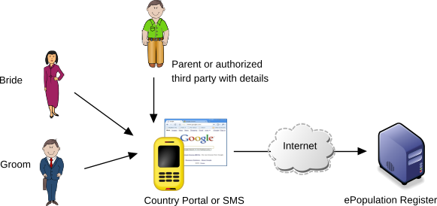
Citizens will be able to
“check the spouse before marriage”
A Web Service over the country portal or SMS will be able to verify if a given PIN/NIC, Date of Birth and Name is eligible for marriage
If details given match, the service will return either: Yes, No or Check manually at a DS

Slide 2
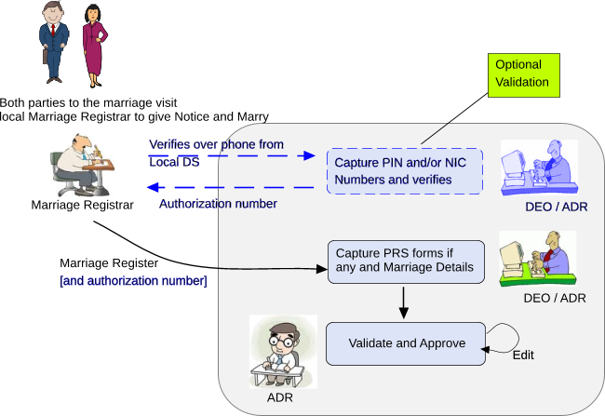
Getting married in a Hurry or outside the system
Registrar “should” verify details from local DS before a marriage wherever possible (i.e. when conducted during office hours)
Where parties are not registered in the PRS, Registrar accepts PRS forms

Slide 3
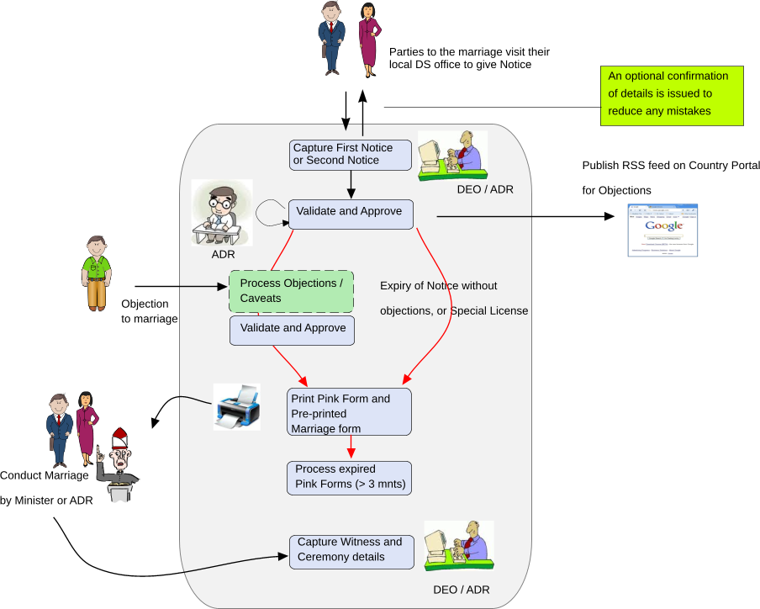
Giving Notice of Marriage at a DS

Slide 4
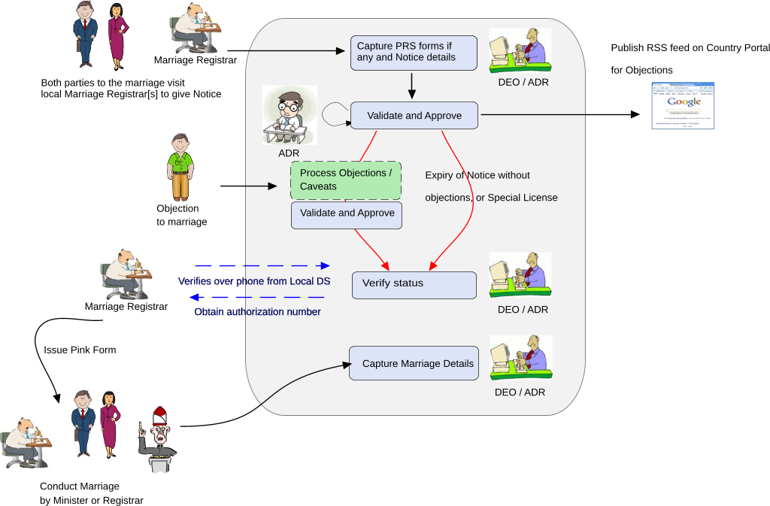
Normal Marriage by Registrar / Minister

