Slide 1
NEXUS ERP
Centralized ERP Platform
for Small and Medium
Businesses
Implementation and live demonstration
Pradeesh A · 310624104225 · CSE D
Guide: Ms. Nagamani
Notes:
Introduce yourself and the project. Explain that the original zeroth-review proposal is now implemented as an academic demonstration. Do not claim that it is a production ERP. The exact live storage mode must be stated: MongoDB or persistent local demo.

Slide 2
Problem and project scope
Disconnected records
Separate spreadsheets make stock, sales and expenses difficult to reconcile.
One shared workspace
Inventory, sales, HR, finance and procurement use connected records.
Role-based access
Owners, managers and departmental users receive appropriate access.
Defined boundaries
Payment gateways and external accounting remain future work.
02
Notes:
Source: uploaded ERP_Platform_Zeroth_Review.pptx, slides 2–8. The proposal describes disconnected systems, duplicated data and missing shared reporting. The implementation covers the five defined modules. Expected business benefits have not been measured in a live company.

Slide 3
Application architecture
React
Dashboard, module screens, forms and printable invoices
Node.js + Express
Session authentication, role checks and validated business commands
MongoDB
Shared collections and atomic cross-module transactions
Local demo option
Persistent JSON adapter for presenting without database installation
03
Notes:
React builds the browser interface. Express exposes a same-origin API and validates requests. Node.js runs authentication and business commands. MongoDB stores separate collections with transactions. The optional JSON adapter runs the same API and rules for a laptop demo. MongoDB transactions require a replica set. References: https://www.mongodb.com/docs/drivers/node/current/crud/transactions/ and https://expressjs.com/en/advanced/best-practice-security.html

Slide 4
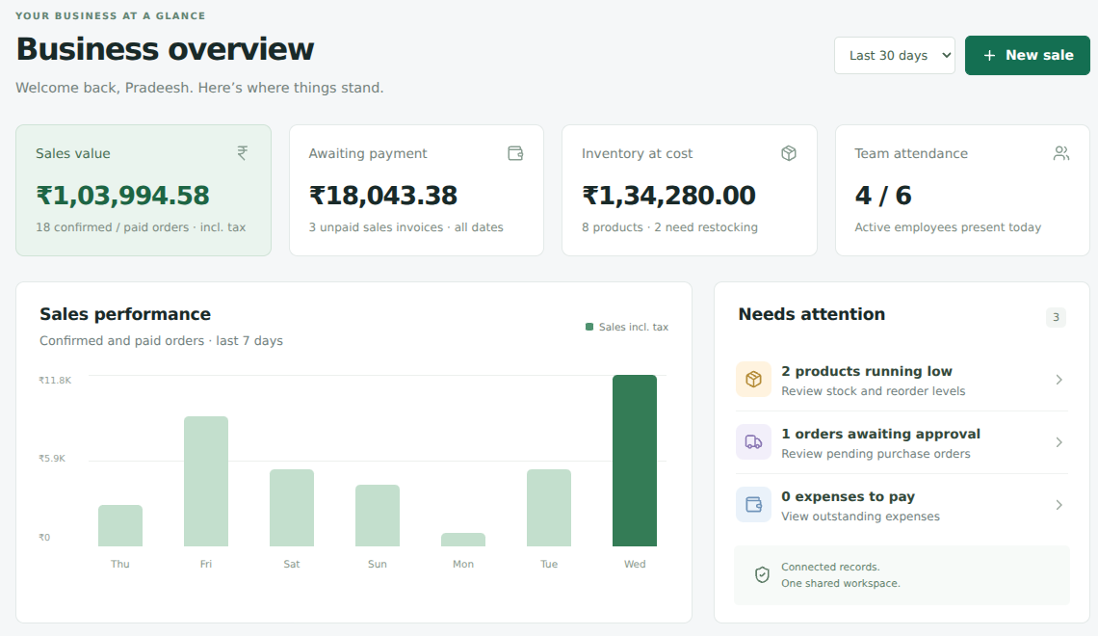
Connected business overview
KPIs derive from module records. Other sessions refresh every 15 seconds.
04
Notes:
Show the dashboard. Explain that sales totals include demonstration tax and exclude draft/cancelled orders. The period selector affects the sales KPI. The chart always displays seven days. Inventory value uses current cost. Screenshot contains fictional sample records.

Slide 5
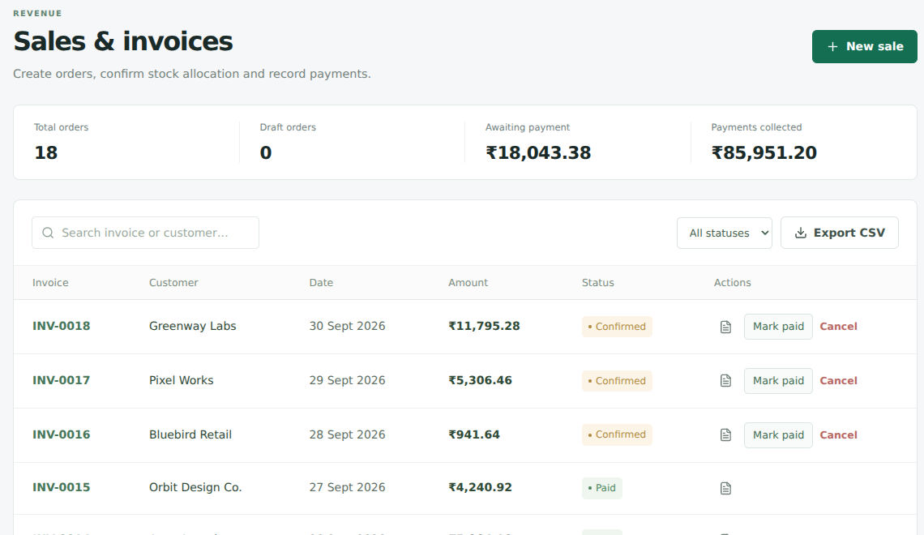
Sales and inventory
Draft creation, stock confirmation, payment recording and invoice printing
05
Notes:
Live demo: create a sale for Horizon Studio, two Wireless keyboards at ₹1,499 each with 18% demonstration tax. Total: ₹3,537.64. Draft leaves stock unchanged. Confirm reduces stock from 42 to 40 in fresh sample data. Mark paid updates cash collected. Open and print the invoice. Confirmed unpaid orders can be cancelled to restore stock; paid orders cannot be cancelled. Screenshot contains fictional sample records.

Slide 6
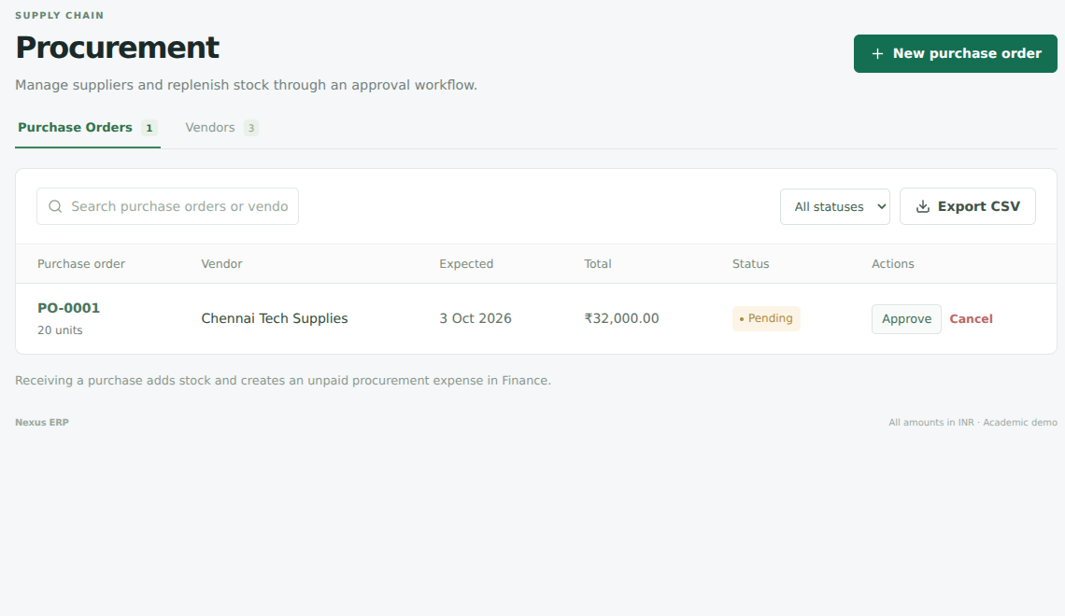
Procurement and stock receiving
Receiving approved goods updates stock and creates an unpaid expense.
06
Notes:
Live demo: approve seeded PO-0001, then receive 20 USB-C hubs. Stock increases from 8 to 28. Finance receives a ₹32,000 unpaid expense. Receipt and payment are separate actions. Repeat receiving is blocked. Screenshot contains fictional sample records.

Slide 7
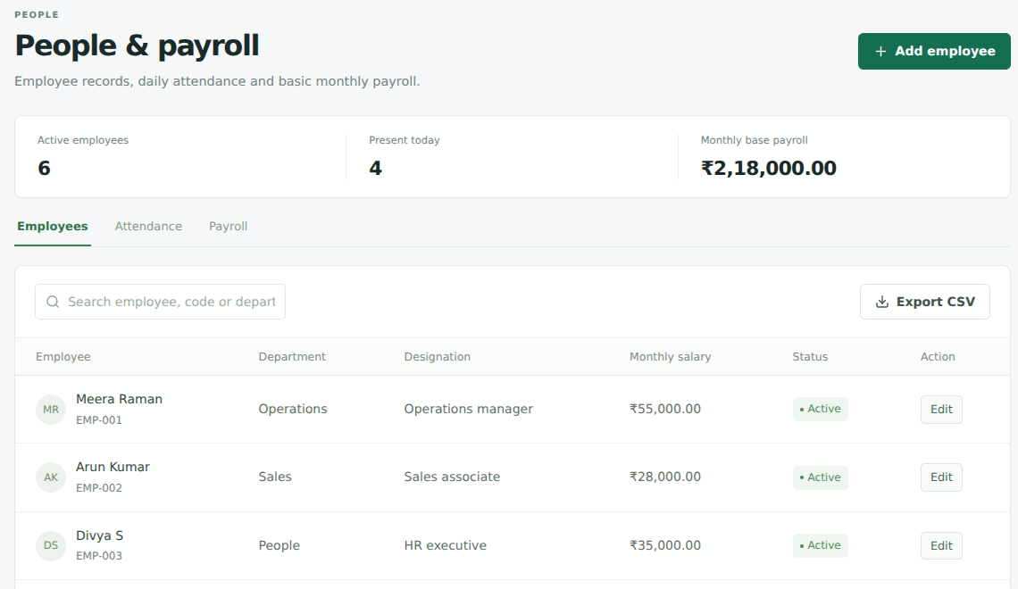
Employees, attendance and payroll
One attendance record per day. One payroll record per employee per month.
07
Notes:
Show employees and the Attendance tab. Mark Rahul P Present. Run current-month payroll. Fresh data creates six base-salary records totalling ₹2,18,000 and matching unpaid finance expenses. Repeating payroll cannot duplicate the same employee-month. Attendance is informational and does not prorate salary. Statutory deductions are outside this implementation. Screenshot contains fictional sample records.

Slide 8
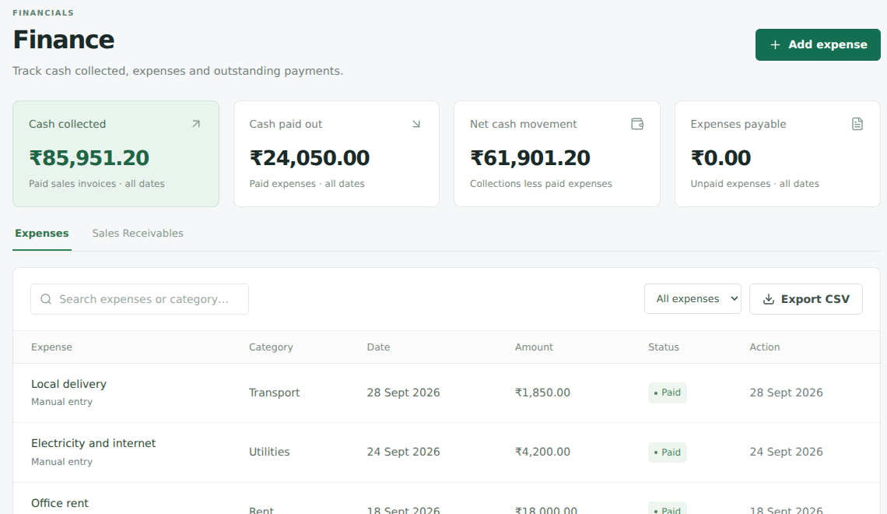
Finance and reporting
Collections less paid expenses gives net cash movement, not accounting profit.
08
Notes:
Show cash collected, cash paid out and expenses payable. Procurement and payroll create linked expenses. Mark an expense paid and show the cash-out update. Explain that this is basic financial reporting, not a double-entry general ledger. Invoice tax is illustrative. Purchase totals exclude tax. Screenshot contains fictional sample records.

Slide 9
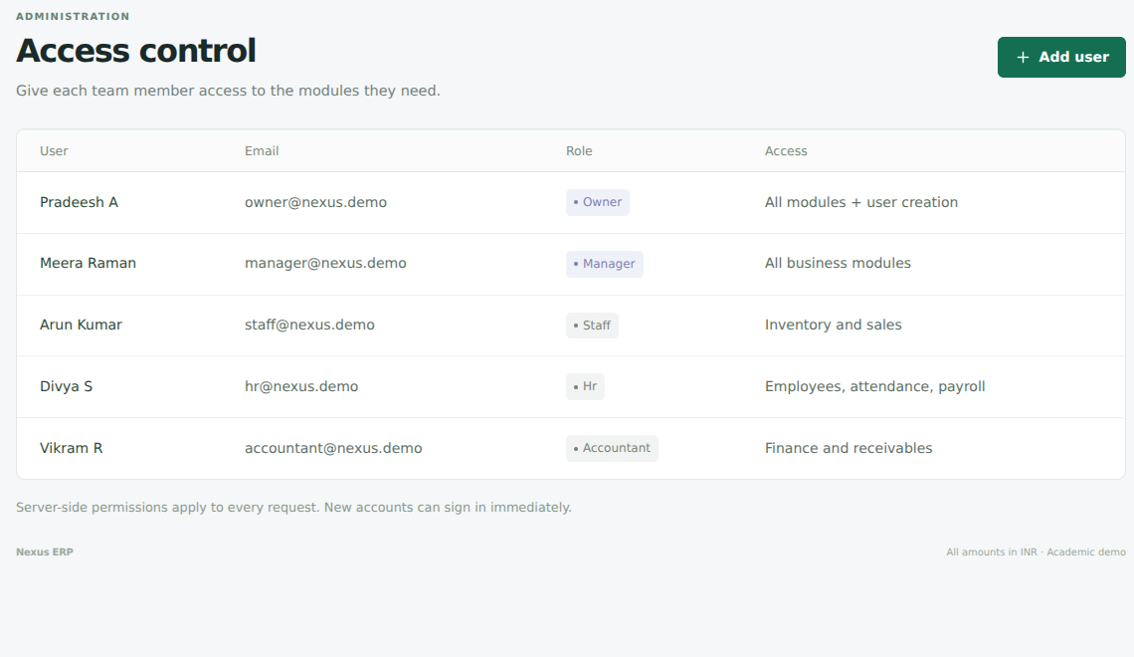
Role-based access
The API verifies permissions and returns only the records allowed for each role.
09
Notes:
Log out and sign in with staff@nexus.demo and Demo@12345. Staff sees Inventory and Sales, but no HR or Finance. Hiding navigation is not the security boundary: server checks reject forbidden commands. Owners can create users. Managers have all business-module access. HR manages people/payroll and accountants manage finance/receivables. Passwords use salted scrypt hashes and are never returned by the API. Screenshot contains fictional sample accounts.

Slide 10
Consistency and validation
Atomic updates
Stock movements and linked financial records commit together.
Duplicate protection
Repeated receipts, payments and monthly payroll are rejected.
Tested scenarios
Workflow, access, persistence and competing-stock checks passed.
Browser demonstration
Sales, purchasing, attendance, payroll and role switching completed.
10
Notes:
Nineteen integration scenarios plus their parent test passed in local demo mode and MongoDB replica-set mode. Browser checks completed the sale, invoice, purchase, attendance and payroll flows and checked staff navigation and mobile width. The project includes the executable test suite and an exact validation record. No load-testing, production security audit or business impact experiment is claimed.

Slide 11
Live demonstration sequence
01 Dashboard and low-stock alerts
02 New sale, confirmation and printable invoice
03 Purchase approval and stock receipt
04 Attendance and monthly payroll
05 Finance payables and payment recording
06 Staff login and restricted access
11
Notes:
Allow around seven minutes. Use docs/PRESENTATION_GUIDE.md for the detailed script, expected numbers and viva answers. Start from fresh seeded data if practising the exact quantity checks. Always keep the server terminal open. Use the screenshots if projection or laptop setup fails.

Slide 12
Scope, limitations and next steps
Implemented
Five connected modules, dashboards, role checks and CSV exports
Academic simplifications
Base-salary payroll, demo tax and current-cost stock valuation
Future capabilities
Refunds, partial receipts, statutory accounting and integrations
Deployment preparation
Account lifecycle, scalable queries, backups and monitoring
12
Notes:
The implementation covers the original five modules and basic workflows. Explain limitations before questions. Default startup is a persistent local demo adapter. MongoDB mode is available and tested separately. The source proposal literature survey is generic; a formal thesis still needs selected, verified academic references. Do not invent research results, performance statistics or production readiness claims.

