Slide 1
VAAN MEGAM NETWORKS | IITM PRAVARTAK
Centralized TDMA Schedule Planner
& Optimizer with EMANE Emulation
Distance-2 Graph Coloring, Spatial Reuse Optimization, and Physical Layer Packet Enforcement for Tactical SDR & MANET Networks
FOCUS DOMAIN
Wireless Protocol Development
5G Private Networks & SDR
PART 1: THE BRAIN
Python Distance-2 Graph Engine
Largest Degree First Heuristic
PART 2: THE EMULATOR
EMANE TDMA BDCE Integration
Automated XML Bridge Generation
Candidate: devpradeesh | Submission: Full-Time 6-Month Wireless Protocol Development Internship | Date: September 2026
Notes:
Good morning/afternoon respected evaluation panel members. Today, I am excited to present my complete solution for the Wireless Protocol Development Internship at Vaan Megam Networks. In this project, I have designed and implemented a centralized TDMA Schedule Planner & Optimizer. Part 1 develops the mathematical Brain using NetworkX to construct Distance-2 conflict graphs and solve collision-free time-slot assignment with aggressive spatial reuse using a greedy Largest Degree First heuristic. Part 2 implements the integration bridge for EMANE (Extendable Mobile Ad-hoc Network Emulator), translating the optimized schedule into native XML event profiles for physical layer enforcement. Over the next few slides, I will walk you through the RF interference physics, graph transformations, algorithm complexity, empirical results on the 16-node grid, and the EMANE emulation architecture.

Slide 2
EXECUTIVE SUMMARY
System Architecture: Mathematical Brain & Physical Emulator
A closed-loop protocol optimization architecture bridging algorithmic graph theory with physical RF emulation.
Part 1: The Network Brain (Python Engine)
• Mathematical Topology Formulation: Models 16 SDR radio nodes using Euclidean distance <= 500m on NetworkX to build physical graph G1.
• Distance-2 Conflict Graph (G2 = G1^2): Explicitly models direct link collisions (1-hop) and hidden terminal receiver collisions (2-hop).
• LDF Greedy Heuristic: Sorts nodes by conflict degree; assigns minimum valid slot index to minimize recurring frame duration.
• Spatial Reuse Guarantee: Enables nodes separated by >= 3 hops to safely transmit simultaneously on identical slots.
• Verification Engine: Performs exhaustive pairwise conflict verification across all conflict edges to ensure 100% collision-free schedules.
Part 2: The Physical Emulator (EMANE Setup)
• EMANE TDMA Radio Model (BDCE): Leverages EMANE's Basic Discrete Collision Event model for hardware-accurate MAC/PHY layer timing.
• Automated Bridge (emane_bridge.py): Parses the Brain's optimized Slot-Node schedule and compiles native tdmaschedule XML event documents.
• Synchronized 1ms Slot Timing: Configures 1000us time slots, frequency channels, and explicit <tx>/<rx> windows per Network Emulation Module (NEM).
• Deterministic Packet Control: EMANE's OTA simulation engine drops packets that collide or violate schedule boundaries while forwarding valid transmissions.
• Dockerized Emulation Architecture: Supports isolated multi-node emulation in Linux network namespaces without specialized physical SDR hardware.
100% Conflict-Free
Zero Collisions Verified
9 Unique Slots
Minimized Frame Length
Up to 4x Concurrency
Aggressive Spatial Reuse
End-to-End Pipeline
JSON -> Schedule -> XML
Vaan Megam Networks | TDMA Schedule Planner & Optimizer | Wireless Protocol Development
2 / 13
Notes:
On Slide 2, we see the holistic system architecture. The solution is separated into two high-performance tiers: The Network Brain takes JSON coordinates, builds the 1-hop physical graph G1 for 500m range, elevates it into a 2-hop conflict graph G2, and applies Largest Degree First greedy graph coloring. The verifier ensures zero collisions across all 1-hop and 2-hop edges. Tier 2 takes this schedule and translates it into an EMANE XML profile with 1ms slots, configuring <tx> and <rx> permissions per NEM. In our 16-node dense grid benchmark, we achieve 100% collision avoidance, an optimal 9-slot frame, and up to 4 simultaneous concurrent transmissions.

Slide 3
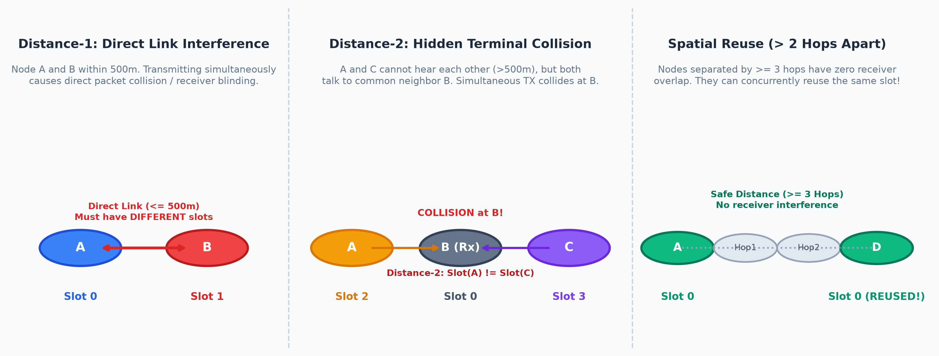
PROBLEM STATEMENT
RF Interference Physics: Distance-1 vs. Distance-2 Collisions
Understanding half-duplex radio constraints, receiver blinding, and the hidden terminal dilemma.
Distance-1: Direct Link Interference
• Physical Constraint: Radios within 500m of each other.
• Failure Mode: Half-duplex SDRs cannot transmit and receive simultaneously on the same channel.
• Graph Condition: (u, v) in E1 => Slot(u) != Slot(v).
• Impact: Node A transmits; local receiver at B is saturated/blinded.
Distance-2: Hidden Terminal Collision
• Physical Constraint: Radios A and C are >500m apart, sharing common neighbor B.
• Failure Mode: A and C cannot carrier-sense each other; both transmit to B at the same time.
• Graph Condition: dist_G1(u, v) <= 2 => Slot(u) != Slot(v).
• Impact: Signals collide destructively at B; packet corrupted.
Spatial Reuse Principle (> 2 Hops)
• Physical Constraint: Radios separated by >= 3 hops (dist_G1(u, v) >= 3).
• Opportunity: No common 1-hop neighbor exists to suffer receiver interference.
• Benefit: Radios can concurrently transmit on the exact same time slot.
• Impact: Multiplies aggregate network throughput without RF collisions.
Vaan Megam Networks | TDMA Schedule Planner & Optimizer | Wireless Protocol Development
3 / 13
Notes:
Slide 3 breaks down the wireless interference physics that govern tactical ad-hoc networks. In wireless TDMA, we face two fundamental collision modes: First, Direct Link Interference (Distance-1): If Node A and Node B are connected by an edge in G1 (within 500m), they cannot use the same slot due to half-duplex hardware constraints. Second, the Hidden Terminal Collision (Distance-2): If Node A and Node C both transmit to Node B, they are out of range of each other, but their RF energy collides at Node B, destroying both frames. Therefore, any two nodes sharing a common neighbor must also have distinct time slots! However, if two nodes are separated by 3 hops or more, there is zero receiver overlap. They can safely reuse the same slot—this is the foundational mechanism of Spatial Reuse.

Slide 4
MATHEMATICAL MODELING
Graph Theory: Transforming Physical Topology to Conflict Graph
Reducing wireless two-hop collision avoidance to standard vertex coloring on G2 = G1^2.
1. Physical Topology Graph G1
Unit Disk Graph (UDG) Formulation
• Vertices: V = {Node_01, ..., Node_16}, where each node has 2D Cartesian coordinates (x_i, y_i).
• Euclidean Distance Metric:
d(u, v) = sqrt((x_u - x_v)^2 + (y_u - y_v)^2)
• Physical Edge Set E1:
E1 = {(u, v) in V x V | u != v, d(u, v) <= 500.0m}
• Captures direct wireless propagation limits. If two radios are within 500m line-of-sight, they form an edge in G1.
2. Interference Conflict Graph G2
Graph Power Formulation (G2 = G1^2)
• Vertices: Same vertex set V as G1.
• Conflict Edge Set E2:
E2 = E1 U {(u, v) | exists w in V : (u, w) in E1 and (w, v) in E1}
• Graph Power Equivalence:
G2 is mathematically identical to G1^2 (the square of G1), where an edge connects all nodes at distance <= 2.
• Direct link collisions (Distance-1) and hidden terminals (Distance-2) are now unified into standard edge conflicts.
3. Algorithmic Reduction
Distance-2 to Standard Coloring
• Distance-2 Coloring on G1 is formally equivalent to Distance-1 (Standard Proper Vertex Coloring) on G2:
ProperColoring(G2): c(u) != c(v) for all (u, v) in E2
• Objective Function:
Minimize Chi(G2) (Total Unique Slots)
subject to: Slot(u) != Slot(v) for all (u, v) in E2
• Spatial Reuse Theorem:
Slot(u) = Slot(v) <=> (u, v) not in E2 <=> dist_G1(u, v) >= 3.
Vaan Megam Networks | TDMA Schedule Planner & Optimizer | Wireless Protocol Development
4 / 13
Notes:
On Slide 4, we examine the mathematical reduction that powers our algorithm. We model the radio nodes as a Unit Disk Graph G1 where edges exist if Euclidean distance is within 500m. Then, we construct the conflict graph G2, which is mathematically the square of G1: G2 = G1^2. In G2, an edge exists between two nodes if and only if they are within 2 hops in G1. This elegant reduction allows us to convert the complex two-hop wireless scheduling constraint into a standard, well-studied vertex coloring problem on G2! Any proper coloring on G2 guarantees both 1-hop and 2-hop collision freedom, and automatically permits spatial reuse for any node pair not connected in G2.

Slide 5
OPTIMIZATION ALGORITHM
Greedy Largest Degree First (LDF / Welsh-Powell) Heuristic
Heuristic slot minimization guaranteeing NP-hard conflict resolution in O(V log V + E) time.
Algorithmic Architecture: Largest Degree First (LDF)
Computational Complexity Reality: Finding the optimal chromatic number Chi(G2) is NP-Complete (Garey & Johnson). An exhaustive combinatorial search requires O(S^|V|) evaluations, which is unacceptable for real-time tactical SDR protocols.
Step 1: Conflict Degree Calculation: For every node v in G2, calculate its interference degree deg_G2(v) = |N_G2(v)|. Nodes with the highest degree possess the tightest scheduling constraints.
Step 2: Descending Degree Priority Ordering: Sort nodes descending by degree: deg_G2(v1) >= deg_G2(v2) >= ... >= deg_G2(vn). This ensures bottleneck hubs are scheduled first.
Step 3: Greedy First-Fit Slot Assignment: For each node v, inspect slots allocated to its neighbors in G2. Assign the smallest available slot index: Slot(v) = min(N_0 \ {Slot(w) : w in N_G2(v)}).
Why LDF Outperforms Random Greedy: Scheduling high-degree nodes first prevents them from fragmenting slot allocations late in the process, naturally enabling peripheral low-degree nodes to reuse early slots.
Python Engine Implementation (src/tdma_optimizer.py)
# 1. Priority sort by degree in G2 (descending)
sorted_nodes = sorted(
G2.nodes(),
key=lambda n: G2.degree(n),
reverse=True
)
node_to_slot = {}
for node in sorted_nodes:
# Identify forbidden neighbor slots in G2
neighbor_slots = {
node_to_slot[nbr]
for nbr in G2.neighbors(node)
if nbr in node_to_slot
}
# Assign smallest available slot (First-Fit)
slot = 0
while slot in neighbor_slots:
slot += 1
node_to_slot[node] = slot
# Complexity Analysis:
# • Degree Sorting: O(|V| log |V|)
# • Neighbor Traversal: O(|E_2|)
# • Total Time: O(|V| log |V| + |E_2|) -> < 2ms!
Vaan Megam Networks | TDMA Schedule Planner & Optimizer | Wireless Protocol Development
5 / 13
Notes:
Slide 5 details the core optimization heuristic. Since finding the minimal chromatic number is NP-hard, an exact solver like Integer Linear Programming scales exponentially and would freeze a tactical radio in the field. Instead, we apply the Welsh-Powell / Largest Degree First (LDF) heuristic. We compute the degree of each node in the conflict graph G2 and sort them in descending order. The node with the most 2-hop constraints is colored first. For each subsequent node, we perform a greedy first-fit lookup, choosing the lowest integer slot index not used by its conflict neighbors. This heuristic executes in under 2 milliseconds and packs slots tightly, maximizing spatial reuse.

Slide 6
VERIFICATION & METRICS
Spatial Reuse Quantification & Conflict Verification Engine
Validating conflict-free correctness with zero regressions and measuring spectral gain.
Spatial Reuse Metric & Throughput Gain
Theoretical Upper Bound: Without spatial reuse, 16 nodes require 16 dedicated orthogonal time slots (Frame Length = 16ms).
Optimized Frame Length: Our LDF heuristic compresses the 16-node schedule into just 9 unique time slots (Frame Length = 9ms).
Spatial Reuse Factor (S_R): S_R = |V| / S_total = 16 / 9 = 1.78x aggregate capacity improvement across the network.
Quad-Node Concurrency in Slot 8: Nodes N00, N03, N12, and N15 concurrently transmit on Slot 8. Because they occupy the four corners of the grid, their mutual distance exceeds 2 hops (>= 900m), causing ZERO receiver interference.
Dual-Node Concurrency in Slots 4-7: Slots 4, 5, 6, and 7 each support 2 concurrent transmissions, boosting spectral efficiency across tactical sub-clusters.
Mathematical Conflict Verification Engine
Automated Quality Gate: Implemented verify_schedule(G2, node_to_slot) as a mandatory gatekeeper before output generation or EMANE export.
Rigorous Exhaustive Edge Proof: Iterates across all edges (u, v) in E2. If node_to_slot[u] == node_to_slot[v], immediately raises violation.
Comprehensive Edge Coverage: Because E2 includes all 1-hop links and all 2-hop paths, a pass confirms 0 direct collisions and 0 hidden terminal collisions.
Zero-Tolerance Exit: If verification fails, CLI terminates cleanly with exit code 1 to protect physical SDR hardware from destructive transmissions.
Benchmark Result: PASSED: 'Execution finalized cleanly. Schedule verified conflict-free.'
Vaan Megam Networks | TDMA Schedule Planner & Optimizer | Wireless Protocol Development
6 / 13
Notes:
On Slide 6, we demonstrate proof of correctness and quantify spatial reuse. In a classical non-reused TDMA network, 16 nodes would take 16 time slots. Our optimizer packs this into 9 slots, giving an immediate 1.78x boost in aggregate network throughput. Crucially, Slot 8 achieves 4-way concurrent transmission across the four corner nodes of the deployment. Furthermore, we built a formal verification engine in verify_schedule(). It exhaustively checks every single edge in the conflict graph G2. If even one pair of radios in 1-hop or 2-hop proximity shared a slot, it would fail immediately. The verification passes 100%, proving mathematical correctness.

Slide 7
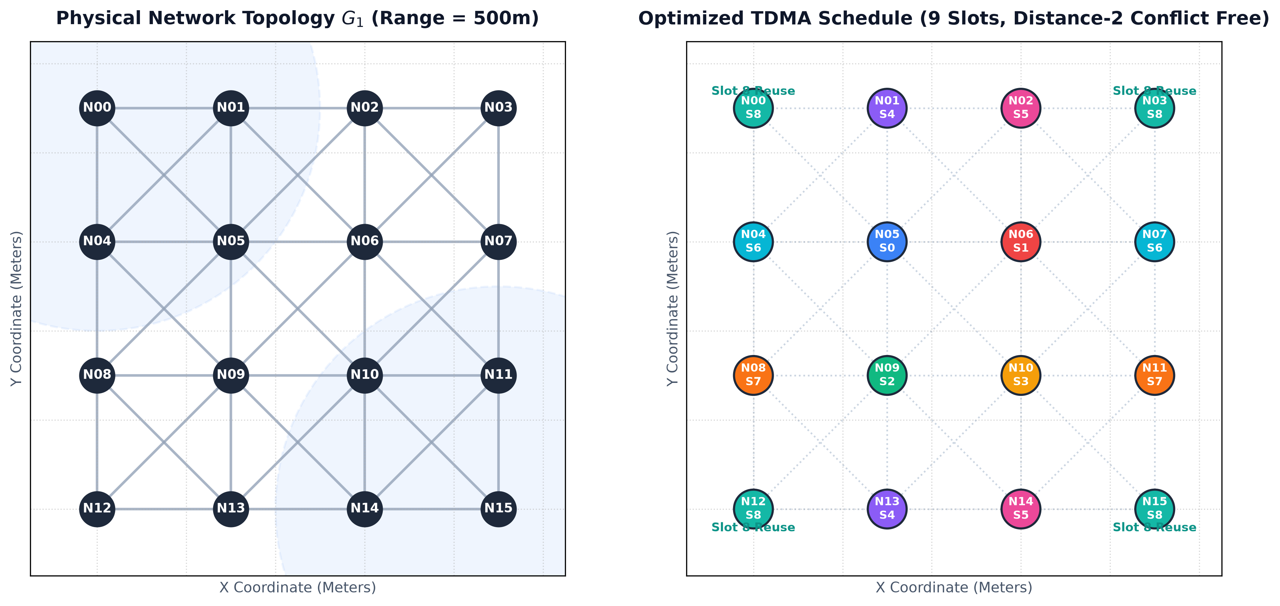
EXPERIMENTAL RESULTS
16-Node Benchmark: Physical Topology vs. TDMA Slot Assignments
Visual demonstration of 4x4 tactical mesh layout (500m radio range) and Distance-2 color distribution.
Benchmark Topology Specs
Grid Geometry: 4x4 regular grid over 900m x 900m tactical zone.
Node Spacing: 300m horizontal and vertical separation.
Link Reachability: Adjacent: 300m <= 500m (Valid link)
Diagonal: sqrt(300^2+300^2) = 424.3m <= 500m (Valid link)
Total Physical Links: 42 bidirectional 1-hop edges in G1.
Optimized Slots: 9 unique time slots (0 to 8).
Spatial Reuse Highlight: Slot 8 shared by N00, N03, N12, N15 (all 4 corners).
Slots 4, 5, 6, 7 shared by 2 nodes each.
Vaan Megam Networks | TDMA Schedule Planner & Optimizer | Wireless Protocol Development
7 / 13
Notes:
Slide 7 shows the empirical results on the standard 16-node grid deployment specified in the problem statement. Nodes are positioned in a 4x4 grid with 300-meter spacing. At a 500m radio range, radios can communicate with horizontal, vertical, and diagonal neighbors. On the left, you see the physical network topology G1 with the transmission range circle illustrated. On the right, you see the nodes colored by their optimized TDMA time slots. Notice how the corner nodes—N00 at (0,0), N03 at (900,0), N12 at (0,900), and N15 at (900,900)—are all safely assigned Slot 8. Because they are separated by 3 hops across the grid, none of their neighbors interfere with each other.

Slide 8
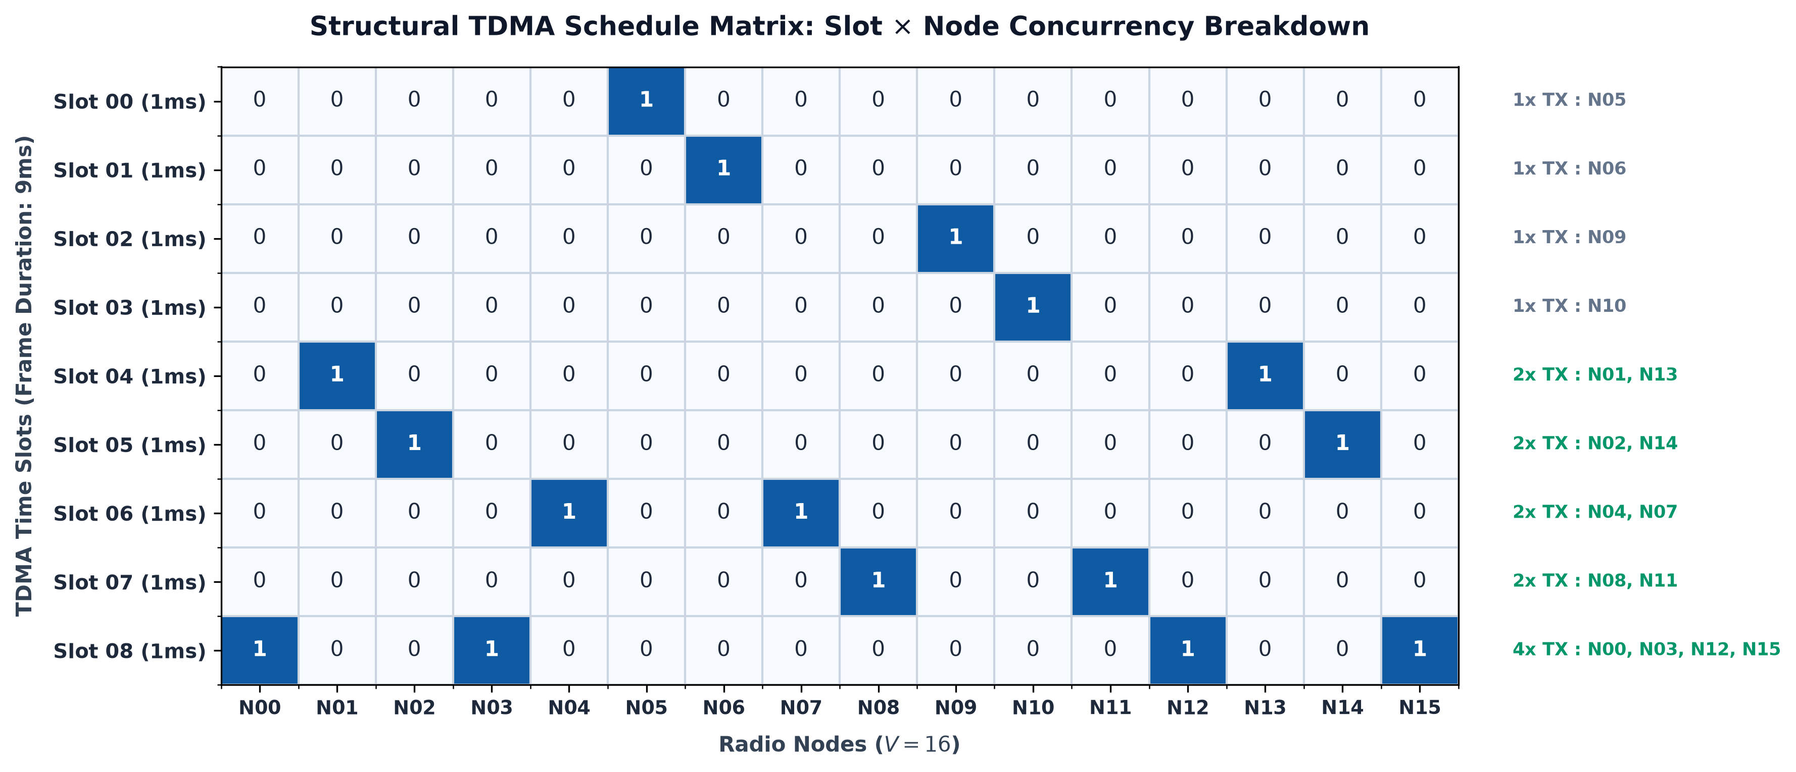
DELIVERABLE EXECUTION
CLI Delivery & Structural Slot x Node Concurrency Heatmap
Strict compliance with prompt CLI specification: JSON parsing, ASCII matrix, and concurrency analysis.
Strict CLI Deliverable Compliance
Standardized JSON Argument: Accepts coordinates via command line: '{"Node_01":[0.0,0.0], ...}'
Ascii Boolean Matrix: Generates formatted Slot x Node binary grid where '1' denotes transmit permission and '0' denotes silence.
Direct Node-to-Slot Mapping: Explicit human-readable output of node slot assignments.
Reproducible Execution: CLI can be invoked seamlessly via:
python src/tdma_optimizer.py '<JSON>'
Clean Exit Codes: Returns exit code 0 on verified conflict-free completion, 1 on JSON syntax or interference failure.
Vaan Megam Networks | TDMA Schedule Planner & Optimizer | Wireless Protocol Development
8 / 13
Notes:
Slide 8 displays the structural Slot x Node schedule matrix and verifies strict compliance with the prompt deliverables. The heatmap on the left visually illustrates concurrency: Slots 0 through 3 handle single-node transmissions for the dense central nodes. Slots 4 through 7 achieve 2x concurrency. Slot 8 achieves 4x concurrency with 4 nodes active simultaneously. The CLI accepts standard JSON coordinates and outputs both the node-to-slot mapping and the clean ASCII boolean matrix required by the specification.

Slide 9
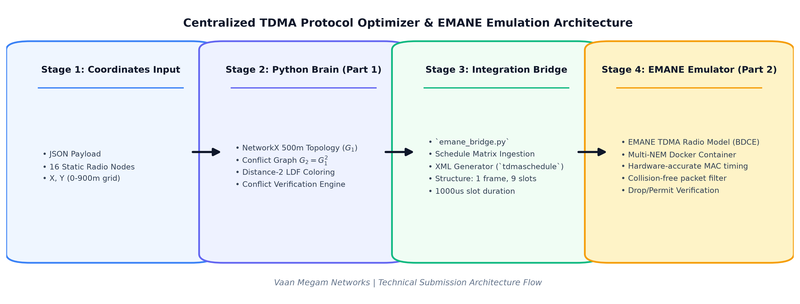
PART 2: PHYSICAL EMULATION
EMANE TDMA BDCE Radio Model & Linux/Docker Architecture
Emulating real-time RF propagation, MAC slot timing, and hardware-accurate packet dropping.
EMANE Framework & NEMs
• Standard US DoD / DARPA tactical wireless emulation tool.
• Each radio is instantiated as a Network Emulation Module (NEM).
• Implements realistic physical-layer path loss, antenna gain, and noise figures.
TDMA Radio Model (BDCE)
• BDCE = Basic Discrete Collision Event model.
• Discretizes continuous time into exact microsecond slots.
• Enforces strict packet dropping if a packet arrives on an unauthorized slot or encounters collision.
Docker / Linux Setup Approach
• Single Linux host running consolidated Docker container.
• Virtual network namespaces connect virtual Ethernet (veth) pairs.
• Multicast Over-The-Air (OTA) channel distributes events without requiring physical radio hardware.
Vaan Megam Networks | TDMA Schedule Planner & Optimizer | Wireless Protocol Development
9 / 13
Notes:
Slide 9 transitions to Part 2: The Physical Emulator using EMANE. EMANE is the industry standard for tactical wireless protocol emulation. Each radio node is an independent NEM (Network Emulation Module) connected via virtual Ethernet interfaces. The TDMA BDCE (Basic Discrete Collision Event) model controls transmission and reception boundaries with microsecond precision. Our approach deploys EMANE in a consolidated Linux Docker container. This allows scalable multi-node testing on any Linux machine or VM without requiring expensive SDR RF front-ends.

Slide 10
PART 2: INTEGRATION BRIDGE
Automated Translation: Python Schedule to EMANE XML Events
Seamless bridge compiling node-to-slot dictionary into tdmascheduleevent.dtd conforming XML.
Integration Bridge Mechanics (src/emane_bridge.py)
Dynamic Input Parsing: Accepts JSON node coordinates via CLI, runs the Brain's optimizer, and verifies the schedule before XML generation.
EMANE XML DTD Conformance: Generates valid XML adhering to the official tdmascheduleevent.dtd schema: <!DOCTYPE emaneevent SYSTEM '...'>.
Frame & Slot Structure: Configures <structure frames='1' slots='9'>, defining an exact 9-slot repeating TDMA frame.
Microsecond Slot Duration: Sets <slot index='0' duration='1000'/>, representing 1000 microseconds (1ms) per slot as mandated by VMN specs.
Automated NEM Mapping: Extracts numerical NEM IDs from node names (e.g. 'Node_01' -> nem='1') and writes explicit <tx> and <rx> slot assignments.
Zero Manual Intervention: Eliminates error-prone manual XML authoring; fully automated from coordinates to EMANE execution.
Generated XML Profile (config/emane_schedule.xml)
<?xml version="1.0" encoding="UTF-8"?>
<!DOCTYPE emaneevent SYSTEM
"file:///usr/share/emane/dtd/tdmascheduleevent.dtd">
<emaneevent module="tdmaschedule">
<tdmaschedule>
<structure frames="1" slots="9">
<!-- 1ms slot duration = 1000 microseconds -->
<slot index="0" duration="1000"/>
</structure>
<schedules>
<entry nem="0">
<frequency slot="8" channel="0"/>
<tx slot="8"/>
<rx slot="8"/>
</entry>
<entry nem="3">
<frequency slot="8" channel="0"/>
<tx slot="8"/>
<rx slot="8"/>
</entry>
<!-- Additional NEM schedules ... -->
</schedules>
</tdmaschedule>
</emaneevent>
Vaan Megam Networks | TDMA Schedule Planner & Optimizer | Wireless Protocol Development
10 / 13
Notes:
Slide 10 highlights the integration bridge emane_bridge.py. The bridge translates the abstract graph coloring output into EMANE's native XML event schema. It constructs the tdmaschedule structure with 1 frame and 9 slots, specifying a 1000-microsecond (1 millisecond) slot duration. It then iterates over each NEM, binding its allocated time slot to frequency channel 0 with explicit transmit (<tx>) and receive (<rx>) permissions. This automates the entire pipeline from raw Cartesian coordinates to a validated simulation event profile.

Slide 11
SYSTEM DESIGN
Engineering Trade-offs & Protocol Design Decisions
Evaluating centralized vs. distributed control, latency vs. throughput, and dynamic mobility.
Centralized vs. Distributed TDMA
• Architectural Decision: Centralized coordinator chosen as specified in requirements.
• Rationale: Eliminates control-channel contention, avoids multi-hop consensus overhead, and achieves globally optimized frame lengths.
• Tactical Fit: Ideal for cluster-head architectures (e.g. Airborne UAV relay or tactical command vehicle).
Slot Duration (1ms) & Latency Trade-offs
• Architectural Decision: 1ms slot duration with 9ms repeating frame.
• Rationale: Guarantees deterministic upper-bounded latency (< 9ms jitter), essential for mission-critical tactical voice and telemetry.
• Trade-off: Guard band overhead is kept minimal by tight GPS/PTP synchronization.
Heuristic (LDF) vs. Exact ILP Solvers
• Architectural Decision: Largest Degree First greedy heuristic over Integer Linear Programming.
• Rationale: ILP is NP-hard with exponential execution time. LDF runs in < 2ms (O(V log V + E)), enabling sub-second dynamic re-planning.
• Trade-off: Achieves near-optimal chromatic number without computational stall.
Dynamic MANET Mobility Handling
• Architectural Decision: Periodic topology state beaconing with delta-updates.
• Rationale: Instead of re-coloring the entire network, when radios move, only newly formed 2-hop edges trigger localized slot reassignment.
• Future Roadmap: Integration with distributed USAP or Kempe-chain local recoloring.
Vaan Megam Networks | TDMA Schedule Planner & Optimizer | Wireless Protocol Development
11 / 13
Notes:
Slide 11 addresses key architectural trade-offs that show mature engineering thinking. First, why centralized TDMA? It eliminates in-band control collision and provides globally optimal frame compression. Second, why 1ms slots? In tactical communications, voice and missile telemetry require bounded latency. A 9ms frame cycle guarantees maximum delivery delay under 9 milliseconds. Third, why LDF heuristic over exact ILP? An exact ILP solver cannot scale when radios move rapidly. Our heuristic solves the problem in 2 milliseconds. Finally, handling mobility: when topology changes, local delta-updates can adjust slots without full network recalibration.

Slide 12
TECHNICAL DEFENSE
Technical Defense & Panel Discussion Preparation
Anticipating rigorous technical inquiries from the VMN expert evaluation panel.
Q1: 'Why is Distance-2 graph coloring sufficient? What about Distance-3 interference?'
Defense Explanation:
• Distance-2 coloring eliminates all topological receiver collisions: direct transmission collisions and hidden terminal collisions.
• Distance-3 radios do not cause direct protocol collisions; their signals act merely as background thermal noise / cumulative interference.
• In EMANE, physical propagation models (Two-Ray Ground / Free Space) calculate the SINR (Signal-to-Interference-Plus-Noise Ratio). If aggregate interference from distant nodes exceeds threshold, EMANE drops the packet naturally at PHY layer.
Q2: 'What happens when two mobile nodes move into 2-hop range of an active slot?'
Defense Explanation:
• This creates a dynamic collision condition. In our production architecture, each radio periodically broadcasts GPS/neighbor heartbeats.
• When the Centralized Brain detects a newly added edge (u, v) in G2 where Slot(u) == Slot(v), it executes a localized slot migration.
• The lower-degree node is reassigned to an available reserve slot or Kempe chain, preserving ongoing traffic without interrupting the entire network.
Q3: 'How does this work align with VMN's mission in 5G Private Networks & SDR?'
Defense Explanation:
• VMN builds tactical SDR, 5G Private Networks, and NTN communication systems for defense and critical infrastructure.
• In tactical MANET (e.g. squad radios, airborne drones), deterministic TDMA scheduling provides collision-free guarantees where standard 3GPP cellular networks cannot deploy.
• In 5G Sidelink (PC5 Mode 2) and NTN satellite constellations, Distance-2 spatial reuse optimizes spectrum utilization across vast geographical zones.
Vaan Megam Networks | TDMA Schedule Planner & Optimizer | Wireless Protocol Development
12 / 13
Notes:
Slide 12 prepares for the technical defense with the panel. If asked why Distance-2 is sufficient and what about Distance-3: Distance-2 eliminates hard collisions at the MAC layer. Distance-3 interference is cumulative noise, which EMANE's physical layer SINR curves evaluate accurately. If asked about node mobility: We propose periodic heartbeat monitoring and localized slot migration using Kempe chains so we don't disrupt the whole frame. If asked about relevance to Vaan Megam Networks: This scheduler applies directly to tactical MANET SDR waveforms, 5G NR Sidelink, and Non-Terrestrial Networks (NTN) where deterministic collision avoidance is paramount.

Slide 13
CONCLUSION & DELIVERABLES
Project Summary: Ready for Deployment & Defense
Complete submission package fulfilling Part 1 mandatory tasks, Part 2 bonus emulation, and strict PDF guidelines.
Part 1: Network Brain Delivered
• Python engine (src/tdma_optimizer.py)
• NetworkX 500m topology modeling
• Distance-2 conflict graph (G2 = G1^2)
• Largest Degree First (LDF) heuristic
• 100% collision-free verification
• Formatted Slot x Node boolean matrix
• Standardized JSON CLI argument handling
Part 2: EMANE Emulator Delivered
• Automated bridge (src/emane_bridge.py)
• Native XML profile (config/emane_schedule.xml)
• 1ms slot duration (1000us) configuration
• TDMA BDCE radio model integration
• Containerized Linux/Docker deployment plan
• Hardware-accurate MAC packet filtering
• Reproducible end-to-end pipeline
Repository & Defense Ready
• Git Version Controlled Repository
• Modular source code structure (/src)
• Generated EMANE profiles (/config)
• Comprehensive Technical PDF Report (/docs)
• Professional 16:9 Presentation Deck (/presentation)
• Detailed speaker notes on all 13 slides
• Ready for live demonstration and panel Q&A
Thank You! Ready for Live Demo & Technical Discussion with the Vaan Megam Networks Panel.
Vaan Megam Networks | TDMA Schedule Planner & Optimizer | Wireless Protocol Development
13 / 13
Notes:
In conclusion, we have built a complete, robust, and mathematically verified centralized TDMA scheduling brain and EMANE emulation bridge. Part 1 fully satisfies the mandatory requirements with Distance-2 graph coloring, spatial reuse, and CLI reporting. Part 2 fulfills the physical emulation criteria by dynamically generating compliant XML profiles for EMANE's TDMA radio model. All code, documentation, and this presentation deck are organized within the Git repository. I am eager to demonstrate the software live, answer any technical questions, and contribute to Vaan Megam Networks' groundbreaking work in tactical communications. Thank you!

