Slide 1
IBM University Engagement Project Submission
“Exploring the Power of Agentic AI with IBM Granite and LangFlow”

Slide 2

Project Title – [Smart Farming Advisor]
Domain of Project – [Agriculture]
Student Name | Recent Passport Photo | Email ID | Mobile number [WhatsApp]
Yerubandi Yagna Nagendra Pradhamesh |  | yerubandistkpv@gmail.com | 739699471

Slide 3
Problem Statement -
Problem Statement : AI Agent for Smart Farming Advice
The Challenge
An AI Agent for Smart Farming Advice, powered by RAG (Retrieval-Augmented Generation), supports small-scale farmers by delivering real-time, localized agricultural guidance.
It retrieves trusted data on weather forecasts, soil conditions, crop recommendations, pest control measures, and current market prices from agricultural departments, meteorological sources, and agri-tech platforms.
The Objective
You are Smart Farming AI Advisor.
Help farmers make informed decisions.
Collect:
1. Location
2. Crop Name
3. Soil Type
4. Season
Use information from agricultural documents.
Provide:
1.Suitable Crops
2.Fertilizer Advice
3.Pest Management
4.Irrigation Guidance
5.Harvesting Tips
6.Market Suggestions
Use simple farmer-friendly language.
Ask follow-up questions if information is missing.
Never provide unsafe recommendations.

Slide 4
Technology Used
Tech Stack (Mandatory)
Use any one of the following approaches:
LangFlow + IBM watsonx.ai + Granite Models
IBM Cloud Agentic Lab with IBM Granite Models
Replicate with LangChain + RAG + IBM Granite Models
I used LangFlow + IBM watsonx.ai + Granite Models

Slide 5
Proposed Solution – AI Agent for Smart Farming Advice
The proposed solution is an AI-powered Smart Farming Advice Agent developed using IBM Watsonx AI, IBM Granite Model, and Langflow with Retrieval-Augmented Generation (RAG) technology.
The system assists small-scale farmers by providing accurate and personalized agricultural guidance. Agricultural documents containing information about crop cultivation, soil management, fertilizers, pest control, irrigation methods, and farming best practices are uploaded into the system as a knowledge base.
When a farmer asks a question, the RAG pipeline retrieves relevant information from the uploaded agricultural documents and provides context to the IBM Granite model. The model then generates clear, reliable, and farmer-friendly responses based on the retrieved information.
The Smart Farming Advice Agent can help farmers with:
- Crop selection recommendations
- Soil health management
- Fertilizer suggestions
- Pest and disease control measures
- Irrigation guidance
- Harvesting recommendations
- General farming best practices
The solution enables farmers to make informed decisions, improve crop productivity, reduce farming risks, and increase overall agricultural income. By combining IBM Watsonx AI, Granite models, Langflow, and RAG technology, the system delivers trustworthy, data-driven farming advice in an easy-to-use conversational interface.

Slide 6
Langflow component Used -
1) Chat Input – Interface where users enter their queries, preferences, or meal details (text/voice/image).
2) IBM watsonx AI Agent - Processes user input using Granite models to generate personalized nutrition insights and recommendations.
3) Name of IBM Granite model - Granite-4.0-8B-Instruct → Fast, efficient for real-time diet recommendations
4) Chat output -Displays AI-generated responses such as diet plans, nutritional analysis, and health suggestions.
5) File component - Stores and retrieves user data, crop production dataset for analysis and tracking.
6) Prompt template – It takes document ,question and template of the given document .
Document is connected to read file and the prompt is connected to System message in language model

Slide 7
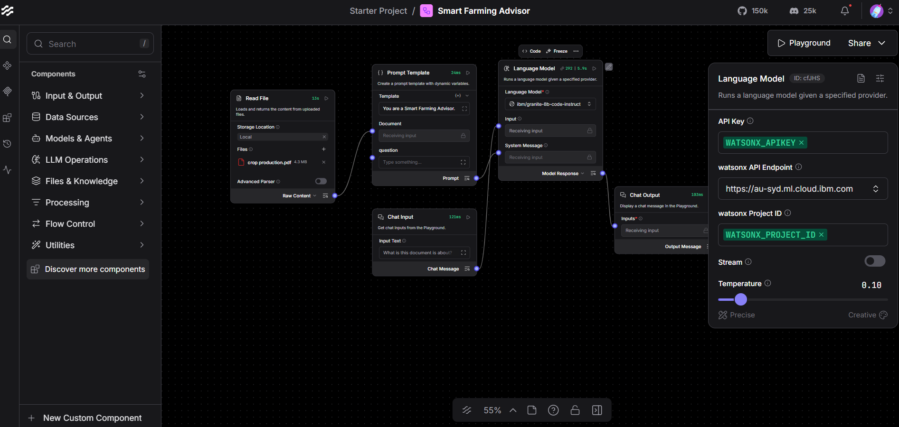
Langflow workflow -

Slide 8

Architecture blueprint

Slide 9

Role of Agentic AI in the solution
Role of Agentic AI in Smart Farming Advisor
Agentic AI enables the Smart Farming Advisor to function as an intelligent, autonomous system rather than a simple chatbot. Using IBM watsonx.ai and IBM Granite models, it coordinates multiple specialized agents to deliver personalized Smart Farming Advice.
Agentic AI acts as an intelligent farming assistant that understands farmer queries, retrieves relevant information from agricultural documents using RAG, and provides personalized recommendations.
It helps farmers by:
- Understanding farming problems
- Retrieving relevant agricultural knowledge
- Suggesting suitable crops and fertilizers
- Providing pest and irrigation guidance
- Delivering accurate and practical farming advice
This enables farmers to make informed decisions, improve crop yield, and reduce farming risks.

Slide 10
Technology Used
Langflow platform -For designing and orchestrating multi-agent workflows visually
IBM Grainte model - for eg – ibm-granite-3-2-8b – For natural language understanding, reasoning, and personalization
IBM Cloud – It provides the infrastructure to build, deploy, and scale the Smart Farming Advisor efficiently. IBM Cloud enables a reliable, secure, and scalable environment for deploying the Nutrition Agent.
RAG– RAG to fetch real data first, then generate intelligent answers, making the Smart Farming Advisor more trustworthy and effective.
IBM Watsonx.ai - For model deployment, embeddings, and AI governance

Slide 11
Novelty and Uniqueness
The Smart Farming Advice Agent combines Agentic AI, RAG, IBM Granite Models, and agricultural knowledge sources to provide accurate and context-aware farming recommendations.
Key unique features include:
- Personalized farming advice based on farmer queries.
- Retrieval of information from agricultural documents using RAG.
- AI-powered recommendations for crops, fertilizers, and pest control.
- Simple conversational interface for easy farmer interaction.
- Reliable and data-driven guidance instead of generic responses.
This solution bridges the knowledge gap between agricultural experts and small-scale farmers, making smart farming support accessible and affordable.

Slide 12
Git Hub Link
Github URL – https://github.com/pradhameshyerubandi/Smart_Farming_Advisor
·
·
·

Slide 13
Future Scope
1. Integration with Real-Time Weather Forecasting Services
The system can be connected to weather APIs to provide farmers with real-time weather updates, helping them make better decisions regarding irrigation, sowing, and harvesting.
2. Support for Multiple Regional and Local Languages
The agent can be enhanced to support various regional languages, making it more accessible and user-friendly for farmers across different regions.
3. Live Market Price Updates
The solution can provide real-time mandi and market prices for crops, enabling farmers to choose the best time and place to sell their produce.
4. Image-Based Crop Disease and Pest Detection
Farmers can upload images of crops, and AI can identify diseases or pests and suggest appropriate treatment measures.
5. Mobile Application Development
A dedicated mobile application can make the system easily accessible to farmers anytime and anywhere.
6. Personalized Recommendations Using Farm Data
The agent can use location, soil type, crop history, and weather conditions to provide highly customized farming advice.
7. Integration with Government Agricultural Schemes
The system can inform farmers about relevant government schemes, subsidies, loans, and support programs available to them.
·
·
·

Slide 14


