Slide 1

AI/ML-Based Predictive Maintenance and Vehicle Health Monitoring System
Predicting vehicle and component failure before it occurs
Random Forest • XGBoost • LSTM • GRU • Transformer • SHAP
Kuntal Pradhan | Institute of Engineering and Management Kolkata | 2026
Notes:
Introduce the project: an AI system that warns about vehicle failure before it happens.
1

Slide 2
Problem and System Architecture
  Breakdowns cause safety risk, downtime and high cost
  Reactive and fixed-interval maintenance are inefficient
  Goal: predict failure probability, score health, explain why, and alert
Vehicle sensors
Preprocessing
ML/DL model
Failure probability
Health score
Maintenance alert
Inputs: engine temp, RPM, oil pressure, vibration, battery voltage, coolant temp, fuel consumption, speed, operating hours
Notes:
2

Slide 3
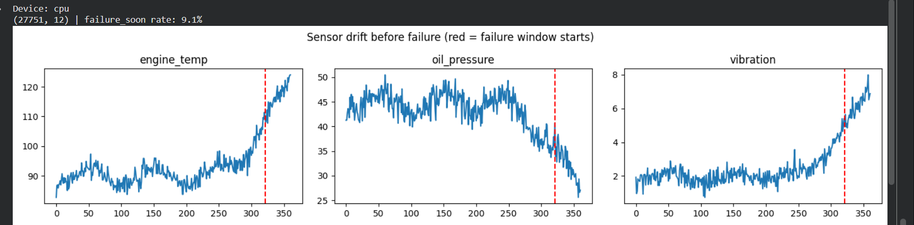
Data and Feature Engineering
Simulated sensors drift before failure (red line = failure window starts)
Dataset
Features
Split
80 vehicles, 27,751 rows; 9.1% failure-soon labels
33 features: raw + rolling mean, std, trend (window 10)
By vehicle: 20,548 train / 7,203 test rows
Notes:
3

Slide 4
Models Compared
Machine learning
Deep learning
Logistic Regression, Decision Tree, Random Forest (300 trees), XGBoost (300 trees, imbalance-weighted) on 33 tabular features
LSTM, GRU (2 layers, 64 units) and Transformer (2 attention layers) on 30-step sensor windows; 15 epochs, Adam
Explainable AI and health logic
SHAP on XGBoost lists the top contributing sensors. Health = 50% (1 − failure probability) + 50% sensor health. Status: NORMAL < 35%, WARNING 35–75%, CRITICAL > 75%.
Notes:
4

Slide 5
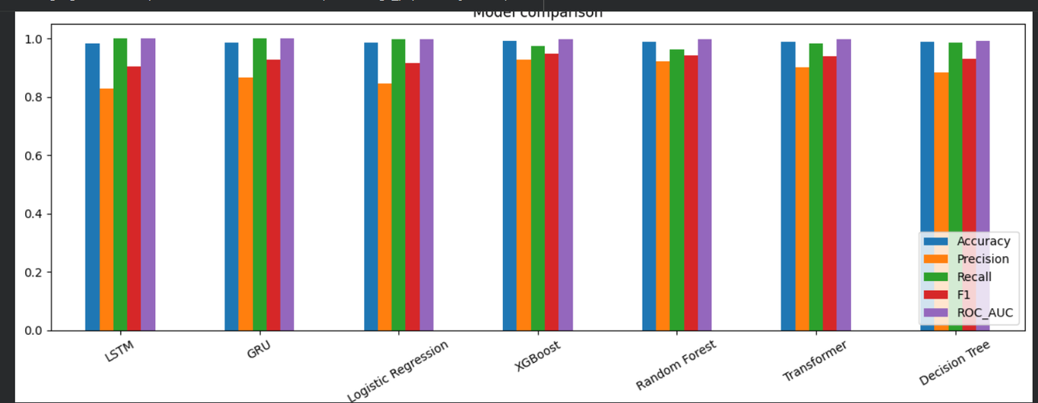
Results
  All models: about 98–99% accuracy, ROC-AUC near 1.0
  XGBoost best overall: precision about 0.93, recall about 0.98, F1 about 0.95
  LSTM and GRU: recall about 1.0 (few missed failures) but more false alarms
  Synthetic data is easy; real data will score lower
Values approximate, read from the comparison chart
Notes:
5

Slide 6
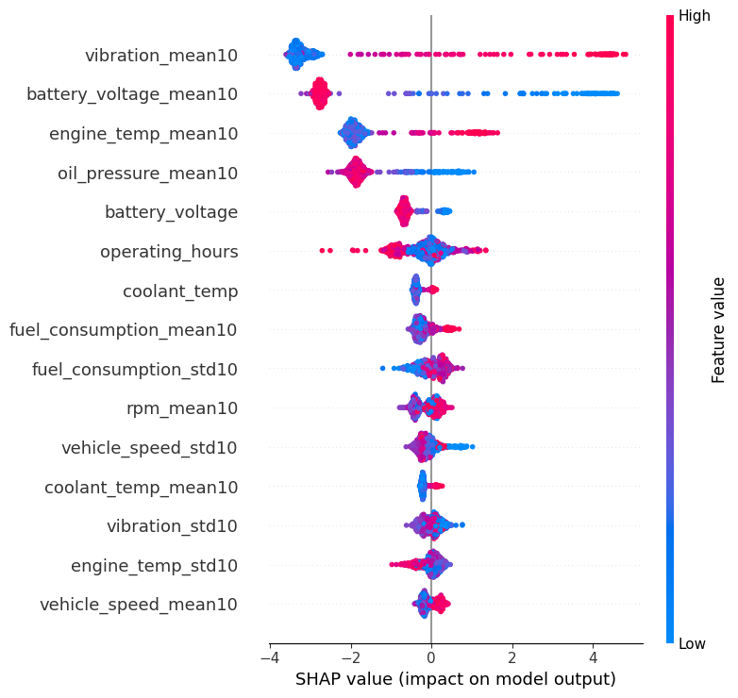
Explainable AI (SHAP)
  Top drivers: vibration, battery voltage, engine temperature, oil pressure
  High vibration, high temperature, low voltage and low oil pressure raise failure risk
  Matches engineering intuition, so alerts are trustworthy
  Top-3 factors are shown in every alert
Notes:
6

Slide 7
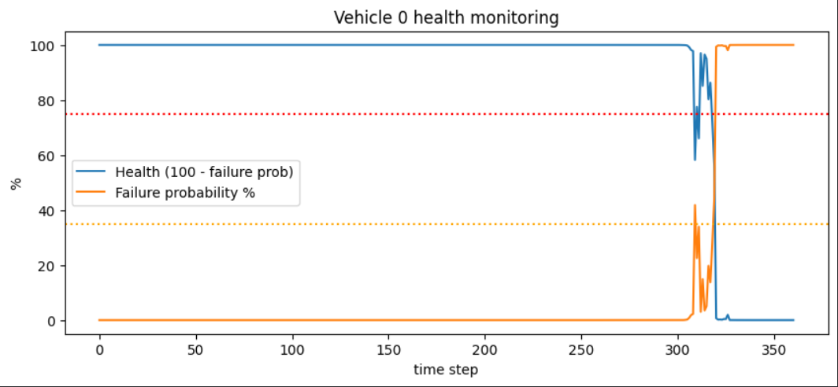
Vehicle Health Timeline
  Steps 0–305: probability near 0%, health near 100%
  From step ~305: risk rises; crosses 35% WARNING near step 309
  By step 320: near 100% failure probability; actual failure at step 361
  Warning arrives about 50 steps early
  Fluctuation at 305–320: use smoothing or consecutive-step rule
Plotted health = 100 − failure probability
Notes:
7

Slide 8
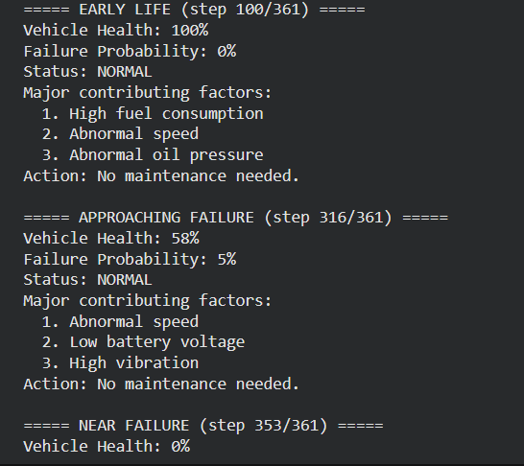
Health Monitoring Demo and Conclusion
  Early life: Health 100%, Failure 0%, NORMAL
  45 steps before failure: Health 58%, factors already flagged
  Near failure: Health 0%
  Next: real fleet data, Remaining Useful Life, live dashboard
Conclusion: an explainable pipeline from sensors to health score and maintenance alert. XGBoost is the best overall model.
Notes:
8

