Slide 1
AUTONOMOUS VEHICLE
DECISION MODULE
Kuntal Pradhan
Institute of Engineering and Management, Kolkata
Notes:
Project selected from Module 2 Assignment & Project, option 4: Decision Making & Actuator Handling.

Slide 2
Project aim
A small, explainable MATLAB project for autonomous vehicle decision making
THE TASK
WHY THIS PROJECT
Choose a safe response to a pedestrian crossing and a stop sign, then simulate the vehicle’s response.
One short MATLAB script
No simulator or external dataset
Easy to explain as four driving states
The controller uses simple rules. It is designed for learning and demonstration.
Notes:
The assignment asks for a simplified decision module such as stop, yield, or turn with simulated actuator response in Carla or MATLAB/Simulink. This implementation uses MATLAB only and a small kinematic vehicle model.

Slide 3
The driving scenario
The script creates two events along a straight road
PEDESTRIAN
CROSSING
STOP SIGN
START
45 m
105 m
The pedestrian is present from 4 to 8 seconds. The vehicle aims for 8 m/s (28.8 km/h).
At the stop sign, the controller waits 2.5 seconds before starting a 3-second right turn.
Notes:
Scenario values are the settings in the supplied MATLAB script. Positions and event times are simulated, not measured road data.

Slide 4
Four decisions
The pedestrian check has priority while the crossing is occupied
01
02
03
04
DRIVE
YIELD
STOP
TURN RIGHT
Move toward the target speed when the road is clear.
Brake while the pedestrian is at the crossing.
Brake for the stop sign, then wait at the line.
Steer right at a lower speed, then return to driving.
State means the vehicle’s current action. It does not mean an AI model detected the event.
Notes:
The controller uses four states represented by numeric codes in the script: 1 driving, 2 yield, 3 stop, and 4 turn right. The pedestrian condition is checked first.

Slide 5
How the MATLAB model moves the vehicle
Decision rules produce simple actuator commands
DECISION
ACTUATORS
VEHICLE
DRIVE / YIELD / STOP / TURN
↓
Throttle
Brake
Steering
↓
Speed, heading,
and road position
A basic bicycle model estimates the path from speed and steering angle. No real sensors or vehicle hardware are connected.
Notes:
The script applies acceleration from normalized throttle and brake values. It updates heading and position using a simple kinematic bicycle model. This is not a full vehicle dynamics or safety validation model.

Slide 6
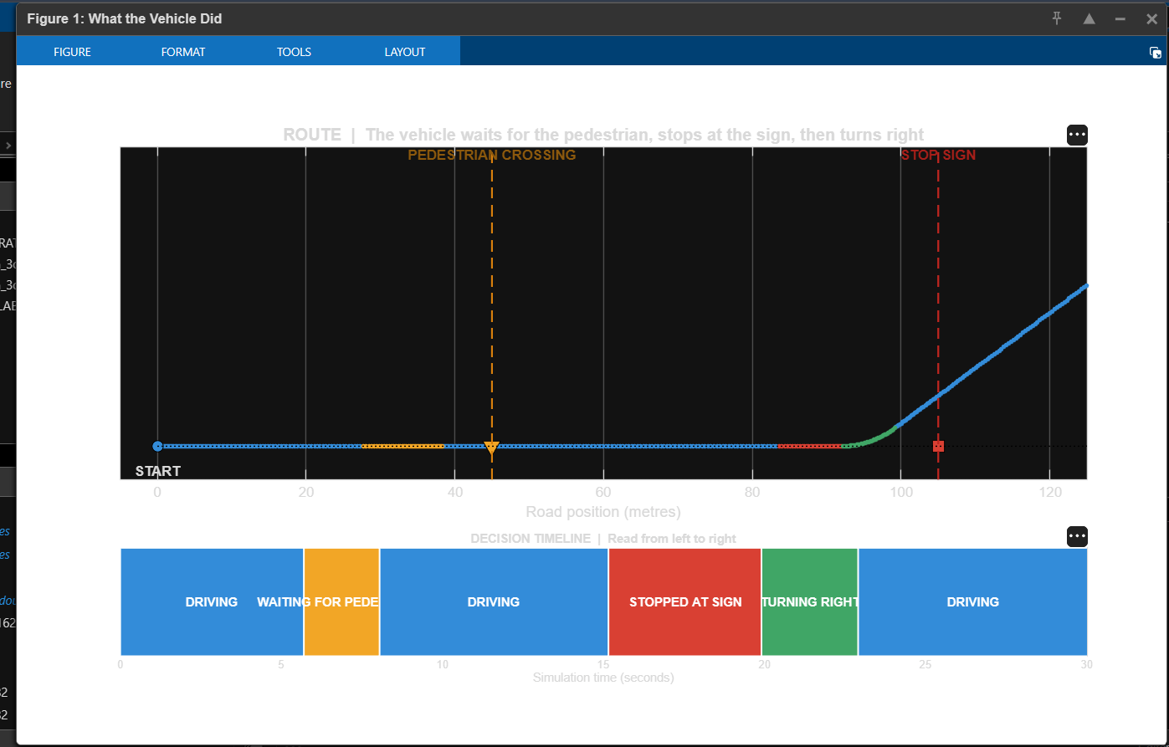
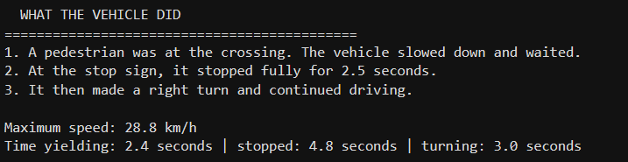
What MATLAB showed
The screenshots are from the run you shared
RUN SUMMARY
The colored timeline reads from left to right. The 4.8 seconds is time in the STOP state, including braking. The programmed full-stop wait is 2.5 seconds.
Notes:
Evidence screenshots were supplied by the project author. The printed 'stopped: 4.8 seconds' counts time in the STOP state, which begins during braking. The script's configured full-stop dwell is 2.5 seconds.

Slide 7
How to read the result
The run demonstrates the decision sequence, not real-world driving performance
28.8 km/h
2.4 s
4.8 s
maximum speed in this run
in YIELD state
in STOP state, including braking
What the run supports
The controller changes actions when scenario conditions change and produces matching throttle, brake, and steering responses.
Limit
The scenario uses preset events and simplified physics. It does not validate safety or performance on real roads.
Notes:
The summary values are read from the screenshots supplied by the user. Interpret the 4.8 seconds as time in the STOP state, including the approach. The configured stationary dwell is 2.5 seconds.

Slide 8
Conclusion
A small project with a clear story for a classroom demonstration
The MATLAB model demonstrates how a finite-state decision module can turn a simple road scenario into understandable vehicle actions.
NEXT STEPS
Add traffic lights and speed limits.
Use uncertain sensor inputs.
Test more pedestrian and stop-sign timings.
Educational simulation only. Do not use to control a real vehicle.
Notes:
Summary of the project implementation and its scope. Next-step ideas are suggestions, not implemented features.

