Slide 1
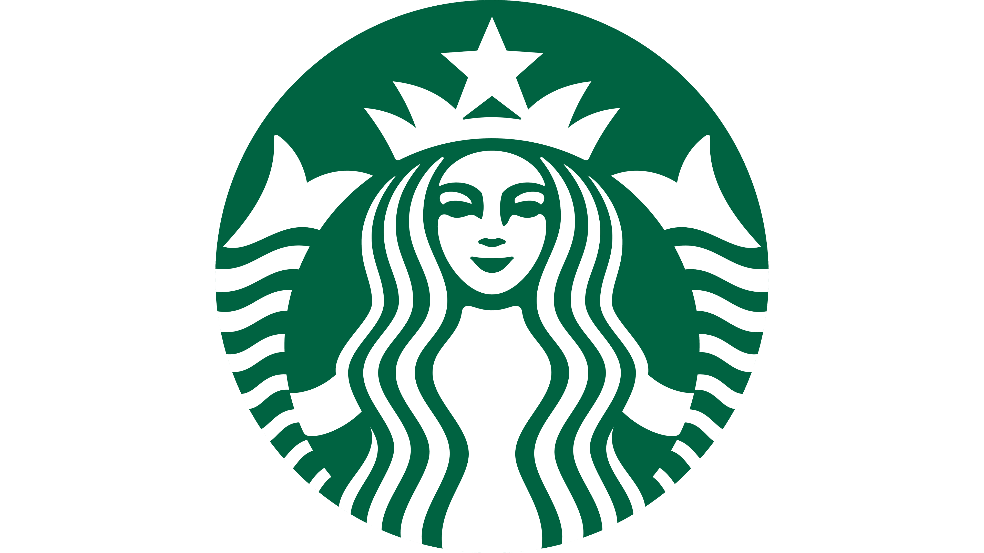
Enhancing Customer Experience through Data-Driven Offer Recommendations at Starbucks
Under the guidance of Prof. Junwei Huang and TA’s Akhilesh Dongre and Manav Malavia
Name: Monalika Pradhan
NUID: 002768020

Slide 2
Abstract
Project Overview: This research project focuses on developing a recommender system for the Starbucks rewards mobile app, aiming to enhance the customer experience by providing personalized offer recommendations.
Data Utilization: The project involves analyzing past data encompassing user activities, profiles, purchases, and responses to various offers, including Buy One Get One (BOGO), discounts, and informational offers.
Methodological Approach: The analysis includes integrating datasets to create a comprehensive view of customer interactions with offers, employing feature engineering techniques to optimize data for machine learning.
Model Development: The project includes the development of a main recommendation engine, an alternative model for improved performance, and a comparative analysis of their efficiencies.
Objective: The primary goal is to customize the app's experience by forecasting and adapting offers to align with each customer's preferences, thereby increasing engagement with the offers.

Slide 3
Introduction
The Importance of Personalized Marketing in Retail:
Highlight the significance of tailored marketing approaches in enhancing customer experience, especially in competitive sectors like coffee retail.
Discuss Starbucks' reputation as a leading coffeehouse chain and its emphasis on superior customer service and experience.
The Challenge: Understanding and Predicting Customer Behavior:
Address the complexities of predicting how customers will respond to various types of offers (e.g., BOGO, discounts, informational offers) through the Starbucks app.
Note the diversity in customer reactions - some offers are ignored, others are viewed, and some lead to actual purchases.
Project Objective: Leveraging Data for Improved Offer Targeting:
Explain the project's aim to use past data (including user activities, profiles, purchases, and responses to offers) for crafting a model that provides personalized offer recommendations.
Emphasize the goal of increasing engagement with these offers by customizing the app experience to align with each customer's preferences.

Slide 4
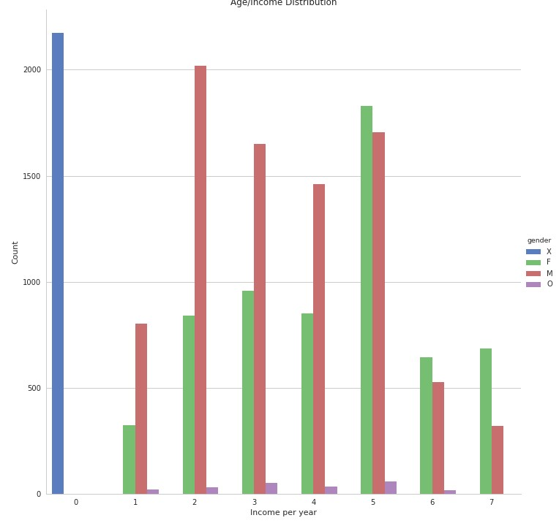
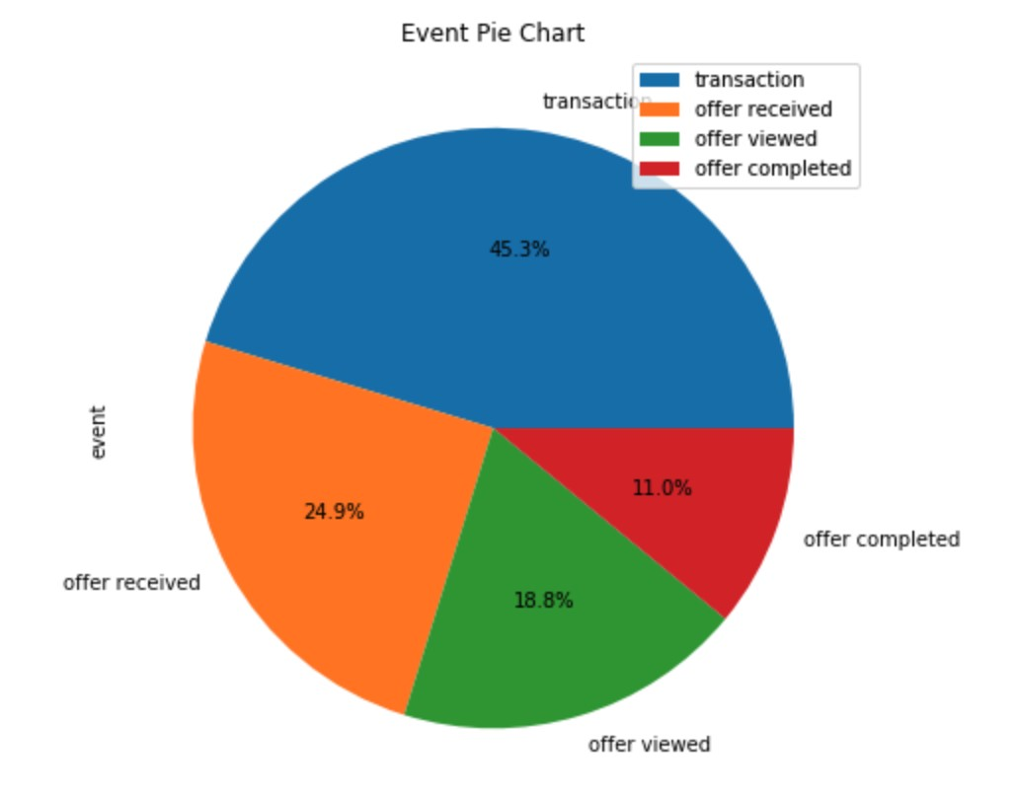
Data Analysis
Overview of the Starbucks Dataset:
The dataset includes comprehensive customer interaction data with Starbucks offers.
Data encompasses demographic information, transaction details, and responses to promotional offers like Buy One Get One (BOGO), discounts, and informational offers.
Key Insights:
Demographics and Transactions:
Analysis of customer profiles including age, gender, income, and membership duration.
Exploration of transaction data revealing purchasing patterns and preferences.
Offer Details and Customer Responses:
Investigation of different types of offers and their distribution through various channels.
Analysis of customer responses to offers: ignored, viewed, or completed.
Feature Engineering for Model Efficacy:
Implementation of encoding techniques and data transformations to optimize the dataset for machine learning.
Specific focus on categorical and continuous data, enhancing the predictive capability of the models.
Exploratory Data Analysis (EDA) Techniques:
Utilization of visual tools like bar charts, pie charts, and heatmaps to illustrate data distributions and correlations.
Insights drawn from EDA, including the relationship between demographic factors and offer responsiveness.

Slide 5
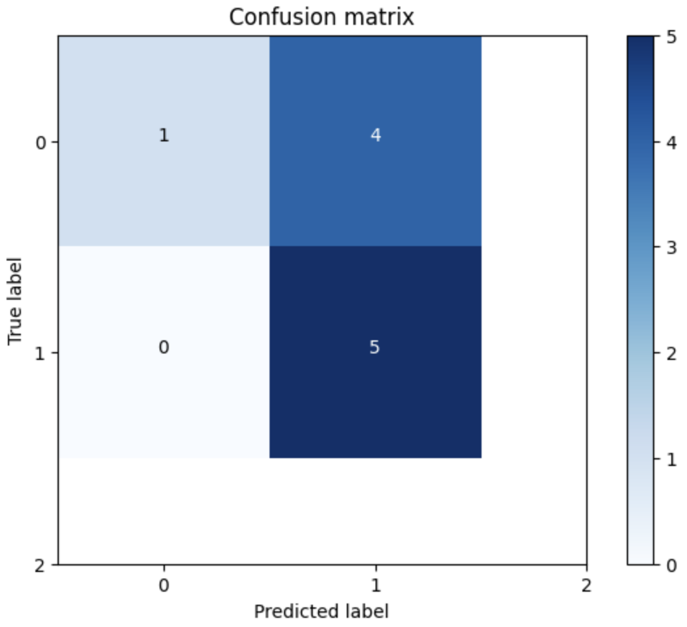
Baseline Model
Model Overview:
The baseline model is a sophisticated neural network architecture developed using PyTorch, a prominent deep learning framework.
It is designed to accommodate recommendation systems, leveraging embeddings and fully connected layers.
Model Structure and Features:
Embedding Layers: Separate embedding layers for users and items to capture latent features.
Dynamic Layer Construction: The neural network consists of Linear layers, ReLU activation functions, BatchNorm1d for normalization, and Dropout layers for regularization.
Weight Initialization: Weights of the first and last linear layers undergo Xavier uniform initialization for stabilizing learning.
Model Purpose:
To establish a foundational understanding of how different customers respond to offers.
Focused on understanding user actions such as ignoring, viewing, or completing offers.
Performance Metrics:
The model's performance is evaluated using metrics like accuracy, precision, and recall.
Accuracy: 60% for the baseline model.
F1 Score: 0.666
Recall: 0.659
Precision: 0.731

Slide 6
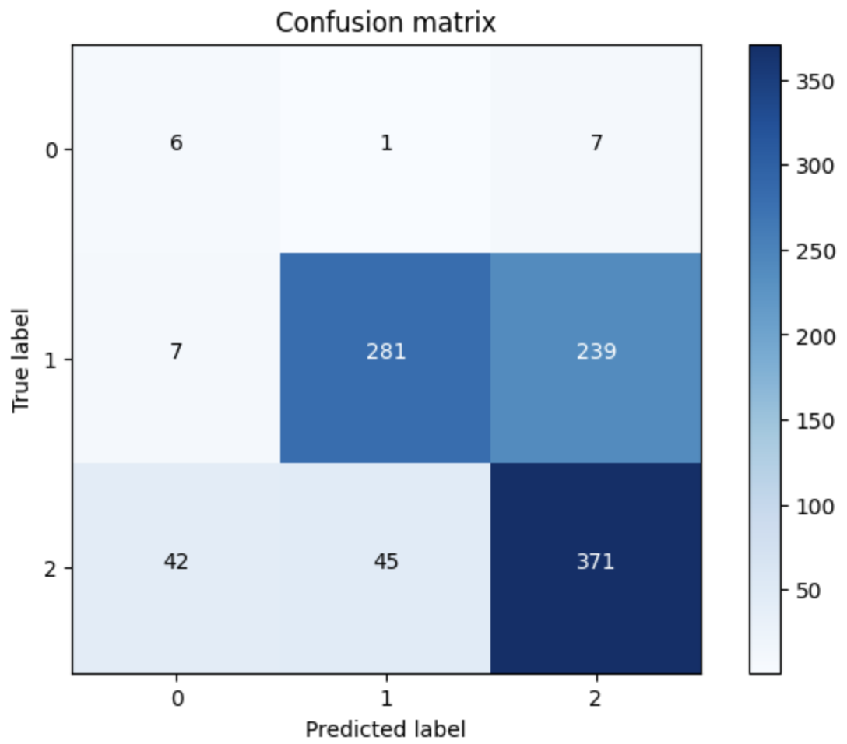
Advanced Recommendation Model
Advanced Model Overview:
The advanced recommendation model, built upon the baseline neural network model, incorporates additional continuous parameters related to users and offers.
Utilizes PyTorch for its implementation, extending the capabilities of the baseline model.
Model Improvements and Features:
Enhanced Parameters: Incorporates dimensions for users (n_users), items (n_items), continuous user parameters (n_cont_user), and continuous offer parameters (n_cont_offer).
Layer Enhancements: Includes embedding layers for users and items, as well as batch normalization layers for continuous parameters of users and offers.
Dynamic Layer Construction: A sophisticated arrangement of Linear layers, BatchNorm1d, Dropout, and ReLU activations, designed to accommodate combined dimensions of user/item embeddings and continuous parameters.
Model Purpose:
Aimed at achieving higher accuracy and more personalized offer recommendations by incorporating both categorical (user/item) and continuous data.
Focuses on providing a nuanced and potentially more accurate prediction of customer responses to various offers.
Performance Results:
Demonstrates an improvement in accuracy, showcasing the effectiveness of the additional features and model complexity.
Specific metrics include an accuracy of 65.86%, highlighting the model's enhanced predictive capability compared to the baseline model.

Slide 7
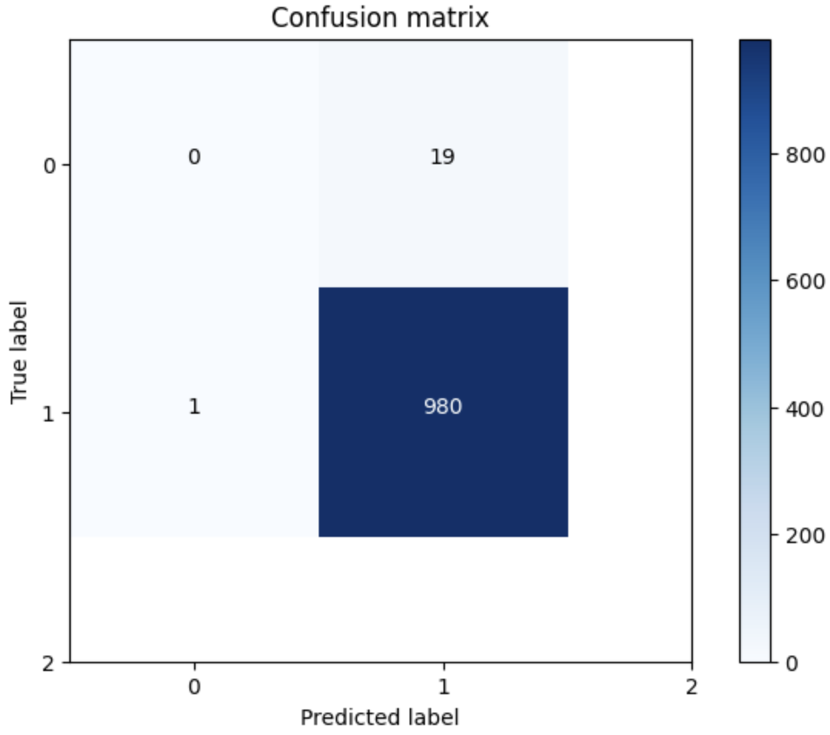
XGBoost Model
Rationale for Using XGBoost:
Decision tree-based algorithms like XGBoost were chosen as they proved to be comparable or even superior to the initial recommendation engine model.
The choice was driven by the need for models that can scale effectively and maintain performance as the number of users and offers grows significantly.
Model Specifics:
The XGBoost model's approach focuses on tracking offers that are mostly ignored by certain users or groups and makes positive predictions for offers that have shown interest.
This model was designed to address the challenge of predicting customer responses to offers more accurately, especially in scenarios with a large user base.
Comparative Performance:
XGBoost demonstrated the capability to perform and scale better than the more complex neural network model, especially in scenarios involving millions of users and thousands of offers.
The model was aimed at providing both ad hoc recommendations and fine-granular predictions for specific customer sets, such as those in large cities or countries with fewer Starbucks stores.
Performance Metrics:
The XGBoost model achieved an exceptional accuracy rate, indicating its effectiveness in accurately predicting customer responses to Starbucks offers​​.

Slide 8
Comparative Analysis
Overview of Model Comparisons:
The project involved a comparative analysis of different models, including a recommendation engine, a Random Forest model, and an XGBoost model.
These models were evaluated to determine their effectiveness in predicting customer responses to offers.
Model Strengths and Limitations:
Recommendation Engine: Showed good predictive accuracy. However, it may have scalability limitations with a significantly larger number of users and offers.
Random Forest Model: Comparable performance to the recommendation engine. Effective in making positive predictions for offers that are generally ignored.
XGBoost Model: Demonstrated superior performance in some cases, especially in tracking ignored offers and making accurate predictions.
Performance Metrics:
Recommendation Engine Accuracy: 68.36%.
Random Forest Model Accuracy: 67.7%.
XGBoost Model Accuracy: 70.7%.
Notably, the XGBoost and Random Forest models achieved even higher accuracy rates (98.0% and 97.6%, respectively) in an alternative approach focused on predicting positive or negative reactions to offers.
Comparative Performance Highlights:
All models showed increased accuracy with the enlargement of the test data set, growing by 3-5% for each model.
The alternative approaches with XGBoost and Random Forest models stood out, especially in ad hoc recommendation scenarios or fine granular predictions for specific customer segments.

Slide 9
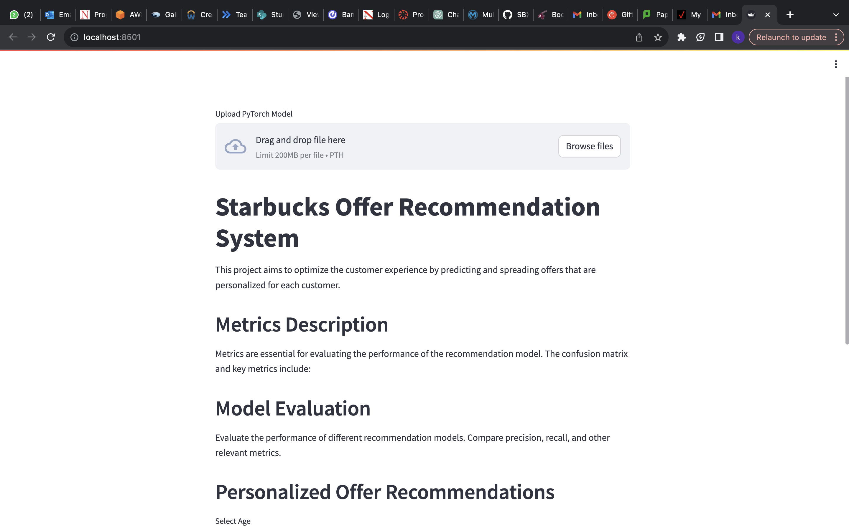
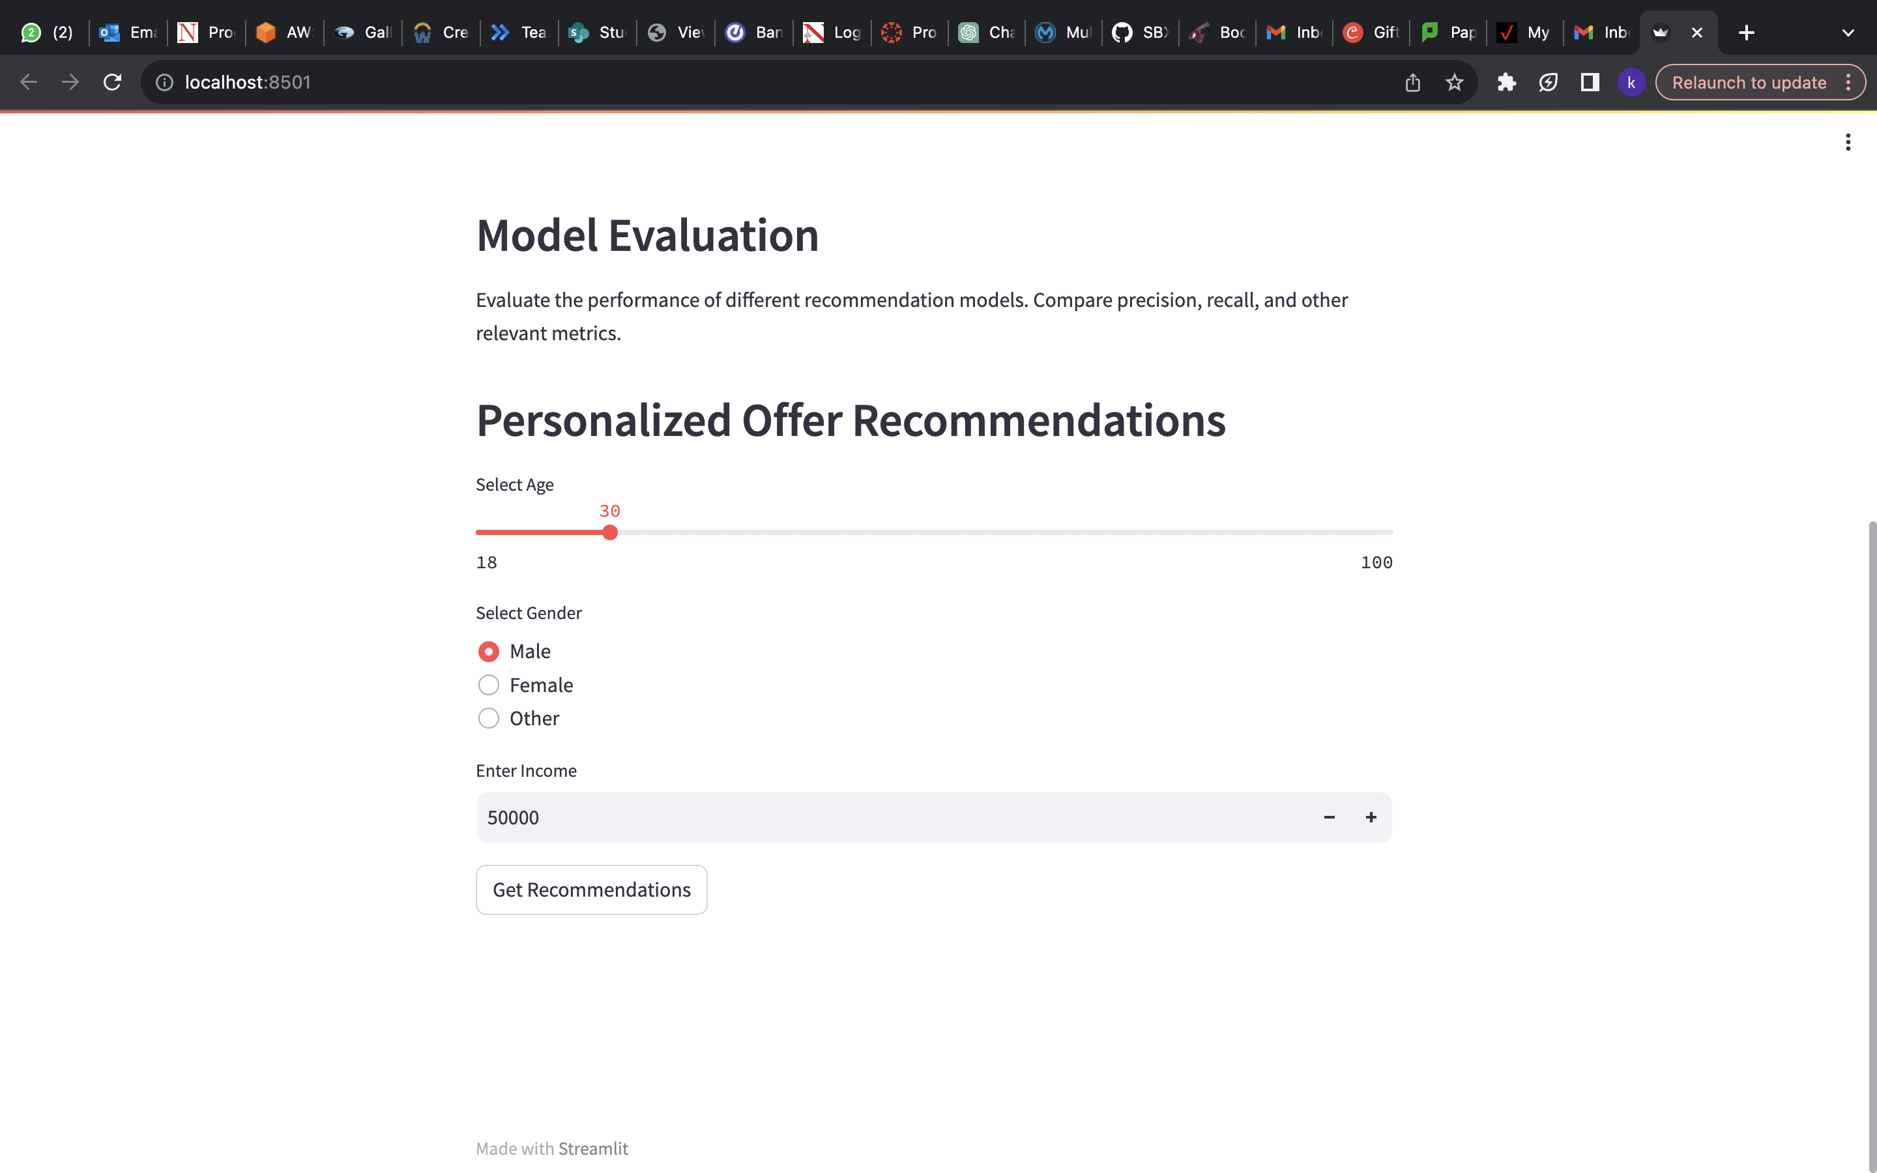
Web Application Using StreamLit

Slide 10
Conclusion and Future Work
Summary of Key Findings:
The project successfully utilized three different datasets from Starbucks, focusing on offers within the app.
The final recommendation model, built using user data and offer matrices, proved to be highly accurate in predicting customer responses to offers.
The model's ability to differentiate between ignored and responded offers, and even predict if a user will view but not act on an offer, showcases its effectiveness.
Future Research Directions:
While the current models demonstrate high accuracy (up to 98% on sample data), further hyperparameter tuning could enhance their performance.
Additional feature engineering could also be explored, such as leveraging transaction data and customer activity patterns to refine recommendations further.
Collaborative filtering, as demonstrated through user/offer embeddings, simplifies building relationships between users and offers, offering a potential area for further exploration and improvement.

Slide 11
References
Regularizing Matrix Factorization with User Embeddings. Papers With Code. Retrieved from https://paperswithcode.com/paper/regularizing-matrix-factorization-with-user
NVIDIA. Recommendation System. Retrieved from https://www.nvidia.com/en-us/glossary/data-science/recommendation-system/
Mage AI. How does Starbucks use machine learning (ML)? Retrieved from https://m.mage.ai/how-does-starbucks-use-machine-learning-ml-6a96cd993d95
How to Build a Recommendation Engine for Starbucks. (2019, Dec 08). Towards Data Science. Retrieved from https://towardsdatascience.com/how-to-build-a-recommendation-engine-for-starbucks-662a982df0c2
Marr, B. (2018, May 28). Starbucks: Using Big Data, Analytics, and Artificial Intelligence to Boost Performance. Forbes. https://www.forbes.com/sites/bernardmarr/2018/05/28/starbucks-using-big-data-analytics-and-artificial-intelligence-to-boost-performance/?sh=2366a59e65cd

Slide 12
Thank you!!!

