Slide 1
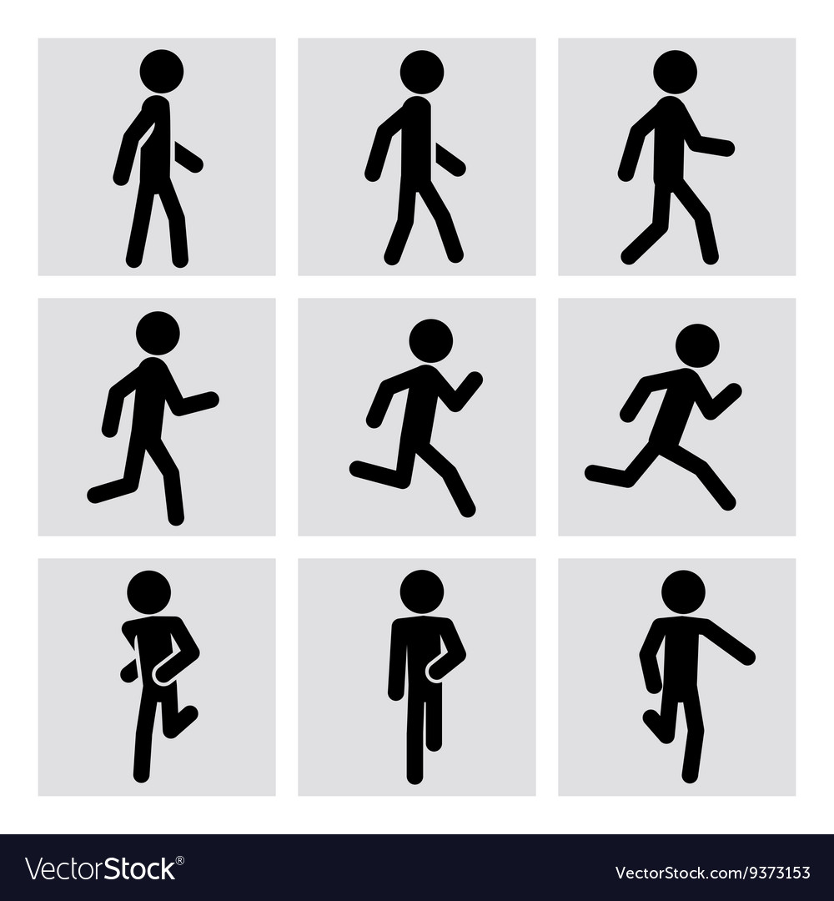
INFO-6105 Data Sci Eng Methods GROUP 7
TOPIC: WALK/ RUN IMAGE CLASSIFICATION
Team members:
Krishnanand Jha (002768931)
Monalika Pradhan(002768020)

Slide 2
BACKground
In our technology-driven world, image analysis has gained immense importance across diverse domains
An intriguing challenge involves classifying images of human activities, such as walking or running
This task has wide-ranging applications, including surveillance, fitness tracking, sports analysis, and healthcare monitoring
Accurately predicting walking or running from images can provide valuable insights and enhance various systems' capabilities

Slide 3

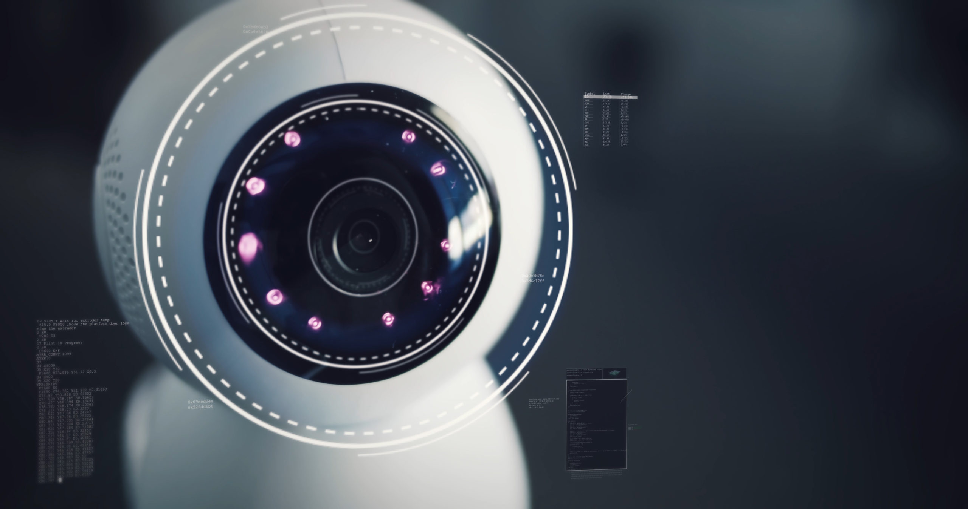
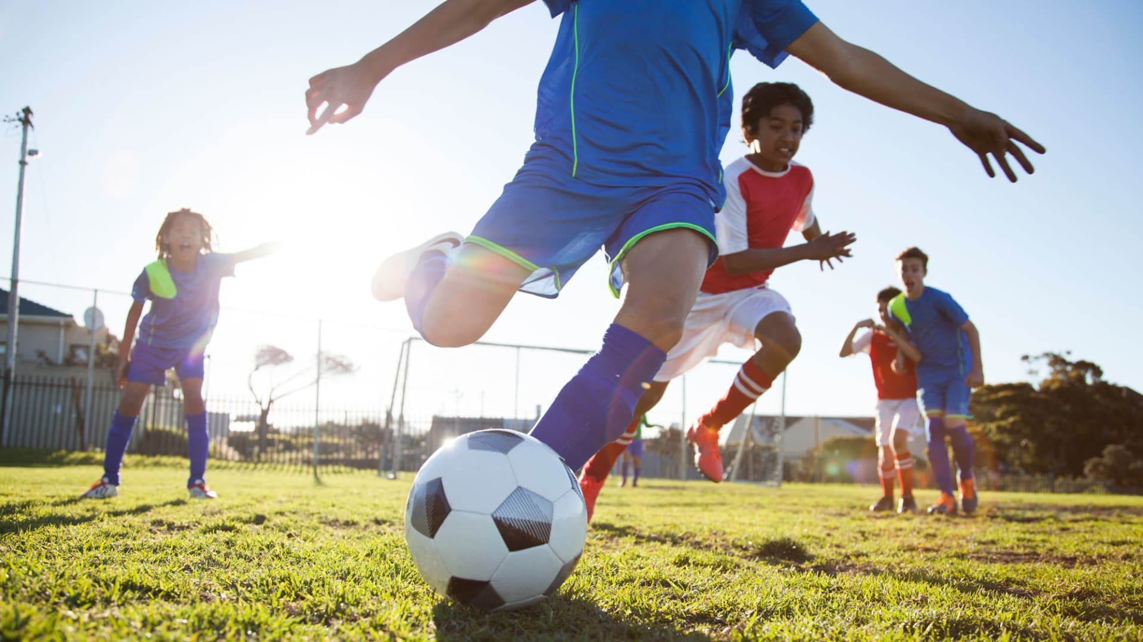
Why the Problem is Important?
In surveillance, this capability can assist in identifying suspicious behavior or unusual activities.
In sports analysis, it offers insights into athletes' performance and aids in optimizing training strategies
In healthcare, it enables remote monitoring of patients' mobility and rehabilitation progress
In the context of smart cities, this project can contribute to optimizing traffic management systems by analyzing pedestrian movement patterns and adjusting signal timings accordingly

Slide 4
SOLUTION TO THE PROBLEM
The project harnessed the capabilities of Convolutional Neural Networks (CNNs) using Inception V3 architecture, a powerful category of deep learning models
CNNs excel at image analysis, allowing them to decipher intricate patterns, textures, and spatial relationships within images
In addition to CNNs, the project also explored the use of the Random Forest classifier and Logistic Regression for image classification
We evaluated all the three machine learning algorithms

Slide 5
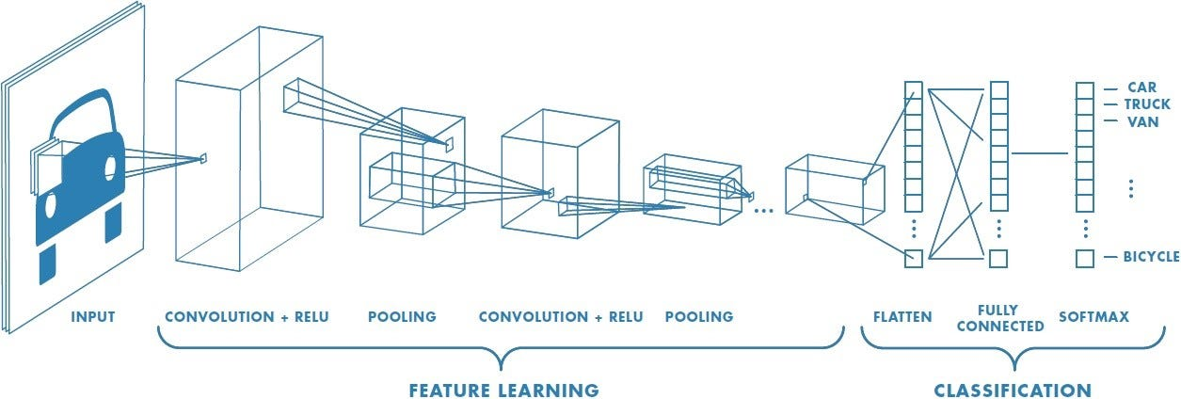
Convolution Neural network
Choosing different layers of CNN to extract and identify different features of the images.
GlobalAveragePooling2D: This layer takes the output feature maps from the previous layer (in this case, the base_model) and computes the average value for each feature map.
Dropout: Dropout is a regularization technique that randomly sets a fraction of the input units to 0 during each training iteration. This helps prevent overfitting by encouraging the network to not rely too much on any specific set of neurons.
Dense: This is a fully connected layer with 1024 units and a ReLU activation function Dense (Output Layer): This is the final layer with 2 units (assuming you have 2 classes).
Notes:
1 box extract features so neurons can learn about image features
Averages out neurons effects of previous layer
Drop out is used to avoid overfiiting to similar type of image in dataset
also helps neurons learn more
Dense layer Relu for non-linear transformations in the image which is not present in RF or Log Reg

Slide 6
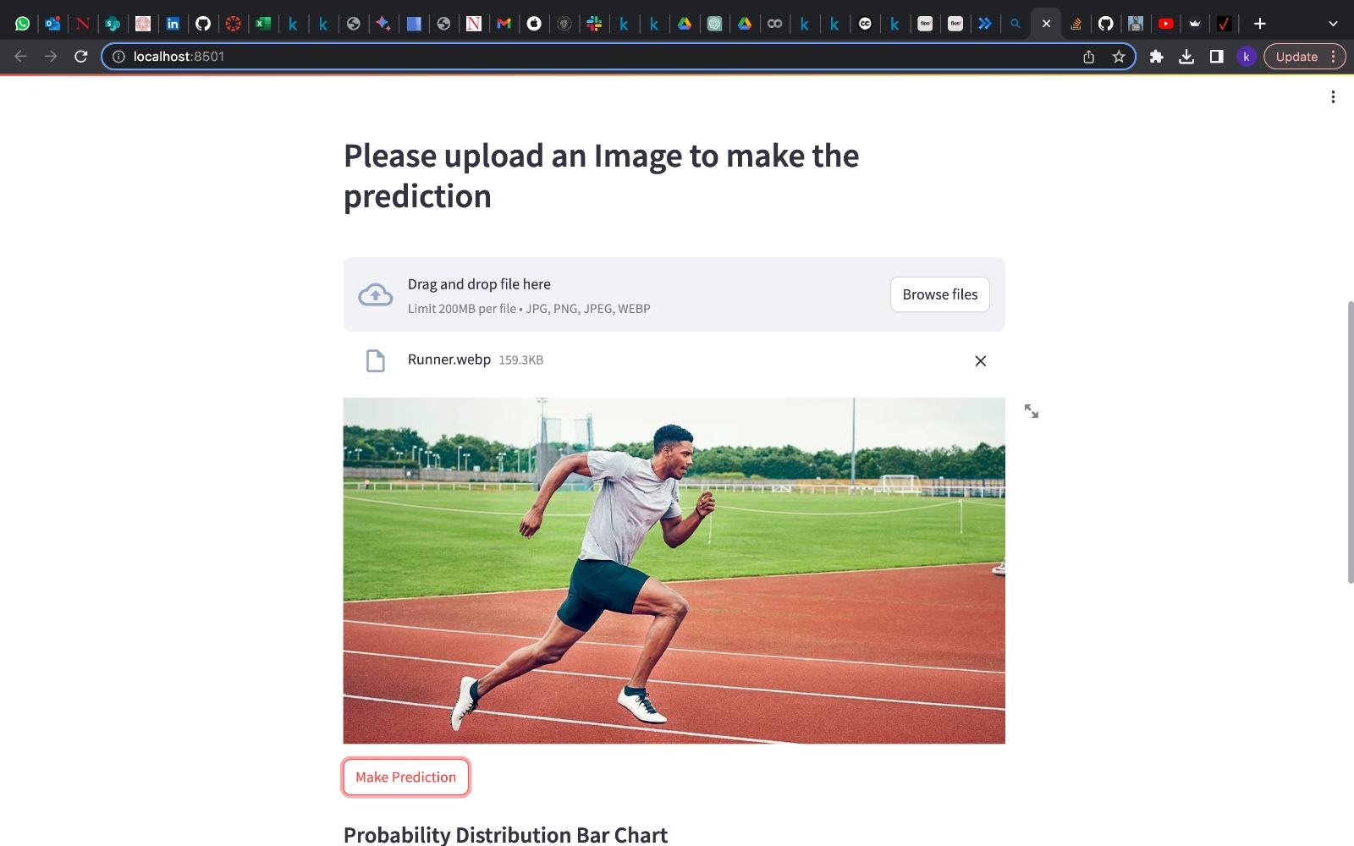
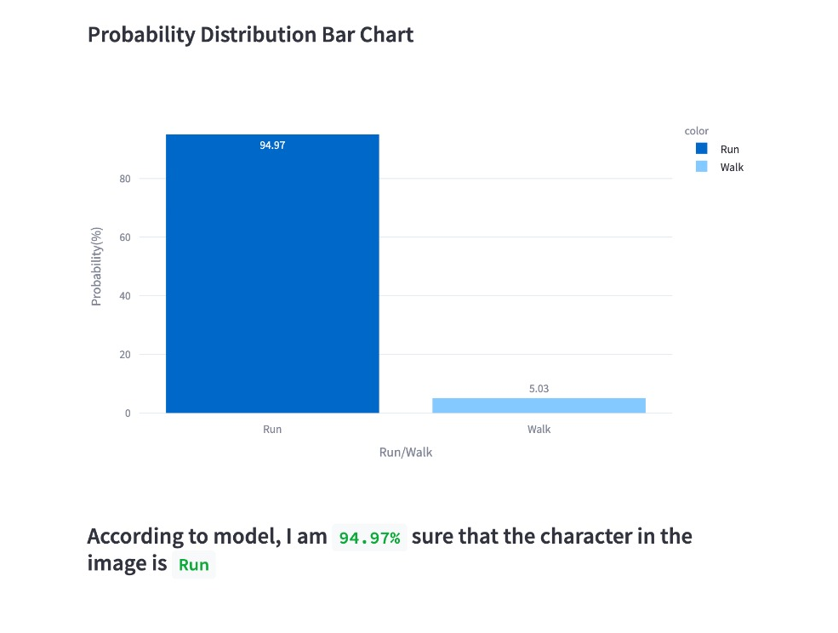
USER Interface
We've designed an intuitive user interface using Streamlit, allowing users to effortlessly upload an image which classifies whether the image is running image or walking image.

Slide 7
CONCLUSION
We evaluated all the three ML Algorithms and came to a conclusion that CNN with Inception V3 is the most suitable ML algorithm with accuracy of 81%
By training a CNN model on a carefully curated dataset of walking and running images, the project achieved impressive accuracy in predicting human activities from images
We also used Random Forest Classifier and Logistic Regression Machine learning algorithms, but these gave a very less accuracy around 56-59%

