Slide 1
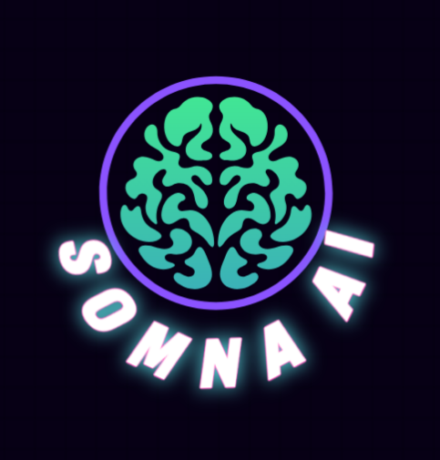
SomnaAI: Your Dream Intelligence Platform
Explore Your Mind. Understand Your Dreams. Visualize the Unseen.

Slide 2

Data Dreamers
Ayush kumar – Team Leader
Ashutosh Jha
Generative Media & Video Integration
AI/NLP & Backend Lead
Nishant
Nandan Pradhan
Frontend & UX Designer
Dream Researcher & Product Lead
Our Mission:
Empowering self-discovery through dreams.

Slide 3
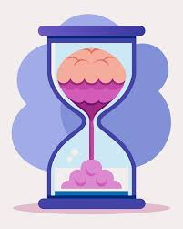



Dreams: Rich Messages, Lost Potential
Fleeting
Mysterious
Untapped
80% of dreams are forgotten
within 10 minutes.
No mainstream app visualizes
dreams meaningfully
Mental health tools rarely explore subconscious insights.

Slide 4
Decoding Your Subconscious
SomnaAI: Our innovative AI application is designed to transform your often-elusive dreams into clear, actionable insights and engaging visual narratives. We go beyond simple dream journaling to provide a deeper understanding of your inner world.
Core Idea: At the heart of SomnaAI is the belief that dreams are not just random nightly events, but rather secret messages from your subconscious feelings and experiences. These messages, expressed through symbols, scenarios, and emotions, hold invaluable clues to your waking life, emotional state, and hidden desires. We empower you to decipher these profound communications.
How it Works: Our comprehensive approach guides you through a seamless journey of self-discovery:
Capture: Easily record your dreams immediately upon waking using intuitive voice notes, text input, or keyword tags.
Analyze: Our advanced AI then processes your recorded dreams, identifying key themes, recurring symbols, emotional undertones, and potential connections to your daily life.
Visualize: Beyond text analysis, SomnaAI transforms your dream content into captivating, personalized videos and artistic representations, making complex concepts visually accessible and memorable.
Grow: Finally, we provide actionable insights and personalized prompts based on your dream analysis, helping you to foster greater self-awareness, process emotions, unlock creativity, and facilitate personal growth.

Slide 5


Hear Your Dreams, Understand Your Mind
Capture & Analyze
Visualize & Grow
Identifies emotions, themes, symbols.
Speak your dreams.
Provides sentiment scores & summaries.
Whisper AI transcribes instantly.
Uncover hidden psychological currents.

Slide 6



See Your Subconscious, Track Your Journey
Dream-to-Video Generator
Dream Journal Timeline
Mood Patterns & Insights
Text prompts → surreal short videos.
All dreams, interpretations, videos in one place.
Tracks recurring emotions/symbols.
Your dream, visualized.
Reveals subconscious cycles & shifts.
Filter by emotion, theme.

Slide 7
Beyond Journaling: Deeper Engagement, Real Impact
Unique Enhancements:
Impact & Benefits:
Lucid Coach Mode
Self-Awareness
Subtle sleep cues.
Deeper understanding.
Encourages lucid dreaming.
Mental Well-being
TTS Dream Narration
Insights for reflection.
Listen to your dreams with music/tone.
Creative Spark
Shareable Visual Dreams
New artistic inspiration.
Share surreal dream videos to social media.
Unleash subconscious creativity.

Slide 8






SomnaAI Flow
Speak your dream
into the app.
AI interprets the
Meaning and themes.
Receive a unique,
surreal video visualization.
Review your dreams and insights in your journal.
Share your creative dream
art or explore lucid cues.
Discover recurring patterns
and subconscious shifts.

Slide 9
Built on Powerful Foundations
Backend
AI/NLP
Audio
Python, FastAPI
OpenAI Whisper, HuggingFace Transformers, SpaCy, NLTK
Web Speech API, ElevenLabs / Google TTS
Frontend
Generative Video
Data
HTML5, Tailwind CSS, JS (PWA)
Pika Labs API / RunwayML (External APIs)
Firebase Firestore/Auth, AWS S3/Firebase Storage

Slide 10






SomnaAI: The Future of Your Inner World
Personalized Dream Guides
AI agents for deeper, interactive insights.
Wearable Integration
Connect with sleep trackers for advanced cues.
Community & Collaboration
Safe spaces for shared dream exploration.
Advanced Visuals
Explore 3D/VR/AR dreamscapes.
Therapeutic Partnerships
Guided dream work with professionals.
Global Reach
Multi-language support.

Slide 11
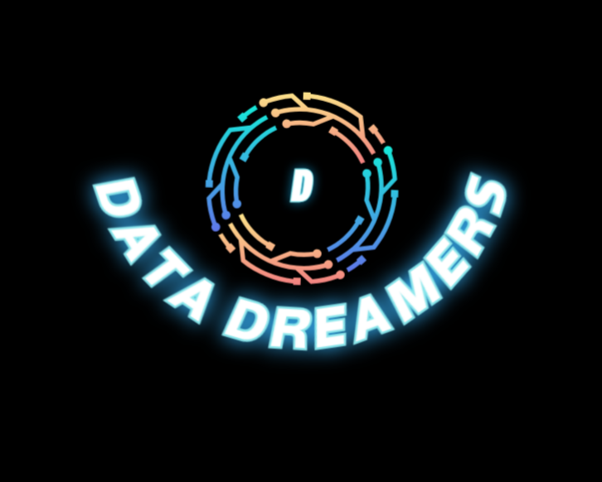
Thank You!
Join us in making dreams speak.

