Slide 1


The CyberArk Approach to Lifecycle Workflows for Account Discovery and Onboarding
Learn how CyberArk's solution can help streamline the account discovery and onboarding process to improve your organization's cybersecurity.
PG
by Pradhumna Gupta

Slide 2
The Importance of Account Discovery and Onboarding Process
1
Securing access
2
Ensuring compliance
3
Optimizing efficiency
Proactively identify and secure privileged accounts, system accounts, and human interactive accounts for all systems and applications – on-premises, cloud, or hybrid
Comply with industry regulations, standards, and best practices while maintaining the ability to scale as your infrastructure changes and audit trails to support auditing requirements
Streamline processes to reduce overhead costs and easily expand coverage to new systems and accounts as needed

Slide 3
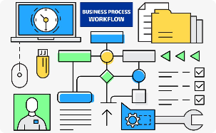
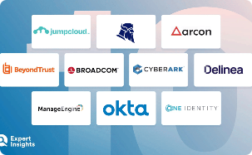
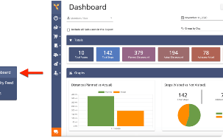
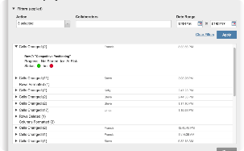
Key Components of Lifecycle Workflow Approach
Automated Workflow
Privileged Access Management
Reporting Dashboard
Create, manage, and execute time-based and event-based workflows to automate account onboarding, provisioning, and de-provisioning.
Gain insight into your organization's account discovery and onboarding status, and quickly identify areas that require attention.
Ensure consistent protection and auditing of privileged accounts across all environments to prevent unauthorized access.
Audit Trails
Record all activity related to privileged accounts and provide clear audit trails for compliance reporting.

Slide 4
How CyberArk's Method Works
Onboarding process
Use a consistent, automated workflow to manage the onboarding, enrolling, and approval of privileged accounts across all systems and applications.
1
2
3
Account discovery
Secure storage and maintenance
Automatically discover and classify all privileged accounts, including human, machine and application identities, to eliminate the blind spots across your organization.
Enforce policies that require rotating, securing, and storing passwords and other secrets, and enforce least-privileged access to applications, systems and other resources.

Slide 5
The Benefits of Implementing a Lifecycle Workflow Approach
Improved security
Better compliance
Reduce risks and detect, alert on, and respond to threats faster with fewer resources.
Ensure compliance with laws, regulations, and standards, and demonstrate compliance through reports and audits.
Streamlined processes
Improved productivity
Automate and standardize time and effort-intensive processes, freeing up expert staff for value-added tasks and strategic planning.
Allow users to quickly and easily obtain access to the accounts and applications they need to do their jobs, with access appropriate to their roles in the organization. Eliminate downtime due to account registration cycles or routine updates.

Slide 6

Challenges in Implementing the CyberArk Method
1
Integration
2
Training
Ensuring that new systems and updates can work with workflows can be challenging, requiring coordinated efforts across IT teams and business owners.
Employees and contractors need to adjust to new procedures and tools, requiring appropriate training and communication options.
3
Resistance to Change
Sometimes staff or business owners may be unwilling to emphasize process or to alter existing roles and procedures to optimize security and efficiency.

Slide 7

Conclusion and Next Steps
Modern enterprises need a dedicated solution for discovering and managing privileged accounts that can help prioritize and safeguard access to critical infrastructure, mitigate risk, and enable compliance.
CyberArk's lifecycle workflow approach streamlines the account discovery and onboarding process while enhancing security and reducing risk, workload and administrative costs, and increasing employee productivity and compliance.

