Slide 1


CyberArk Proposal Document
In today's world, cybersecurity has become more important than ever. Creating a CyberArk proposal document can help protect businesses and organizations from emerging threats and provide an extra level of security.
PG
by Pradhumna Gupta

Slide 2
The Current Cybersecurity Landscape & Risks
1
Cybersecurity Landscape
Cyber threats are becoming more advanced and sophisticated. From malware to ransomware, organizations must take proactive measures to protect their digital assets.
2
Risks & Consequences
The impact of a cyber attack can be devastating - from financial loss to reputational damage. It's crucial to stay ahead of these threats to prevent them from occurring in the first place.
3
What's at Stake
Organizations have their reputation and customers' trust at stake, not to mention the risk of huge financial loss if a breach occurs.

Slide 3
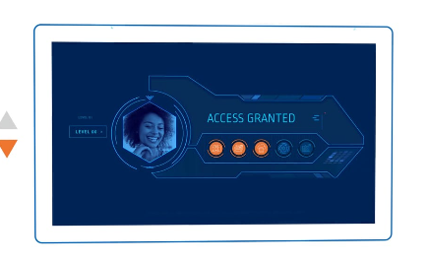
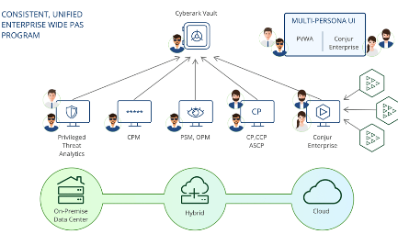
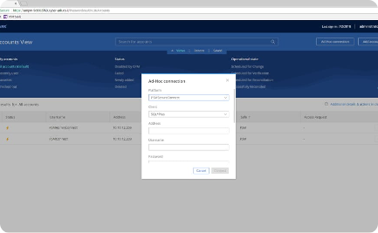
CyberArk's Solutions & Benefits
Solutions
Benefits
User Interface
CyberArk offers a variety of solutions to help protect digital assets, including privileged account security, endpoint detection and response, and threat analytics.
By implementing CyberArk, organizations can have peace of mind, prevent breaches, lower risk of attack, and reduce overall costs associated with cybersecurity.
CyberArk's intuitive and user-friendly interface makes it easy to navigate and understand. Its dashboard provides real-time information on threats and alert notifications.

Slide 4
Discovery of Accounts Across Environment
Phase-Wise Approach
Requirements
Discovery Process
Discovering and securing privileged accounts should be a phased approach, starting with the highest risk accounts and systems.
Requirements for account discovery and management will vary by organization and industry, but CyberArk provides a flexible and customizable solution to meet those needs.
The discovery process includes onboarding accounts, configuring auto discovery, and identifying privileged accounts that may have been missed.

Slide 5

Onboarding Accounts & Configuring Auto Discovery
CyberArk's onboarding process is simple and straightforward, with a variety of customization options available.
Auto discovery can help identify privileged accounts in real time, and can detect changes in accounts or systems that may impact security.
Proper configuration of auto discovery is crucial in order to minimize false positives and ensure the accuracy of results.

Slide 6
Best Practices for Onboarded Accounts
Security Hygiene
Workflow Optimization
Compliance & Reporting
Regularly change passwords and rotate credentials
Assign proper roles and permissions to reduce the risk of accidental misuse
Ensure compliance with industry regulations and standards
Use multi-factor authentication to enhance security
Limit lateral movement of credentials to prevent unauthorized access
Keep detailed logs and reporting on system activity
Monitor system activity and unusual behavior
Conduct regular security audits and risk assessments
Implement privilege escalation workflows for emergency situations

Slide 7
Timeline, Objectives, and Goals
Timeline
Phase 1: Discovery and onboarding Phase 2: Configuration of auto discovery and system monitoring Phase 3: Best practices implementation and compliance reporting
Objectives
To identify, secure, and monitor privileged accounts across multiple systems and environments, and reduce overall cybersecurity risk.
Goals
To minimize exposure to cyber threats, prevent unauthorized access, and reduce the risk of financial and reputational losses.

