Slide 1


Sample PPT for Proposal Document
Welcome to this sample PPT for proposal document. Discover how to create a professional and effective presentation for your business proposals!
PG
by Pradhumna Gupta

Slide 2
A Clear Purpose
Introduction
Purpose
Contents
Introduce your proposal document and make sure that your audience has a clear understanding of your goals.
Define the purpose and benefits of the proposal document, outlining why your audience should invest time in reading it.
Provide a brief overview of the key topics that the document will cover, and highlight the most important sections.

Slide 3
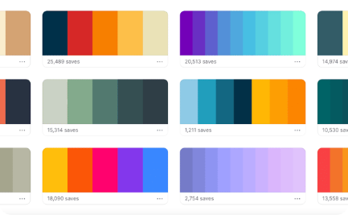
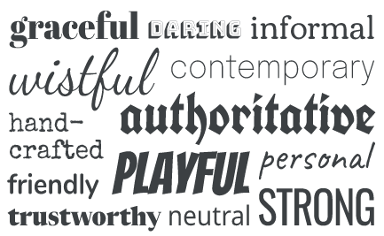

Design Choices
Colors
Fonts
Visuals
Choose a color palette that matches your branding, and use it consistently throughout the document to reinforce your identity.
Select a font or fonts that are easy to read and visually appealing, and use them consistently throughout the document to maintain a professional look.
Include images, graphics, and other visual elements that enhance the content of the proposal, making it more engaging and memorable.

Slide 4
Contents
Executive Summary
The Problem
Provide a brief overview of the proposal, highlighting key points and outlining the benefits to the reader.
Define the problem that the proposal aims to solve, and explain why it is important for the reader to address it immediately.
The Solution
The Offer
Explain the proposals and how they solve the problem, describing the benefits to the reader and how they can be applied.
Describe the offer and outline the terms, highlighting the benefits to the reader.

Slide 5
Suggestions for Customizing
Targeted Sales Copy
Modify the sales copy to hone in on the specific concerns or issues of your audience to make the presentation more relevant to them and improve engagement.
1
2
3
Custom Branding
Integrating Video and Audio
Add your own logo and graphics to the presentation to truly make it your own and unique. This can help grab attention and make your presentation more memorable.
You can add extra appeal by including multimedia elements such as audio clips and video recordings. These will also help keep your audience more engaged.

Slide 6
Tips for Delivery
1
Speak Clearly and Confidently 🎤
2
Use Engaging Visuals 👀
3
Keep It Concise ⏱️
Be respectful of your audience's time by keeping your presentation concise. Focus only on the most important points and leave out unnecessary information.
Practice your delivery so that you feel confident and speak clearly. This will improve the audience's understanding and make it easier for them to focus on the content.
Incorporate visual aids such as images and graphs to illustrate your points and keep your audience interested.

Slide 7
Conclusion and Next Steps
Recap
Call to Action
Summarize the main points that you have covered in the presentation, reminding the audience of the key benefits of your proposal document.
Conclude with a strong call to action, urging your audience to take the next step, whether it's to sign a contract or learn more about your proposal.

