Slide 1


Creating a Secure Environment with CyberArk
CyberArk's privileged access management solutions can help safeguard your critical assets by securing privileged accounts and credentials, reducing your attack surface and mitigating risks.
PG
by Pradhumna Gupta

Slide 2


Discovery of Accounts
Phase-Wise Approach
Requirements
Our phased approach includes a detailed inventory of accounts, account classification, and prioritization based on criticality.
We'll need access to all systems and applications, network diagrams, and host information to discover accounts.

Slide 3
Onboarding and Auto-Discovery
Onboarding
Auto-Discovery Configuration
We use a combination of manual and automated processes to onboard accounts, following best practices for account creation and control.
We configure CyberArk to automatically discover new accounts and prevent the creation of unsecured accounts with a centralized platform for credential management.

Slide 4
Best Practices
Password Management
Role-Based Access Control
We enforce strong password policies, regular password rotation and use of multi-factor authentication.
We limit user access with role-based access control, using the principle of least privilege.
Activity Monitoring
Regular Reviews
We continuously monitor the activity of privileged users and alerts are raised if any unauthorized attempts are made.
We conduct reviews of user access and audit trails on a regular basis to ensure compliance with both internal and external regulations.

Slide 5


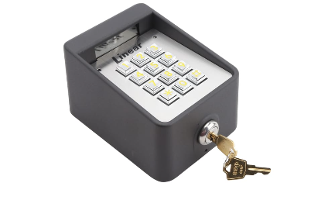
Securing Privileged Accounts
Account Password Management
Monitoring and Analysis
Access Control
We monitor and analyze privileged account activity to identify unusual behavior and stop potential breaches.
We control access to privileged accounts based on the user's role and assign granular permissions to determine scope of access.
We secure privileged account passwords with a vault. Passwords are rotated frequently and checked for compliance with organization-wide policies.

Slide 6
CyberArk Solutions
Conjur
Cloud-native security for DevOps teams providing secrets management, machine identity, and application-to-application authorization.
1
2
3
Endpoint Privilege Manager
Core Privileged Access Security
Securely manage local administrative privileges and control applications on Windows, Mac, and Linux workstations, servers and point-of-sale systems.
An integrated solution for advanced threat protection, enterprise-wide policy and compliance management, and privileged access governance.

Slide 7
Case Studies and Success Stories
Healthcare Provider
Financial Services
Global Manufacturer
CyberArk helped this healthcare provider provide secure access to patient data, reduce risk, and ensure compliance with HIPAA regulations.
CyberArk helped this financial services firm protect their sensitive customer information, comply with regulatory requirements, and reduce their attack surface.
CyberArk helped this global manufacturer improve operational efficiency, reduce cybersecurity costs, and strengthen their cybersecurity posture.

Slide 8

Conclusion and Next Steps
1
Conclusion
Secure privileged account access is essential for organizations. CyberArk provides a comprehensive solution for securing those assets and reducing risk.
2
Next Steps
Contact CyberArk to learn how we can help you protect your critical assets, reduce your risk, and achieve compliance with regulations.

