Slide 1
Business Problem
Analyze, design and train a model to predict the number of predicted bike rentals for a specific day/hour of day

Slide 2
Available variable description
Date : Datetime(day/month/year).
Rented Bike Count(Target) : Target feature.
Hour : Hour of datetime.
Temperature(°C) : Temperature in Celsius.
Humidity(%) : Humidity.
Wind speed (m/s) : Wind speed.
Visibility (10m) : Visibility range.
Dew point temperature(C) : Temperature of the area.
Solar Radiation (MJ/m2) : The total solar energy for a day.
Rainfall(mm) : Represents the total depth of rainwater (mm) for particular day.
Snowfall (cm) : The amount of snow that falls in a given area.
Seasons : (Winter, Spring, Autumn, Summer).
Holiday : That day is holiday or not.
Functioning Day : Working day or close.
There is a delightful spring (April to June), a muggy and wet summer (July to August), a refreshing autumn (September to November) and a freezing cold, snowy but dry winter (December to March).
Still can derive another variable as Day or night based on temperature/ If ride taken more than 6 hrs and less than 18hrs then its day, else night.

Slide 3
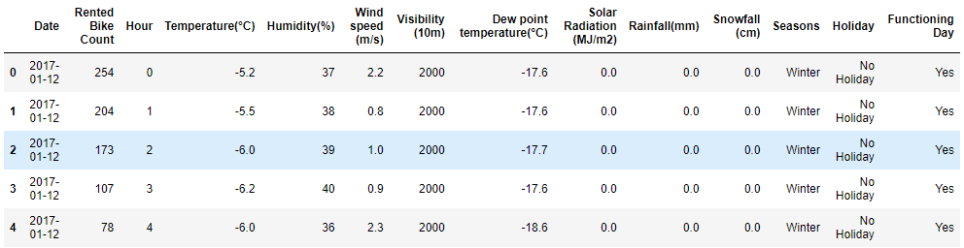
Data preprocessing and EDA
Dataset
There are no null values in dataset.
There are no duplicate records in dataset.

Slide 4
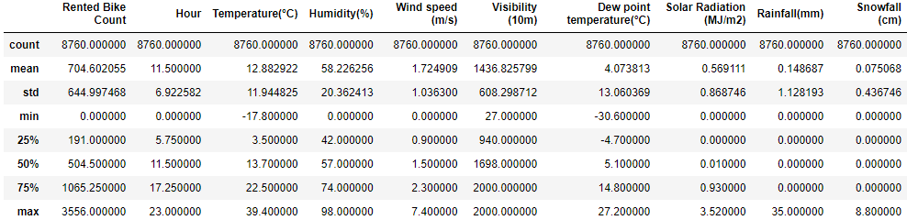
Summary of the dataset

Slide 5
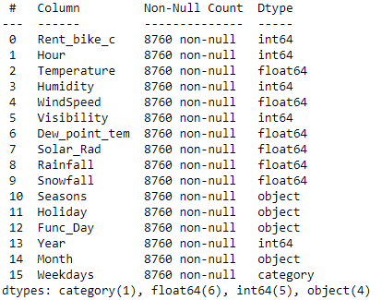
Data types of variables

Slide 6
Feature engineering
Derived new features from Date variable:
Year
Month
Weekday
Can derive another variable as Day or night based on temperature/ If ride taken more than 6 hrs and less than 18hrs then its day, else night.
Created dummy variables for categorical variables.(Seasons, Holiday, Func_Day, Month, Weekdays ,Year).
Scaling data(Normalizer) - to bring all numerical variables into single unit and remove different units from dataset.(Rented Bike Count, 'Hour, Temperature(°C), Humidity(%), Wind speed (m/s), Visibility (10m), Dew point temperature(°C), Solar Radiation (MJ/m2), Rainfall(mm), Snowfall (cm)

Slide 7
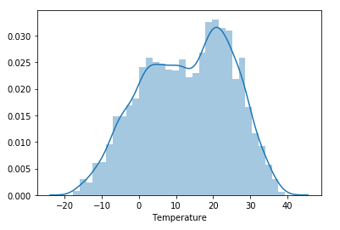
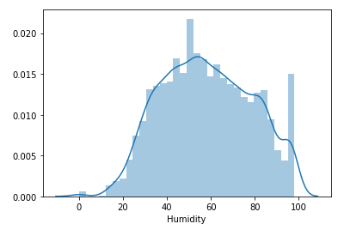
Univariate and Bivariate analysis
The distplot represents the univariate distribution of data i.e. data distribution of a variable against the density distribution.
From the below graphs its we can say that data is following partial normal distribution

Slide 8
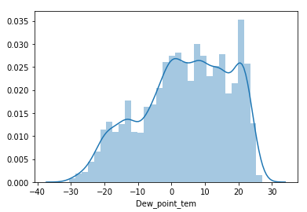
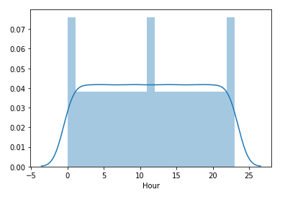

Slide 9
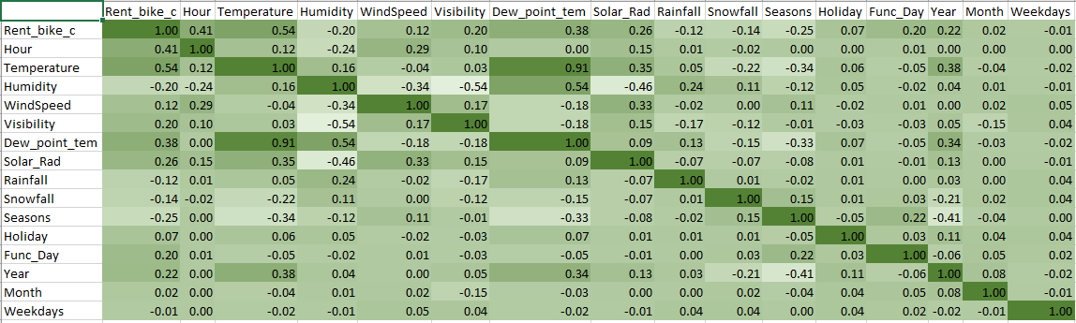
Correlation matrix
A correlation matrix is simply a table which displays the correlation. It is best used in variables that demonstrate a linear relationship between each other.
Correlation matrix to understand relationship between target and input variables

Slide 10
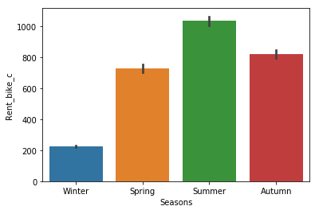
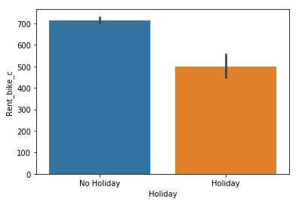
A barplot is used to display the relationship between a numeric and a categorical variable.
Rented bike count V/S Seasons
Rented bike count V/S Holiday

Slide 11
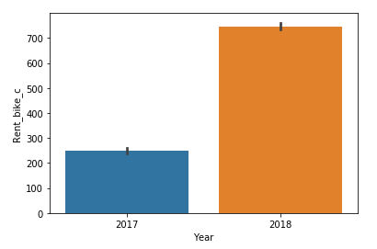
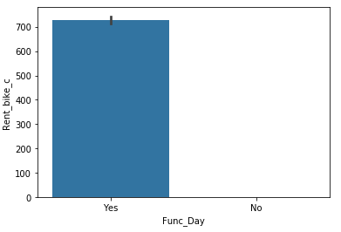
Rented bike count V/S Year
Rented bike count V/S Functioning day

Slide 12
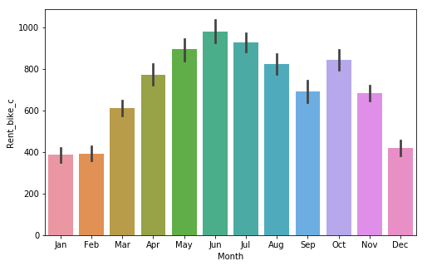
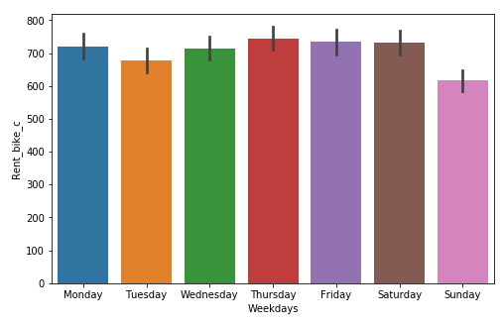
Rented bike count V/S Month
Rented bike count V/S Weekdays

Slide 13
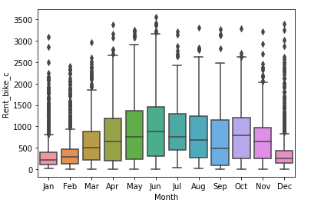
A Box Plot is also known as Whisker plot is created to display the summary of the set of data values having properties like minimum, first quartile, median, third quartile and maximum. In the box plot, a box is created from the first quartile to the third quartile, a vertical line is also there which goes through the box at the median. Here x-axis denotes the data to be plotted while the y-axis shows the frequency distribution.

Slide 14
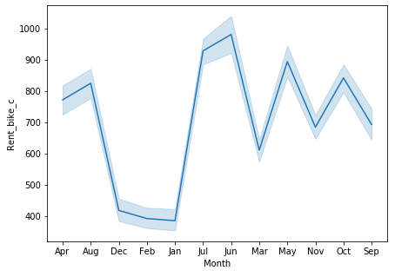
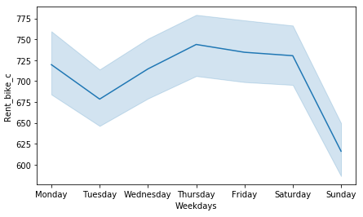
When data is varying with time we use lineplot to understand how data change as time moves
Rented bike count VS Months
Rented bike count VS Weekdays

Slide 15
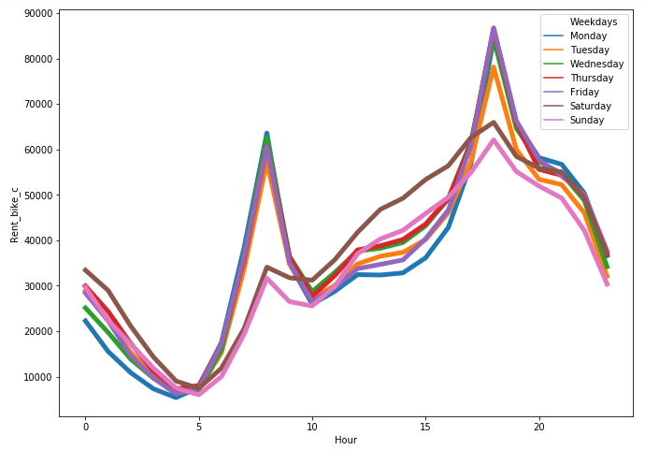
Rented bike count VS Hours

Slide 16
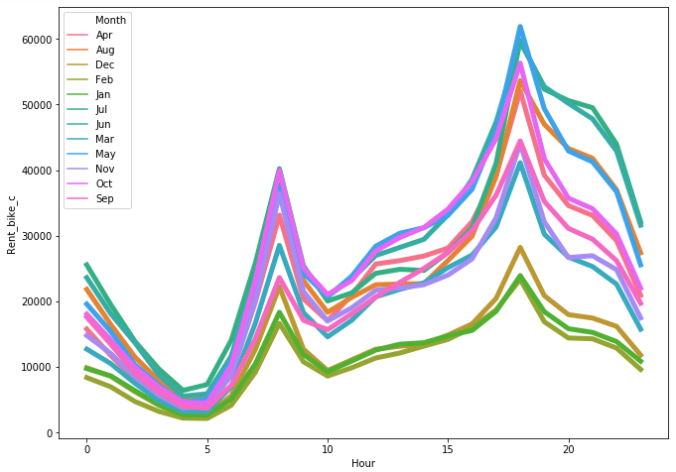
Rented bike count VS Months

Slide 17
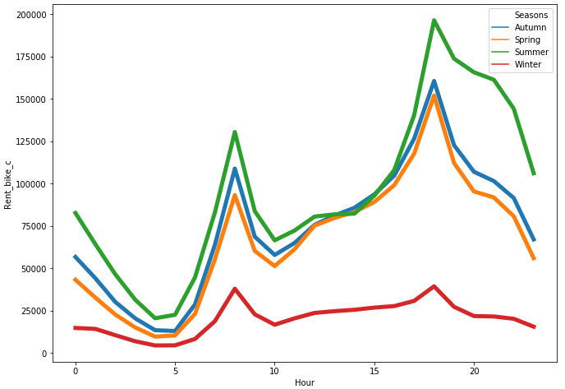
Rented bike count VS Hours

Slide 18
Variable selection method.
Here we used P value for considering variable. Where P value is less than 0.05 those variables are considered for model building.
Considered 11 variables for model building. Those are
1 | Hour
2 | Temperature
3 | Humidity
4 | Visibility
5 | Solar_Rad
6 | Rainfall
7 | Seasons_Spring
8 | Seasons_Winter
9 | Month_Jun
10 | Month_Sep
11 | 'Weekdays_Saturday'
Metrics used for model evaluation:
For Logistic Regression : Adjusted R-Squared value(0.87)
And Mean squared error(0.009439)
For Random Forest – R Squared Value- (0.95)

Slide 19
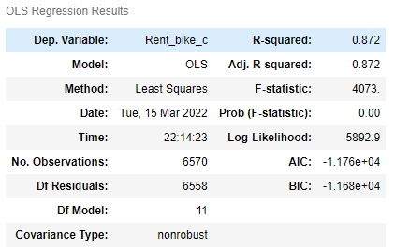
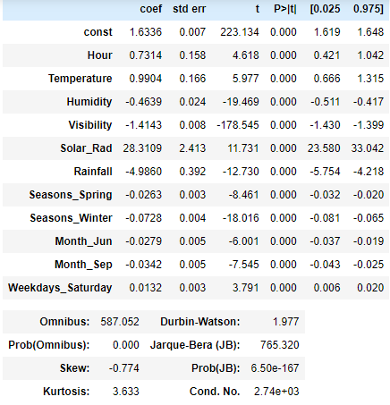
Logistic Regression mode results

