Slide 1


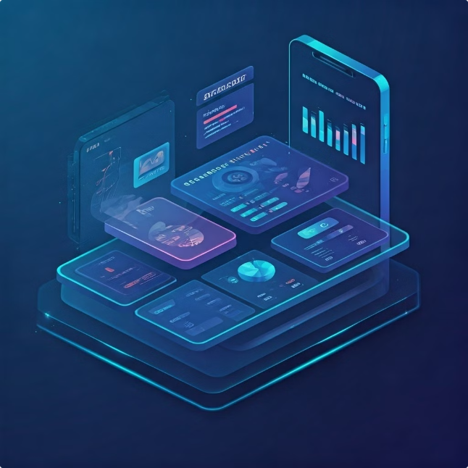
Expense Tracker App
Welcome to our comprehensive guide on building an Expense Tracker App using ASP.NET Core MVC and SyncFusion components. This application demonstrates the development of a robust and feature-rich enterprise solution from scratch.

Slide 2
ASP.NET Core MVC Architecture
Model-View-Controller (MVC)
ASP.NET Core
SyncFusion Components
ASP.NET Core provides a lightweight and modular framework for building web applications.
SyncFusion offers a suite of high-quality UI components to enhance the user experience and functionality of the application.
The MVC architecture pattern separates the application into distinct components for data, presentation, and logic.

Slide 3
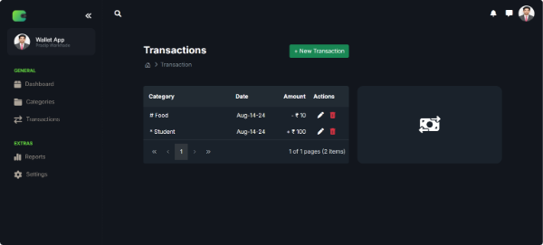
SyncFusion Components Integration
1
Grid
2
Chart
The SyncFusion Grid component provides a powerful and flexible way to display and manage data, including features like sorting, filtering, and editing.
The SyncFusion Chart component enables the visualization of data trends and insights, helping users to better understand their expenses.
3
Side Menu
4
Dockable Side Bar
The SyncFusion Side Menu component provides a navigation system that allows users to easily access different features of the application.
The SyncFusion Dockable Side Bar component allows users to customize the layout of the application by docking different panels and components.

Slide 4
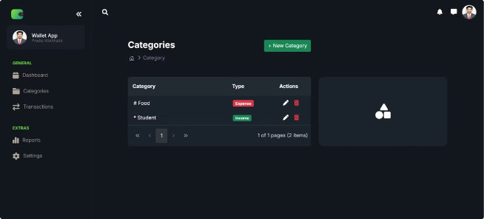
CRUD Operations for Categories
1
Create
Users can create new categories to organize their expenses.
2
Read
Users can view a list of existing categories.
3
Update
Users can modify the details of existing categories.
4
Delete
Users can remove unnecessary categories from the list.

Slide 5


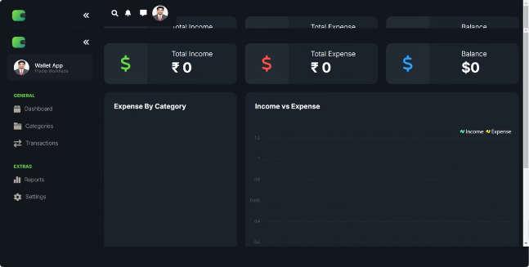


Dashboard with Chart Elements
Expense Breakdown
Monthly Expenses
Visualize the distribution of expenses across different categories using charts.
Track expenses over time to identify patterns and trends.
Budget Tracking
Category Breakdown
Compare actual spending against a pre-defined budget.
Analyze spending by category to understand where money is being allocated.

Slide 6

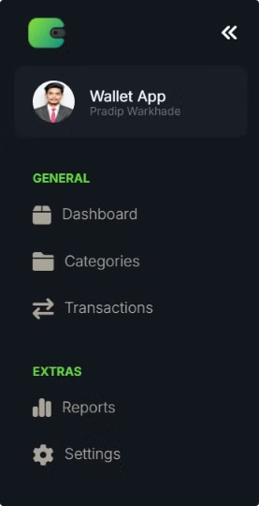

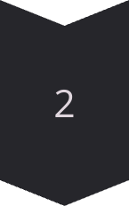
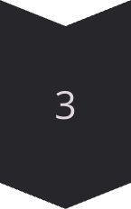
Side Menu with Dockable Side Bar
Navigation
The side menu provides easy access to different sections of the application.
Customization
Users can customize the layout of the application by docking the side bar to different positions.
Efficiency
The dockable side bar improves the user experience by providing a streamlined and organized interface.

Slide 7
Transaction Grid with Paging and Sorting
Feature
Description
Paging
Displays data in manageable chunks, allowing users to navigate through large datasets.
Sorting
Enables users to arrange transactions by different criteria, such as date, amount, or category.
Filtering
Provides users with the ability to narrow down the displayed transactions based on specific criteria.

Slide 8


Conclusion and Key Takeaways
The Expense Tracker App effectively demonstrates the power of ASP.NET Core MVC and SyncFusion components for developing enterprise-grade applications. The app provides comprehensive features like data management, visualization, and user-friendly interface elements.

