Slide 1


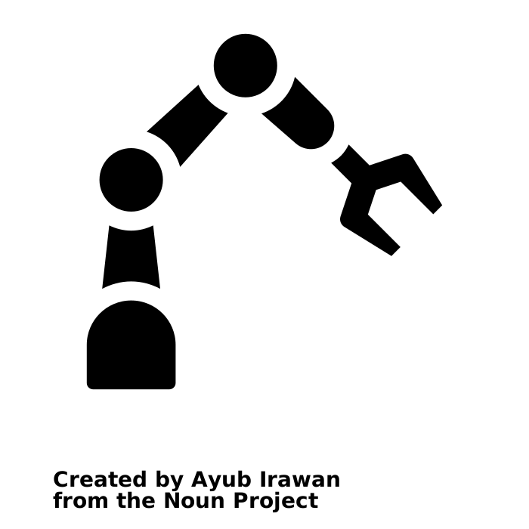
RobotControl
C++ Library
plan and execute trajektories to specified goals receiving actual TCP poses change tools set different forcemodes set robot into freedrive mode set parameters (velocity, acceleration…)
catkin roscpp ros_msgs
MoveIt
ROS Node
environmental collision detection selfcollision detection path planning with OMPL
ur10e_with_drill_description ur10e_drill_moveit_config rviz
Legende
Name
Kategorie
Aufgaben …
Bestandteile …
Eigene Implementierung
open source Projekte
ur_rtde
sdurobotics: C++ Library
control robot with basic commands receive information from robot
rtde_control_interface rtde_receive_interface
TaskControl
C++ Interface
interface to superior controller provide tasks (searchmotions…) waiting for task request via ros_msgs
catkin roscpp ros_msgs
DrillControl
C++ Library
set drill progam receive status information start drill programs
catkin roscpp ros_msgs
phidgets_ik
ROS Node
sending digital outputs receiving digital inputs
Phidget 1018_2 USB A to Sub-D-25 Pin

