Slide 1
Acknowledgement
In performing our assignment,
we were given the help and guideline of our teachers and seniors to whom we extend our sincere gratitude. We would also like to thank our Lecturer respected sir Er. Birendra Singh Dhami for giving us the opportunity to work on the project.
We would like to express our gratitude and appreciation to all those friends associated to our project. Without their continuous support and encouragement, it would have never been possible for us to work at a project. We would also like to expand our deepest gratitude to all those who have directly and indirectly guided us in this project.

Slide 2
Problems statements
In the existing system,
storing and accessing the data is in the form of Excel sheets and account books is a tedious work. It requires a lot of laborious work. Following are the main drawbacks of the existing system:
The existing system is totally manual thus there are chances of error in processing.
The basic and major drawbacks in the existing system are the speed of retrieval of data from files, which leads to delay.
Maintenance of voluminous data is very cumbersome and laborious job.
There are plenty of chances of duplicity of data and information.

Slide 3
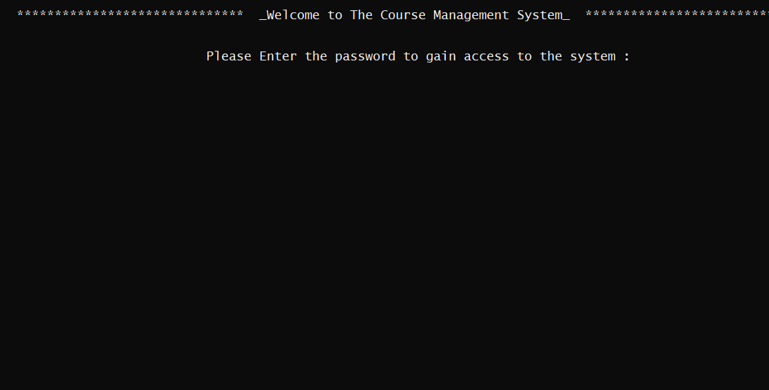
First Display
This is our software’s first display

Slide 4
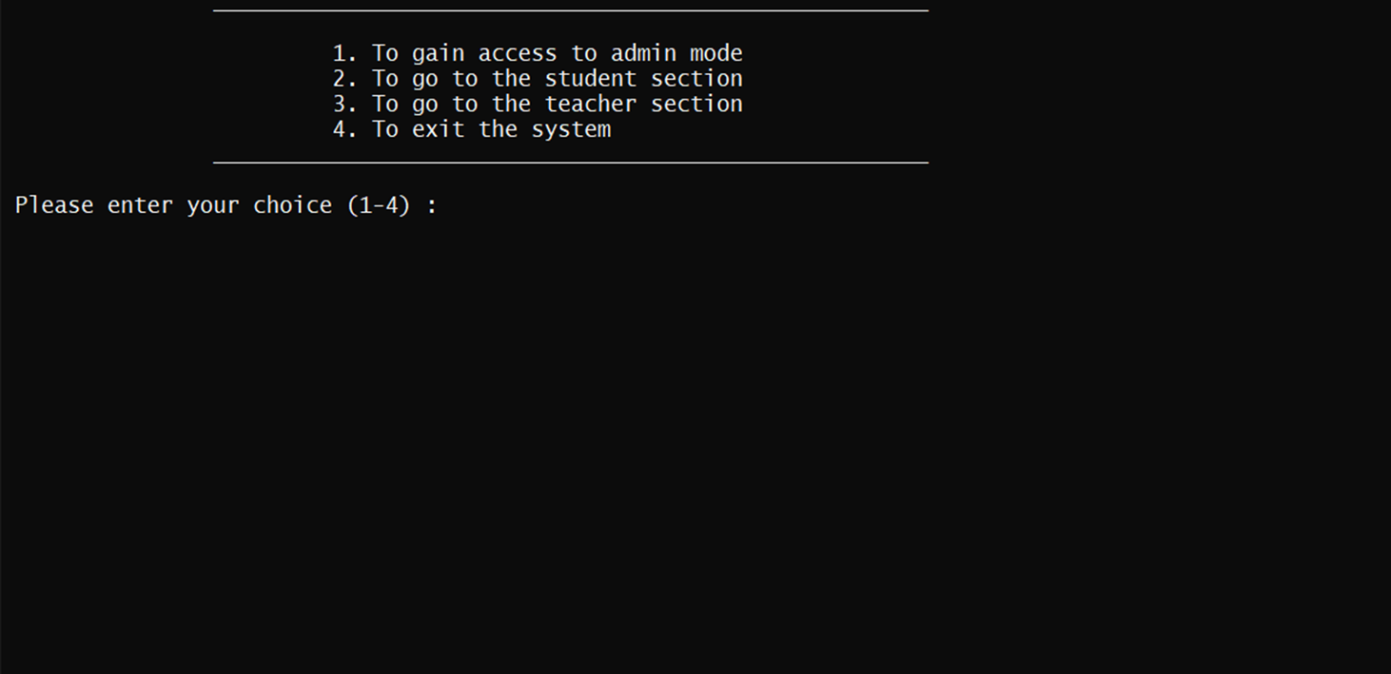
Main section
This is the main display section

Slide 5
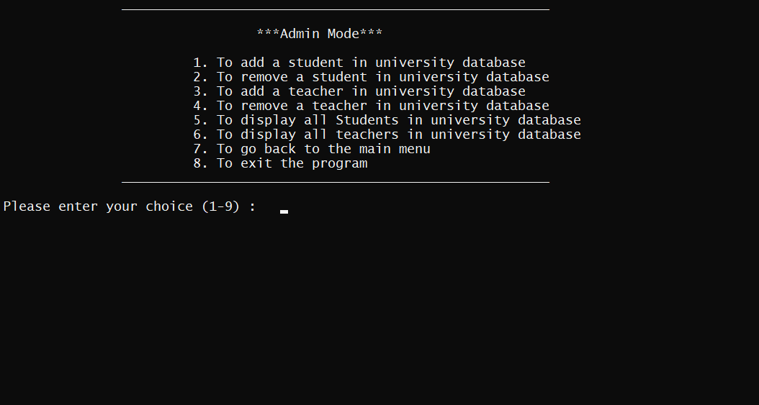
Third display
Menu bar of Admin section

Slide 6
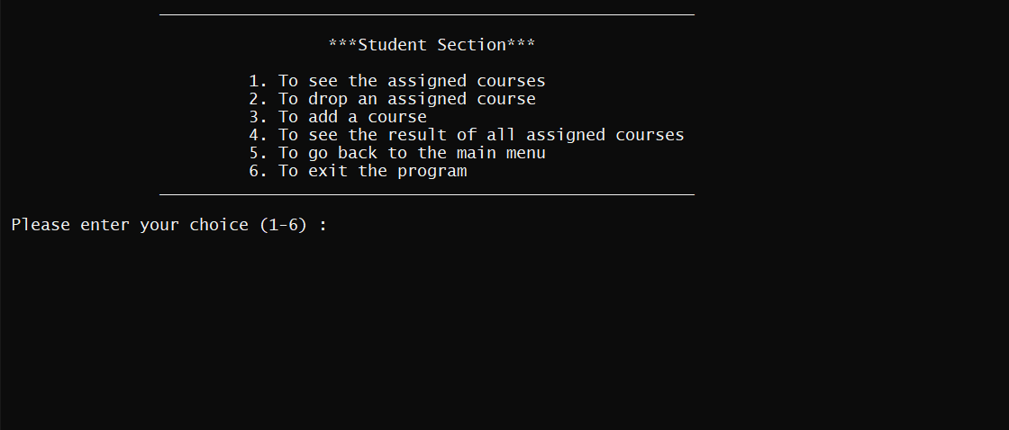
Fourth display
This is the menu bar for student section

Slide 7
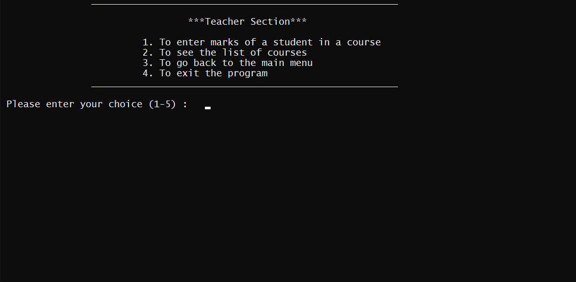
Fifth Display
This is the menu bar for teacher section.

Slide 8
Flow-chart of Program
Main menu
Admin mode
Student Mode
Teacher Mode
Add students
Delete students
Add teachers
Delete teachers
Go back to main menu
See Assigned course
Drop assigned course
Go to main menu
Enter the Marks
See assigned Course
Go to main menu

Slide 9
Block-diagram
Drop Courses
Delete student
Add Teacher
See Assigned Courses
ADD new students
Add Course
See courses
Enter Marks
Go to main
Go back to Main
Delete Teacher
Student Section
Admin Section
Teacher Section

Slide 10
Literature review
By exploitation of the computers in access and management of information, FWU can now administer the departments’ operational efficiencies and organizational effectiveness. The more informative system in department can efficiently aid the knowledge by supplying the useful information.
The computerized database system in FWU is expected to lessen the burden on both department and students in searching for the marks teachers students and information.
PROCESS
The integrated process of a computerized DBMS system can keeps the track of all the records and periodicals and keeping the status updated.
Through the use of the necessary infrastructure and implementation of the process, the computerized DBMS system can be effective. However, FWU department of computer engineering should answer the various challenges including the interactive connections (telephone and modem, the electricity problems, and the process of accessibility and privacy issues. and building the strengths, it is for most important to address the issues that might affect the efficiency and effectiveness of the process.

Slide 11
Advantages
This will serve as an advantage of the FWU to implement and negotiate the movement towards the computerized DBMS systems.
There are many universities that openly participated in the computerized DBMS systems which add to their value of promoting the learning. However, it is obvious that most of the universities that managed this new system are private or semi-private institutions.
For good project productivity, some teams break it up into individual tasks to manage accountability and utilize team strengths.

