Slide 1
Product Tagging in VEO360
Digital Twin Using Object Recognition
Project Hail Mary
VEO Hackathon Challenge | Pradip Nath & Thang Ngo
1

Slide 2
Project Overview
An automated computer vision and document-linking pipeline for industrial digital twins.
Bridges the gap between clean master product imagery and complex industrial point-cloud environments.
Automatically detects assets, reads identifiers, locates equipment in 3D scans, and links technical documentation.
Designed to reduce manual tagging effort and support scalable deployment across industrial sites.
2

Slide 3
Business Problem & Motivation
Industrial digital twins often depend on manual asset tagging.
Manual tagging can cause human error, slow site deployment, and increase operational costs.
Real-world labeled industrial datasets are limited, making scalable computer vision difficult.
The project addresses these constraints by generating realistic training data from clean reference imagery.
3

Slide 4
Core Solution
1
Reference Image
Clean ABB REX615
product imagery
2
Synthetic Data
Domain-randomized
industrial scenes
3
Detection + OCR
YOLOv8 finds assets;
OCR reads labels
4
3D Tagging
Scan location linked
to documents
4

Slide 5
Architecture & Pipeline Workflow
Clean Reference
Image
ABB REX615
Synthetic Data
Generator
Domain randomization
YOLOv8 + OCR
Detector
Detection & text
Matterport / E57
Scan
3D environment
Interactive 3D Tag
& Documents
Asset retrieval
The pipeline converts a clean product reference into robust detection models and then maps detected assets into the 3D digital twin.
5

Slide 6
How the Pipeline Works
Synthetic Data Generation — applies affine transformations, lens artifacts, lighting variation, occlusions, and background blending.
Model Training & Text Extraction — trains YOLOv8 to locate the relay and panel labels; OCR reads identifiers such as “615 ABB RELAY”.
Digital Twin Extraction — parses cloud_0.e57 point-cloud data to obtain 2D equirectangular / panoramic scan perspectives.
Asset Matching & 3D Tagging — matches extracted text with technical datasheets/manuals and computes 3D anchor coordinates.
6

Slide 7
Data, Models & Technology
Reference asset: ABB REX615 relay master product imagery.
Synthetic dataset: YOLO-format annotations with industrial background compositing.
Scan input: cloud_0.e57 point-cloud file with extracted panoramas.
Computer vision: YOLOv8 + OCR.
Python ecosystem in the README: Ultralytics, Albumentations, OpenCV, NumPy, pye57, EasyOCR, Pillow.
Output: interactive 3D tags connected to an asset/document registry.
7

Slide 8
Demo & Results
1,000+
synthetic industrial training samples
Real scans
robust detection demonstrated on Matterport frames
No site labels
real scan testing without manual annotations
Interactive
3D pin with specifications, status, and manual link
8

Slide 9
Repository Structure
data/
reference, background, synthetic, scans
scripts/
E57 extraction, synthetic generation, training, inference/tagging
docs/
technical manuals and asset registry
web_viewer/
prototype interactive 3D digital twin viewer
requirements.txt
Python dependencies
README.md
project documentation
9

Slide 10
Pipeline Execution
01
Extract scan imagery
python scripts/01_extract_e57.py ...
02
Generate synthetic dataset
python scripts/02_generate_synth.py ...
03
Train detector
python scripts/03_train_detector.py ...
04
Run inference & output tags
python scripts/04_infer_and_tag.py ...
10

Slide 11
Impact & Value
Reduces site-preparation overhead through automated asset identification.
Improves access to maintenance documentation by linking physical assets to digital records.
Supports faster and more scalable digital-twin deployment across industrial environments.
Demonstrates how synthetic data can help overcome limited real-world industrial labeling.
11

Slide 12
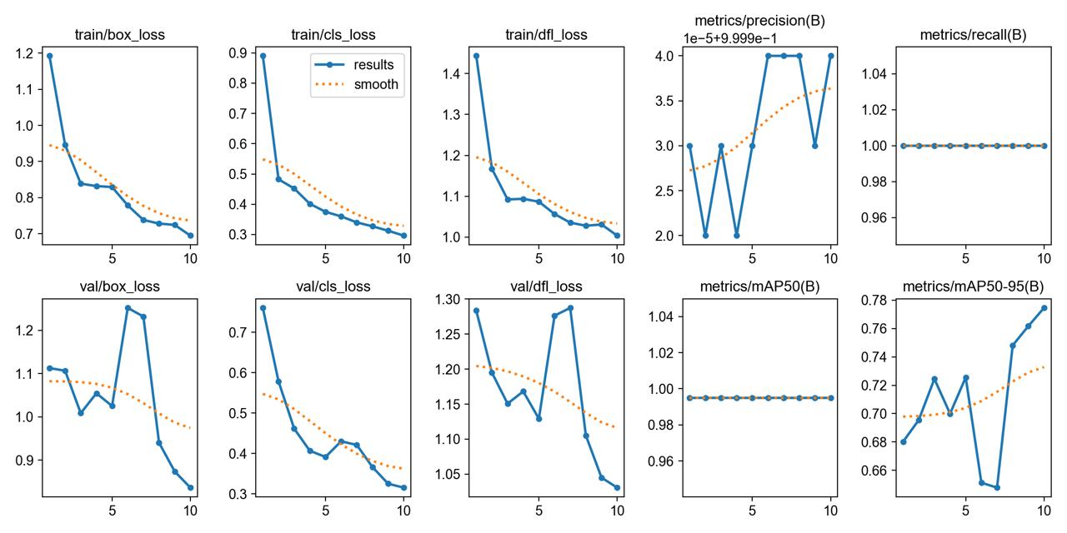
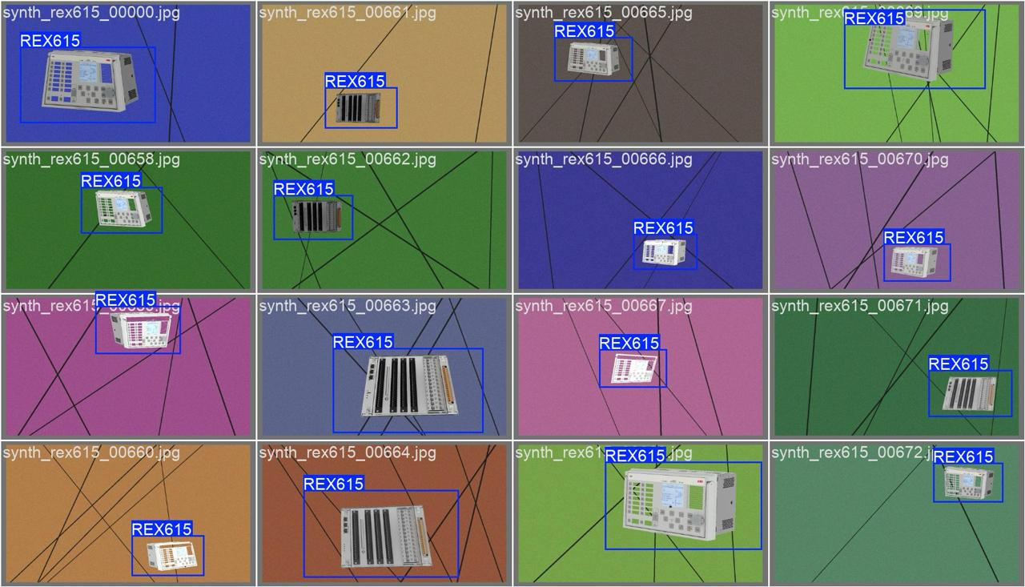
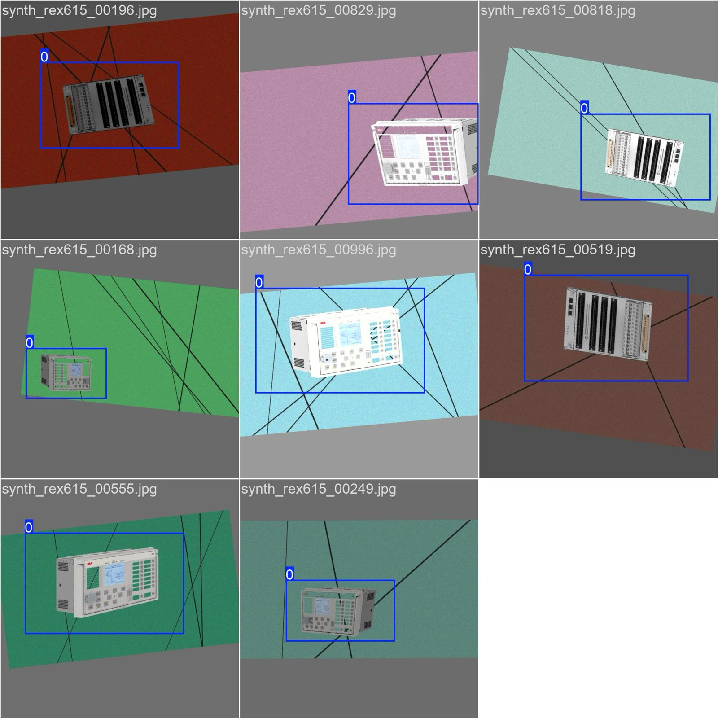
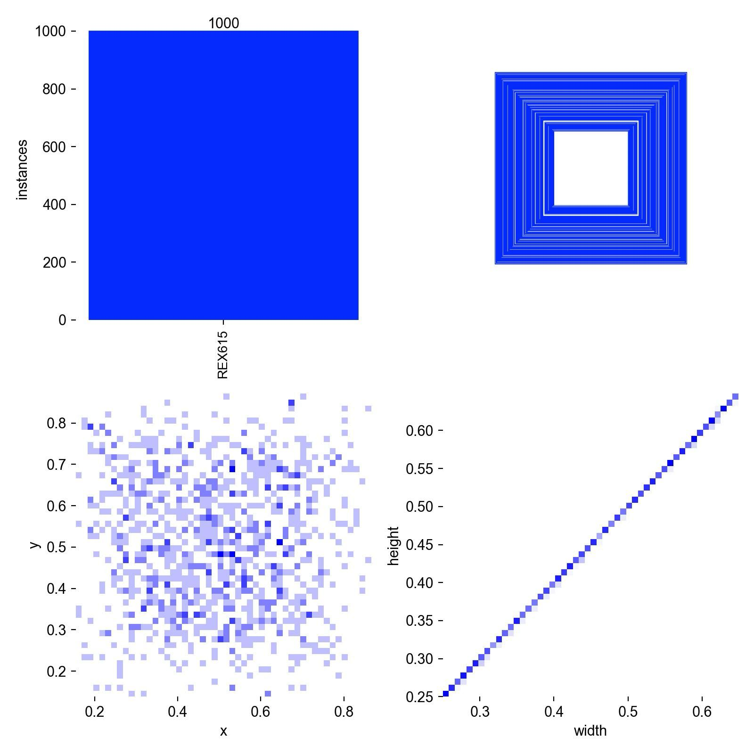
YOLOv8 Training Metrics & Loss Curves
Validation Predictions (val_batch1_pred.jpg)
Train Batch images
Dataset Distribution Analysis

Slide 13
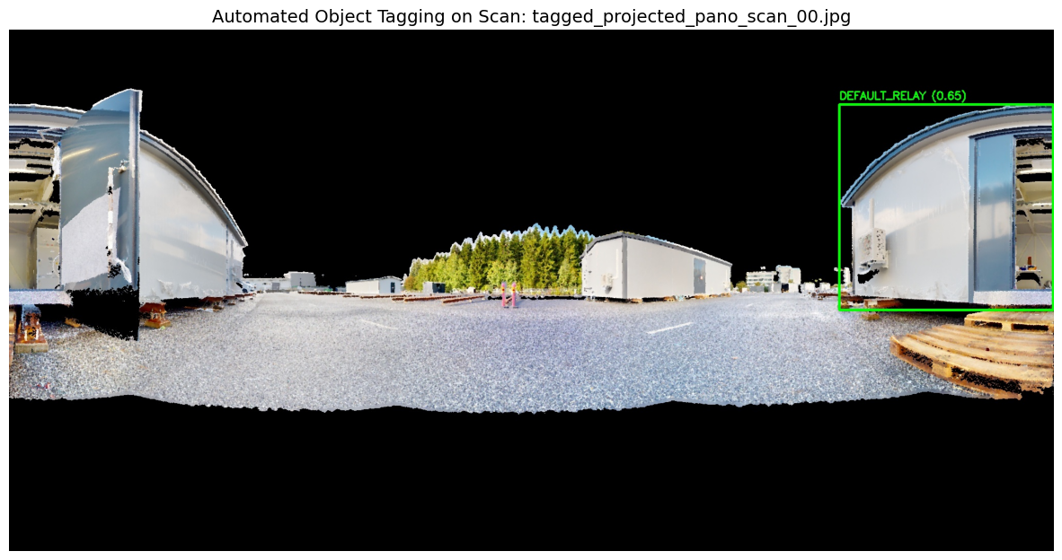
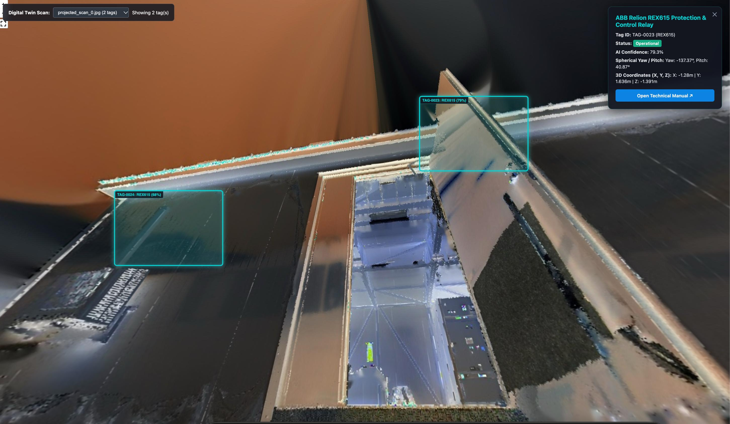
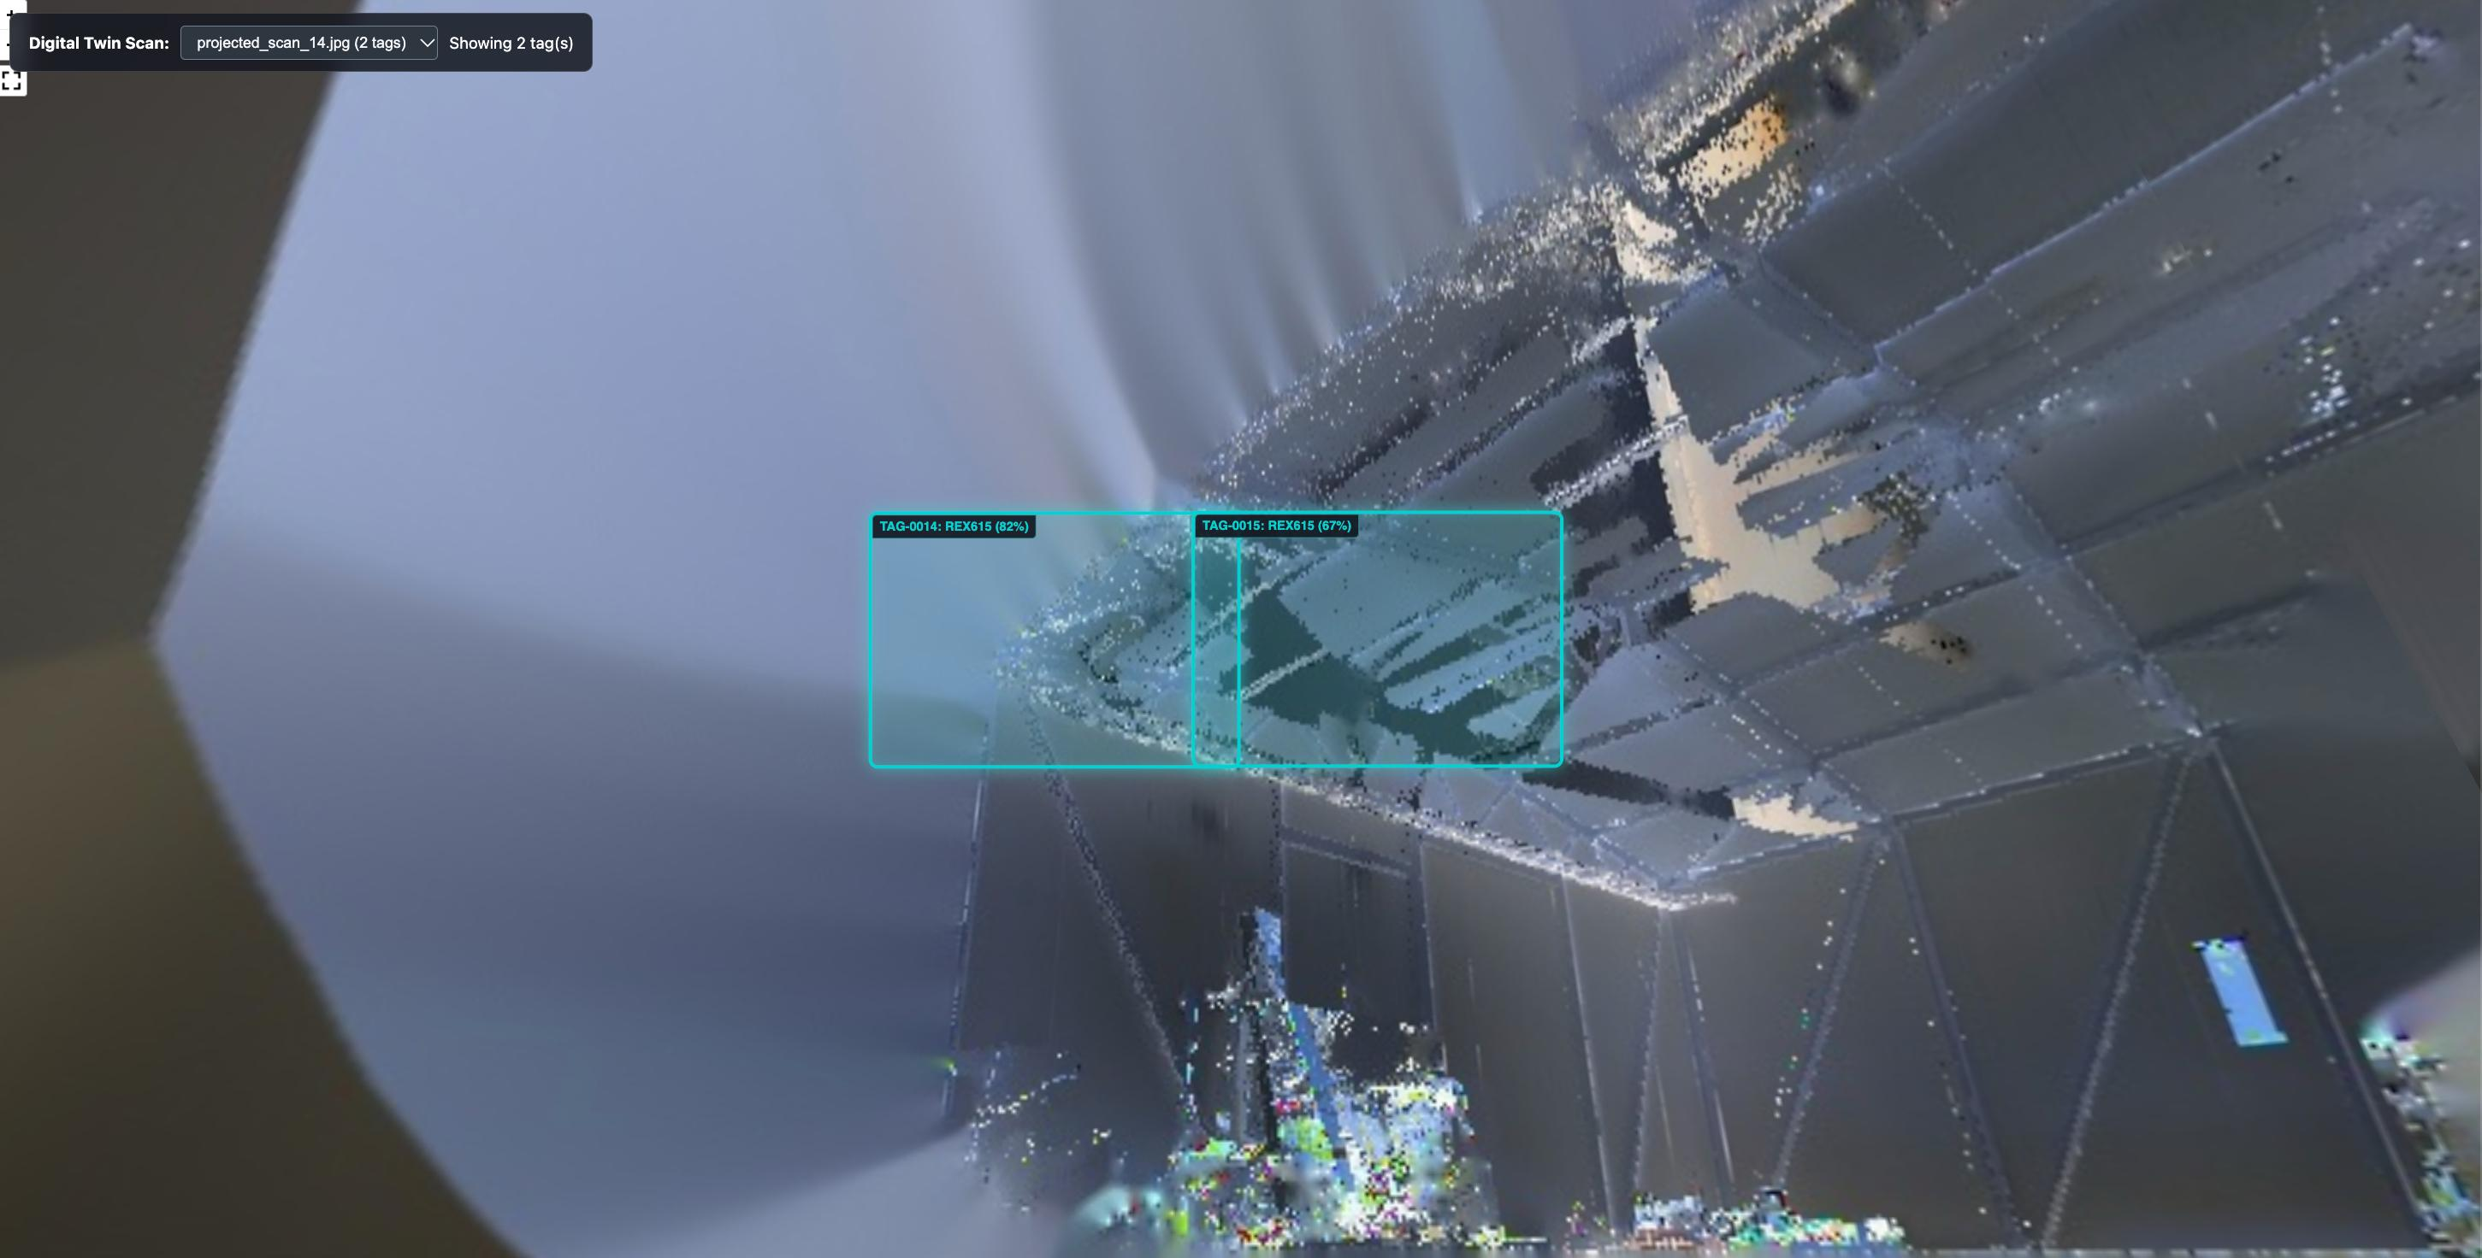
3D Web view

Slide 14
Thank You
Product Tagging in VEO360 Digital Twin
Project Hail Mary
Pradip Nath & Thang Ngo
12

