Slide 1
API
Application Programming Interface

Slide 2
What is API?
API is the acronym for Application Programming Interface, which is a software intermediary that allows two applications to talk to each other.
Each time you use an app like Facebook, send an instant message, or check the weather on your phone, you’re using an API.

Slide 3
Types of REST API Client
Retrofit
Volley
okHTTP
Android Asynchronous HTTP client
etc.

Slide 4
Retrofit
Retrofit is a REST Client for Java and Android. It makes it relatively easy to retrieve and upload JSON (or other structured data) via a REST based webservice.
In Retrofit you configure which converter is used for the data serialization. Typically for JSON you use GSon, but you can add custom converters to process XML or other protocols.
Retrofit uses the OkHttp library for HTTP requests.

Slide 5
For testing we use this link
http://dummy.restapiexample.com/

Slide 6
Using Retrofit
Retrofit mainly need three things in android :
Model class (the POJO we did in previous classes) which is used as a JSON model
Interfaces that define the possible HTTP operations (every method here represents a single possible API call)
Retrofit.Builder class - Instance which uses the interface and the Builder API to allow defining the URL end point for the HTTP operations

Slide 7
Setting up
Define gradle dependencies :
implementation 'com.squareup.retrofit2:retrofit:2.5.0'
implementation 'com.squareup.retrofit2:converter-gson:2.5.0’
Provide Network permission in Android Manifest file :
<uses-permission android:name="android.permission.INTERNET" />

Slide 8
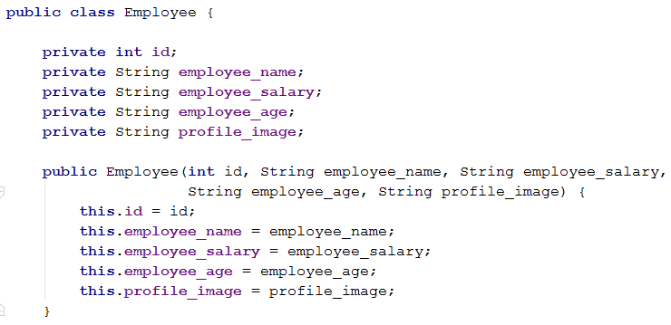
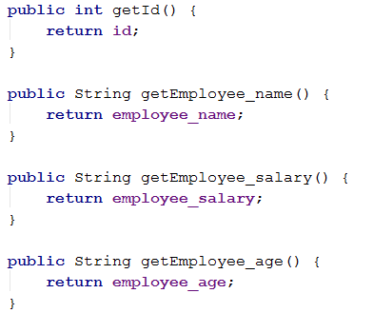
Using Retrofit
1. Model Class

Slide 9
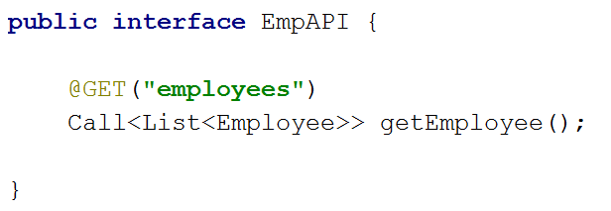
Using Retrofit
2. An Interface for possible API Call

Slide 10
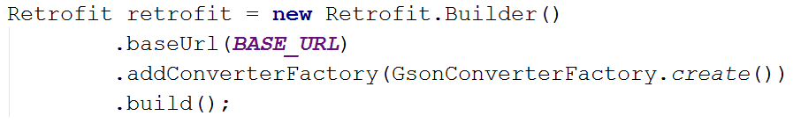
Using Retrofit
3. Retrofit Instance

Slide 11
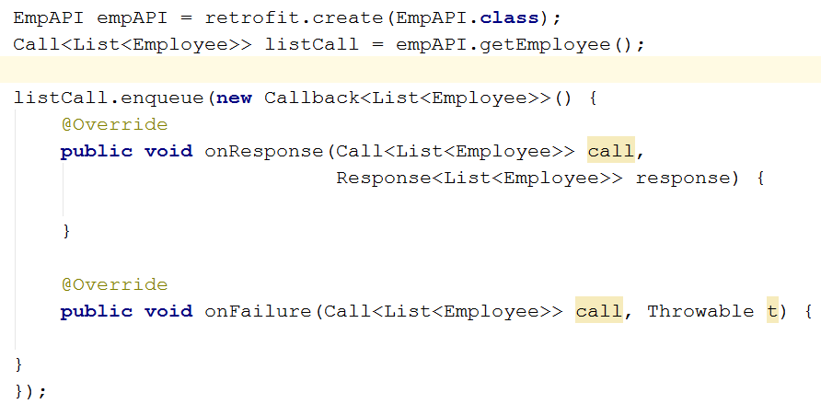
Using Retrofit
Making a request

Slide 12
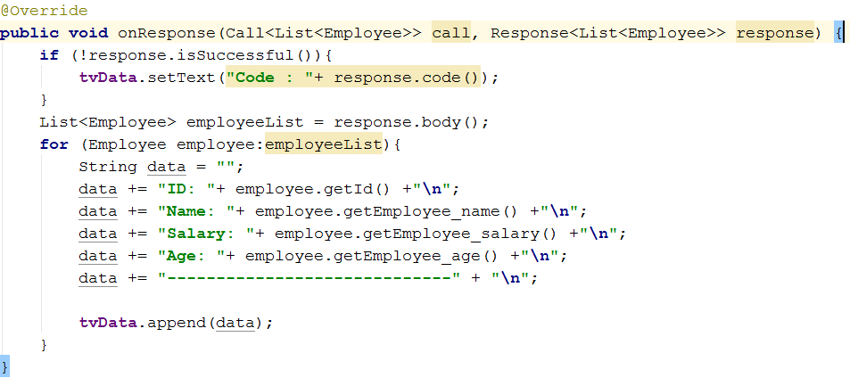
Using Retrofit
Showing data in TextView

Slide 13
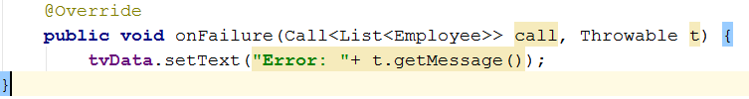
Using Retrofit
Get error message

