Slide 1
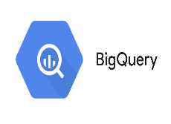
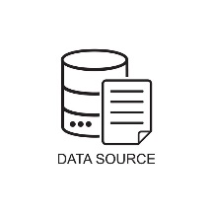
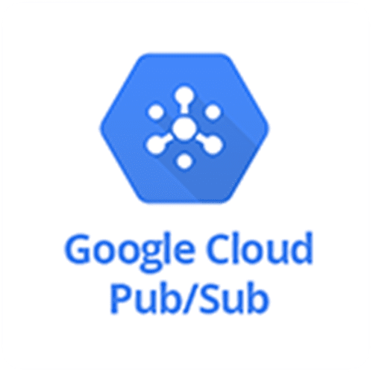
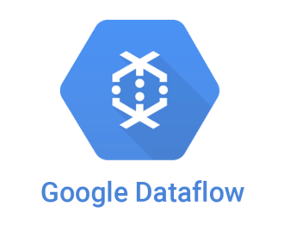


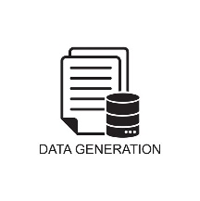

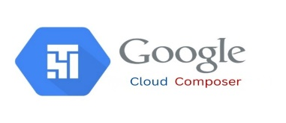



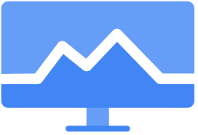


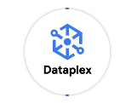

Real-Time Trade Event Streaming & Analytics Architecture
Google Cloud environment
Source system
Analytic tool
Firewall
Firewall
1
3
Cloud Interconnect
Publish message
Subscribe message
Write to BQ
trade_event.trade_landing
5
Outbound
trade_event.trade_rejected
2
4
trade_event.trade_current
Start Dataflow job & process data
Data enrichment & aggregation
trade_event.trade_history
Orchestration
CICD
Logging ,Monitoring & Security
Trade events are streamed from source systems into Pub/Sub.
A scheduled orchestration workflow triggers a Dataflow pipeline every 5 minutes.
The pipeline processes, validates, and loads data into BigQuery (landing and reject tables).
Post-ingestion, enrichment and aggregation logic is executed in BigQuery.
Curated data is instantly available for real-time dashboards and reporting.
Catalog & Data governance

