Slide 1


Final Presentation
Notes:
sss

Slide 2

Final Presentation
Analysis of Zomato dataset
Team Members
Baburam Shrestha Pallavi Shrestha Pradip Sapkota

Slide 3
Contents
Dataset
Tasks
Implementation
Data Pipeline Diagram
Pre-processing
Challenges
1
2
3
4
5
6

Slide 4
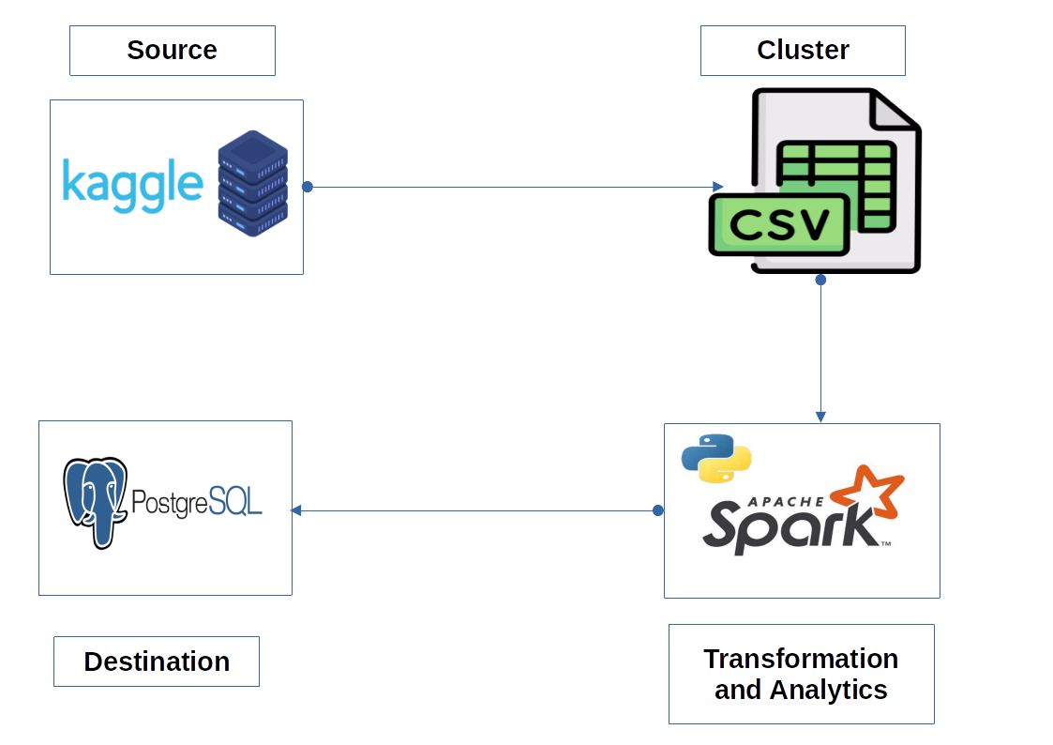
Data Pipeline Diagram
Data

Slide 5
2. Dataset
Name: Zomato
URL: https://www.kaggle.com/datasets/rishikeshkonapure/zomato
Size: 574.1 MB
Rows: 51717
Columns: 17
Description: This dataset contains the data about the restaurants present in Zomato app database (an Indian restaurant aggregator and food delivery application).

Slide 6

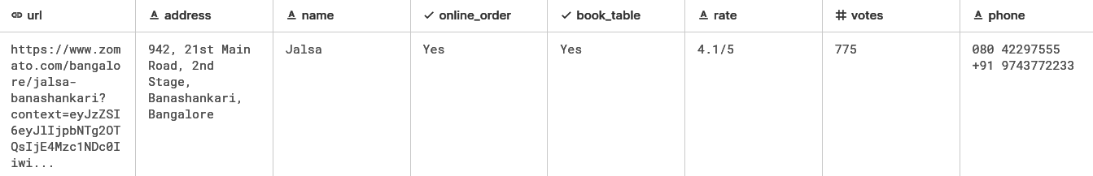
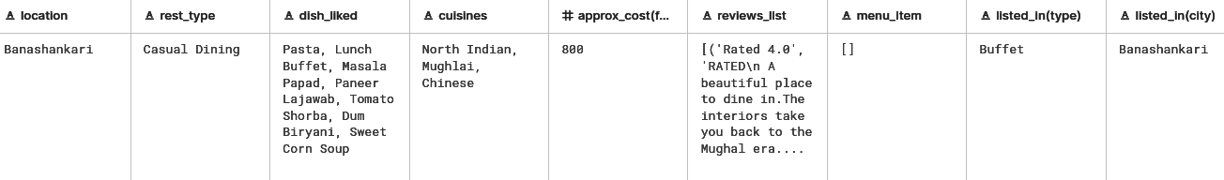
Dataset (..contd)

Slide 7
3. Pre-processing of Data
Dropped duplicate rows
Dropped rows containing null values
Dropped unnecessary columns (url, address, listed_in(city), menu_item, listed_in(type), review_list)
Changed column names [eg:rest_type → type, approx_cost(for two people) → approx_cost_two_people]
Changed data types (approx_cost_two_people → integer)

Slide 8
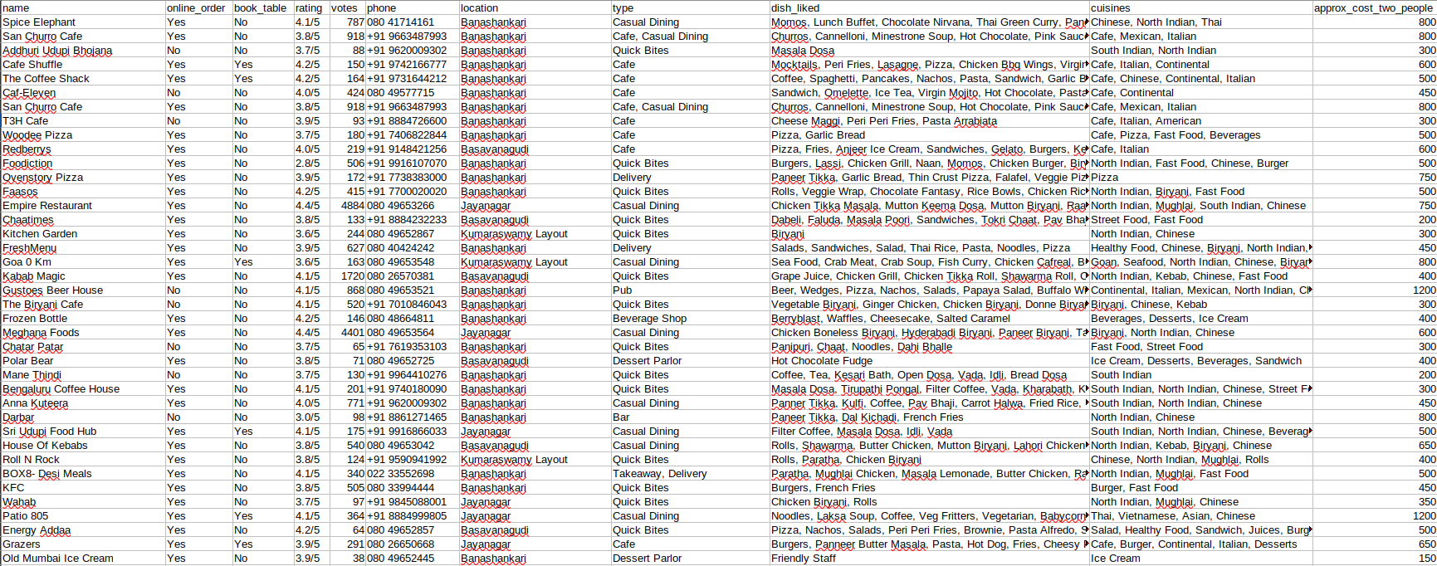
Cleaned Dataset
Cleaned Dataset

Slide 9
4. Tasks
Find the details of the restaurant that has the facility of a “book table” before.
Suggest where one can open a new restaurant (location).
Compare the restaurant to whether it has the facility of an “online order” or not.
Make a list of restaurants according to the type of restaurant and location of the restaurants.
List the top ten restaurants in a given city.
List the top ten restaurants with the highest number of branches.
Count the number of restaurants that allows online orders
List the top ten restaurants with the highest rating
List restaurants that are either cafes or Quick Bites
List the best restaurants in each location(best in accordance with rate)
Find the average, max, and min of votes grouped by location
Change yes to true and Not to False in columns online_order and book_table using UDP.
Most liked dishes in the city Banashankari
Change rate to float type by removing ‘/5’
Find the total no. of unique dishes found in each city (window function)
Find the correlation between cost and rating of the restaurants.

Slide 10
Work Division
Work | Assigned to
Searching and selecting dataset | All team members
Designing the schema of dataset | Pallavi Shrestha
Preparing data pipeline diagram | Pradip Sapkota
Preparing list of tasks to be done | Baburam Shrestha, Pradip Sapkota
Preparing presentation slides | Pallavi Shrestha
Tasks | 5-6 tasks each
Integration | All team members

Slide 11
Task Division
Pallavi Shrestha
Find the details of the restaurant that has the facility of a “book table” before.
Make a list of restaurants according to the type of restaurant and location of the restaurants.
List the top ten restaurants with the highest rating.
Find the average, maximum, and minimum votes grouped by location.
Change rate to float type by removing ‘/5’.
ind the correlation between cost and rating of the restaurants.

Slide 12
Task Division
Baburam Shrestha
Find the restaurants which serve Italian items.
Most liked restaurant in the city Banashankari
Change yes to True and Not to False in columns online_order and book_table using UDF.
List the best restaurants in each location(best in accordance with rate
Find the total no. of voters in each cities (window function)

Slide 13
Task Division (..contd)
Pradip Sapkota
Suggest where one can open a new restaurant
Compare the restaurant to whether it has the facility of an “online order” or not.
List the top ten restaurants with the highest number of branches.
List restaurants that are either cafes or Quick Bites
Count the number of restaurants that allows online orders and book table.
Get the number of restaurants in each city.

Slide 14
5. Implementation
Let’s see the codes in
Jupyter Notebook & VSCode and
output in PostgreSQL
Notes:
sss

Slide 15
6. Challenges Faced
Noisy data in dataset
Large dataset
Problems in dumping output df to postgresql
Difficulty in working with team remotely

Slide 16
THANK YOU!
Notes:
sss

