Slide 1



Final Project - Zomato
(Schema, Pipeline Diagram, Tasks)
Team Members
Baburam Shrestha Pallavi Shrestha Pradip Sapkota
Date: 2022-11-02

Slide 2
Contents
Dataset
Data Pipeline Diagram
Tasks
Work Division
Schema
Task Division
1
2
3
4
5
6

Slide 3
Work Division
Work | Assigned to
Searching and selecting dataset | All team members
Designing the schema of dataset | Pallavi Shrestha
Preparing data pipeline diagram | Pradip Sapkota
Preparing list of tasks to be done | Baburam Shrestha, Pradip Sapkota
Preparing presentation slides | Pallavi Shrestha
Tasks | 5-6 tasks each
Integration | All team members

Slide 4
2. Dataset
Name: Zomato
URL: https://www.kaggle.com/datasets/rishikeshkonapure/zomato
Size: 574.1 MB
Rows: 51717
Columns: 17
Description: This dataset contains the data about the restaurants present in Zomato app database (an Indian restaurant aggregator and food delivery application).

Slide 5

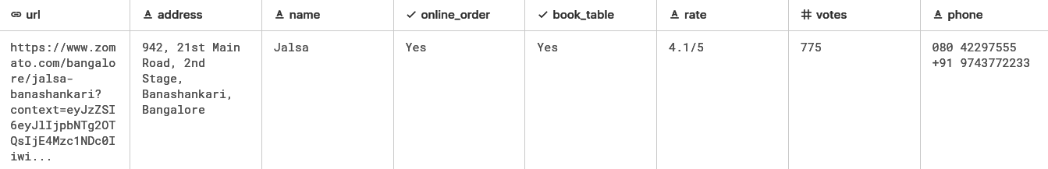
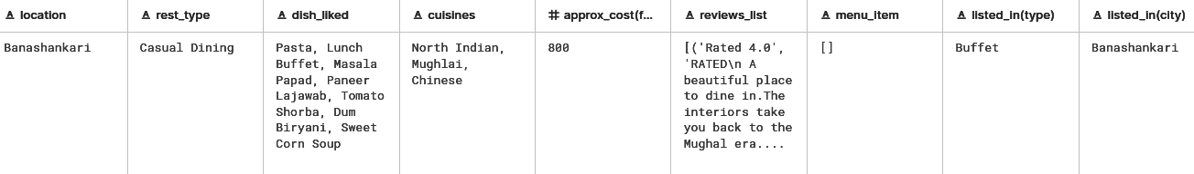
Dataset (..contd)

Slide 6
3. Schema
S.N. | Column | DataType | Description
1. | url | string | URL of the restaurant in zomato
2. | address | string | Complete address of the restaurant
3. | name | string | Name of the restaurant
4. | online_order | boolean | Do they accept online orders? (Yes/No)
5. | book_table | boolean | Can we book a table at the restaurant? (Yes/No)
6. | rate | string | Rating given to the restaurant on the zomato app
7. | votes | integer | Number of people who gave the rating
8. | phone | string | Phone Number of the restaurant
9. | location | string | Area of the restaurant (area in the address)

Slide 7
Schema (..contd)
S.N. | Column | DataType | Description
10. | rest_type | string | Type of the restaurant (Casual Dining/Cafe/Quick….)
11. | dish_liked | string | Dishes liked by most people
12. | cuisines | string | Cuisines served by the restaurant
13. | approx_cost (for two people) | float | Approximate Cost for Two people
14. | reviews_list | string in JSON | List of reviews received by the restaurant (JSON)
15. | menu_item | string in List | List of items in the restaurant’s menu
16. | listed_in(type) | string | Category of restaurant(Delivery/ Dine-Out/Buffet etc...)
17. | listed_in(city) | string | Name of the city

Slide 8
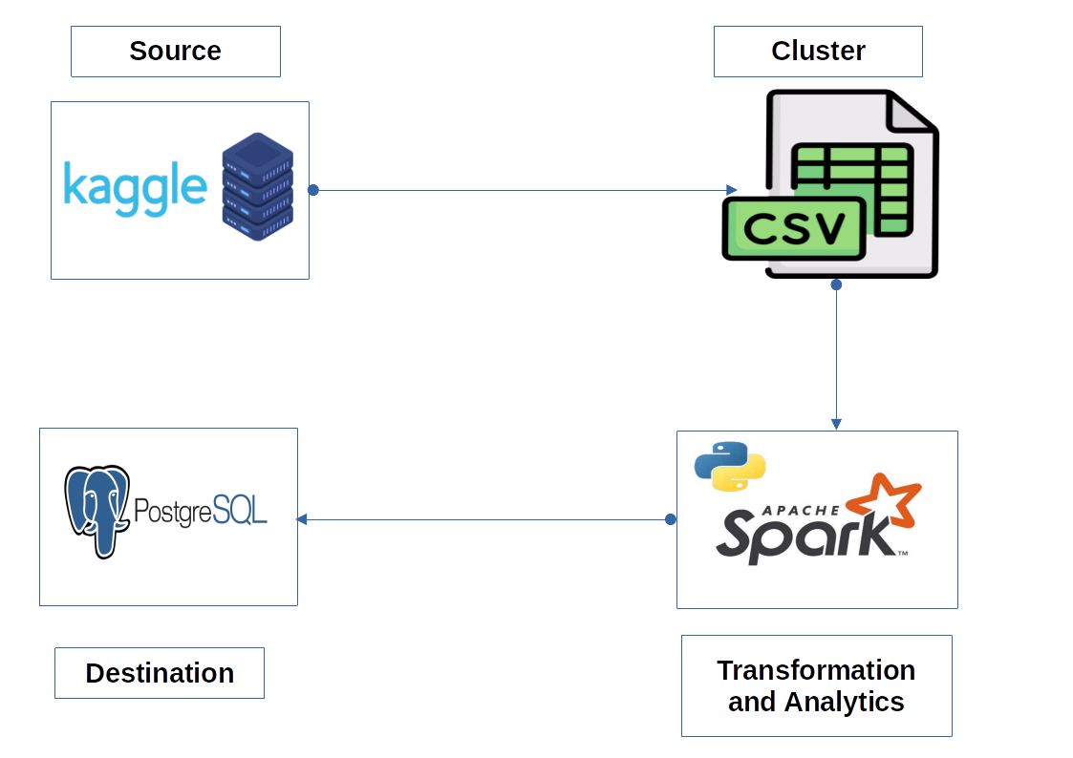
4. Data Pipeline Diagram
Data

Slide 9
5. Tasks
Find the details of the restaurant that has the facility of a “book table” before.
Suggest where one can open a new restaurant (location).
Compare the restaurant to whether it has the facility of an “online order” or not.
Make a group of restaurants according to the type of restaurant and location of the restaurants.
List the top ten restaurants in a given city.
List the top ten restaurants with the highest number of branches.
Count the number of restaurants that allows online orders
List the top ten restaurants with the highest rating
List restaurants that are either cafes or Quick Bites
List the best restaurants in each location(best in accordance with rate)
Find the average, max, and min of votes grouped by location
Change yes to true and Not to False in columns online_order and book_table using UDP.
Most liked dishes in the city Banashankari
Change rate to float type by removing ‘/5’
Find the total no. of unique dishes found in each city (window function)

Slide 10
6. Task Division
Baburam Shrestha
Find the restaurants which serve Italian items.
Most liked restaurant in the city Banashankari
Change yes to True and Not to False in columns online_order and book_table using UDF.
List the best restaurants in each location(best in accordance with rate
Find the total no. of voters in each cities (window function)

Slide 11
Task Division (..contd)
Pallavi Shrestha
Find the details of the restaurant that has the facility of a “book table” before.
Make a group of restaurants according to the type of restaurant and location of the restaurants.
Change rate to float type by removing ‘/5’
List the top ten restaurants with the highest rating
Find the average, max, and min of votes grouped by location
Find the correlation between approx_cost_two_people and rating of the restaurants.

Slide 12
Task Division (..contd)
Pradip Sapkota
Suggest where one can open a new restaurant
Compare the restaurant to whether it has the facility of an “online order” or not.
List the top ten restaurants with the highest number of branches.
List restaurants that are either cafes or Quick Bites
Count the number of restaurants that allows online orders and book table.
Get the number of restaurants in each city.

Slide 13
THANK YOU!
Notes:
sss

