Slide 1
Pradist keawborisut
Tech designer program
Final presentation
KASIKORN technology Academy

Slide 2
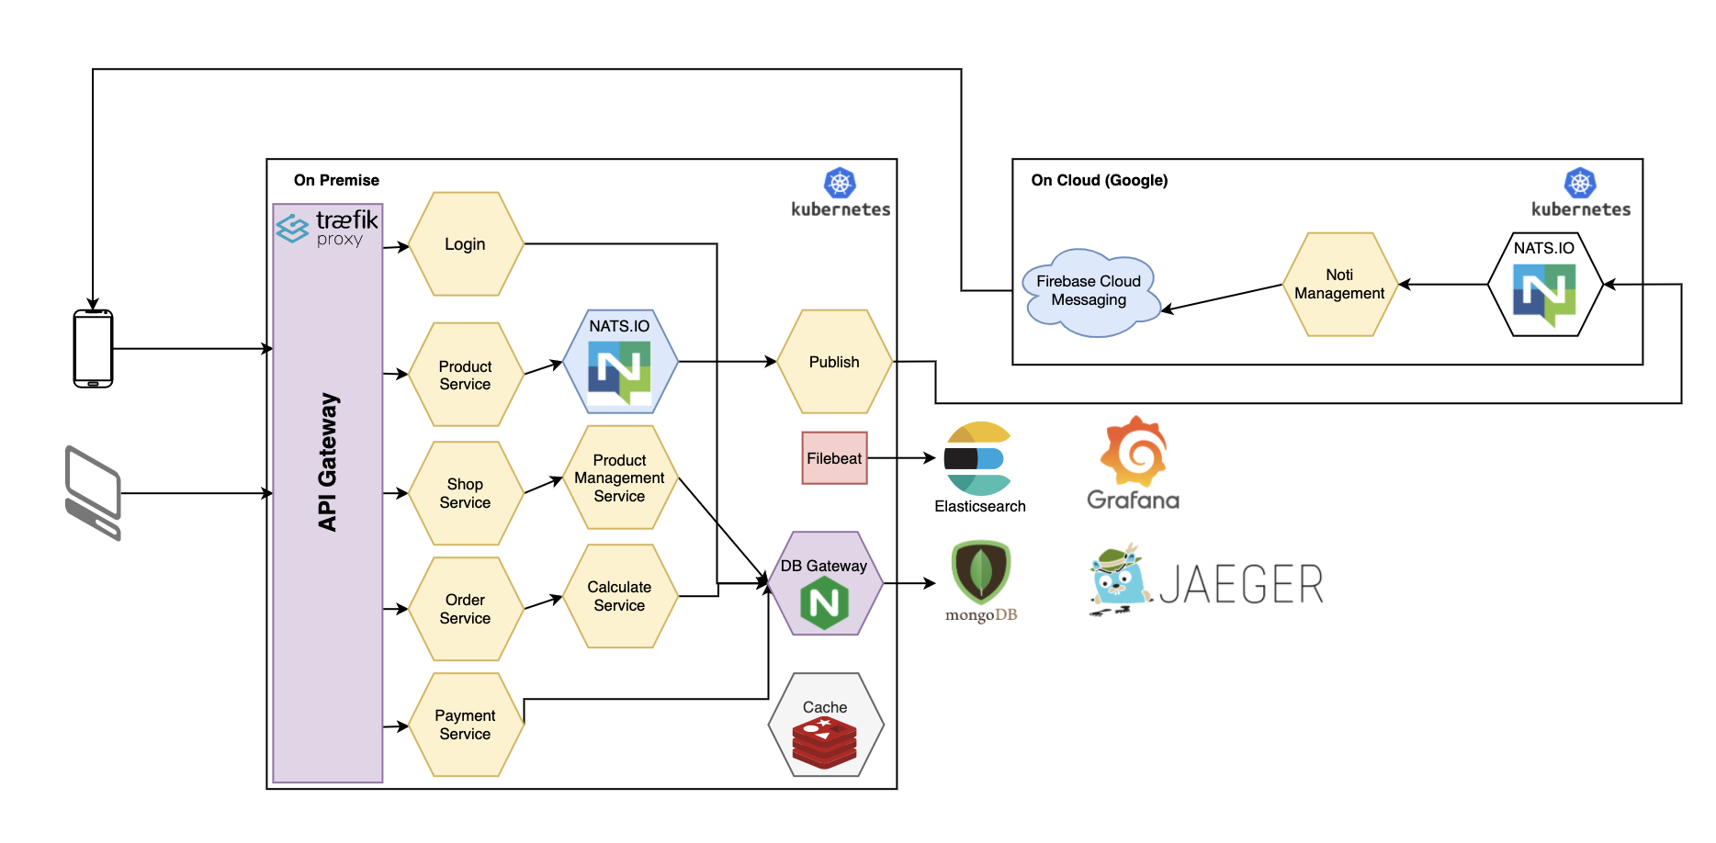
Design Principles

Slide 3
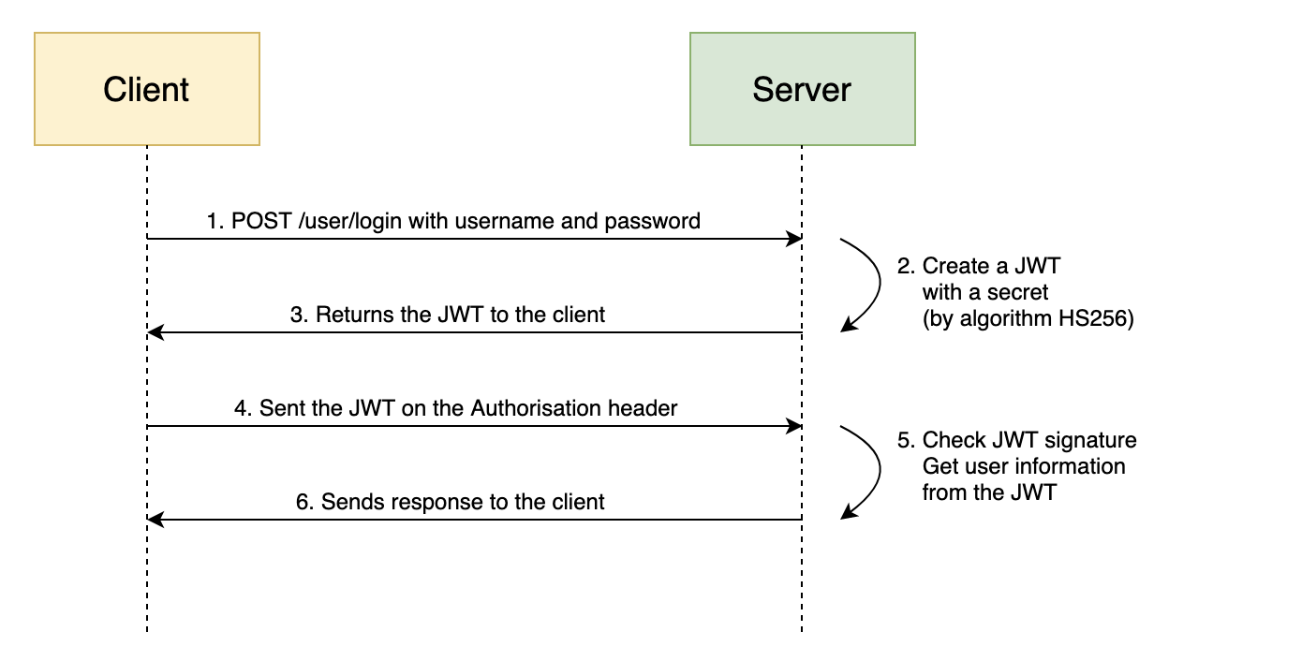
Design Principles

Slide 4
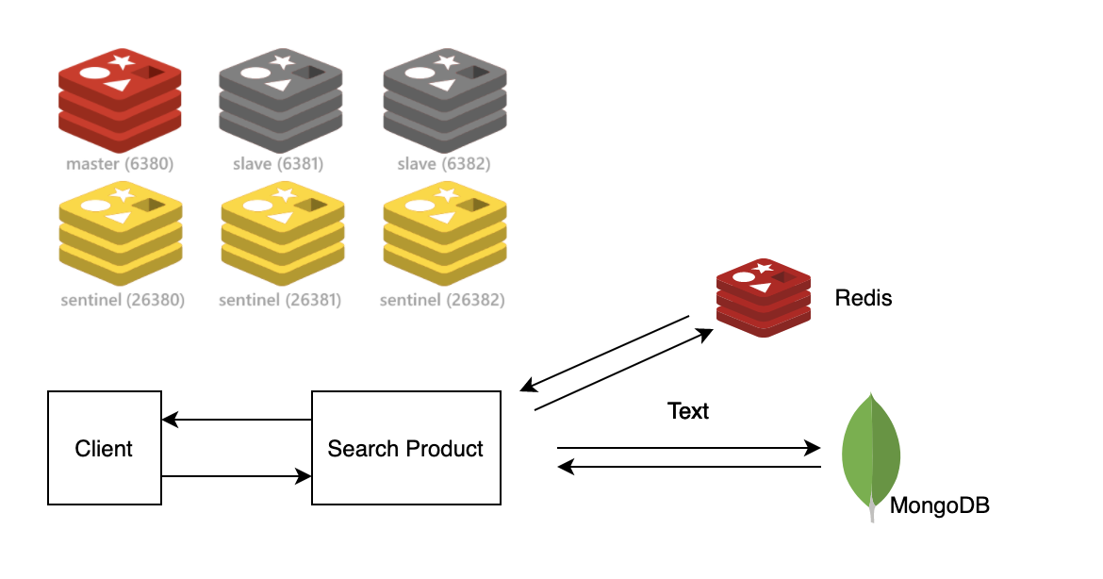
Design Principles

Slide 5
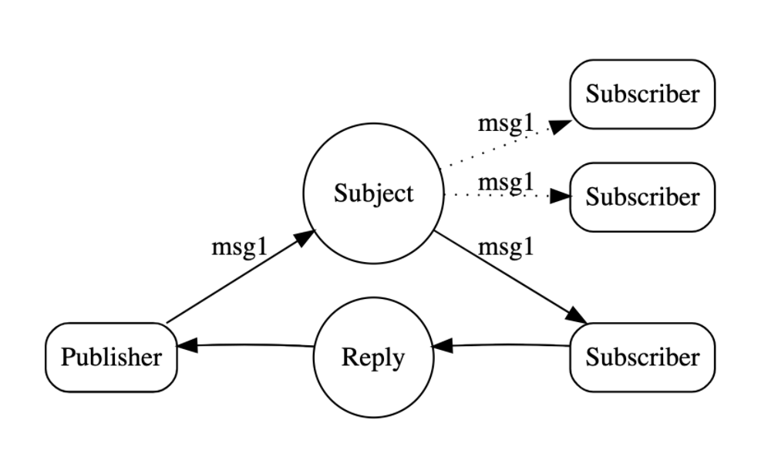
Design Principles

Slide 6
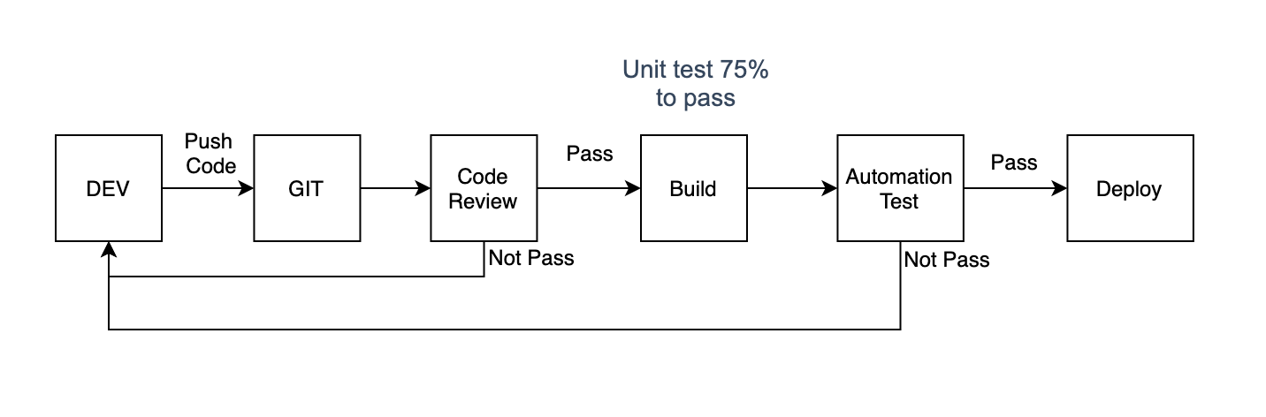
Design Principles

Slide 7
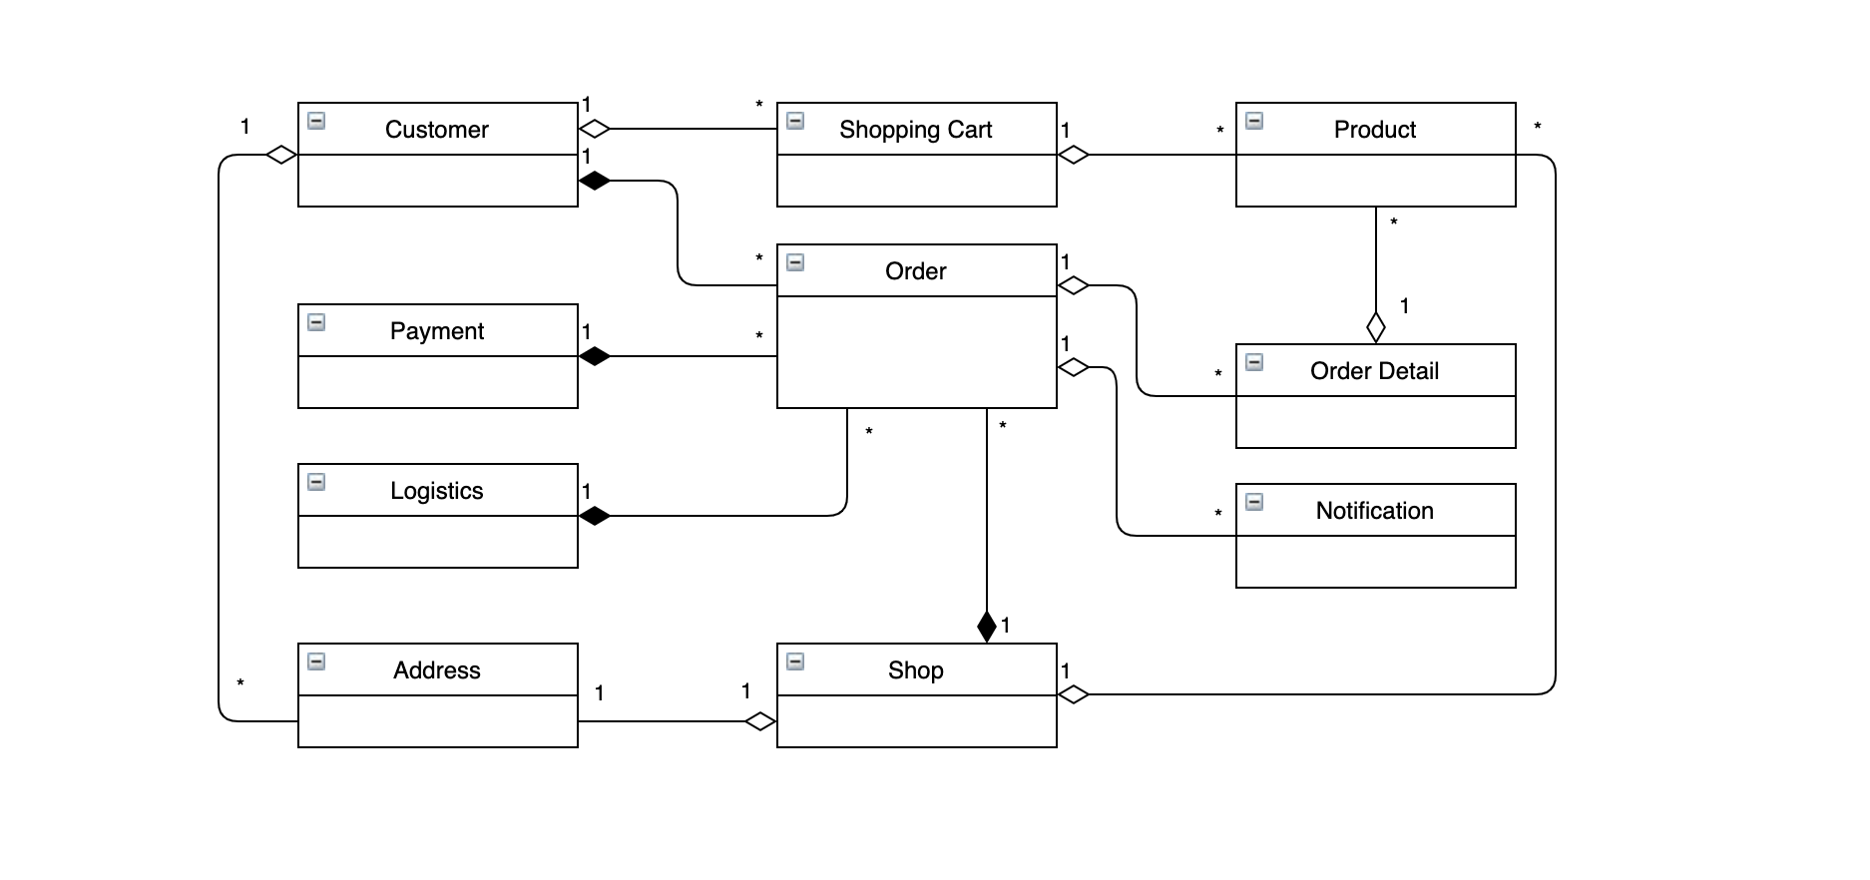
Design Principles

Slide 8
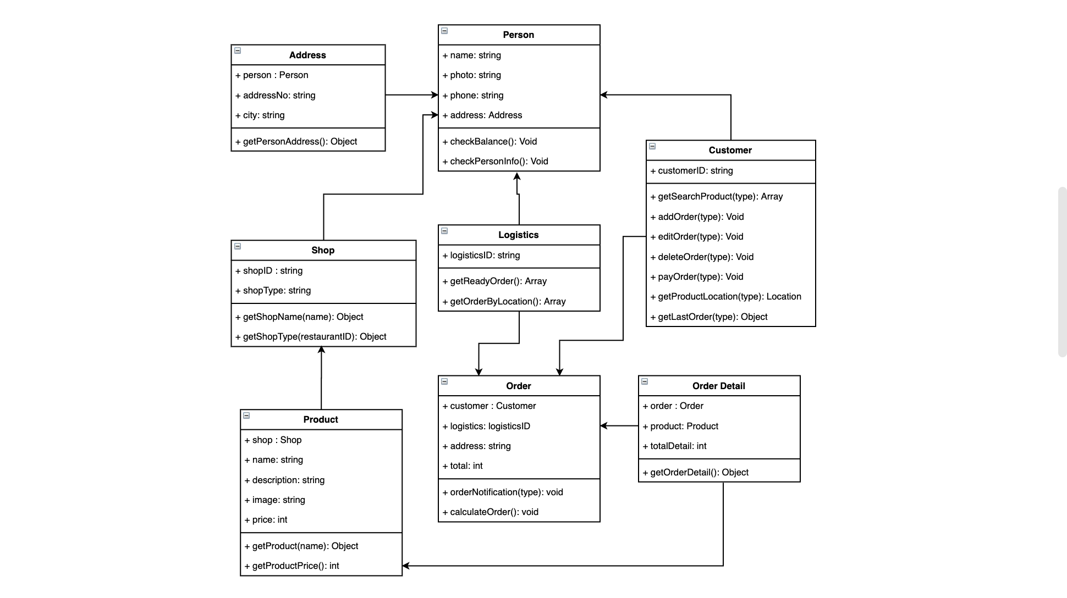
Design Principles

Slide 9

Design Principles

Slide 10
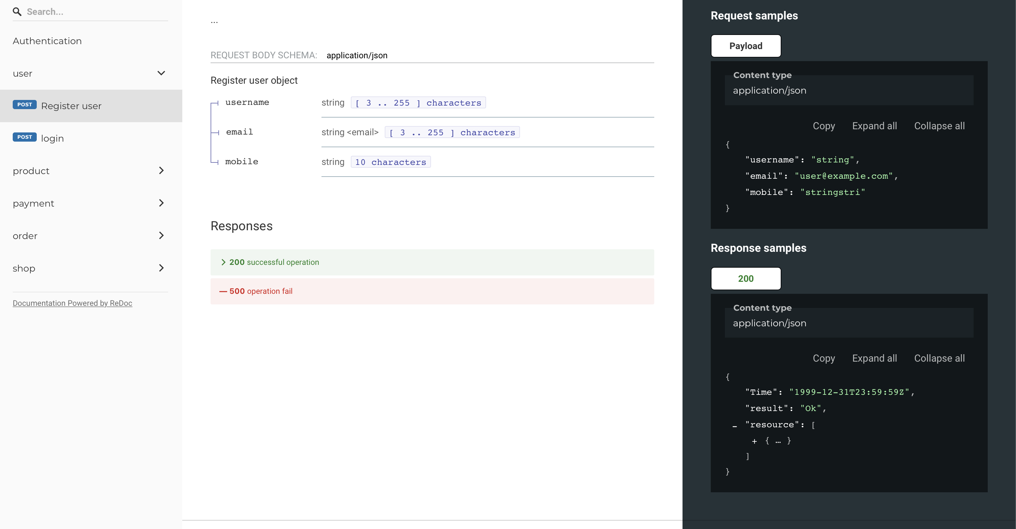
Design Principles

Slide 11
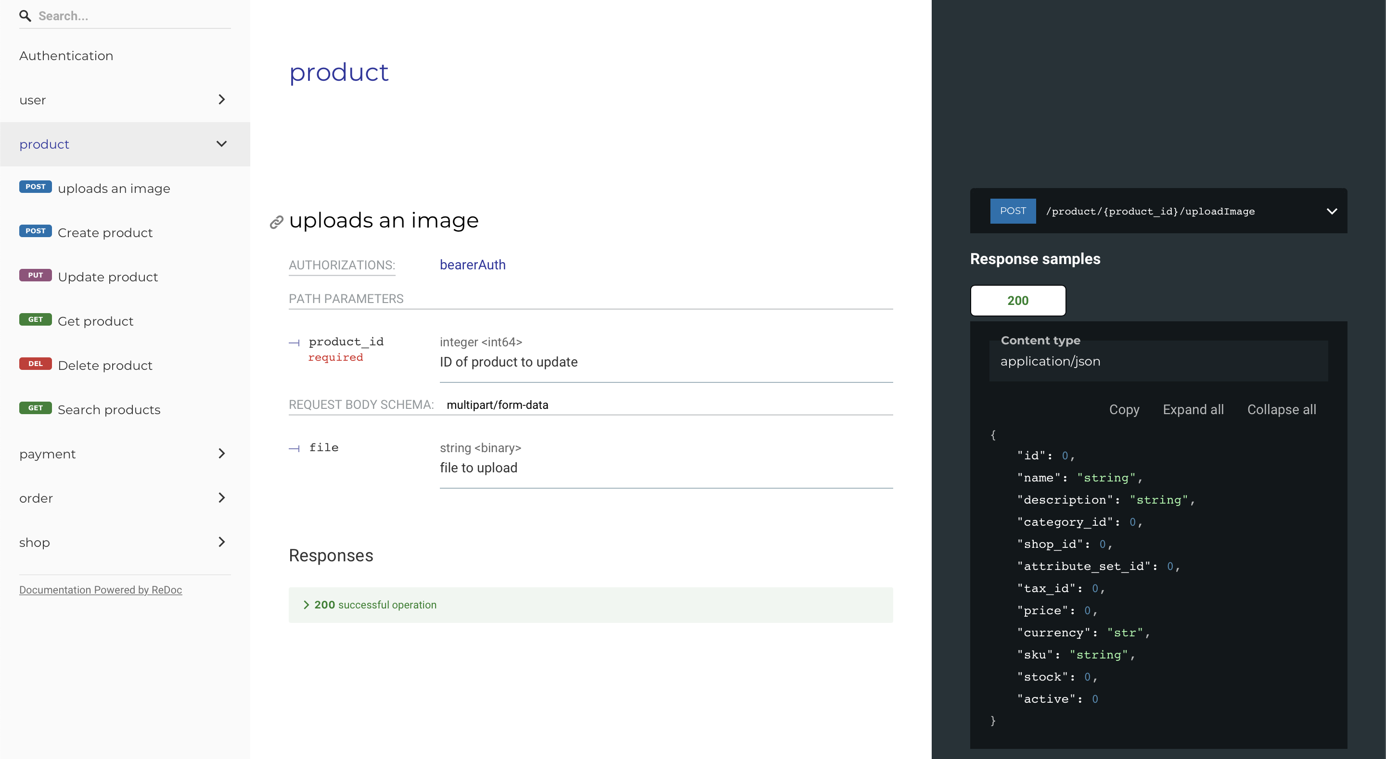
Design Principles

Slide 12
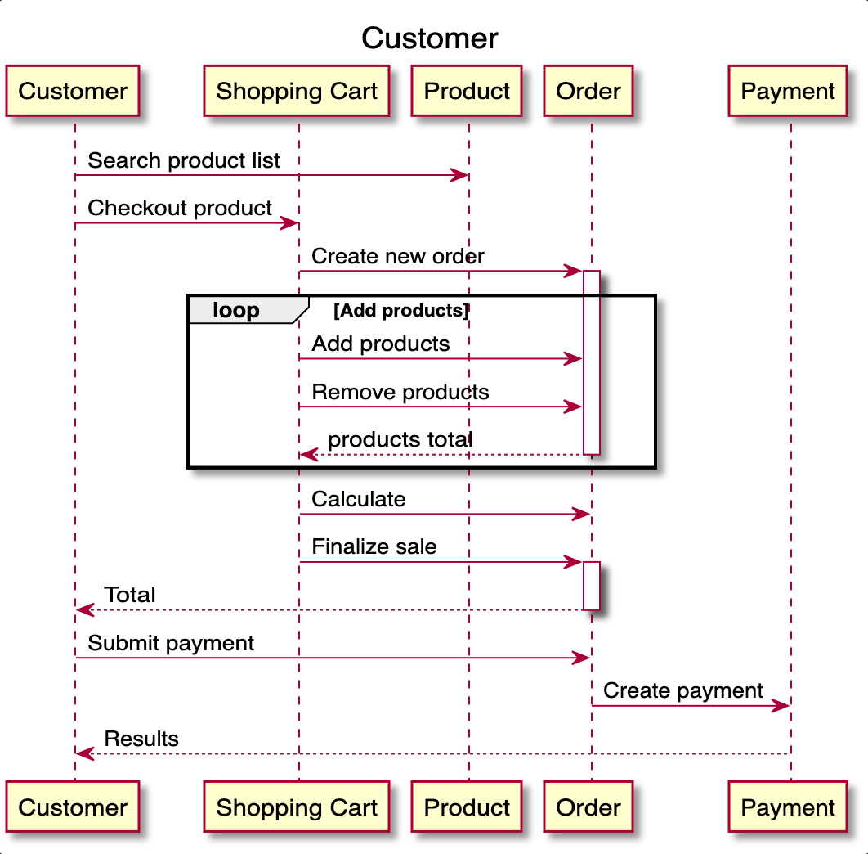
Design Principles

Slide 13
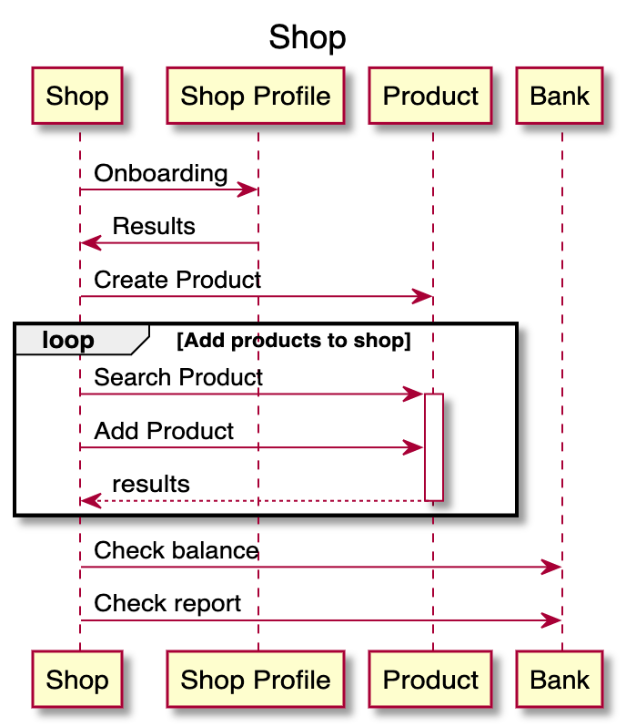
Design Principles

Slide 14
Design Principles

