Slide 1
Social Marketplease
By Pradist Keawborisut

Slide 2
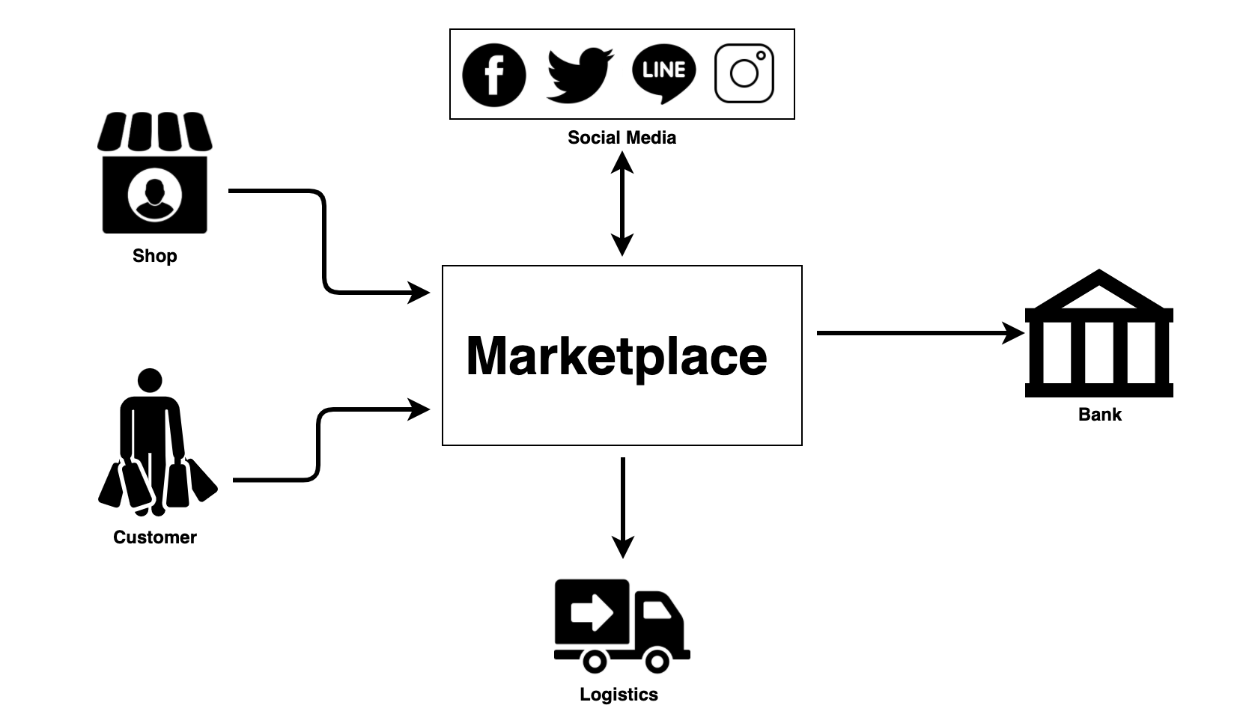

Slide 3
