Slide 1
ELECTRICITY BILLING SYSTEM
BALAJI.S(113220031021)
KRISH KUMAR GUPTA(113220031061)
PRADNESH.S(113220031092)

Slide 2
Title of the project-ELECTRICITY BILLING system
This java project is a contemporary take on the classic electricity billing system where a person gathers data from our electricity meter. The primary objective of this project is to automate the entire process to make it seamless, convenient, and effective. The software can compute the bill amount on the basis of units of electricity consumed in a month. Electricity Billing System is considered one of the best java project ideas for beginners. The app should have the below-mentioned features:
Accurately calculate the bill amount.
Instantaneous sharing of data between local electricity offices and users.
Extremely safe to negate the chances of tampering

Slide 3
Introduction to company-shiash info solutions
Shiash Info Solutions is an IT services, Digital and Business solutions company based in Chennai (India) providing Customized Software Development, Web Application Development, Mobile Application Development and IT Consulting Services. We have earned the pride of being one of the leading desktop & web based software solution provider in India, we develop software solution that helps our customers to outperform the competition and stay ahead in today’s competitive business environment. We firmly believe that business needs can be only met when technology is in sync with business process. At Shiash Info Solution , we provide multi-dimensional IT services that caters to high-end internet strategy, software development and design solutions for corporate clients all across the globe. We have a wide and varied range of products & services that can suit the divergent needs of our large client base. We understand that for the success of any project Time, Quality and Sup port has to be top class, for this our planning & quality control team make sure that your projects are very planned & designed to be delivered on time & also the quality of the project is more than what you have expected.

Slide 4
INTRODUCTION TO ELECTRICITY BILLING SYSTEM
This Java application was created using Intelli J . Additional library was added for the support of JDBC (Required to setup the connection between the Database and Java Application). It contains 9 different classes which works together to create a better user experience .
->Login Screen class
->Main System class
->Add Customer class
->Pay Bill class
->Generate Bill class
->Show Details class
->Last Bill class
->Connection Setup class(JDBC - MySQL)

Slide 5
software and hardware specifications
Software Requirements:-
i. A database like DBMS to store the list of authors and the articles.
ii. A web browser like Chrome, Mozilla Firefox etc.
iii. Operating System – Windows, Linux, macOS 32 bit and 64 bit

Slide 6
Hardware specification
Hardware Requirements:-
i.A device (Computer/laptop)
ii.Memory (RAM): Minimum 2GB RAM
iii.Processor:- Minimum 1GHZ; Recommended 2GHZ or more.
iv.Hard disk– 40 GB; Recommended 64 GB or more.
v.Ethernet connection (LAN) or, a wireless adapter (Wi-Fi)

Slide 7
Project modules of electricity billing system
->Login Screen class
->Main System class
->Add Customer class
->Pay Bill class
->Generate Bill class
->Show Details class
->Last Bill class
Java communicates with MySQL tables using JDBC which stands for Java Database Connectivity.

Slide 8
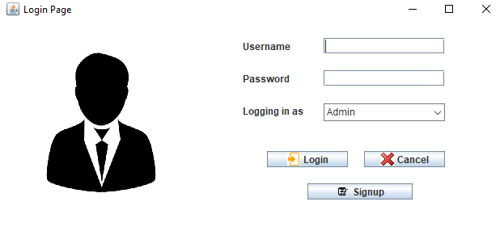
module 1
(1. login page)

Slide 9
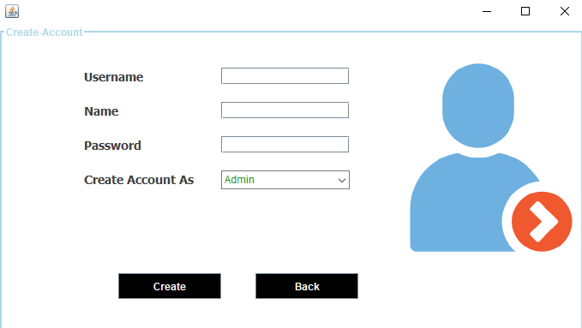
module 2
(2. signup page)

Slide 10
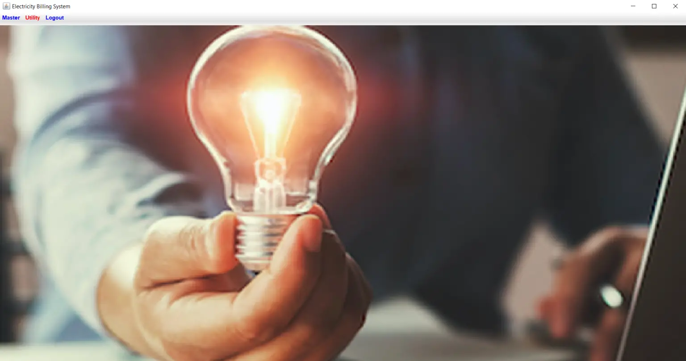
module 3
(3. main screen)

Slide 11
conclusion

