Slide 1
Mini Project
2021`-2022
IOT BASED SMART KEYCHAIN
Domain : INTERNET OF THINGS
TEAM MEMBERS
KRISH KUMAR GUPTA
PRADNESH S
BALAJI S
II Year CSE C
Dr. P VISU (Prof / Associate / AP – CSE)
SIGNATURE
Velammal Engineering College
Department of Computer Science and Engineering

Slide 2
Objective/Aim of the Project
To develop a smart keychain which connects through WiFi and can be used to find the keys with a buzzer sound being activated when lost.
Velammal Engineering College
Department of Computer Science and Engineering

Slide 3
Existing Problem Identified
Conventional keychain do not have any circuit , buzzer to find if it is lost.
No software is used between the keychain and our mobile phone or any smartdevice.
Velammal Engineering College
Department of Computer Science and Engineering

Slide 4
Proposed Solution
Smart keychain with software application connectivity,buzzer through WiFi module is implemented.
Velammal Engineering College
Department of Computer Science and Engineering

Slide 5
Hardware and Software Specifications
ESP-8266-01 Serial WiFi wireless Transceiver Module.
A general purpose battery(9v).
A Buzzer.
Arduino IDE.
Ip address in web page.
Velammal Engineering College
Department of Computer Science and Engineering

Slide 6
Modules of the Project
ESP8266 WiFi Module Circuit.
Web page with ip address of esp8266.
Velammal Engineering College
Department of Computer Science and Engineering

Slide 7
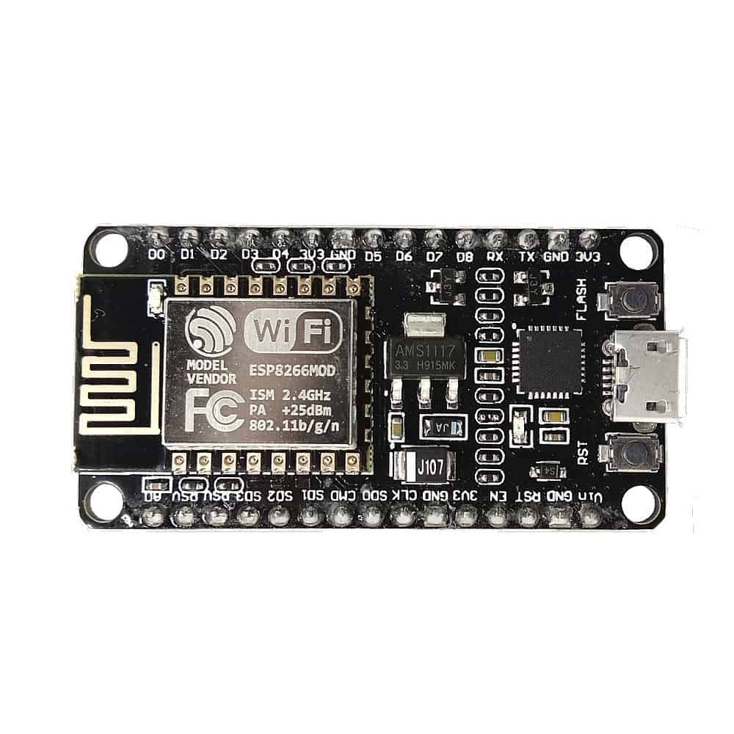
Module1
Velammal Engineering College Department of Computer Science and Engineering

Slide 8
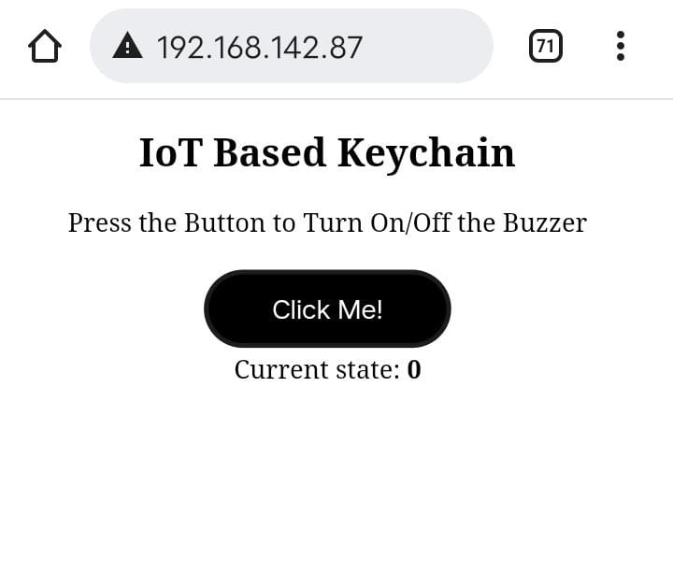
Module2
Velammal Engineering College Department of Computer Science and Engineering

Slide 9
Source Code
#include <ESP8266WiFi.h>
#include <WiFiClient.h>
#include <ESP8266WebServer.h>
ESP8266WebServer server(80);
const int buz_pin = D2;
char ssid[] = “name";
char pass[] = “password";
String html_code = "<!DOCTYPE html><html><head><style>.button {border: none;padding: 12px 40px;text-align: center;text-decoration: none;display: inline-block;font-size: 16px;margin: 4px 2px;cursor: pointer;}.button1 {background-color: black; color: white; border: 3px solid
Velammal Engineering College Department of Computer Science and Engineering

Slide 10
#1c1c1b;border-radius: 30px}body {text-align: center;}</style></head><body><h2>IoT Based Keychain</h2><p>Press the Button to Turn On/Off the Buzzer</p><form action=\"/BUZ\" method=\"POST\"><button class=\"button button1\">Click Me!</button></form>";
boolean buzzing_state = false;
void handleRoot() {
server.send(200, "text/html", html_code + "Current state:
<b>"buzzing_state);
}
void handleBUZ() {
buzzing_state = !buzzing_state;
server.sendHeader("Location","/");
server.send(303);
}
Velammal Engineering College Department of Computer Science and Engineering

Slide 11
void handleNotFound(){
server.send(404, "text/plain", "404: Not found");
}
void setup(void){
Serial.begin(115200);
delay(10);
pinMode(buz_pin, OUTPUT);
Serial.print("\n\nConnecting Wifi... ");
WiFi.begin(ssid, pass);
while (WiFi.status() != WL_CONNECTED)
{
delay(500);
}
Serial.println("OK!");
Serial.print("IP address: ");
Serial.println(WiFi.localIP());
Serial.println();
server.on("/", HTTP_GET, handleRoot);
server.on("/BUZ", HTTP_POST, handleBUZ);
Velammal Engineering College Department of Computer Science and Engineering

Slide 12
server.onNotFound(handleNotFound);
server.begin();
Serial.println("HTTP server started\n");
}
void loop(void){
server.handleClient();
if (buzzing_state == true) {
digitalWrite(buz_pin, HIGH);
delay(400);
yield();
digitalWrite(buz_pin, LOW);
delay(200);
yield();
delay(400);
yield();
}
}
Velammal Engineering College Department of Computer Science and Engineering

Slide 13
THANK YOU
Velammal Engineering College
Department of Computer Science and Engineering

