Slide 1
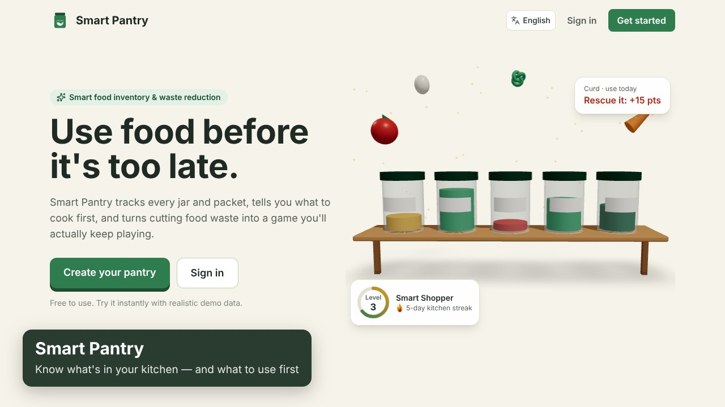
Smart Pantry Manager
Smart Food Inventory & Waste Reduction System
Presented by Pradnya Bhosale
November 2026
Notes:
Introduce yourself and the project in one line: Smart Pantry Manager helps households use food before it expires, and measures waste so it goes down over time.

Slide 2

Food is wasted because we forget what we have
1.05 bn
79 kg
55 kg
tonnes of food wasted worldwide in 2022 — 19% of food available to consumers
of food wasted per person per year at home, worldwide
of food wasted per person per year in Indian homes
The root cause is simple: food is forgotten at the back of the fridge, bought twice, or noticed only after its date. A household needs to know what it has, what expires first, and what to cook with it.
Source: UNEP Food Waste Index Report 2024 (global figures); India per-capita household figure as reported from the same index.
Notes:
These numbers frame the problem. Most household waste is not careless — it is forgotten food. That is exactly the gap this app fills.

Slide 3






What the system set out to do
Track every item
Warn before it expires
Quantity, category, storage place and expiry — batch by batch
Expiring, expired, low-stock and run-out alerts
Help use it up
Plan shopping
Recipes that use what is about to go off
Low-stock items to the list; bought items back to the pantry
Measure waste
Be secure and reliable
Monthly trends, reasons and real cost, with CSV and PDF reports
Private accounts, safe data handling, fully tested
Notes:
These six goals come straight from the requirement specification. Every one is implemented and tested.

Slide 4
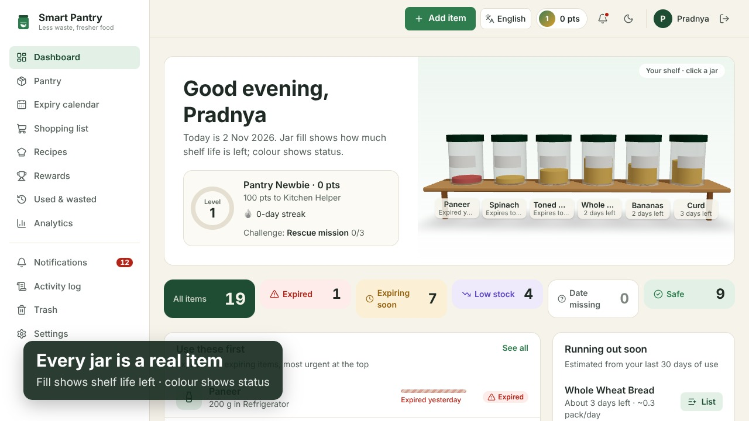
The solution at a glance
A full-stack web app
Works on phones and computers, installable like an app
A dashboard that answers “what first?”
Items to use first, run-out forecast and a live status strip
Every jar on the 3D shelf is a real item
Fill = shelf life left; colour = status
Notes:
This is the real dashboard with demo data. Point at the shelf: each jar is a real item; fuller jars have more shelf life left, and red means expired.

Slide 5


Key features
Batch-wise expiry (FEFO)
Quick add by voice or text
Recipes and cook-along
Each purchase keeps its own date; use takes the earliest-expiring first
“2 kg potatoes expiring Friday” fills the whole form; barcode scan too
39 built-in recipes plus online ones; animated, narrated steps with timers
Smart shopping list
Waste analytics
Alerts everywhere
Low-stock items in one click; ticking off restocks the pantry
Trends, top wasted items, reasons and cost; CSV and PDF export
In-app, daily email and phone push — each alert only once
Notes:
Six headline features. FEFO means First-Expiry-First-Out: when you use milk, it comes from the pack that expires first, as in real inventory systems.

Slide 6

How it works
1. Add
2. Track
3. Alert
4. Use or cook
5. Analyse
Type, speak, scan or import a spreadsheet
Status computed daily from the user's own time zone
Expiring, expired, low stock, running out
Record use, or cook a recipe that updates stock
See waste fall month by month
Effective expiry: the earlier of the label date and (opened date + days it keeps once opened). Status is never stored — it is computed fresh, so it can't go stale.
Notes:
Walk the loop left to right. Mention that opening a jar of curd moves its expiry earlier automatically.

Slide 7
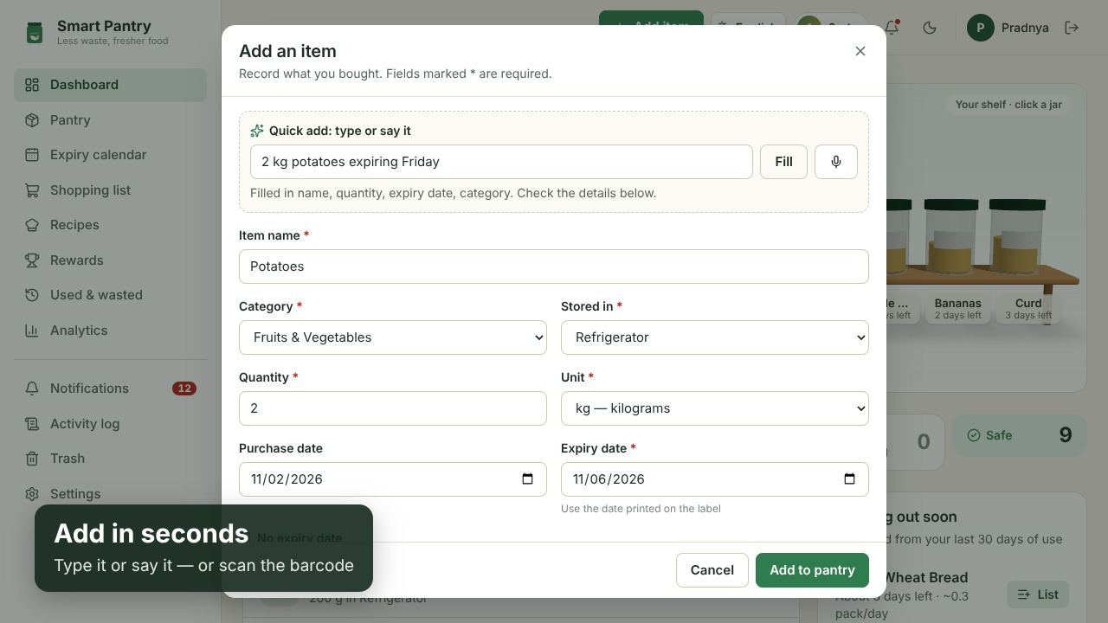
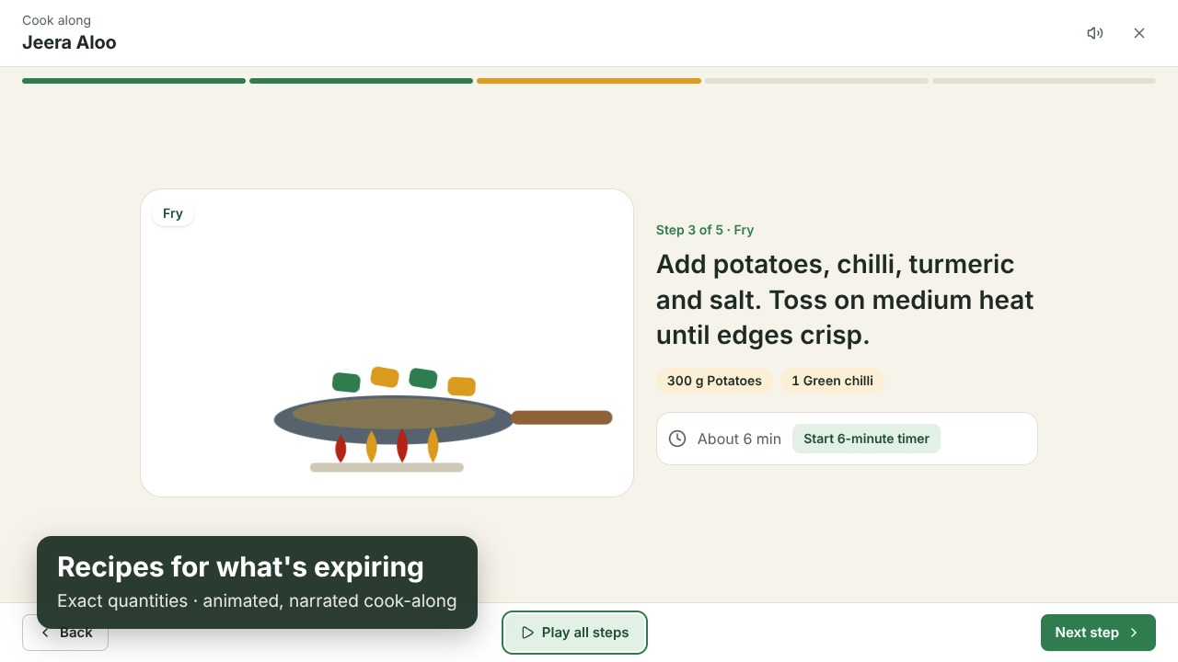
Fast to use, every day
Quick add
Cook-along
One sentence fills name, quantity, unit, expiry date, category and storage place.
An animation for every cooking action, read aloud, with real timers. “I cooked this” updates the pantry.
Notes:
Two everyday moments: adding food after shopping, and cooking with what is about to expire.

Slide 8
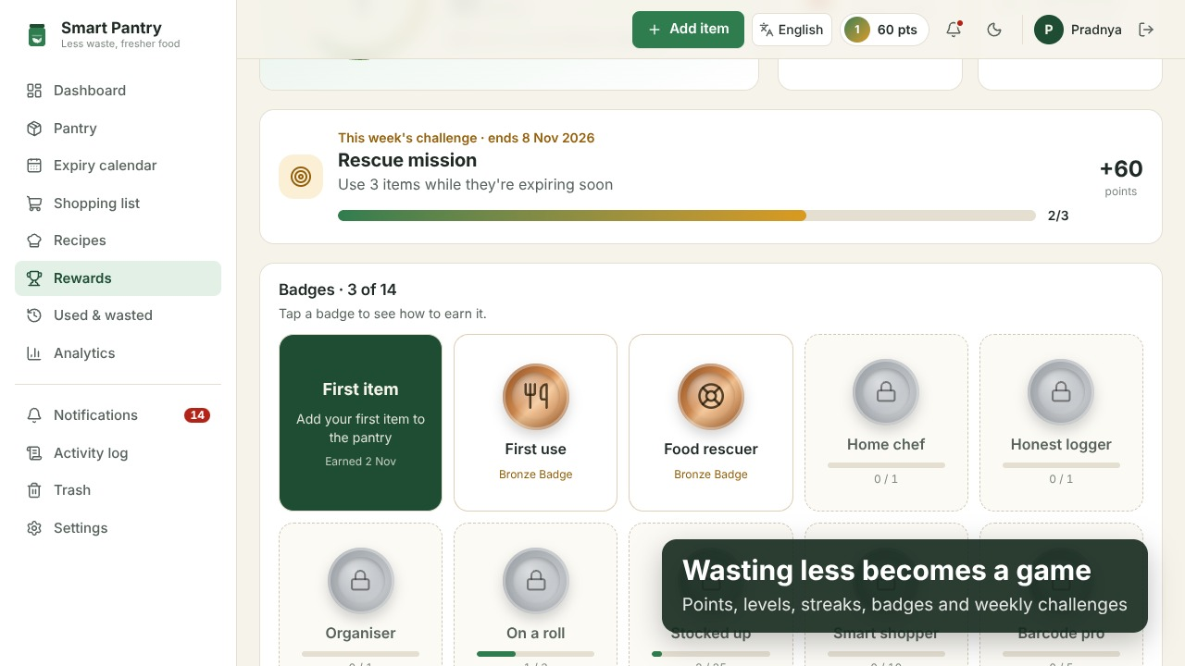
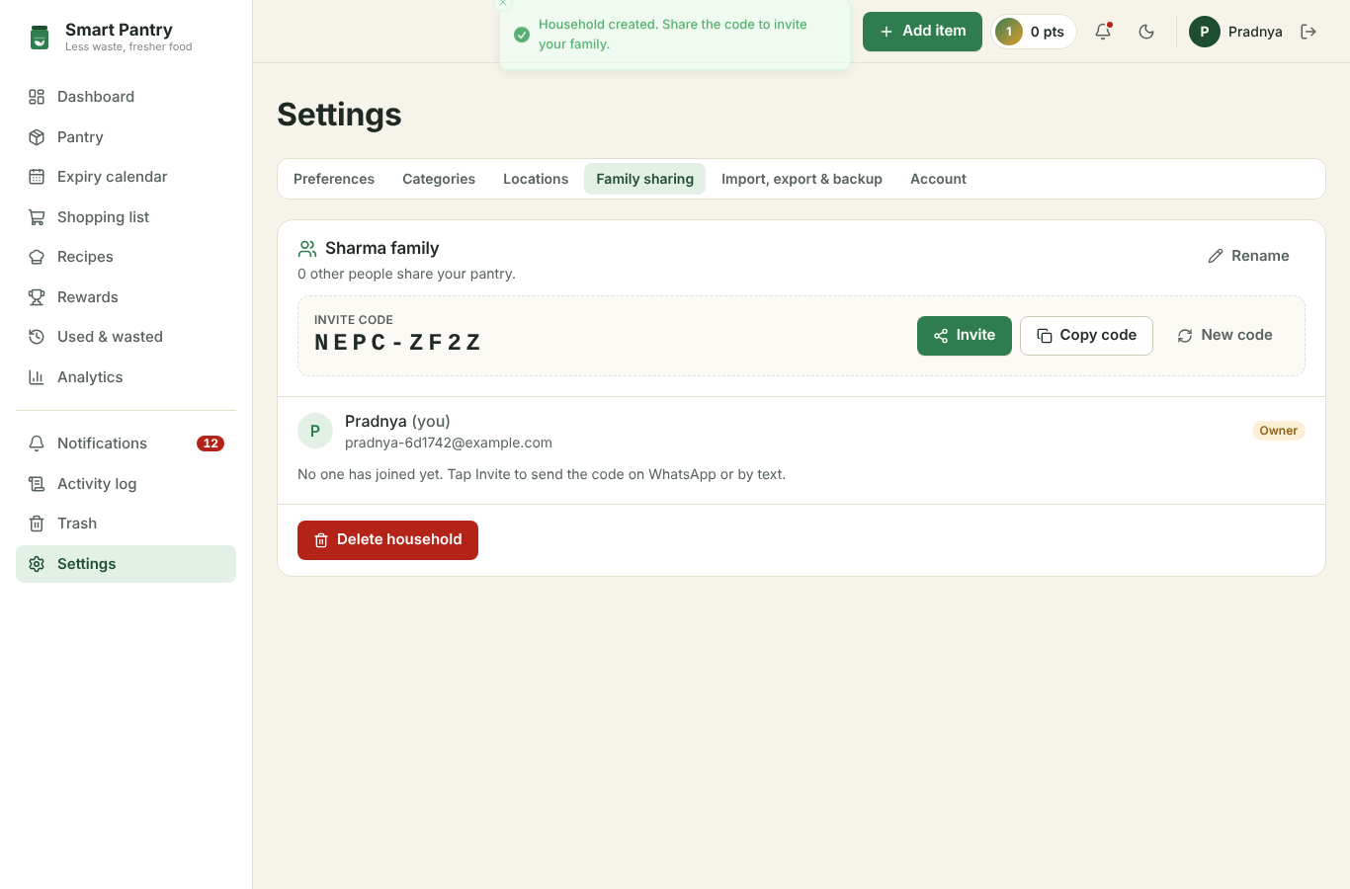
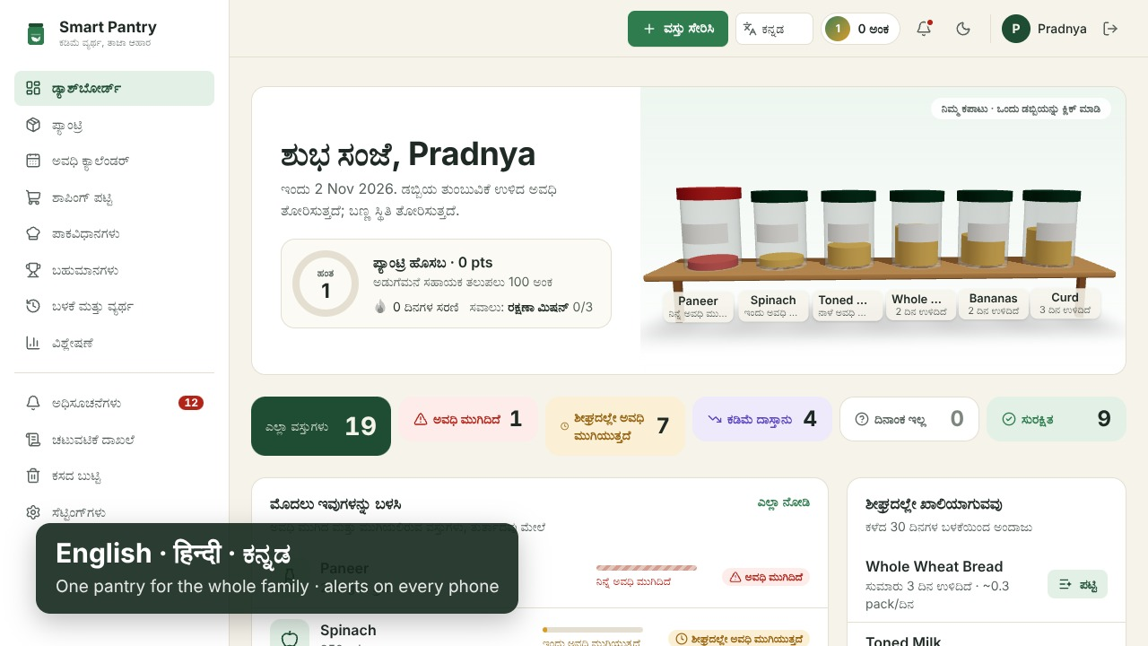
Built for real households
Rewards for wasting less
Family sharing
English · हिन्दी · ಕನ್ನಡ
Points, levels, streaks and 14 badges — earned only from real actions, capped daily
One pantry for the family with an invite code; editors and view-only members
The whole interface switches instantly; item names stay as typed
Notes:
These go beyond the specification: gamification keeps people coming back, family sharing matches how Indian households actually shop, and Hindi and Kannada make it usable for elders at home.

Slide 9







System architecture
Web app (client)
REST API (server)
PostgreSQL
React + TypeScript, Tailwind, Recharts, three.js 3D. Installable PWA with a service worker for push.
Hosted on Vercel.
Node.js + Express, Zod validation, JWT in an httpOnly cookie, daily reminder job.
Hosted on Render.
Prisma ORM with versioned migrations; transactions and row locks keep stock correct.
Hosted on Neon.
External services (optional — the app keeps working without them)
SMTP email
Web Push
TheMealDB
Open Food Facts
Daily reminders, password reset
Phone notifications (VAPID)
Online recipes and videos
Barcode product lookup
Client ↔ API over HTTPS (/api, same-site cookie); API ↔ database over SQL. Runs locally with one command using Docker Compose.
Notes:
Three tiers. The client never talks to the database directly; every query goes through the API and is filtered by the signed-in user's pantry.

Slide 10
Technology stack
Layer | Technology | Why
Frontend | React 19, Vite, TypeScript, Tailwind CSS | Fast, type-safe UI; responsive on phones
Charts & 3D | Recharts, three.js (React Three Fiber) | Accessible charts with table views; interactive 3D shelf
Backend | Node.js, Express 5, Zod | Simple REST API with strict input validation
Database | PostgreSQL 16, Prisma ORM | Relational data, transactions, exact decimals, migrations
Auth & security | bcrypt, JWT in httpOnly cookie, rate limits, CSP | Protects accounts and data
Notifications | Nodemailer, Web Push (VAPID), node-cron | Email and phone alerts on a daily schedule
Testing & CI | Vitest, Supertest, Playwright, GitHub Actions | Every push is tested automatically
Deployment | Vercel, Render, Neon, Docker Compose | Free hosting tiers; one-command local run
Notes:
Each choice has a reason. PostgreSQL because the data is relational and stock changes need transactions.

Slide 11
Data model
User
Item
Batch
email, password hash, settings, token version
name, category, location, unit, min stock, version
quantity, purchase date, expiry, opened date
Household
UsageEvent
Notification
name, invite code; members with roles
used or wasted, reason, quantity, cost
type, dedupe key, read, email/push status
ShoppingItem
Achievement
name, quantity, bought, added to pantry
badge key, earned and seen dates
Every record belongs to a pantry owner (userId). Also: Category, Location, Activity log, ItemImage, PushSubscription
Notes:
The key design decision: items have batches. Two packs of milk bought on different days keep their own dates, which is what makes First-Expiry-First-Out possible.

Slide 12




Security and reliability
Passwords hashed with bcrypt
Every query scoped to the user
Login token in an httpOnly cookie that page scripts can't read
Another user's item IDs simply return “not found”
Strict input validation
Correct stock under load
Clear field-level messages; CSV formula injection blocked
Transactions, row locks and version checks stop double updates
Honest notifications
Accessible by design
An email is “sent” only if the mail server accepted it
Keyboard use, screen-reader labels, colour-blind-safe charts
Notes:
Examiners often ask how you stop one user seeing another's data. Answer: the user ID comes from the verified token, never from the request, and there's a test that tries exactly that attack.

Slide 13
Testing and quality
100
9
8
✓
API and unit tests on a real PostgreSQL database
client tests for the quick-add language parser
browser tests on desktop and phone (Playwright)
GitHub Actions runs everything on every push
Real bugs the tests caught (and were fixed)
Two quick clicks could buy the same shopping item twice — now locked so it happens once
A deleted alert came back on the next refresh — alerts are now dismissed, not re-created
Expiry dates flipped at 5:30 AM because of UTC — dates now follow the user's own time zone
Signing up from a family invite link lost the invite — the link now survives sign-up
Notes:
Testing wasn't an afterthought — these are real defects found by the tests, each with a test that keeps it fixed.

Slide 14
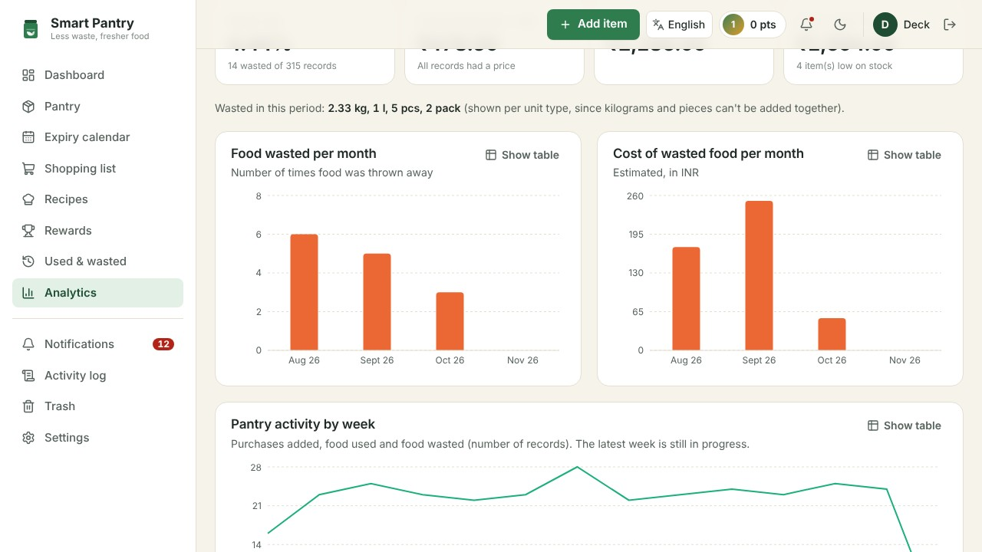
Seeing waste go down
−50% waste events from August to October in the sample household, with a 4.4% waste rate overall.
Sample household from the app's demo data (three months of history). The same report is generated for any real account.
Notes:
The analytics page turns records into a trend. In the sample household, waste halves over three months as the alerts and 'use these first' list take effect.

Slide 15
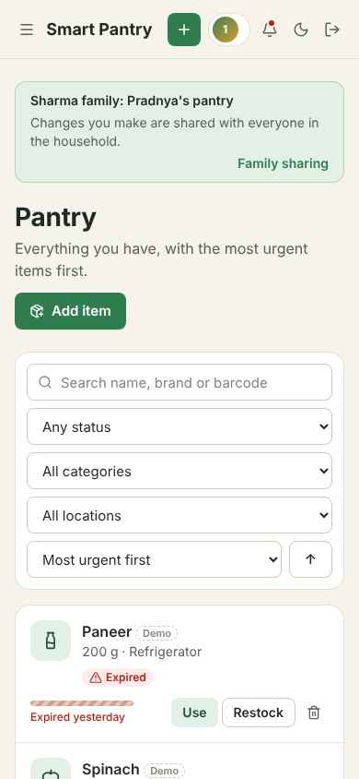


Future scope
Receipt scanning
Read a shopping bill and add every item at once
Smarter forecasts
Weight recent days and seasons when predicting run-out dates
Donate surplus
Connect near-expiry food to local food banks before it's wasted
More languages
Translate recipe steps and add Marathi, Tamil and Telugu
Notes:
Close the technical part with what comes next. Donating surplus links nicely to the food-waste numbers from the start.

Slide 16
Thank you
Questions?
Pradnya Bhosale
github.com/pradnyabhosalecs24-byte/Smart-Pantry
Notes:
Offer a live demo if there's time: register, load demo data, and show the dashboard.

