Slide 1
Django
The web framework for perfectionists with deadlines.

Slide 2
About Django
Web programmers at Lawerence Journal World Newspapers started Python application and initiated Django in 2003
Main purpose was to create database driven web sites
Especially creating news articles and contents easily and rapidly
It is named after famous guitarist Django Reinhardt
Django Software Foundation(DSF) maintains the Django Project
For more details please check https://www.djangoproject.com/

Slide 3
Why Django?
Superfast Development
Batteries included
Very Scalable
Secure and Stable
Incredibly versatile
Flexible

Slide 4

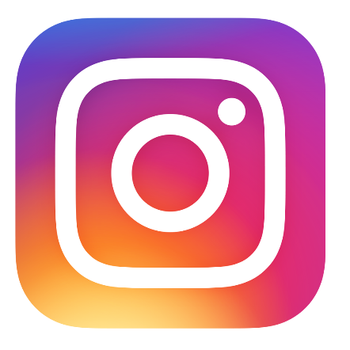
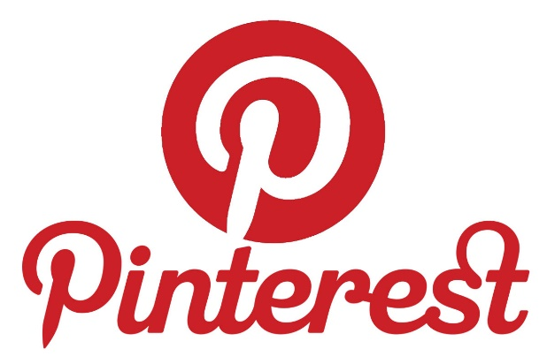


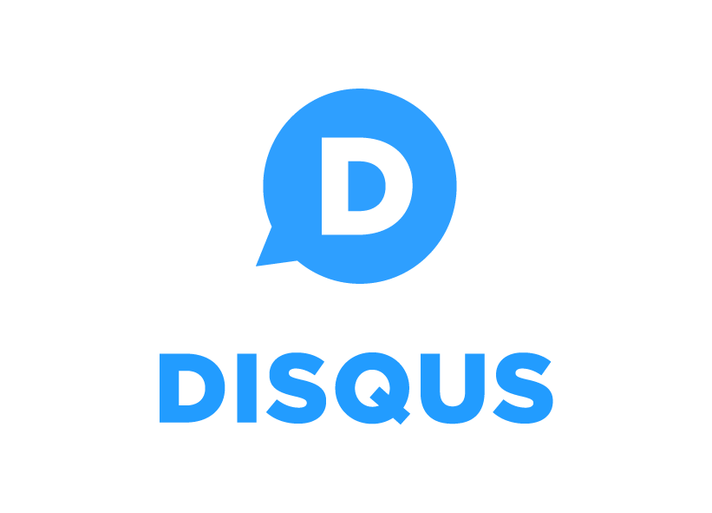
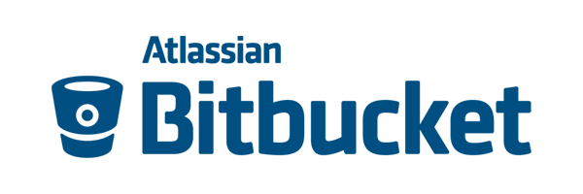
Some of websites powered by Django

Slide 5
Django Fundamentals
MVT
DRY
Loose coupling
Extensibility
Simplicity
Less Code

Slide 6
Django Project Components
Inbuilt ORM
Schema Migrations with Django ORM
Supports 3rd Party ORMs like SQLAlchemy
Supports multiple Relational and Non relational database engine
Generic Views
Templates With Jinja 2 Templating engine
Middleware
Context Processors

Slide 7
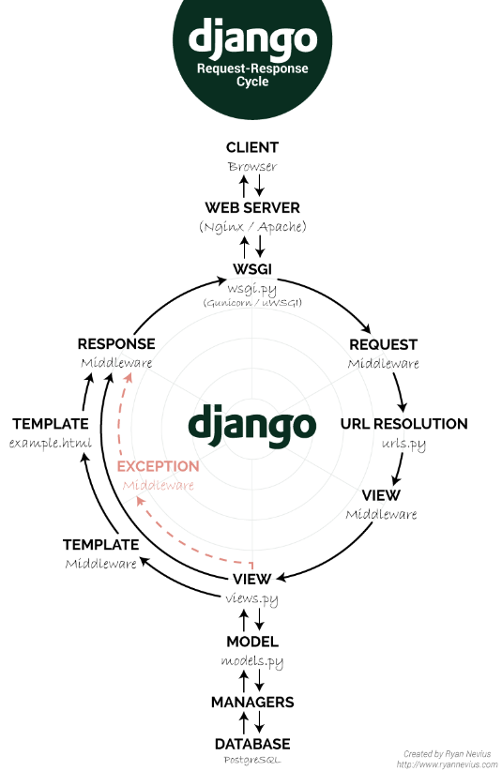

Slide 8
Thank you!!
Any Questions

