Slide 1
Library Management System

Slide 2
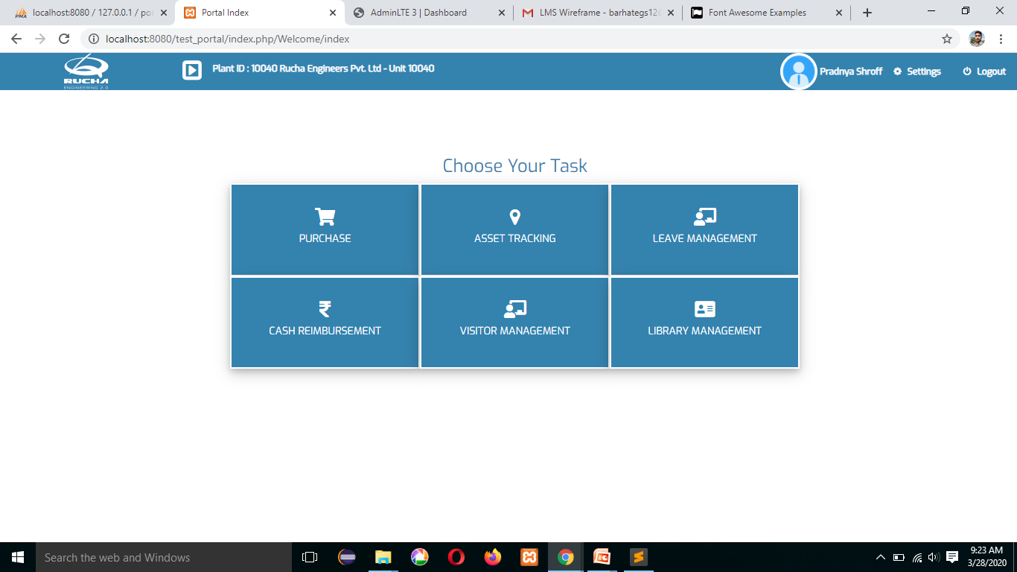
DashBoard
Login Event Verification Notification
Employee Code
Employee Password
Login Button

Slide 3

User

Slide 4
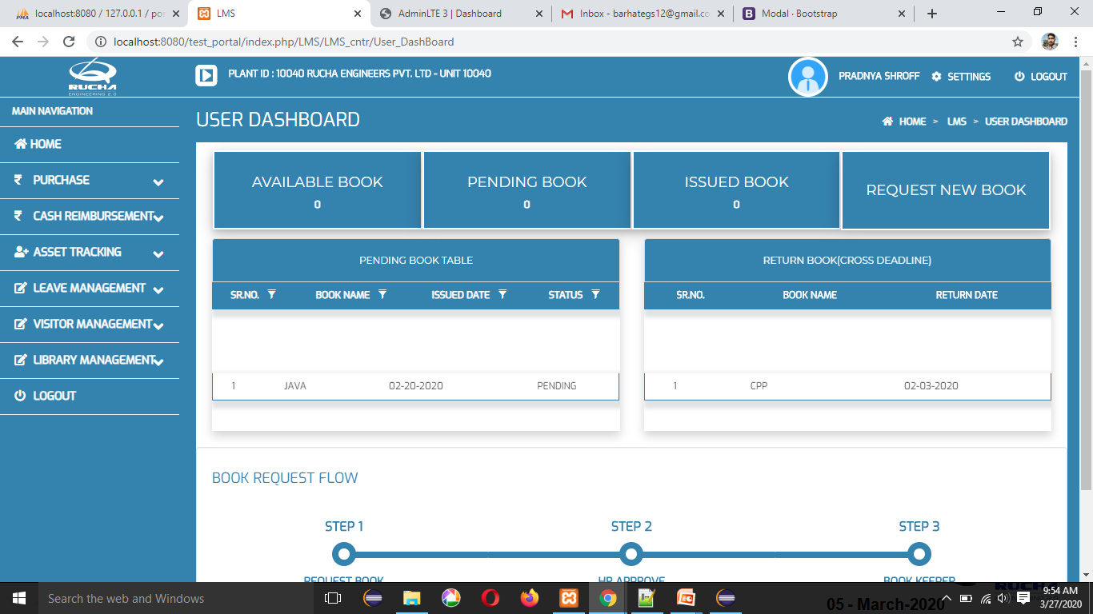
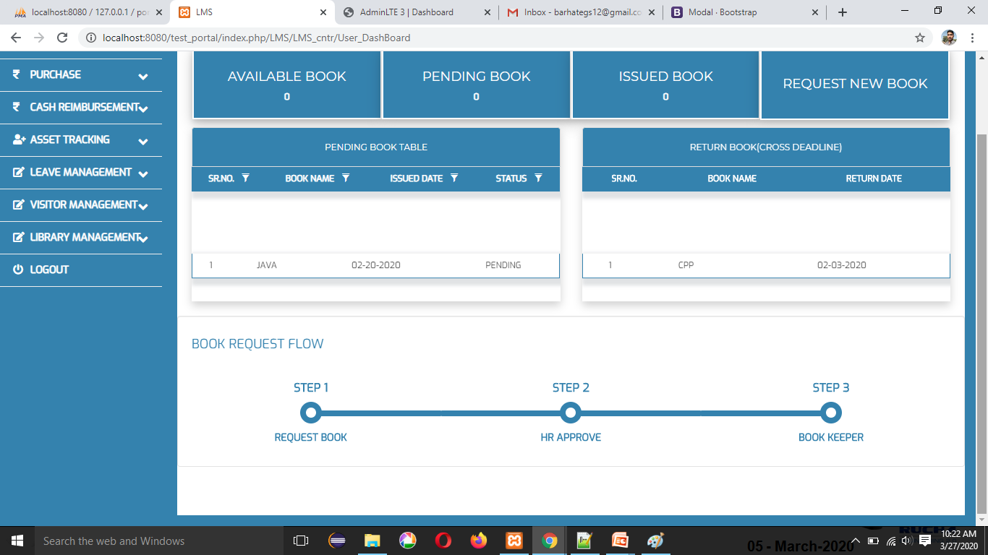
User DashBoard

Slide 5
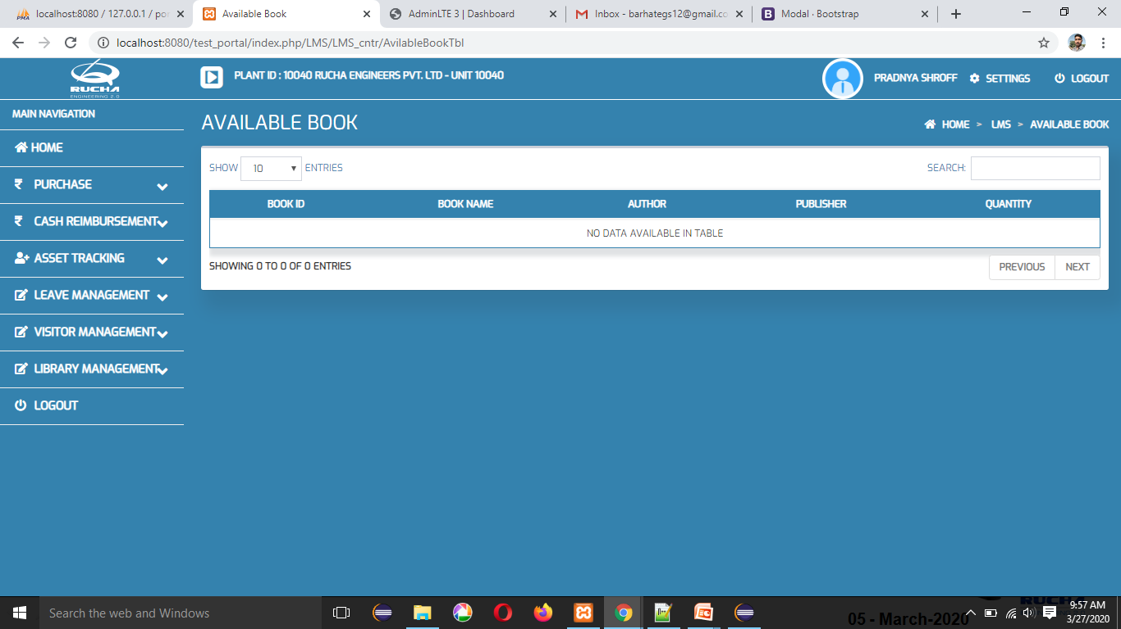
Available Books Table

Slide 6

Pending Books Table

Slide 7

Issued Book Table

Slide 8
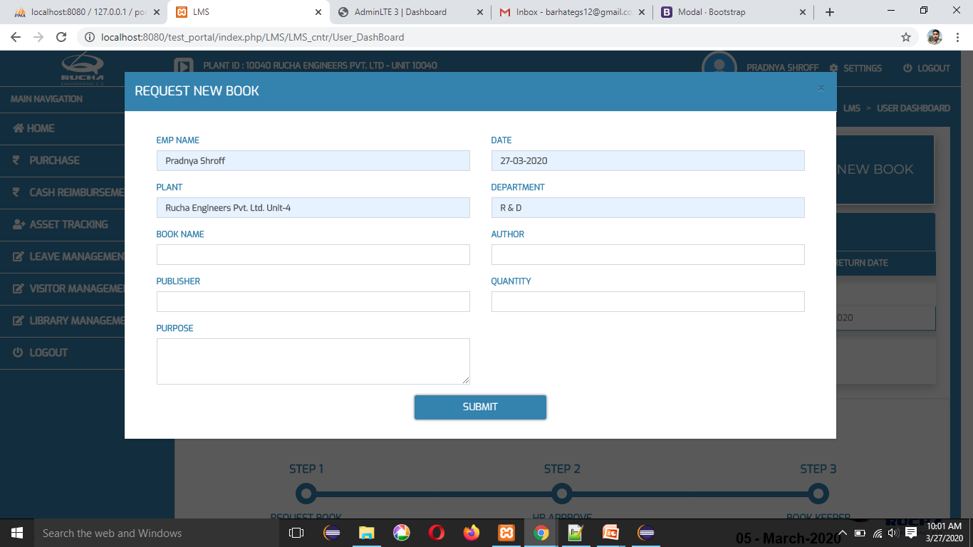
Request New Book

Slide 9
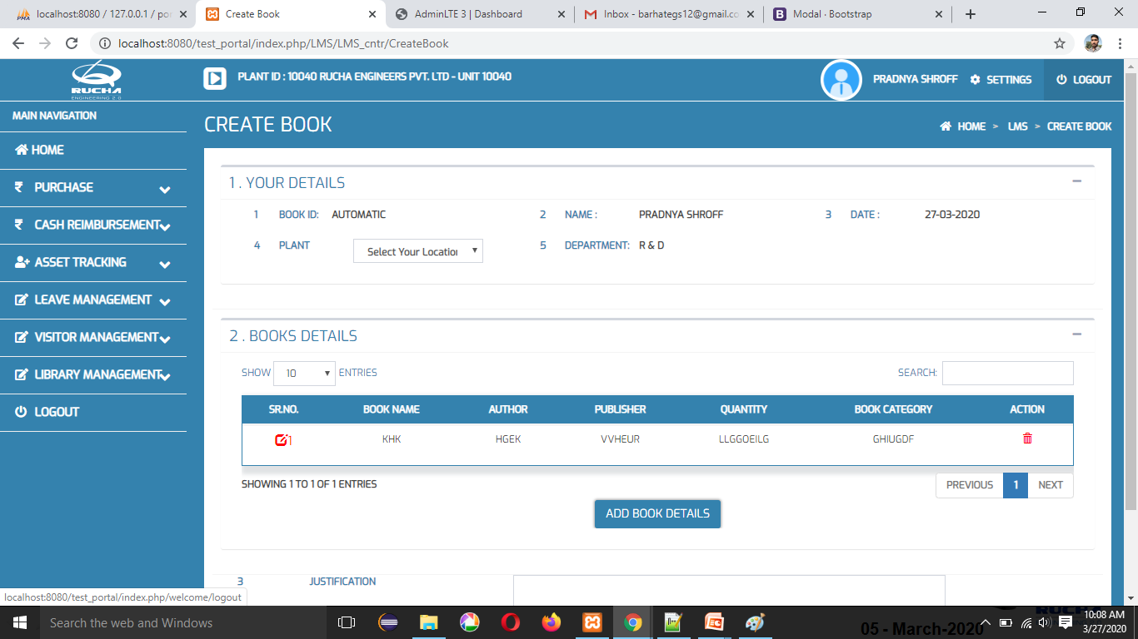
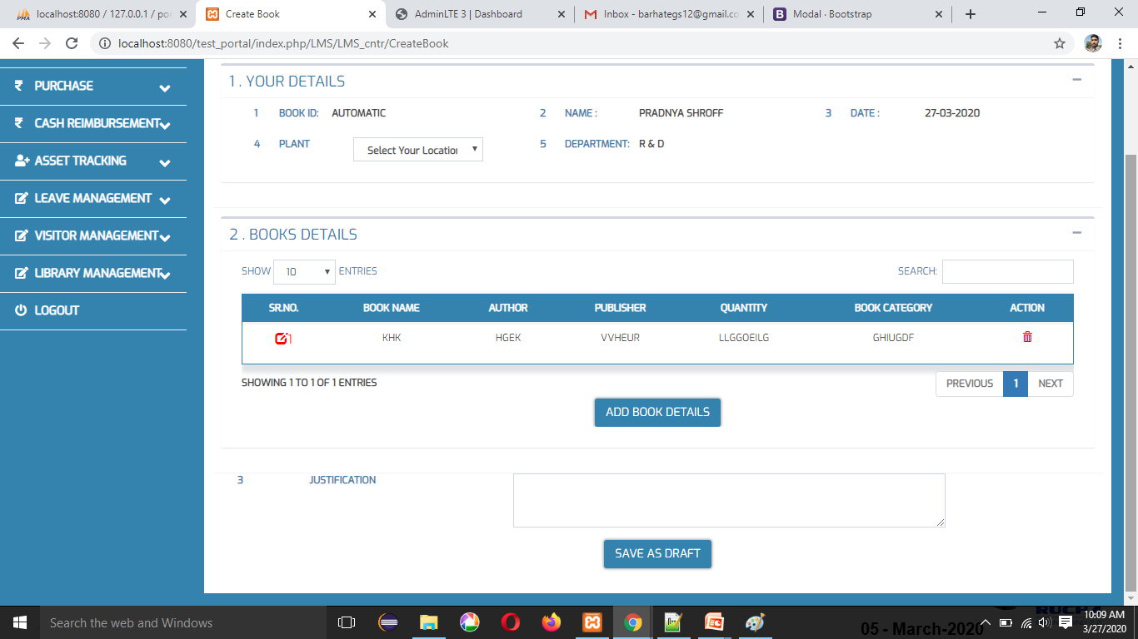
Create Book

Slide 10
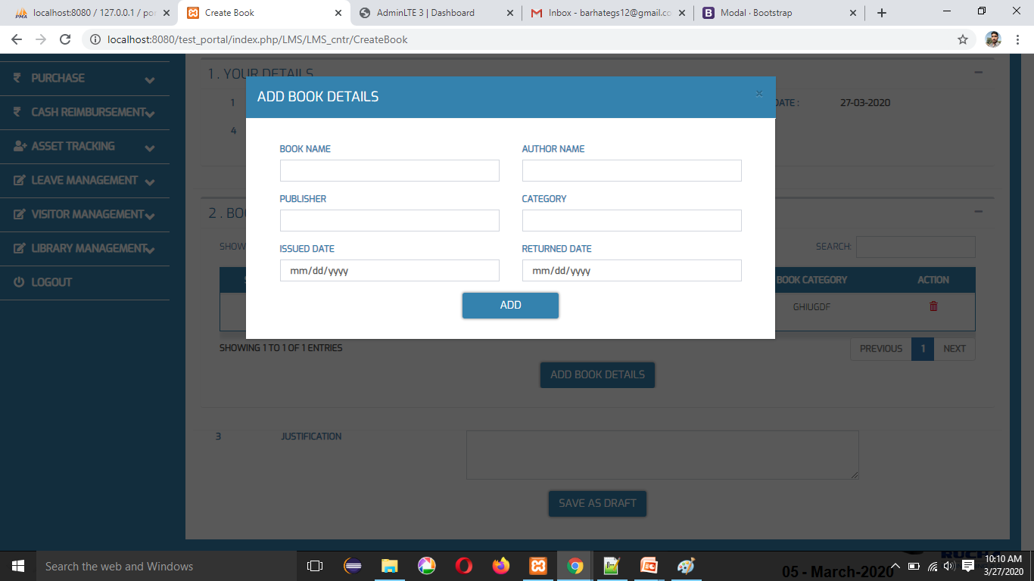
Add Book Details

Slide 11

Edit Book Details

Slide 12
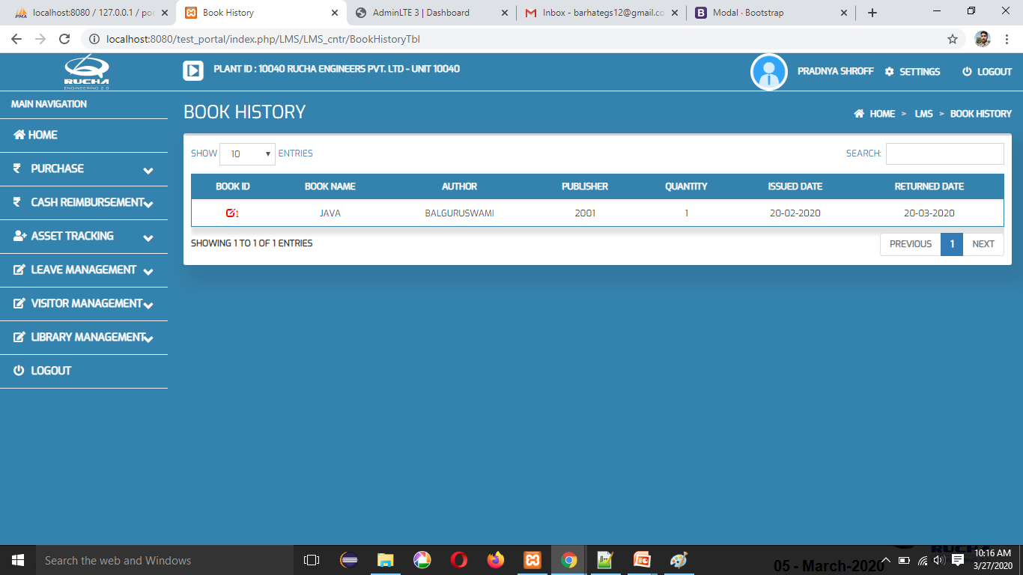
Book History Details

Slide 13
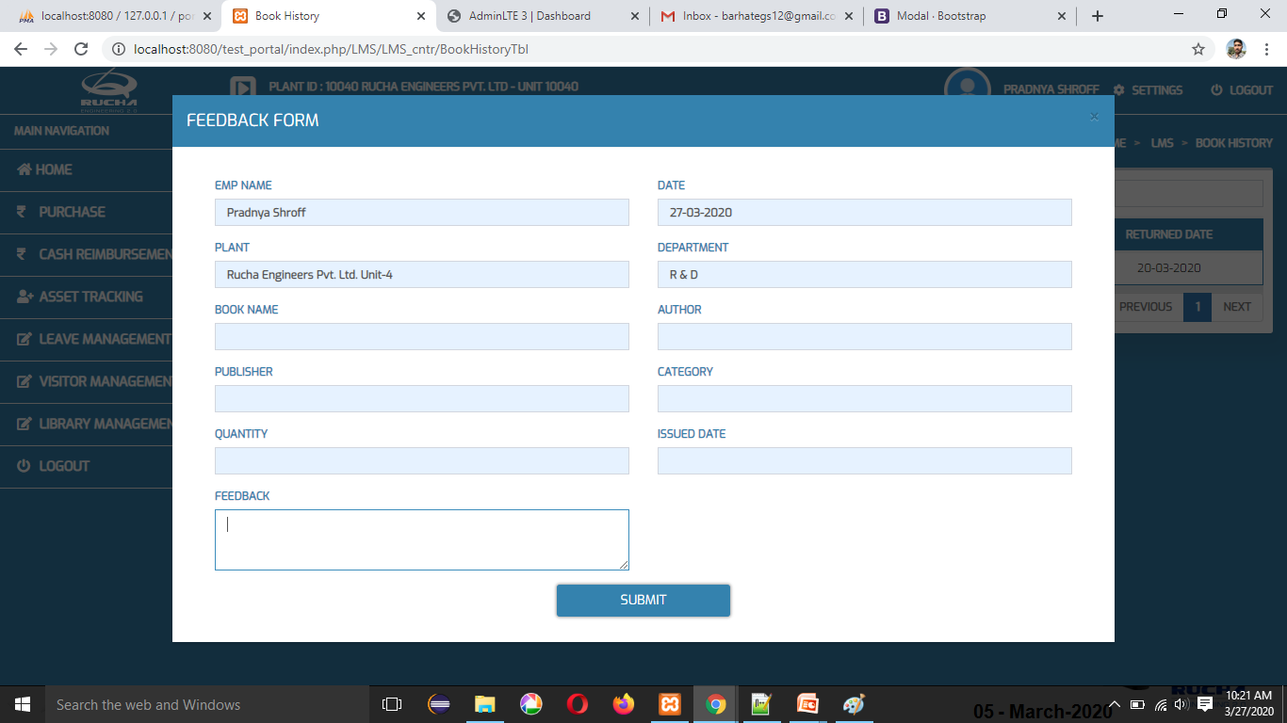
Feedback Form

Slide 14

HR Role
HR User

Slide 15
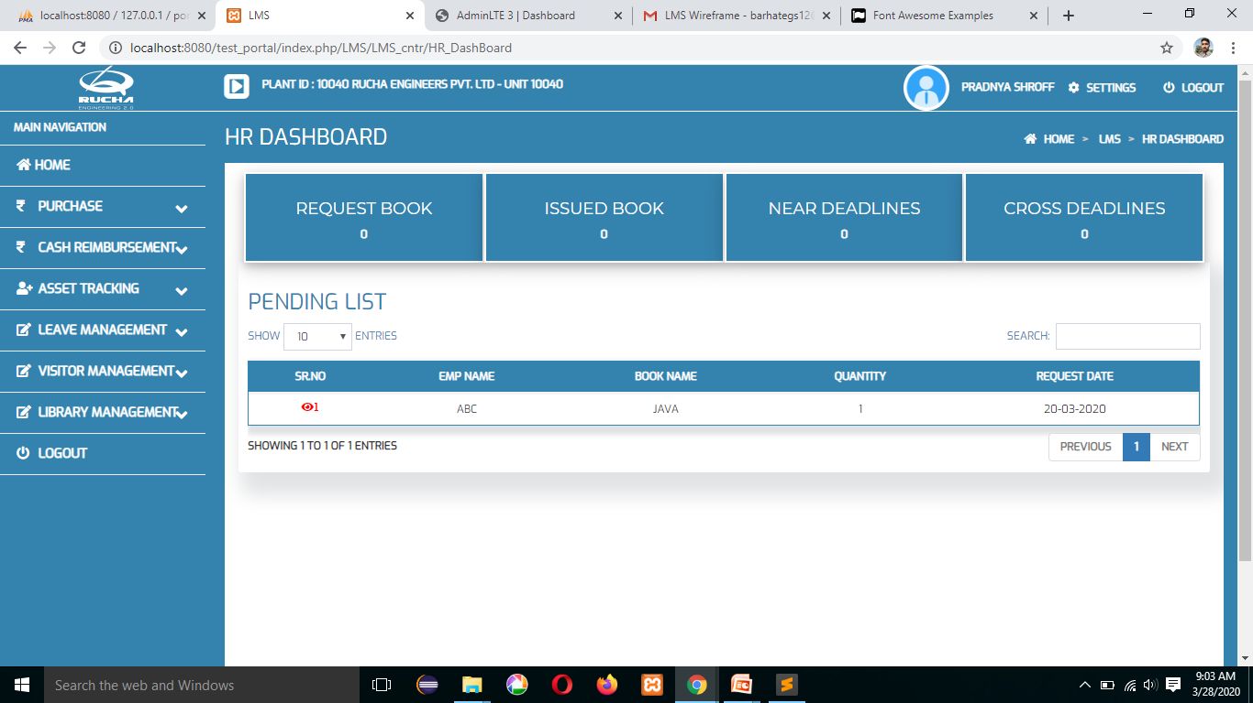
HR Dashboard

Slide 16
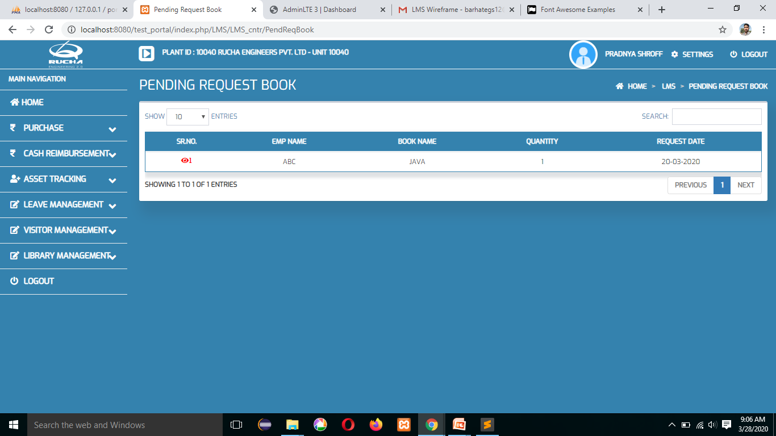
Pending Request Book

Slide 17
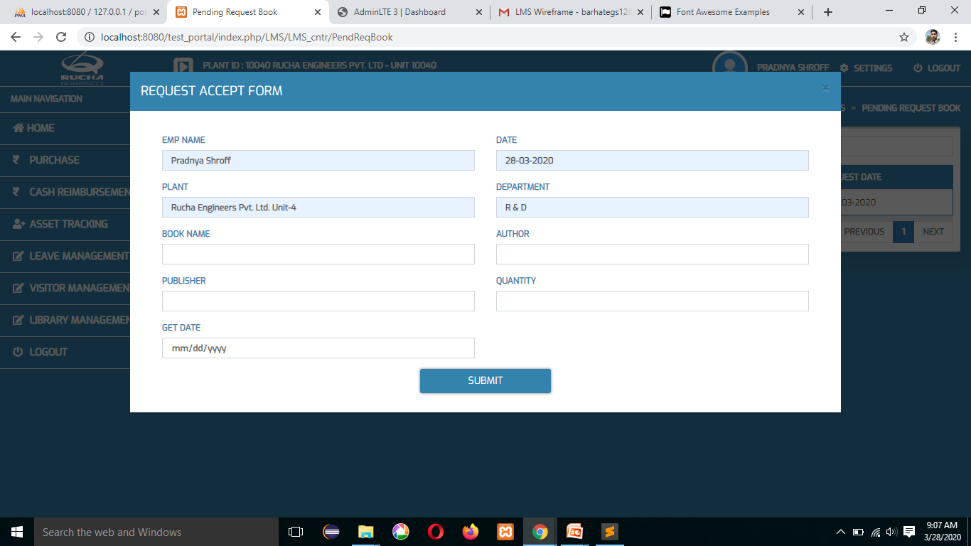
Request Accept Form

Slide 18
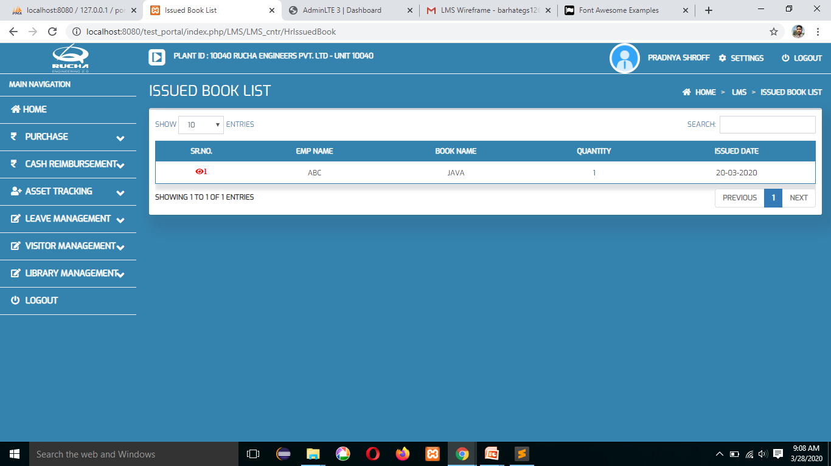
Issued Book List

Slide 19
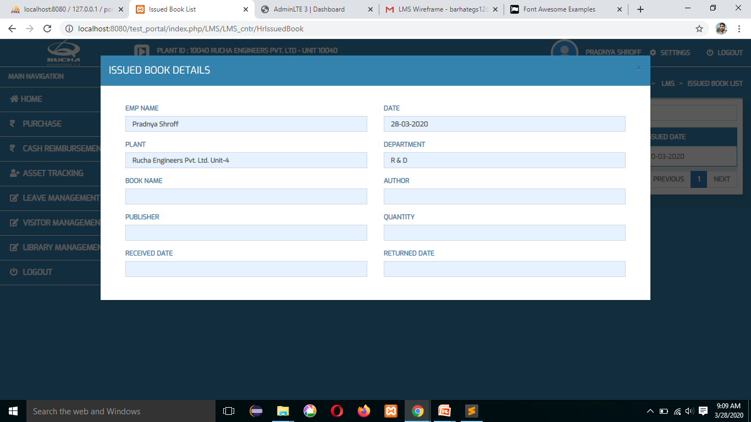
Issued Book Details

Slide 20

Near Deadline Book Table

Slide 21
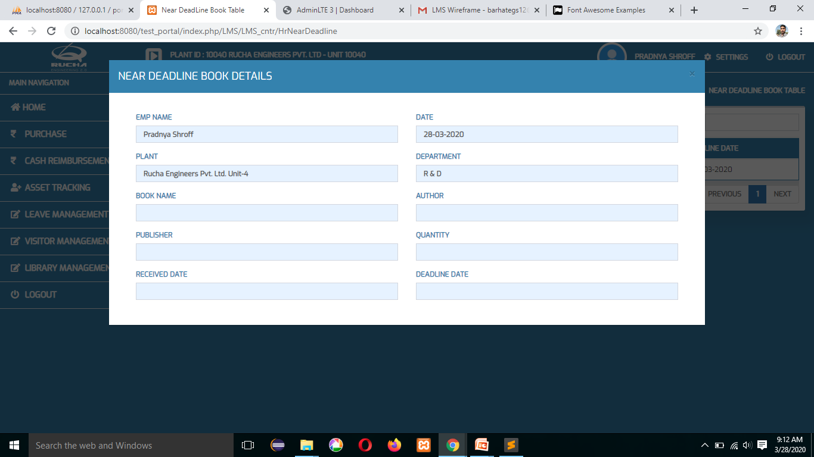
Near Deadline Book Deatils

Slide 22

Cross Deadline Book Table

Slide 23
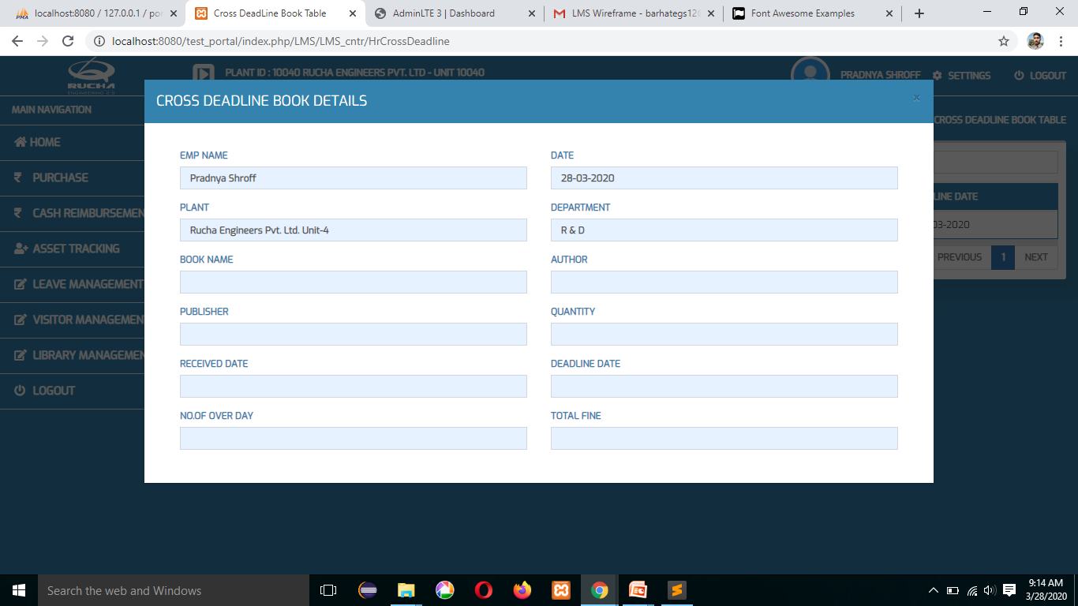
Cross Deadline Book Details

Slide 24

Book Delivered Table

Slide 25
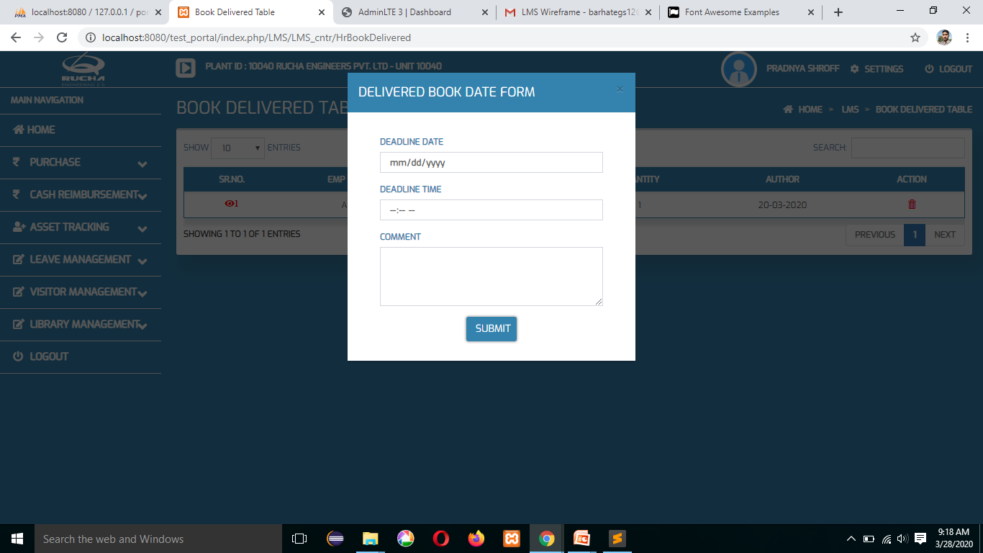
Delivered Book Date Form

Slide 26
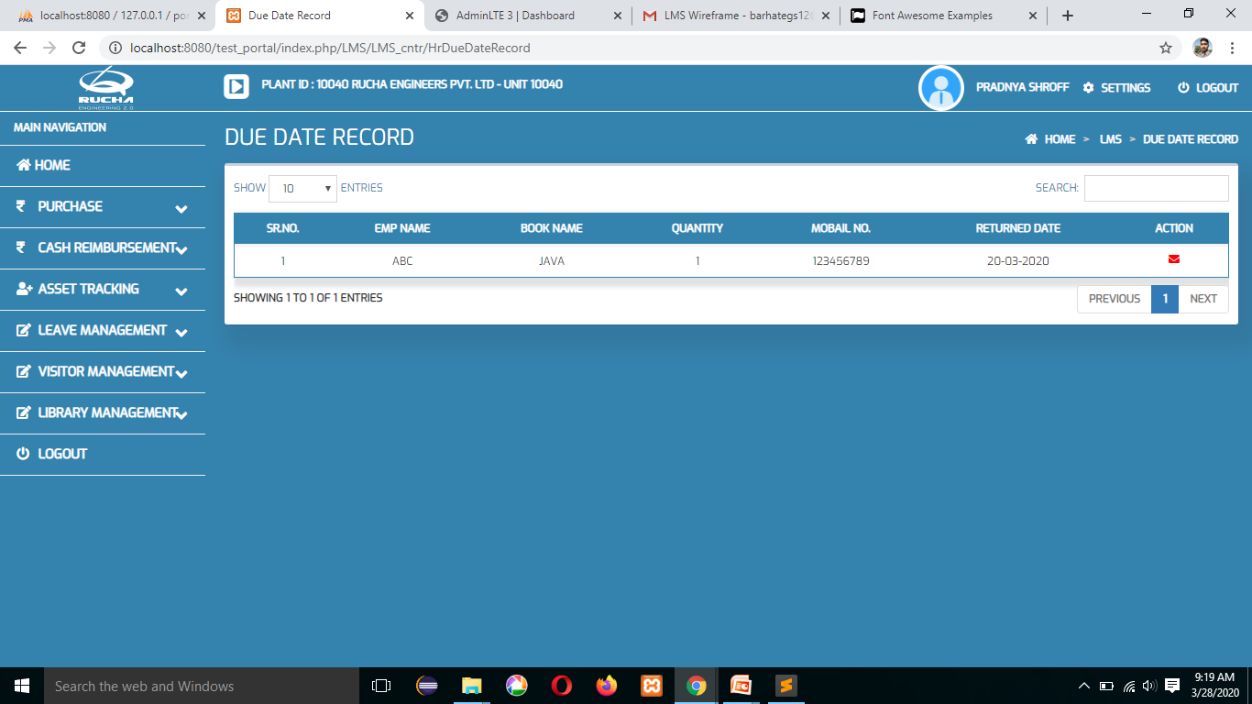
Due Date Records

Slide 27
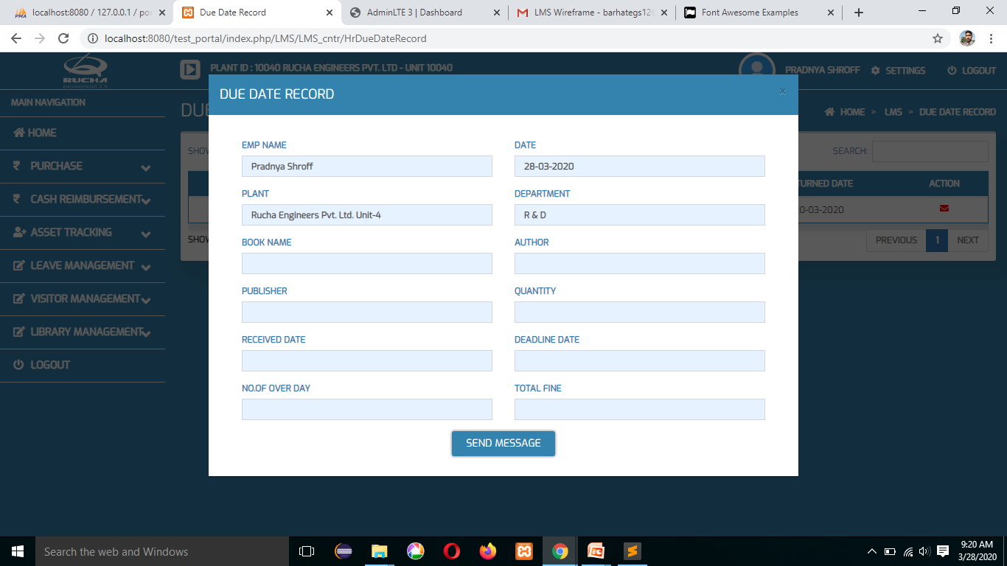
Due Date Records

Slide 28

Total Book

Slide 29
Thank You…
Login Event Verification Notification
Employee Code
Thank You
Employee Password
Login Button

