Slide 1
Source Data
S3 parent bucket Name : p-xxx-aadp-landing
Source data residing under separate sub folder :
<bucket name >/customer
<bucket name >/olist_order_items
<bucket name >/olist_orders

Slide 2
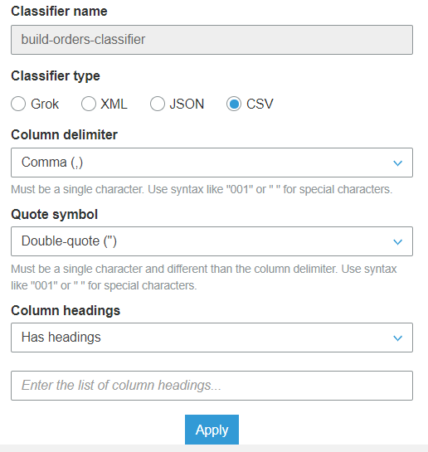
Crawler
Source Crawler : aadp_landing_<tblname>_crwl
csv files are crawled.
Once crawled, by using edit schema , the source datatype of all the columns should be string
It automatically uses the LazySerde , but sometimes it does not read the header . So it’s better to use a classifier while defining the crawler.
If the files under the folder are of same structure then it will create a table with the parent folder name.
Target Crawler : aadp_foundation_<tgt tblname>_crwl
- Parquet files are crawled using this particular crawler. It has worked successfully in parsing the current files which we have tested during this prototyping.

Slide 3
Target Data
S3 target parent bucket Name : p-xxx-aadp-foundation
Target Data gets written into separate sub folder in parquet format
<bucket name >/customer_tgt
<bucket name >/olist_order_items_tgt
<bucket name >/olist_orders_tgt

Slide 4
Glue Job
Glue Job Name: aadp_<target table>_gj
Glue job currently has these below parts to it
Import the required library
Initialize the context and session
Assign the database name and table name to python variable
Read the Source Data catalog and loading it into a glue data frame
These are transformations we are trying to achieve
Add audit columns
Create Hash keys out of the primary key column
Do partitioning
Then reorder the dataframe in the desired order ( Currently this is being achieved in an explicit manner but still exploring if we can reorder it by passing a schema )
Finally writing it to a sink folder

