Slide 1
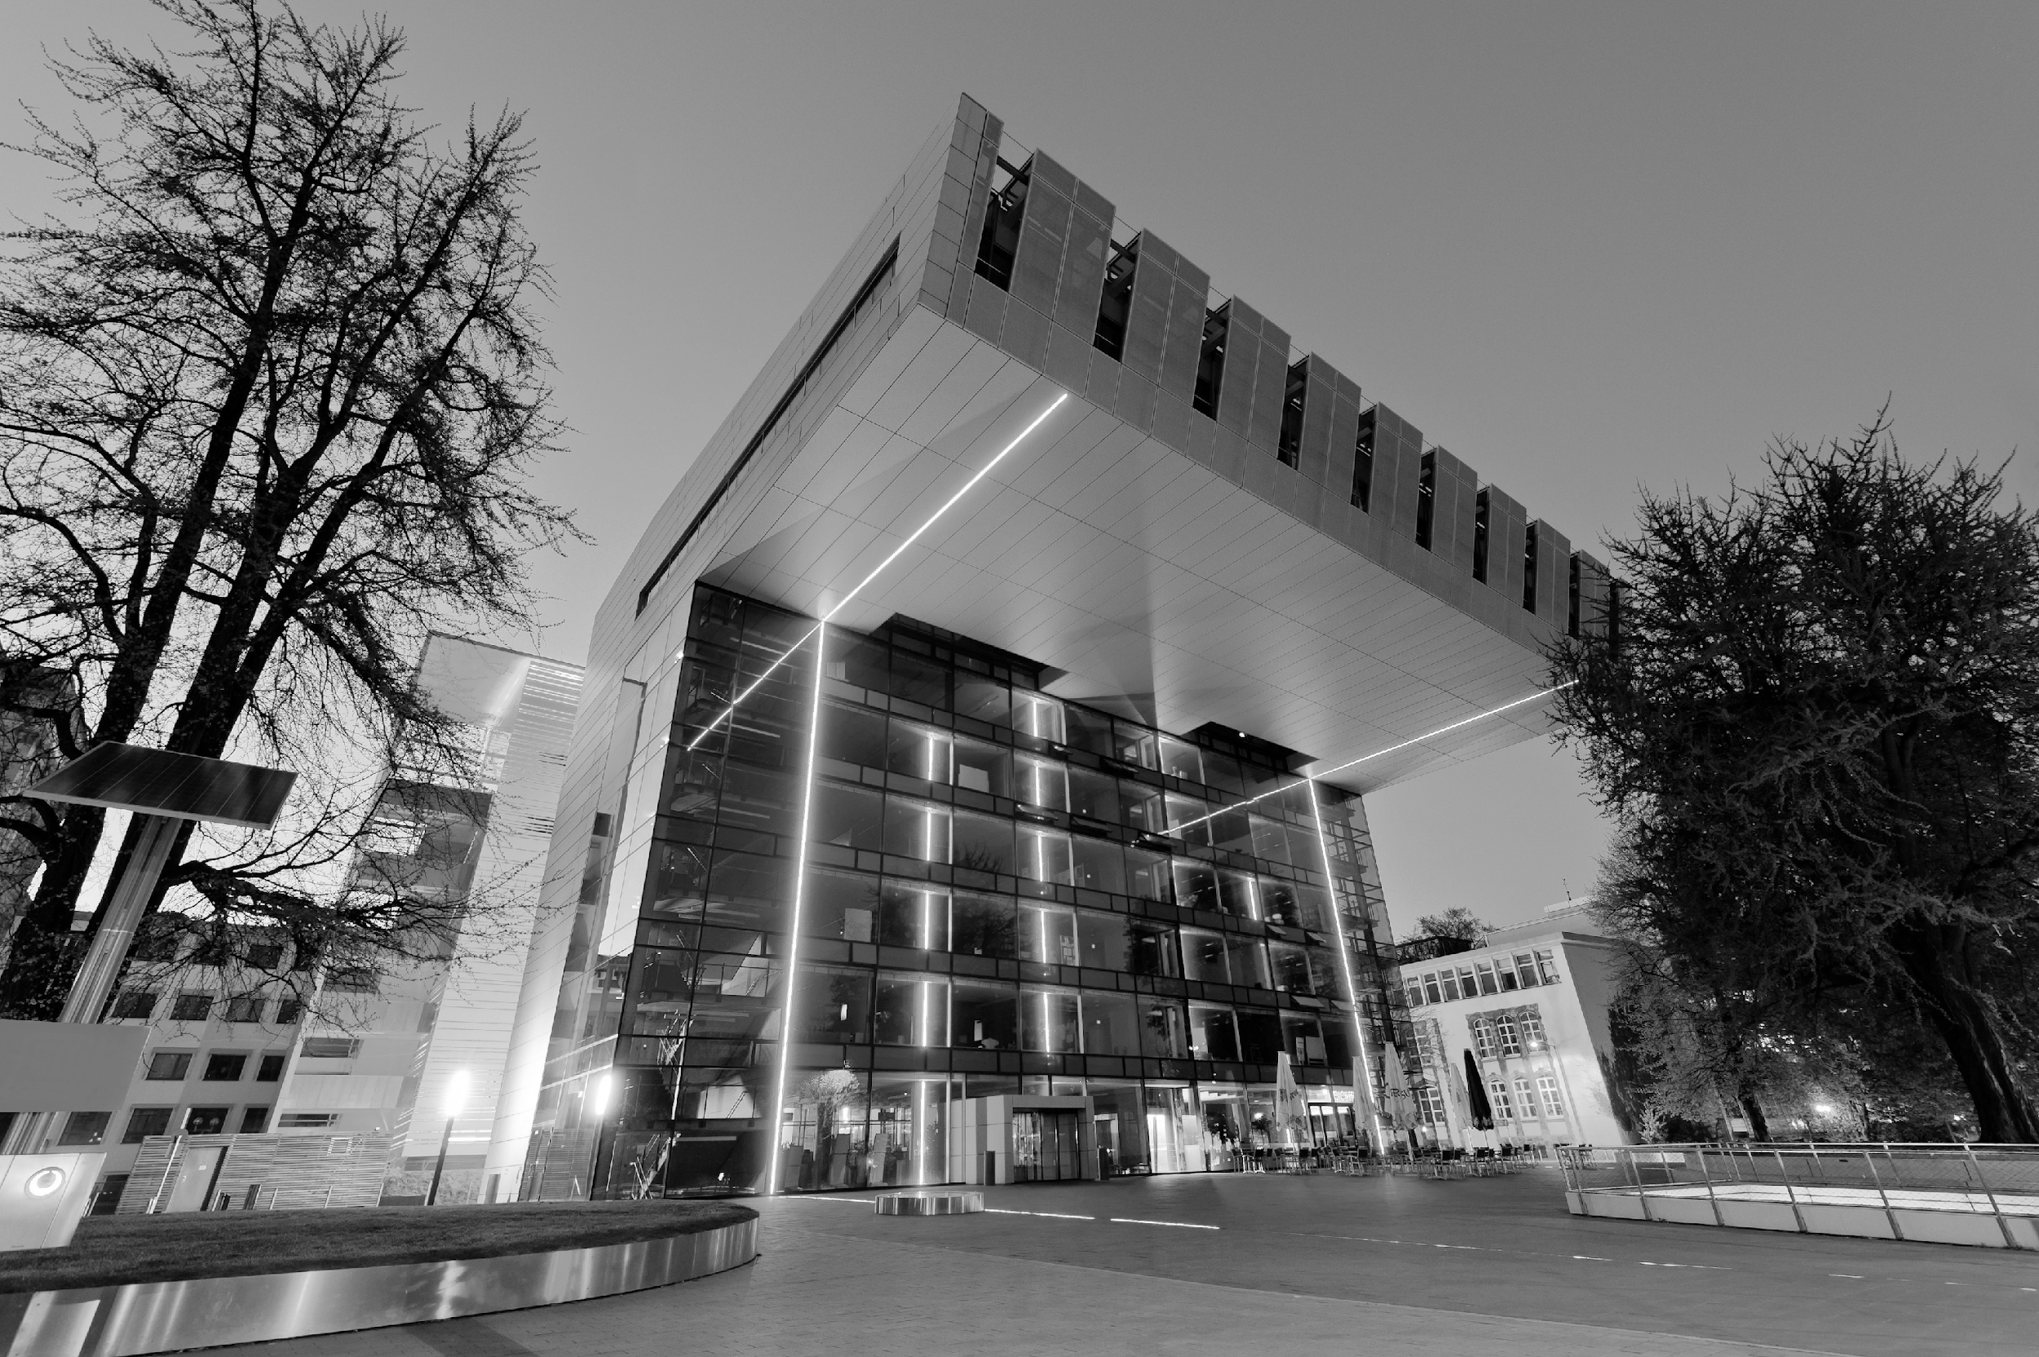

Group 4
Aachen
Organizer Robot
Team:
Pradyumn
Shubham
Ahmed
Hisham
Mentor: Amine

Slide 2
What’s our project about?
Desk always unorganized and too tired to clean it after work
However, clean desk is needed to perform at maximum efficiency
Solution: Use a gripper robot to organize it to a preferred state!
How?:
Detect objects on the table
Process the current state
Calculate required actions and joint positions
Move the objects to their desired, preset location
Output the success

Slide 3

Milestones
Kick-Off
01.07.2025
01.08.2025
01.09.2025
October
Finish line
Information gathering
Initial programs
Experimentation
Finalize
Research
Gather Virtual Data
Define ML model
Customize ML model
Setting up environments
Run custom model on data
Simulation Set-Up
Optimize running use-cases
Model Set-Up
Expand the dataset
Data Definition
Optional: Test on real robot

Slide 4
Progress
Discussed two approaches:
Using a transformer model (OpenVLA) based on Llama to detect objects and move them using one framework
Splitting the workload to 2 different stages:
Object detection using YOLO object detection model: A pretrained model which allows customizability of objects, rather lightweight
Object manipulation using a Reinforcement Learning approach which trains the desired joint actions or positions.
Set up the simulation environment on IsaacSim

Slide 5
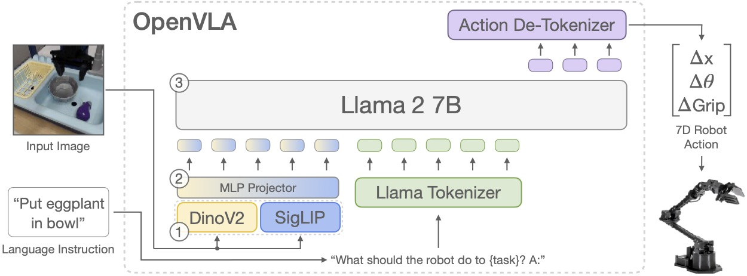
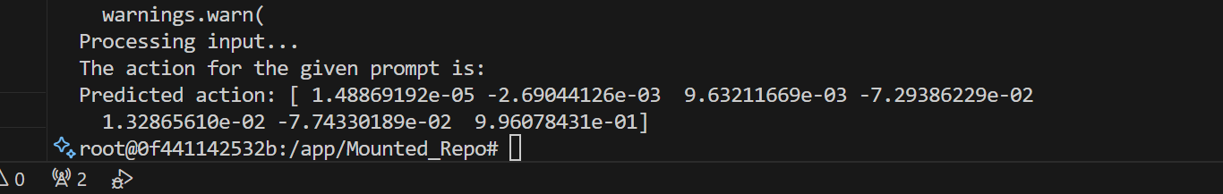
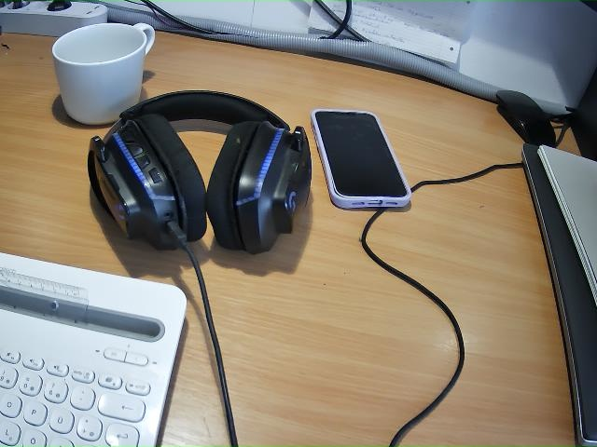
Current work
Focus on OpenVLA framework
Initial model running with basic testing:
Prompt: What action should the robot take to pick up the white cup?
Result:
As expected by the model!
From https://openvla.github.io/

Slide 6
Challenges
Goal: Data Generation and model training on a simulation
Customize pre-trained model to our use-case
Simulation environment selection
Documentation
Applicability to our robot

Slide 7
Challenges & Solutions

