Slide 1

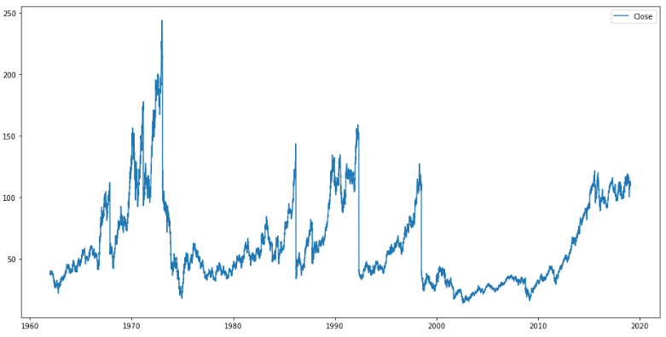
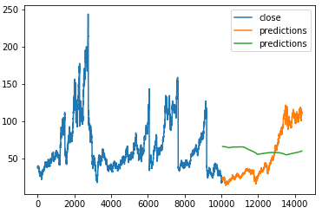
Predicting the Stock Price variation Of Walt Disney
Pradeep Kolli | Advisor: Dr. Charles Hoot
Email: S533625@nwmissouri.edu
This dataset has the data of the stock prices of Walt Disney from the start of the listing into NASDAQ till start of the project date.
By looking at the time forecasting graphs we could observe that there is no huge fluctuations in the data.
By looking at the data the decision tree classifier has delivered good metrics compared to the Scalar vector classifier.
By analysis I have found out that Long Short Term Memory (LSTM) a sequence prediction technique helps us predict the trend of the stock price as it is based on timely data. This is one Future task I have planned on to preform to predict the stock prices.
Features used are:
Date
Closing price of the stock
In some classifiers I have taken Avg_high and Avg_low as features.
Performed Linear regression to train the model.
Used Decision Tree Classifier to implicitly perform feature selection.
https://www.quandl.com/data/EOD/DIS-The-Walt-Disney-Company-DIS-Stock-Prices-Dividends-and-Splits
https://scikit-learn.org/stable/modules/svm.html
Git hub repository
https://github.com/pradykolli/MLPoster.git

