Slide 1


Jyothy Institute of Technology
Department of Electronics and Communication Engineering
Internship Seminar(21INT68)
TOPIC: THERMOELECTRIC PELTIER EFFECT
Portable Medical Cooling Solutions
YEAR: 2023-2024
Presented by :
GR PRADYUMNA MAIYA
1JT21EC019

Slide 2
Institution Vision & Mission
Vision of the Institution:
To be an institution of excellence in Engineering education, Innovation and Research and work towards evolving great leaders for the country’s future and meeting global needs.
Mission of the Institution :
The Institution aims at providing a vibrant, intellectually and emotionally rich teaching learning environment with state of art infrastructure and recognizing and nurturing the potential of each individual to evolve into one’s own self and contribute ro the welfare of all.

Slide 3
Department of ECE Vision & Mission
Vision of the department:
To be a Department of excellence at a global level in Electronics and Communication Engineering education, incorporating Research & Innovation and Leadership training components.
Mission of the department:
The Department will
M1: Strive to provide state of Art infrastructure in classrooms and laboratories.
M2: Enable all-round development with individual attention and innovative teaching learning methodology.
M3: Impart leadership qualities into the students by exposing them to industry and research in global Electronics and Communication Engineering domain.

Slide 4
Department of ECE PEO’s
Program Educational Objectives (PEOs)
PEO 1. (Domain Knowledge) Graduates of Electronics & Communication Engineering will be able to utilize mathematics, science, engineering fundamentals, theoretical as well as laboratory based experiences to identify, formulate & solve engineering problems and succeed in advanced engineering or other fields.
PEO 2. (Professional Employment) Graduates of Electronics & Communication Engineering will succeed in entry-level engineering positions in VLSI, Communication and Fabrication industries in regional, national, or global industries.
PEO 3. (Engineering Citizenship) Graduates of Electronics & Communication Engineering will be prepared to communicate and work effectively on individual & team based engineering projects while practicing the ethics of their profession consistent with a sense of social responsibility.
PEO 4. (Lifelong Learning) Graduates of Electronics & Communication Engineering will be equipped to recognize the importance of, and have the skills for, continuous learning to become experts in their domain and enhance their professional attributes

Slide 5
Department of ECE PSO’s
Program Specific Outcomes (PSOs)
PSO 1. (Knowledge/ Skills) Explore emerging technologies in the field of Electronics & Communication Engineering using the knowledge and skills gained.
PSO 2. (Application/Analysis/Problem solving) Apply techniques in different domains to create innovative products and services in the Communication, VLSI, DSP, and Networking.
PSO 3. (Value/ Attribute) Work on various platforms as an individual/ team member to develop useful and safe Circuits, PCB, Power Management Systems and Automation for the society and nation.

Slide 6
OVERVIEW
INTRODUCTION
OBJECTIVES
LITERATURE SURVEY
BLOCK DIAGRAM
HARDWARE/SOFTWARE TOOLS
APPLICATIONS
RESULT
REFERENCE PAPERS
2

Slide 7
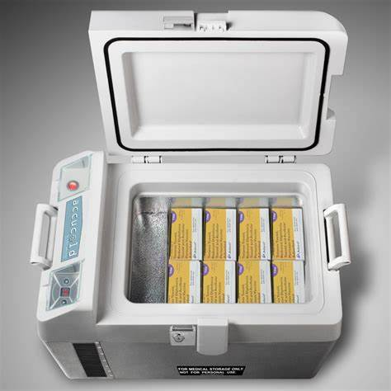
INTRODUCTION
PROBLEM STATEMENT
Importance of Temperature-sensitive Medicines
Challenges in Transportation and Storage

Slide 8
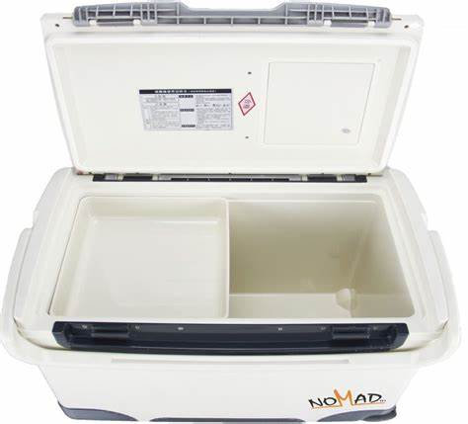
OBJECTIVES
Temperature Control
Portability
Energy Efficiency
Reliability
3

Slide 9
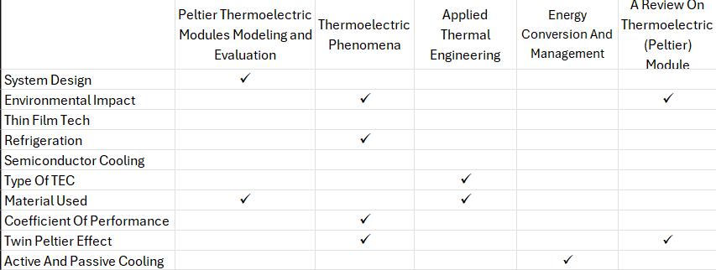
LITERATURE SURVEY
ü
ü
6

Slide 10
BLOCK DIAGRAM
Cooling Chamber
Peltier Module
Power Supply
Microcontroller
Heat sink And Fan
Temperature Sensor
7

Slide 11
HARDWARE TOOLS
HARDWARE
TEC12706
ESP32
Power Supply
Temperature Sensor
LCD Display
Heat Sink and Fan
Container
8

Slide 12
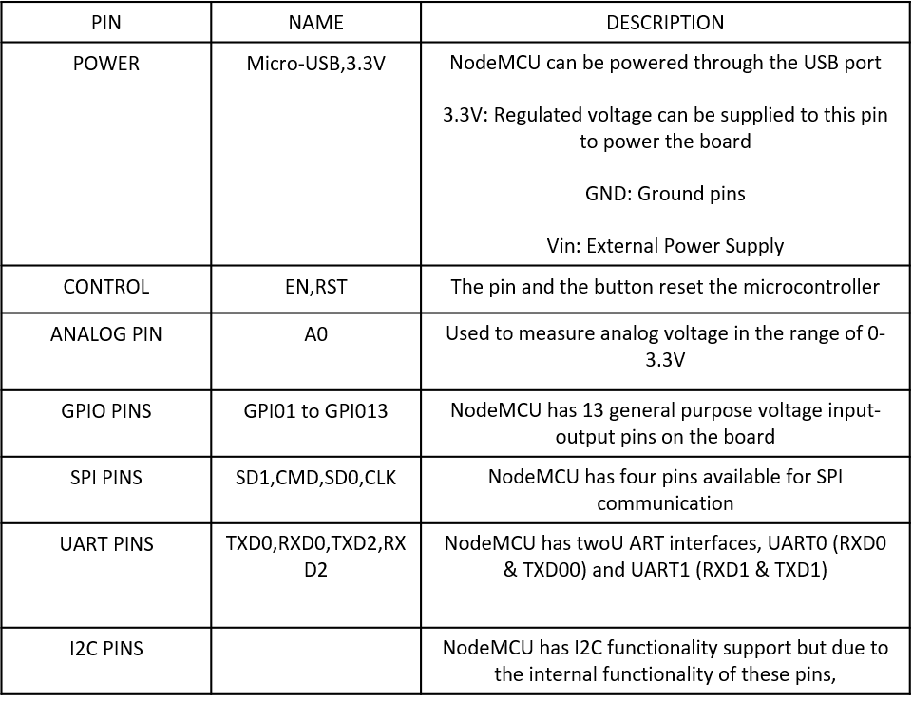
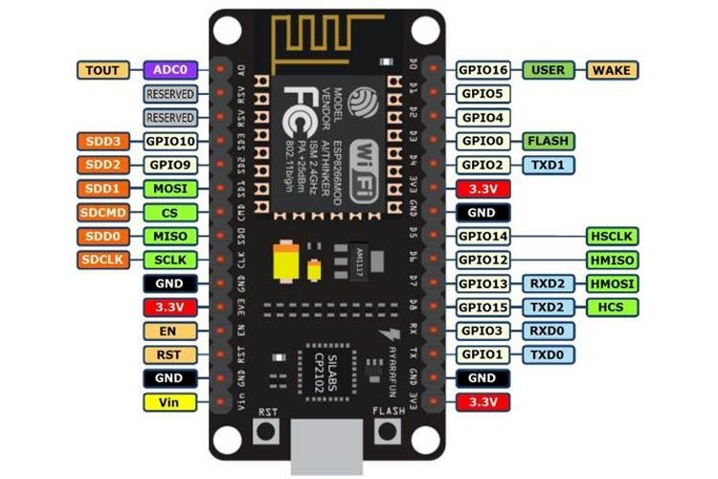
HARDWARE COMPONENTS
ESP8266
10

Slide 13
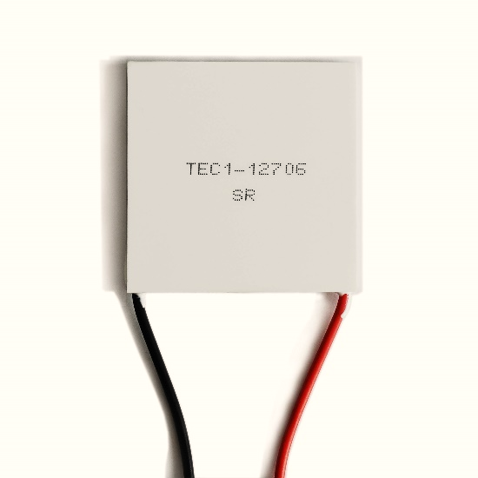
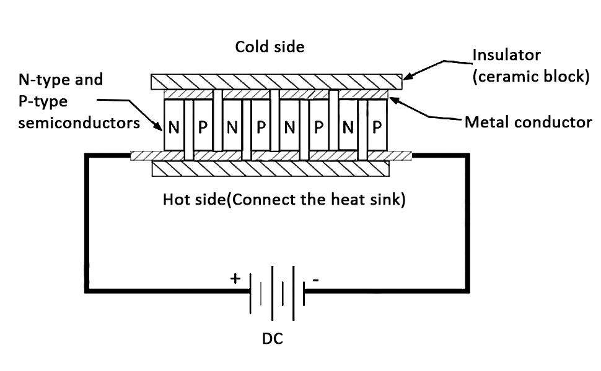
HARDWARE COMPONENTS
TEC12706
Specification | Conditions
Imax | 6.0A | T=30º
Vmax | 15.0V | T=30º
ΔTmax | >=67ºC | Qc = 0, T=30º
Qmax | 51.4W | ΔT = 0, T =30º
Tr | 50~100ºC
9

Slide 14
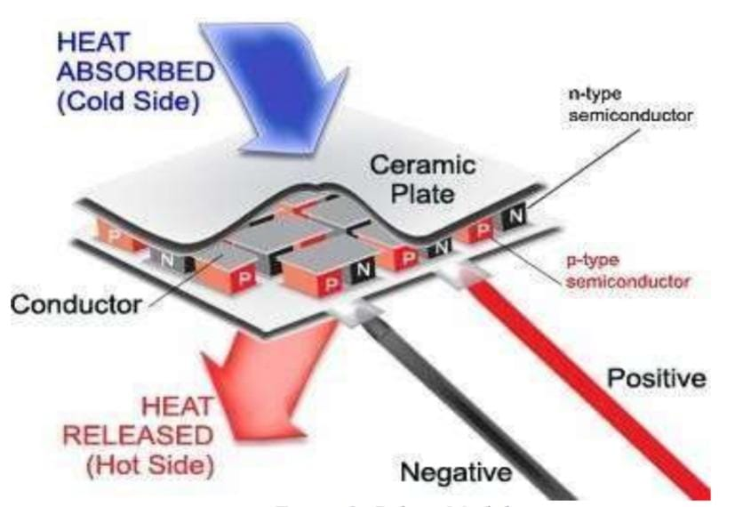
HARDWARE COMPONENTS

Slide 15
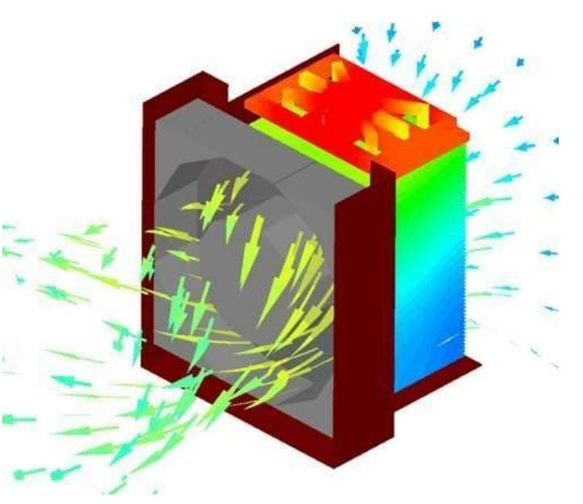
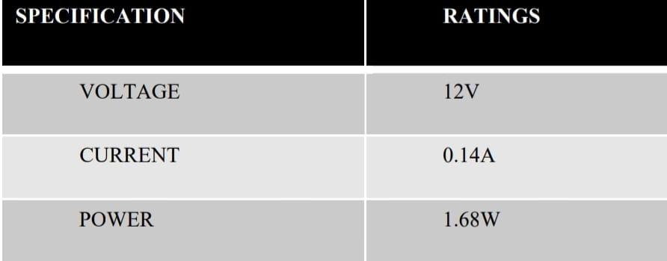
HARDWARE COMPONENTS
Heat Sink And Fan

Slide 16
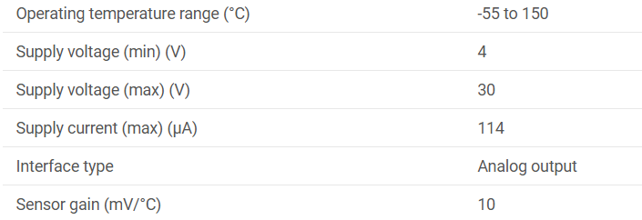
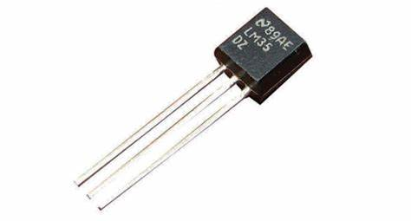
HARDWARE COMPONENTS
LM35- ANALOG SENSOR
11

Slide 17
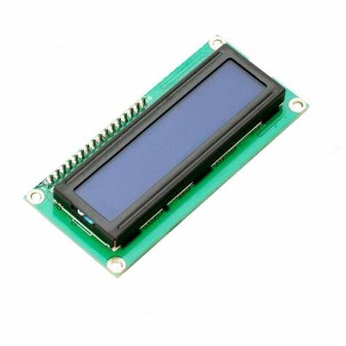
HARDWARE COMPONENTS
LCD Display

Slide 18
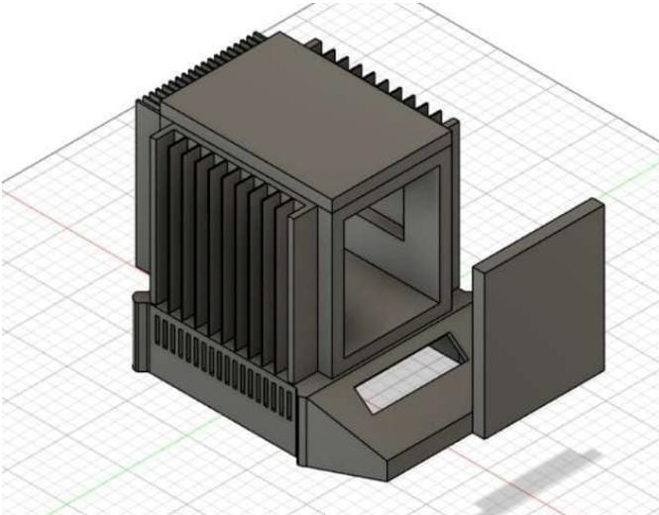
HARDWARE COMPONENTS
CONTAINER

Slide 19
Methodology
Temperature Monitor
Temperature Control and Regulation
Peltier Module
Cooling Chamber

Slide 20
APPLICATIONS
Vaccine Transportation and Storage:
Emergency Medical Services (EMS):
Mobile Clinics and Health Camps:
Research and Field Studies:
Combat Medic Equipment
12

Slide 21
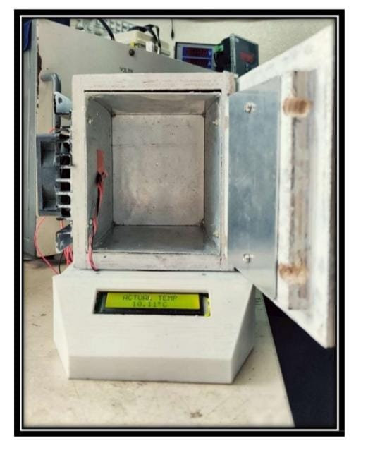
EXPECTED RESULT
14

Slide 22
CONCLUSION & FUTURE SCOPE
In conclusion, By leveraging the thermoelectric effect of Peltier modules, we have addressed several critical challenges in medical logistics and healthcare delivery:
Temperature Control
Portability
Energy Efficiency
Reliability
Efficiency
FUTURE SCOPE
Advanced Temperature Monitoring
Enhanced Cooling Efficiency
Alternate source of Energy(Solar Energy)
Miniaturization and integration
15

Slide 23
References
[1] Chakib Alaoui,“Peltier Thermoelectric Modules Modeling and Evaluation”,International Journal Of Engineering, Vol-5, Issue-1, April 2011
[2] Witold Brostow , Gregory Granowski , Nathalie Hnatchuk , Jeff Sharp and John B. White ,” THERMOELECTRIC PHENOMENA”, Journal of Materials Education Vol. 36 (5-6): 175 - 186 (2014)
[3] Mingjian Liao, Zhu He, Chengpeng Jiang, Xi'an Fan , Yawei Li , Fengsheng Qi,” A three-dimensional model for thermoelectric generator and the influence of Peltier effect on the performance and heat transfer ”, https://doi.org/10.1016/j.applthermaleng.2018.01.080
[4] Jun Wang , Peiguo Cao , Xingjun Li , Xiangxiang Song, Chuang Zhao , Lei Zhu,” Experimental study on the influence of Peltier effect on the output performance of thermoelectric generator and deviation of maximum power point”, https://doi.org/10.1016/j.enconman.2019.112074
[5] Nagesh Kudva, Veeresha R K, Muralidhara“A Review on Thermoelectric (Peltier) Module,” Mechanical, Vol. 1Issue-4, Jul. 2020.
16

Slide 24
THANK YOU
17

