Slide 1
Red Black Trees
Name | Pradyot SN | Shagil Siddiqui | Amit Pradhan
Roll No | 10 | 17 | 27
Reg No | 190948012 | 190948019 | 190948027
M.Tech CSIS
Program Lab
CSE 5162
Department of Computer Science & Engg., MIT, Manipal

Slide 2
Agenda
Overview

Slide 3
Red-black trees: Overview
Red-black trees are a variation of binary search trees to ensure that the tree is balanced.
Height is O(lg n), where n is the number of nodes.
Operations take O(lg n) time in the worst case.
Department of Computer Science & Engg., MIT, Manipal

Slide 4
Red-Black Tree Properties
Every node is either red or black.
The root is black.
Every leaf (nil) is black.
If a node is red, then both its children are black.
For each node, all paths from the node to descendant leaves contain the same number of black nodes.
Department of Computer Science & Engg., MIT, Manipal

Slide 5
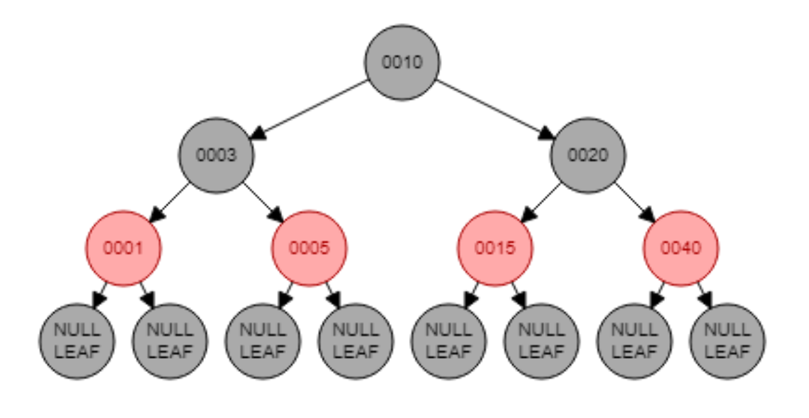
Example: RED-BLACK-TREE
For convenience we use NIL[T] to represent all the NULL nodes at the leafs
NIL[T] has the same fields as an ordinary node
Color[NIL[T]] = BLACK
The other fields may be set to arbitrary values

Slide 6
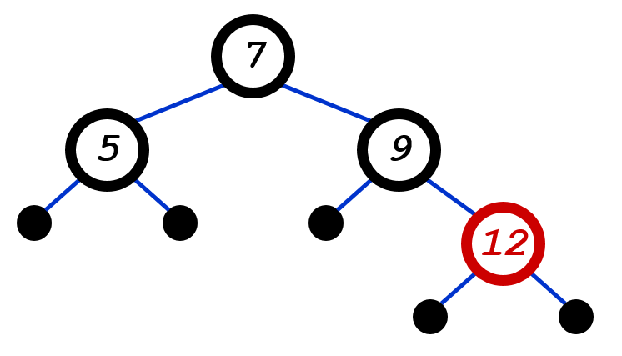
The Problem With Insertion
Insert 8
Where does it go?
1. Every node is either red or black
2. Every leaf (NULL pointer) is black
3. If a node is red, both children are black
4. Every path from node to descendent leaf contains the same number of black nodes
5. The root is always black

Slide 7
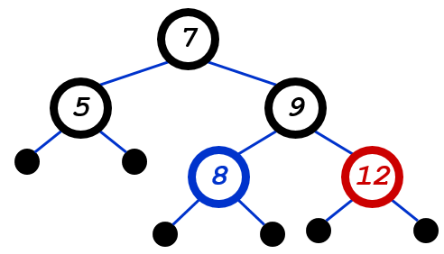
The Problem With Insertion
Insert 8
Where does it go?
What color should it be?
1. Every node is either red or black
2. Every leaf (NULL pointer) is black
3. If a node is red, both children are black
4. Every path from node to descendent leaf contains the same number of black nodes
5. The root is always black

Slide 8
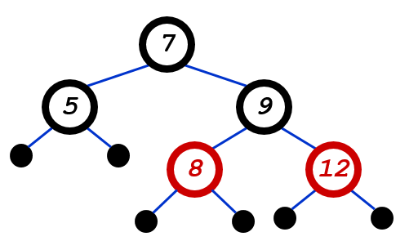
The Problem With Insertion
Insert 8
Where does it go?
What color should it be?
1. Every node is either red or black
2. Every leaf (NULL pointer) is black
3. If a node is red, both children are black
4. Every path from node to descendent leaf contains the same number of black nodes
5. The root is always black

Slide 9
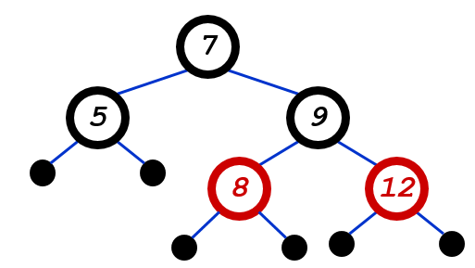
The Problem With Insertion
Insert 11
Where does it go?
1. Every node is either red or black
2. Every leaf (NULL pointer) is black
3. If a node is red, both children are black
4. Every path from node to descendent leaf contains the same number of black nodes
5. The root is always black

Slide 10
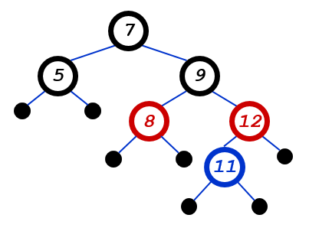
The Problem With Insertion
Insert 11
Where does it go?
What color should it be?
1. Every node is either red or black
2. Every leaf (NULL pointer) is black
3. If a node is red, both children are black
4. Every path from node to descendent leaf contains the same number of black nodes
5. The root is always black

Slide 11
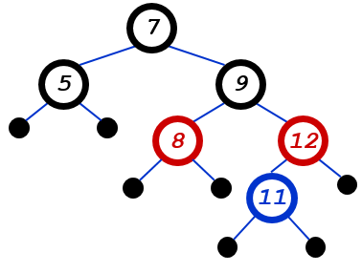
The Problem With Insertion
Insert 11
Where does it go?
What color should it be?
Can’t be red! (#3)
Can’t be black! (#4)
1. Every node is either red or black
2. Every leaf (NULL pointer) is black
3. If a node is red, both children are black
4. Every path from node to descendent leaf contains the same number of black nodes
5. The root is always black

Slide 12
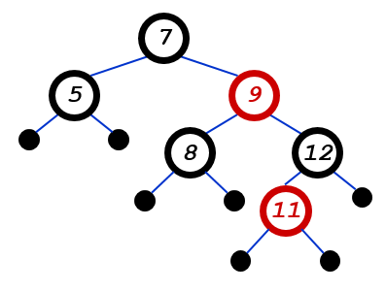
The Problem With Insertion
Insert 11
Where does it go?
What color should it be?
Solution: recolor the tree
1. Every node is either red or black
2. Every leaf (NULL pointer) is black
3. If a node is red, both children are black
4. Every path from node to descendent leaf contains the same number of black nodes
5. The root is always black

Slide 13
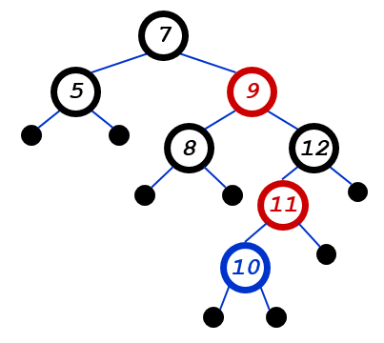
The Problem With Insertion
Insert 10
Where does it go?
What color should it be?
1. Every node is either red or black
2. Every leaf (NULL pointer) is black
3. If a node is red, both children are black
4. Every path from node to descendent leaf contains the same number of black nodes
5. The root is always black

Slide 14
The Problem With Insertion
Insert 10
Where does it go?
What color?
A: no color! Tree is too imbalanced
Must change tree structure to allow recoloring
Goal: restructure tree in O(lg n) time

Slide 15
RB Trees: Rotation
Our basic operation for changing tree structure is called rotation:
y
x
rightRotate(y)
x
C
A
y
leftRotate(x)
A
B
B
C

Slide 16
Rotation Example
Rotate left about 9:
7
5
9
8
12
11

Slide 17
Rotation Example
Rotate left about 9:
7
5
12
9
8
11

Slide 18

Questions
Department of Computer Science & Engg., MIT, Manipal

Slide 19
Thank You

