Slide 1


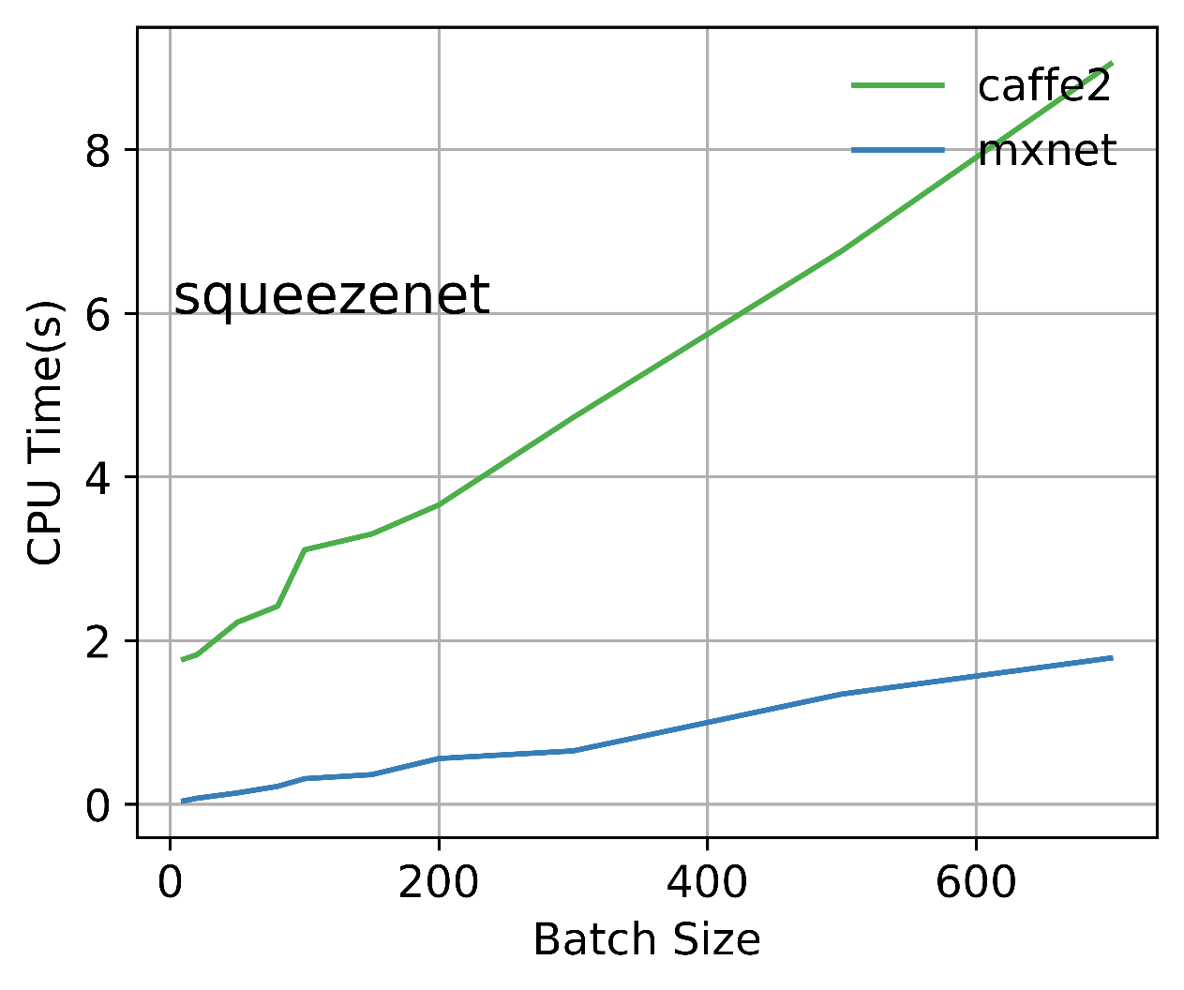
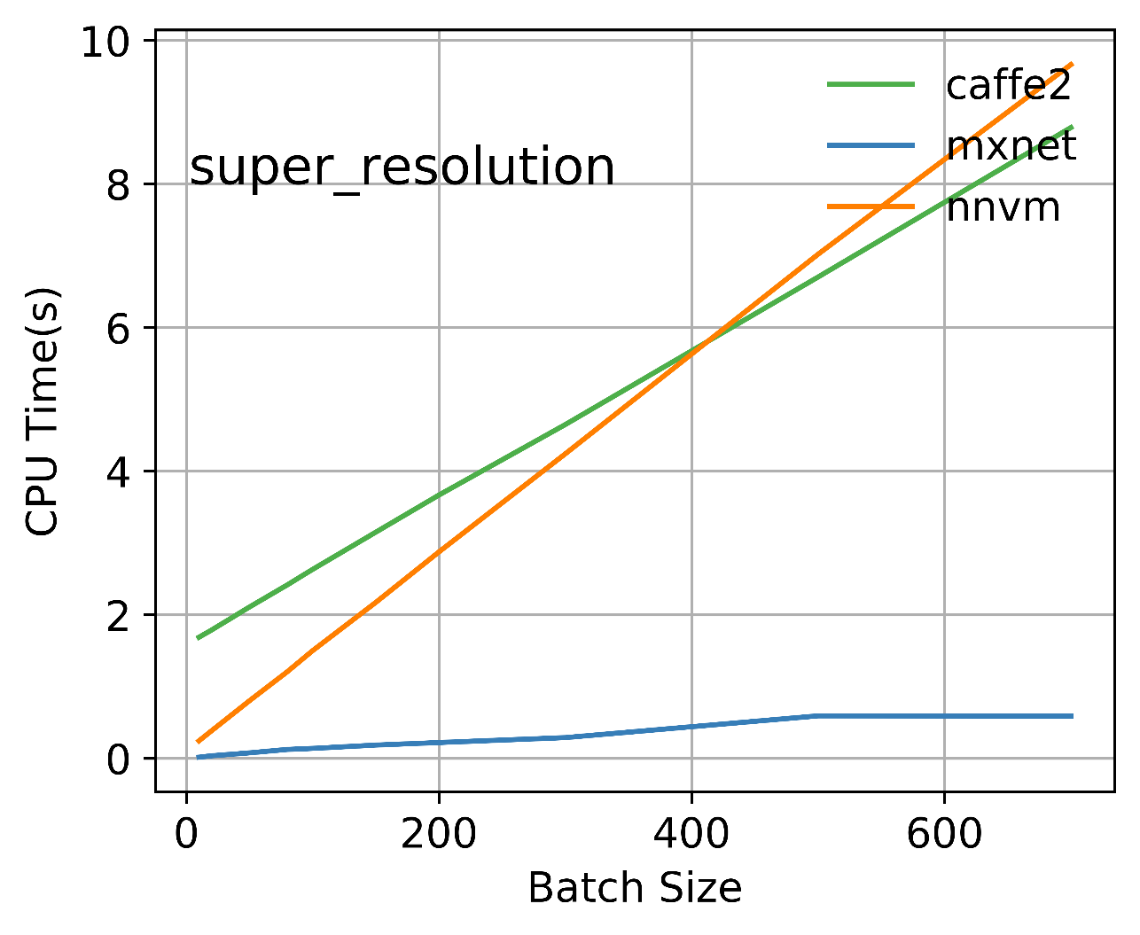
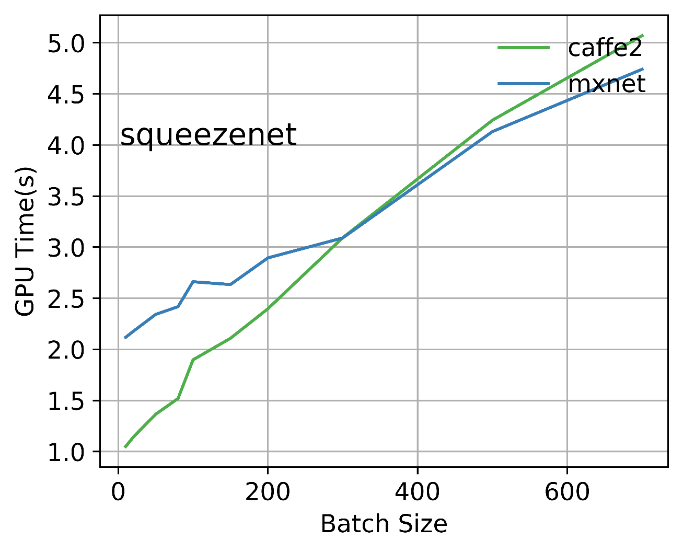
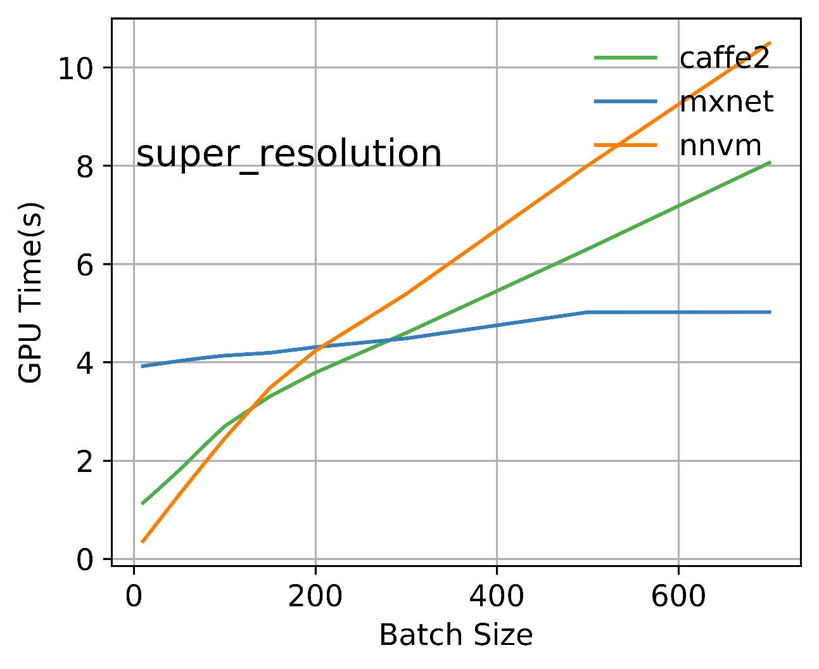
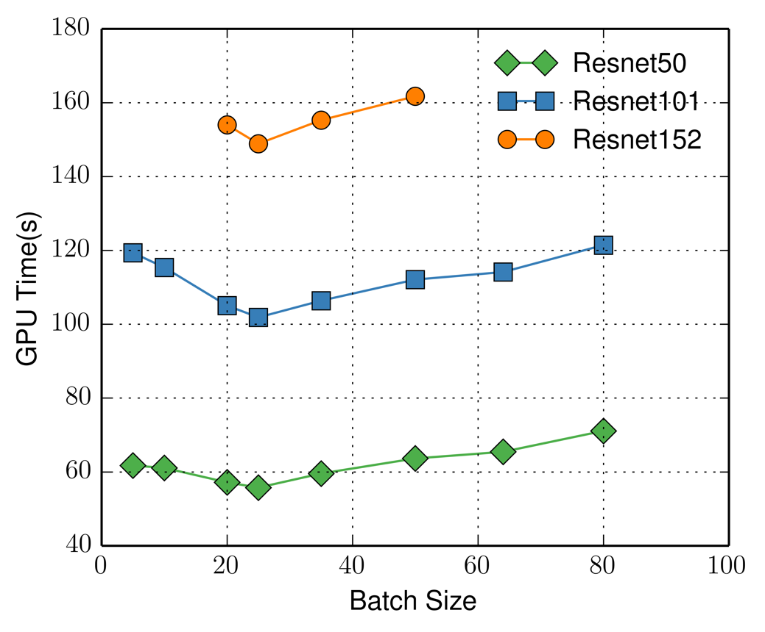
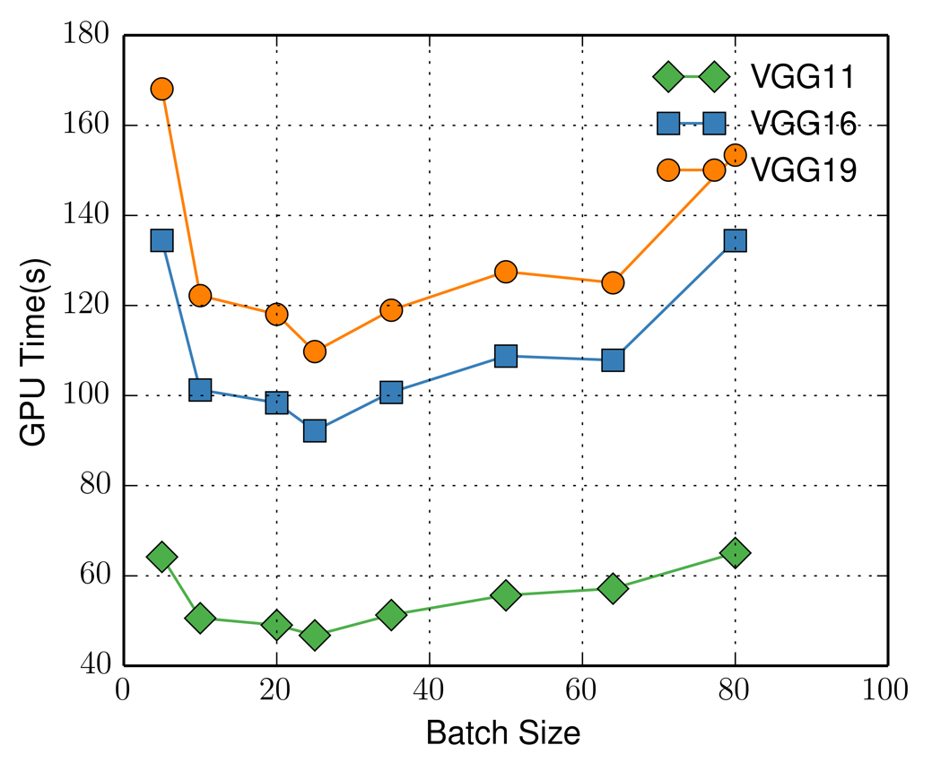
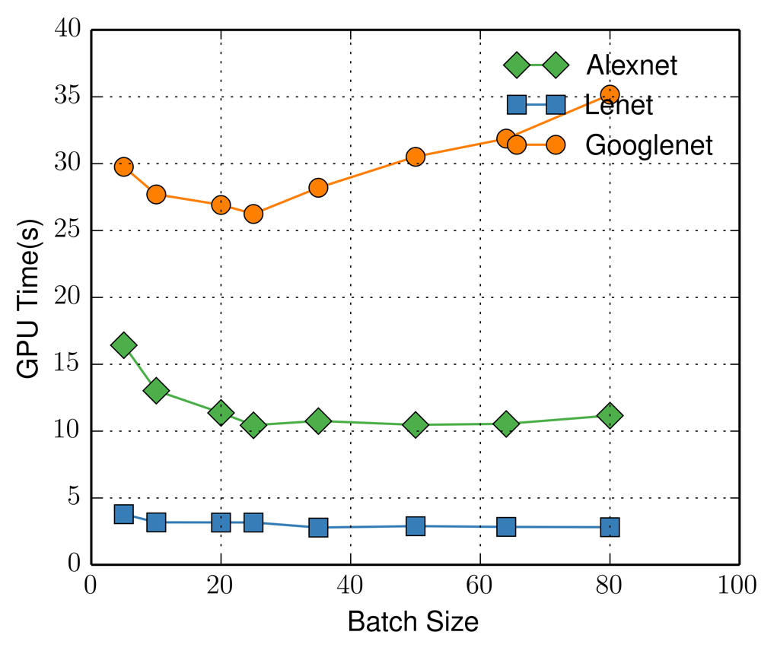
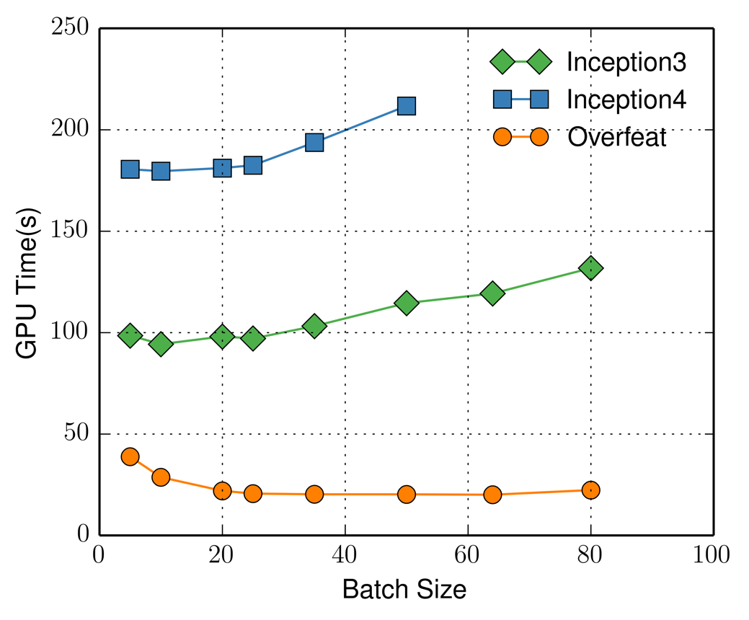
GPU Profiling for Deep Learning Frameworks
CS744: Big Data Systems – Group 30
Pradyot Prakash, Kausik Subramanian
Motivation
Intermediate Representation - Overview
Deep Learning is all pervasive – Computer Vision, Speech Recognition, Natural Language Processing
Deep Learning Frameworks – MXNet, Caffe2 and Tensorflow leverage GPUs for accelerating DL
High-level Neural Network -> Low-level framework-specific GPU Kernels (CuDNN, Tensorflow etc.)
Important goal – GPU interoperability and optimizations
TVM & NNVM
Open source format to represent neural networks
Operators represented as nodes of a graph
Attributes and properties stored in a JSON-like way
Inputs and outputs of a node define the edges
Built-in operators portable across frameworks
NNVM provides a graph-like network representation similar to ONNX
Provides interoperability across frameworks by supporting model imports from other frameworks (partially through ONNX)
TVM is the backend runtime (GPU/CPU)
Can be deployed on light-weight devices
Both modules jointly help optimize the execution graph
Comparison across Frameworks
Squeeze net: Neural net for image classification across 1000 classes
Super resolution: Neural net to scale images
For small # of test images, NNVM has lowest GPU time
MXNet better for larger batch sizes
Hypothesis: MXNet spends more time preprocessing and utilizes concurrency well => explains the lower CPU time
# of kernel calls in MXNet much lower than Caffe2/NNVM
Caffe2 better optimized than NNVM to use GPU
Note: GPU time can be > CPU time due to concurrency
Caffe2 spends lot of time synchronizing => lower concurrency
Caffe2 uses CuDNN kernels heavily vs custom kernels in NNVM (needs more optimization) and MXNet (well optimized)
Tensorflow GPU Profiling
GPU Kernel + API times for varying batch sizes for training 1000 images for different models
Trained deep convolution neural networks used in Image Recognition with different batch sizes
For most models, we observe fastest GPU execution for a batch size of around 25 (Total time shows similar trend)
Popular CuDNN Kernels
Wgrad_alg0_engine
Implicit_convolve_sgemm
Dgrad_engine
Popular Tensorflow Kernels
SwapDimensionTensor
BiasNCHWKernel
BiasGradNCHW_Shared..
Conclusion/Future Work
Using common IR ONNX – MXNet > Caffe2 > NNVM for model inference on GPUs
CNN Model Training – many models optimal batch sizes
For Resnet: Tensorflow > Caffe2 [Optimized kernels]
ONNX/NNVM does not currently support operations for training convolutional neural networks
ONNX support to Tensorflow still in progress, can be used to compare Tensorflow with other frameworks
References
[1] NNVM Compiler: Open Compiler for AI Frameworks: https://github.com/dmlc/nnvm
[2] Open Neural Network Exchange: https://onnx.ai/

