Slide 1
INDIAN TOURISM ANALYTICS DASHBOARD
Project Dataset Overview
Analysis of the Indian Tourism Dataset used to build the Power BI dashboard. This presentation explains the dataset, dashboard pages, chart selection, insights, and project workflow.
Dataset: indian_tourism_dataset.csv

Slide 2
Choosing the Right Chart
Every chart type is built to answer one kind of question well. The dashboard pairs each visual to the question it needs to answer — not the other way around.
Trend over time
Line / Area Chart
Connects points across a continuous timeline so growth, decline, or seasonality is visible at a glance.
Compare categories
Bar / Column Chart
Puts values side by side so the eye can rank and compare discrete groups like states or months.
Part-to-whole split
Pie / Donut / 100% Stacked / Treemap
Shows how a total breaks into shares, so the mix or proportion matters more than the raw count.
Relationship between two numbers
Scatter Chart
Plots two measures against each other to reveal correlation, clusters, or outliers.
Geographic pattern
Filled Map
Anchors data to real locations so viewers instantly connect numbers to places.
Exact values / cross-tab detail
Table / Pivot Table
Delivers precise figures across two dimensions when an exact number matters more than a shape.

Slide 3
Understanding the Dataset
1,000 records across 14 columns describe Indian tourism activity from 2021 to 2025 — enough breadth to support every chart in this dashboard.
Time span
year, month, season
Five years of monthly records (2021–2025) across 12 months and 5 named seasons make trend and seasonality analysis possible.
Geography
state, destination
20 states and 120 named destinations give the dataset enough spatial detail to rank and map demand.
Visitor profile
visitor_type, number_of_visitors
Domestic vs. foreign split, with per-record visitor counts ranging from 52 to nearly 50,000.
Travel behavior
purpose_of_visit, avg_stay_days, transport_mode
10 travel purposes, stays of 1–10 days, and 5 transport modes describe how and why people travel.
Experience & spend
accommodation_type, avg_spend_inr, rating_out_of_5
7 accommodation types, spend from ₹1,511 to ₹74,580, and a 1–5 rating capture the experience side of each trip.
Scale & keys
id: 1–1,000, no gaps
A clean, unique row identifier with zero duplicates makes the table a reliable base for pivoting and slicing.

Slide 4
Data Cleaning & Preparation
Before any chart was built, the raw extract was checked end to end — here is what that pass confirmed and fixed.
Row count & structure
1,000 rows × 14 columns
Confirmed the full extract loaded with the expected shape before any transformation began.
Missing values
0 nulls, all 14 columns
Every field came back 100% populated — no imputation or default-filling was needed.
Duplicate records
0 duplicates, id unique 1–1,000
Checked the id column for repeats and compared full rows — no duplicates found.
Category standardization
state, purpose, accommodation, transport
Trimmed whitespace and confirmed casing so each category maps to one clean label, not near-duplicate variants.
Range validation
rating 1–5, stay 1–10 days
Checked every numeric field against a sane min/max — no negative, zero, or out-of-range values slipped through.
Logic checks
month vs. season labels
Cross-checked month against season and found inconsistencies worth flagging — see Problems & Questions.

Slide 5
Working in Power BI Desktop
From raw CSV to published dashboard, here is the workflow behind every page in this report.
Get Data
Import the CSV
Connected directly to indian_tourism_dataset.csv and loaded it into Power BI Desktop as the source table.
Power Query
Transform & shape
Used Power Query Editor to check data types, trim text, and rename columns before loading the model.
Data Modeling
Calculated columns & DAX measures
Built measures such as total visitors, average spend, and average rating on top of the flat table.
Visuals
Line, bar, pie, map, scatter, table
Placed one chart type per guiding question — see ‘Choosing the Right Chart’ — across five report pages.
Slicers & interactivity
Month, State, Destination, Accommodation
Added slicers so every visual on a page filters together the moment a user picks one value.
Publish & share
Power BI Service
Published the .pbix so the dashboard can be viewed, refreshed, and shared online.

Slide 6
1
Tourism Growth & Seasonality
How has tourism grown over time, and when do tourists travel most?
LINE CHART
CLUSTERED COLUMN
Visitors Over Time
Visitors by Month
A line connects one continuous timeline (year), making it the clearest way to read overall growth or decline at a glance.
Twelve independent, discrete categories (months) are easiest to compare when placed as separate bars side by side.
100% STACKED COLUMN
AREA CHART
Visitors by Season
Visitor Type by Month
Normalizing every year to 100% isolates the seasonal mix — so a shift in proportion is visible even if total volume changed.
Filled areas emphasize magnitude as well as trend, making it easy to compare domestic vs. international volume over time.
Slicer — Month: a control, not a chart, letting users filter every visual above without changing chart type.
Add-on: Page 1 of 5 — Tourism Growth & Seasonality
Indian Tourism Dataset

Slide 7
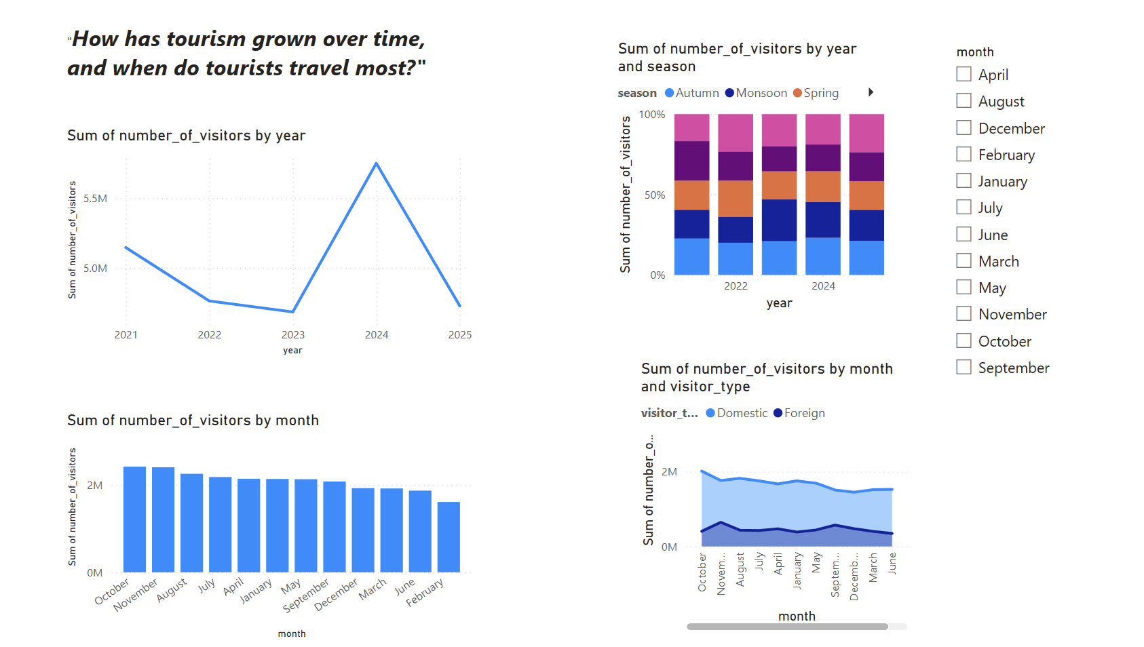
1
Live Dashboard — Tourism Growth & Seasonality
How has tourism grown over time, and when do tourists travel most?
KEY INSIGHTS
Visitors rose from ~5.2M (2021) to a peak of ~5.9M in 2024, after dipping to ~4.8M through 2022–2023 — then fell sharply back to ~4.8M in 2025.
October is the busiest month (~2.3M visitors); February is the quietest (~1.7M) — roughly a 35% swing between peak and trough.
The season mix (stacked by year) stays fairly stable from 2021–2025 — no single season is pulling the overall growth.
Domestic visitors consistently outnumber foreign visitors by roughly 4:1 in every month, with foreign volume the flatter of the two lines.
Live view: Page 1 of 5 — Tourism Growth & Seasonality
Indian Tourism Dataset

Slide 8
2
State-Level Demand
Which states attract the most tourists, and how big is the gap between them?
BAR CHART
TREEMAP
Visitors by State
State Visitor Share
Horizontal bars handle many categories and long labels gracefully, so states can be ranked top to bottom at a glance.
Tile size shows part-to-whole proportion across many categories — better for a quick 'who's biggest' read than precise values.
BAR CHART
FILLED MAP
Visitor Type Count by State
Avg Visitors by State
Another ranking task — comparing counts across many states — so bars are reused for consistent, easy comparison.
Coloring an actual map of India taps spatial memory, so viewers connect the data straight to real geography.
Slicer — State: filters every visual on the page to a single state for focused comparison.
Add-on: Page 2 of 5 — State-Level Demand
Indian Tourism Dataset

Slide 9
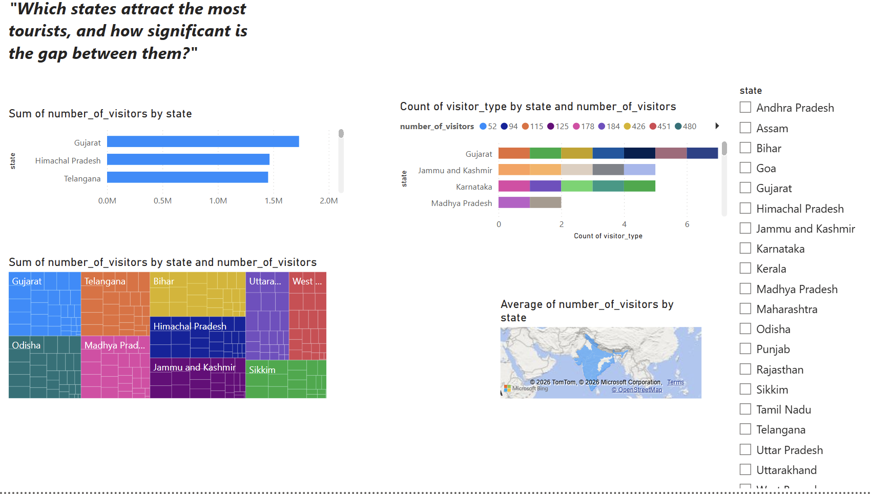
2
Live Dashboard — State-Level Demand
Which states attract the most tourists, and how big is the gap between them?
KEY INSIGHTS
Gujarat leads all states at ~1.7M visitors, narrowly ahead of Himachal Pradesh (~1.5M) and Telangana (~1.4M).
The treemap shows a long tail: after Gujarat, Telangana, Bihar, Uttarakhand and West Bengal, the remaining states shrink quickly in share.
Visitor-type mix varies by state — Gujarat and Jammu & Kashmir show the most segmented visitor-type breakdown of the states shown.
A 20+ state checklist slicer lets any single state's figures be isolated across all four visuals on the page at once.
Live view: Page 2 of 5 — State-Level Demand
Indian Tourism Dataset

Slide 10
3
Destination Value
Which destinations offer the best value — high visitors, good ratings, reasonable spend?
BAR CHART
SCATTER CHART
Visitors by Destination
Spend vs. Rating
Consistent with other ranking visuals — bars make it easy to spot the most and least visited destinations.
Scatter is the standard way to test a relationship between two numeric measures; bubble size adds visitor volume as a third dimension.
CLUSTERED COLUMN
PIVOT TABLE
Avg Stay by Destination
Destination x Rating
A single metric compared across categories — columns keep the comparison simple and precise.
When the question needs exact counts crossed by two dimensions, a matrix beats a chart for precision.
Slicer — Destination: lets users isolate one destination across every visual on the page.
Add-on: Page 3 of 5 — Destination Value
Indian Tourism Dataset

Slide 11
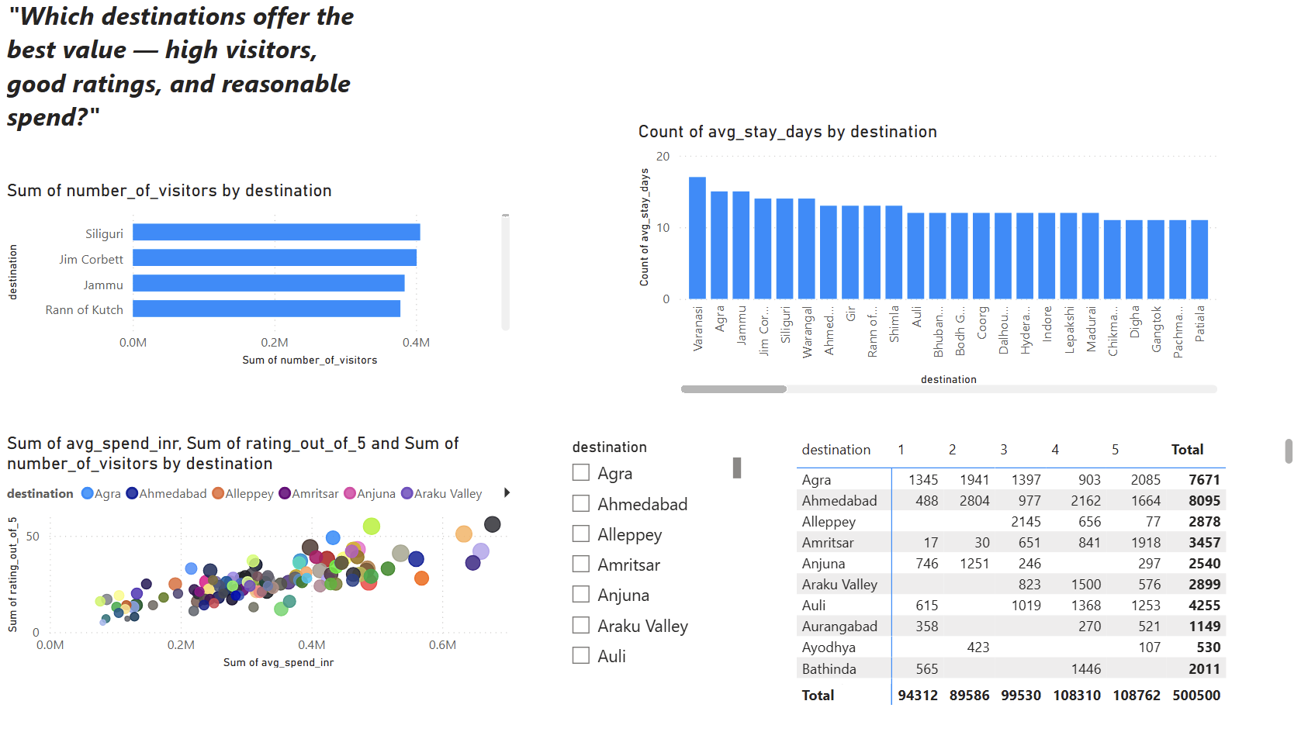
3
Live Dashboard — Destination Value
Which destinations offer the best value — high visitors, good ratings, reasonable spend?
KEY INSIGHTS
Siliguri tops the destination ranking at ~0.42M visitors, just ahead of Jim Corbett, Jammu and Rann of Kutch (~0.35–0.38M each).
Varanasi has by far the longest average stay (~17 days) — well above Agra, Jammu and Jim Corbett (~14–15) and the rest of the pack (~11–13).
The spend-vs-rating scatter trends positive: destinations with higher average spend tend to cluster at higher ratings, with few exceptions.
The rating table totals 500,500 visits; bands 4 and 5 (108,310 and 108,762) each outweigh band 1 (94,312) — ratings skew positive.
Live view: Page 3 of 5 — Destination Value
Indian Tourism Dataset

Slide 12
4
Purpose of Travel
Why do people travel, and how does purpose affect spend and stay?
PIE CHART
CLUSTERED COLUMN
Visitors by Purpose
Avg Spend by Purpose
With only a handful of categories, a pie makes the part-to-whole split immediately readable.
Comparing one metric across a few categories — columns give a clean, precise side-by-side read.
BAR CHART
PIVOT TABLE
Avg Stay by Purpose
Season x Purpose
Same comparison logic as spend, kept visually consistent so patterns across metrics are easy to spot.
Two dimensions crossed together call for a matrix, so exact visitor volume per combination is visible.
Table — Season: a simple reference list of season categories used elsewhere on the page.
Add-on: Page 4 of 5 — Purpose of Travel
Indian Tourism Dataset

Slide 13
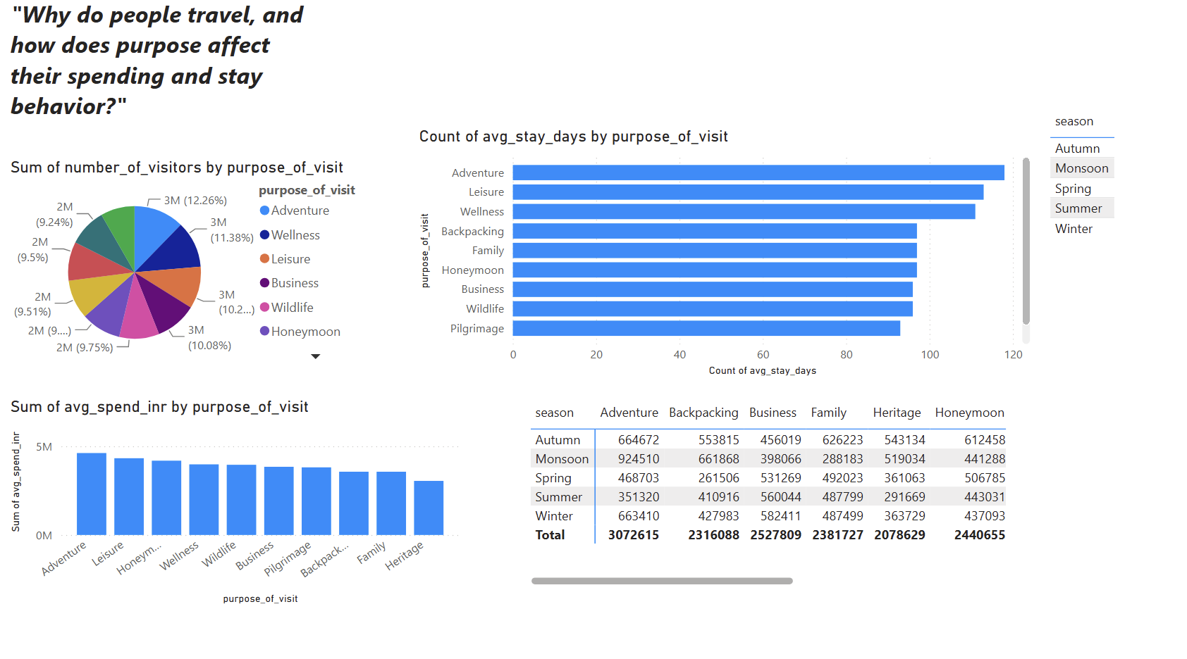
4
Live Dashboard — Purpose of Travel
Why do people travel, and how does purpose affect spend and stay?
KEY INSIGHTS
Travel purpose is nearly evenly split — Adventure leads at 12.26% while the smallest categories sit near 9%, so no single motive dominates.
Adventure travelers also stay longest and spend the most (~5M INR sum) — the strongest segment on both stay and spend.
Pilgrimage has the shortest average stay of all purposes, while Heritage has the lowest total spend (2,078,629).
By total spend: Adventure (3,072,615) leads, followed by Business (2,527,809), Honeymoon (2,440,655), Family (2,381,727) and Backpacking (2,316,088).
Live view: Page 4 of 5 — Purpose of Travel
Indian Tourism Dataset

Slide 14
5
Accommodation & Transport
How do accommodation and transport choices relate to tourist spending?
BAR CHART
DONUT CHART
Avg Spend by Accommodation
Visitors by Transport Mode
A straightforward category comparison, kept as bars for consistency with the rest of the report.
A pie variant that shows share of total while freeing the center for a total or label — good for a handful of transport modes.
100% STACKED COLUMN
PIVOT TABLE
Visitor Type by Accommodation
Accommodation x Transport
Normalizing to 100% again isolates the mix — showing how domestic vs. international share shifts by accommodation type.
A cross-tab matrix delivers exact average spend for every accommodation-transport combination at once.
Slicer — Accommodation Type: filters every visual on the page by lodging type.
Add-on: Page 5 of 5 — Accommodation & Transport
Indian Tourism Dataset

Slide 15
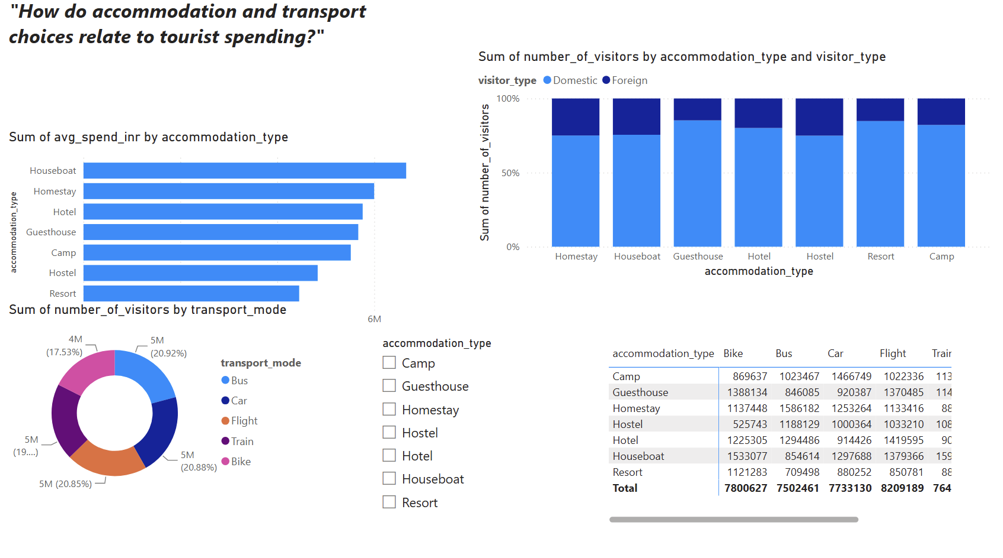
5
Live Dashboard — Accommodation & Transport
How do accommodation and transport choices relate to tourist spending?
KEY INSIGHTS
Houseboats command the highest average spend, clearly ahead of Homestay and Hotel, with Resort the lowest of the seven types.
Domestic travelers dominate every accommodation type at roughly 75–80% of visitors — foreign share never exceeds ~25%, whatever the lodging.
Transport mode is used almost equally: Bus (20.92%), Train (20.88%) and Flight (20.85%) are nearly tied; Bike trails at 17.53%.
Flight-linked spend totals the highest across accommodation combos (8,209,189), just ahead of Bike (7,800,627) and Car (7,733,130).
Live view: Page 5 of 5 — Accommodation & Transport
Indian Tourism Dataset

Slide 16
Problems & Questions We Found
Building the dashboard surfaced a few data patterns worth a second look before trusting every number at face value.
Month vs. season mismatch
e.g. April appears under 3 different seasons
Season labels don’t consistently follow India’s real calendar — worth relabeling before trusting seasonal splits.
Wide spend range
₹1,511 to ₹74,580 per trip
Such a broad spread raises the question of whether budget and luxury travelers should be analyzed as separate segments.
Visitor count skew
52 to 49,916 visitors per record
Very small counts sit next to very large ones — worth checking whether these are real pilot destinations or entry errors.
State concentration
Gujarat ~1.7M, then a long tail
Demand is concentrated in a handful of states — are smaller states genuinely lower-demand, or under-surveyed?
Domestic–foreign gap
~4:1 domestic to foreign, every month
Foreign share never breaks ~25% anywhere in the data — is this the true mix, or is international travel under-captured?

Slide 17
The Takeaway
Nothing on this dashboard is decorative. Each chart type was picked because it is the clearest way to answer that page's guiding question.
Trend
Line, Area
Ranking
Bar, Column
Proportion
Pie, Donut, 100% Stacked, Treemap
Relationship
Scatter
Geography
Filled Map
Precision
Table, Pivot Table
Thank you

