Slide 1


Cartesian Tree
Combination of Min-Heap + In-Order Traversal

Slide 2


What is a Cartesian Tree?
A Cartesian Tree is a binary tree derived from an array such that:
Heap Property
For Min Cartesian Tree: Parent ≤ Children
Root contains the minimum element
In-Order Traversal Property
In-order traversal of the tree gives the original array
It uniquely represents the array if all elements are distinct.

Slide 3
Key Properties
Binary Tree
Maintains heap structure
Preserves original order
Useful for range queries
Can be built in linear time O(n)
Types:
Min Cartesian Tree
Max Cartesian Tree

Slide 4
Construction Idea
Given array:
A = [5, 10, 40, 30, 28]
Steps:
Smallest element becomes the root → 5
Left subtree → elements left of 5 (none)
Right subtree → [10, 40, 30, 28]
Repeat recursively
➡ Final tree satisfies:
Heap order
In-order traversal = original array

Slide 5
Time & Space Complexity
Time Complexity
Space Complexity
Naive method: O(n²)
Stack-based method: O(n)
Tree nodes: O(n)
Stack (construction): O(n)

Slide 6
Why Cartesian Tree?
Preserves data order
✔ Fast query processing
✔ Linear-time construction
✔ Strong theoretical guarantees
✔ Ideal for static arrays
Why better than other trees?
BST loses order
Heap loses sequence
Cartesian Tree keeps both

Slide 7
Overview
1. Range Minimum Query (RMQ)
Used to find minimum value in a subarray
Cartesian Tree + LCA solves RMQ efficiently
2. Compiler Design
Expression parsing
Syntax tree construction
3. Data Compression
Used in suffix arrays
Important in text indexing

Slide 8
Procedure BuildCartesianTree(A, n)
1. Create an empty stack S
2. Set root as NULL
3. For each element A[i] from left to right:
a. Create a new node with value A[i]
b. Set lastPopped as NULL
c. While stack is not empty and
the value at the top of stack is greater than A[i]:
- Remove the top node from stack
- Store it in lastPopped
d. If stack is not empty:
- Make current node the right child of stack top
Else:
- Set current node as the root of the tree
e. Make lastPopped the left child of the current node
f. Push the current node into the stack
4. Return root
Pseudocode

Slide 9
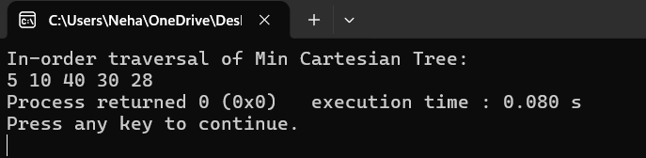
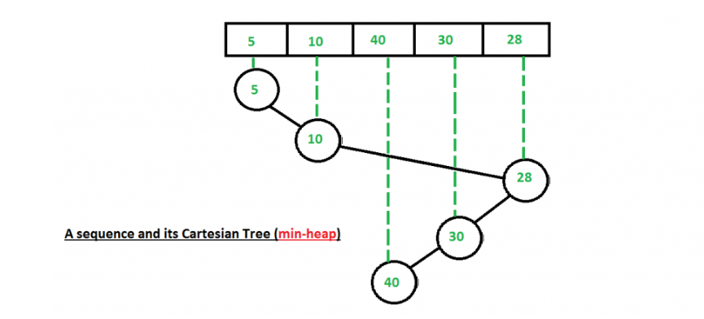
output

Slide 10
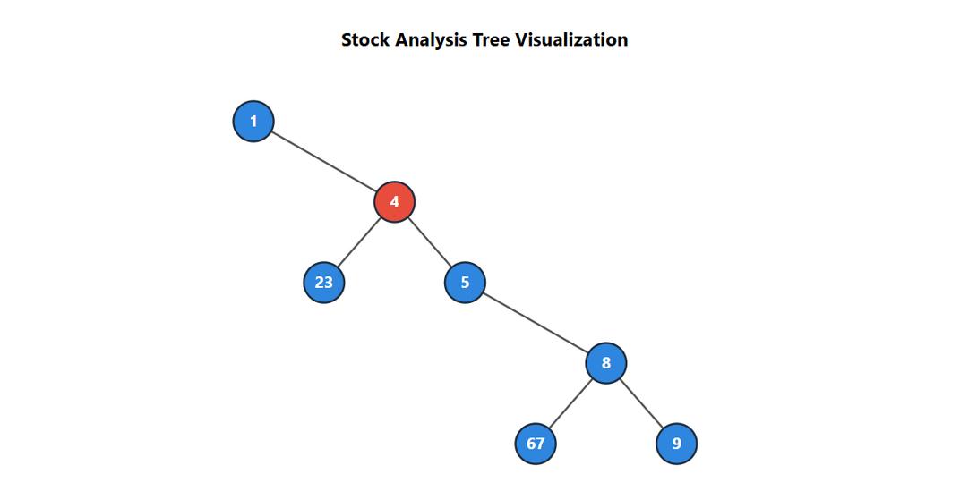
Real-Life Application of Cartesian Tree
Stock Crash Detection & Time-Series Analysis
Problem:
Financial markets generate hourly stock price data.
We need to quickly detect the lowest price within a selected time window.
Solution Using Cartesian Tree:
Construct a Min-Cartesian Tree from stock prices.
Root always stores the global minimum.
Range Minimum Query (RMQ) reduces to LCA in the tree.
How It Helps:
Detects crash intervals instantly.
Efficient for static time-series datasets.
Enables fast financial risk analysis.

Slide 11
Limitations of Cartesian Tree
Static Structure – Not efficient for frequent updates; requires rebuilding in O(n).
Skewed Tree Risk – If input array is sorted, tree height may become O(n), reducing efficiency.
Higher Space Usage – Requires node storage and parent pointers compared to simple array-based methods.
Single Priority Type – Supports either Min-Heap or Max-Heap property, not both simultaneously.

Slide 12
MEMBER | CONTRIBUTION
CB.SC.U4CYS24043 | Cartesian Tree Implementation
CB.SC.U4CYS24044 | Live Demo & Code Execution
CB.SC.U4CYS24045 | Algorithm Design & Pseudocode Preparation
CB.SC.U4CYS24046 | Complexity Analysis & Theoretical Comparison
CB.SC.U4CYS24047 | PPT Design, Diagrams & Real-Life Application Research

