Slide 1

Go, change the world
RV College of
Engineering
Twitter Sentiment Analysis
16EC82 : Technical seminar Phase 2
D Chetan Karthikeya Reddy 1RV17EC034
Pradyumna C 1RV17EC103
Guide Name: Mrs. Rohini Hallikar
Designation: Assistant Professor
Department of Electronics and Communication Engineering
*
Department of ECE
1

Slide 2

Go, change the world
RV College of
Engineering
Outline
Introduction
Literature Survey
Problem Statement
Objectives
Brief Methodology
Results
References

Slide 3

Go, change the world
RV College of
Engineering
Introduction
Twitter is a popular and one of the most used social media website
People usually use twitter to express their opinion or view or an emotion on particular subject
Sentiment Analysis is the process of computationally determining whether a piece of writing is Positive , Negative or Neutral .
Sentiment analysis is also referred as Opinion Mining
*
Department of ECE
3

Slide 4
Go, change the world
RV College of
Engineering
Introduction
In marketing field companies use it to develop their strategies, to understand customers’ feelings towards products or brand
In political field, it is used to keep track of political view, to detect consistency and inconsistency between statements and actions at the government level
Polarity is the parameter to check the sensitivity of sentiment where it is positive or negative. If the value of polarity is close to 1 the particular tweet is positive and if it is close to 0 then it is negative.
*
Department of ECE
4

Slide 5
Go, change the world
RV College of
Engineering
Literature Survey
Sl No | Paper Title Journal Name, Year | Major findings / observations
1 | S. E. Saad and J. Yang, "Twitter Sentiment Analysis Based on Ordinal Regression," in IEEE Systems Journal, vol. 7, pp. 163677-163685, 2019, doi: 10.1109/ACCESS.2019.2952127 | This paper proposes a way to analyze the sentiment of twitter threads using Multinomial Logistic Regression algorithm. Web scrapping was done using Twitter APIs The accuracy obtained was around 72%
2 | Z. Jianqiang, G. Xiaolin and Z. Xuejun, "Deep Convolution Neural Networks for Twitter Sentiment Analysis," in IEEE Access, vol. 6, pp. 23253-23260, 2018, doi: 10.1109/ACCESS.2017.2776930. | A model called GloVe-DCNN is presented which implements the binary task of classifying the tweet into negative or positive sentiment categories
*
Department of ECE
5

Slide 6
Go, change the world
RV College of
Engineering
Literature Survey
Sl No | Paper Title Journal Name, Year | Major findings / observations
3 | H. Rehioui and A. Idrissi, "New Clustering Algorithms for Twitter Sentiment Analysis," in IEEE Systems Journal, vol. 14, no. 1, pp. 530-537, March 2020, doi: 10.1109/JSYST.2019.2912759. | Sentiment analysis done using ca combination of k-means clustering algorithm(kNN) and DENCLUE .
4 | Z. Jianqiang and G. Xiaolin, "Comparison Research on Text Pre-processing Methods on Twitter Sentiment Analysis," in IEEE Access, vol. 5, pp. 2870-2879, 2017, doi: 10.1109/ACCESS.2017.2672677 | The paper shows that the accuracy and F1-measure of Twitter sentiment classification classifier are improved when removing URLs, removing stop words. The NaBs and Random Forest classifiers are more sensitive than Logistic Regression and SVMs classifiers when various pre-processing methods were applied.
*
Department of ECE
6

Slide 7
Go, change the world
RV College of
Engineering
Literature Survey
Sl No | Paper Title Journal Name, Year | Major findings / observations
5 | L. Mandloi and R. Patel, "Twitter Sentiments Analysis Using Machine Learninig Methods," 2020 International Conference for Emerging Technology (INCET), Belgaum, India, 2020, pp. 1-5, doi: 10.1109/INCET49848.2020.9154183. | Twitter Sentiment analysis was done by passing through various algorithm and comparing the algorithms for the same based on accuracy .
6 | Sentiment Analysis of Twitter Data: A Survey of Techniques - International Journal of Computer Applications (0975 – 8887) Volume 139 – No.11, April 2016 | Various machine learning algorithms like Naive Bayes, Max Entropy, and Support Vector Machine were discussed In this paper Lexicon based approach was discussed as well.
*
Department of ECE
7

Slide 8
Go, change the world
RV College of
Engineering
Base Paper :
S. E. Saad and J. Yang, "Twitter Sentiment Analysis Based on Ordinal Regression," in IEEE Systems Journal, vol. 7, pp. 163677-163685, 2019 .
Justification :
In this paper Twitter APIs were used to webscrape twitter to use them as dataset or input to know the sentiment of that particular tweet .
Such Sentiment analysis can help in Political or Marketting field .
Multinomial Logistic Regression Algorithm was used to train the model .
*
Department of ECE
8

Slide 9
Go, change the world
RV College of
Engineering
Problem Statement
“To parse and webscrape through tweets in twitter using Twitter APIs and use them as Dataset for ML algorithms and classify whether the given message/tweet is of positive, negative, or neutral sentiment and then compare the algorithms used .”
*
Department of ECE
9

Slide 10
Go, change the world
RV College of
Engineering
Objectives
Parsing the Tweets fetched from Twitter using Twitter APIs
Data preprocessing .
To perform a detailed sentiment analysis of tweets using various machine learning algorithm.
*
Department of ECE
10

Slide 11
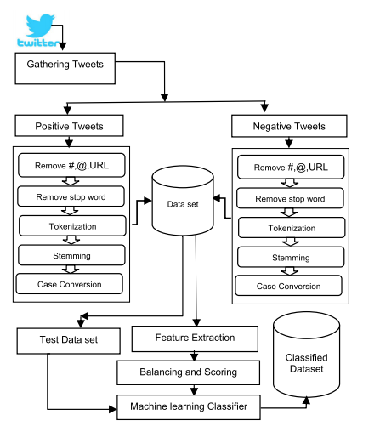
Go, change the world
RV College of
Engineering
Design Methodology
*
Department of ECE
11

Slide 12




Go, change the world
RV College of
Engineering
Details of Software
Python and its associated libraries – NLTK,Numpy,Pandas,Scikit Learn .
Jupyter Notebook
Twitter for data-scaping .
*
Department of ECE
12

Slide 13
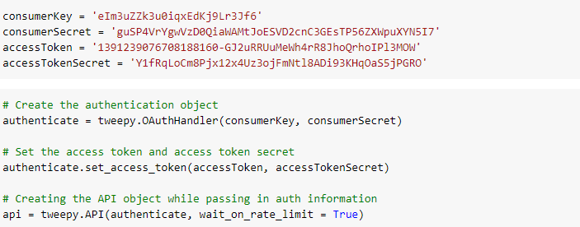
Go, change the world
RV College of
Engineering
Implementation
*
Department of ECE
13

Slide 14
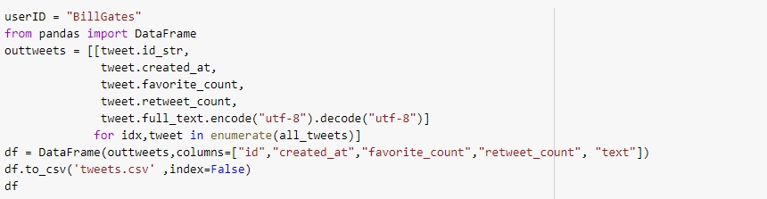
Go, change the world
RV College of
Engineering
Implementation
*
Department of ECE
14

Slide 15
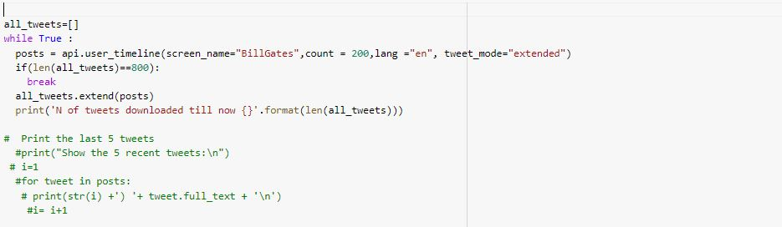
Go, change the world
RV College of
Engineering
Implementation
*
Department of ECE
15

Slide 16
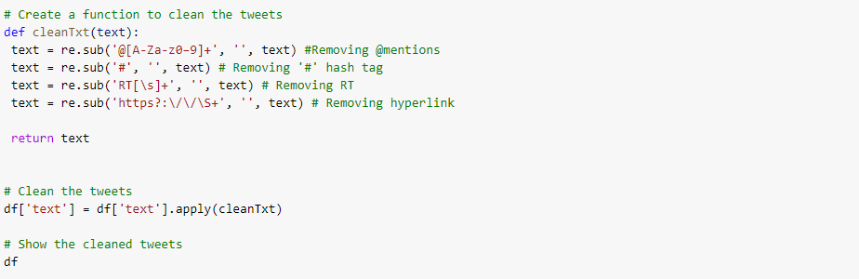
Go, change the world
RV College of
Engineering
Implementation
*
Department of ECE
16

Slide 17
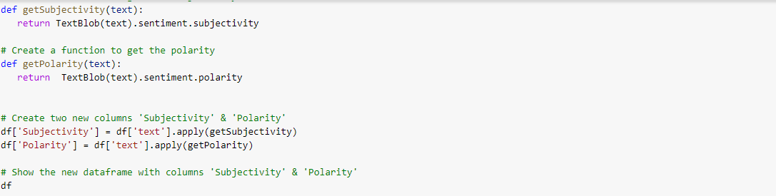
Go, change the world
RV College of
Engineering
Implementation
*
Department of ECE
17

Slide 18
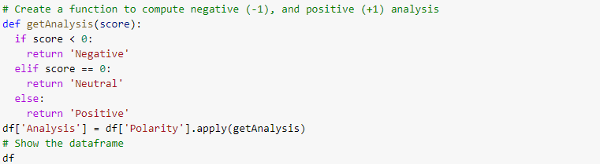
Go, change the world
RV College of
Engineering
Implementation
*
Department of ECE
18

Slide 19
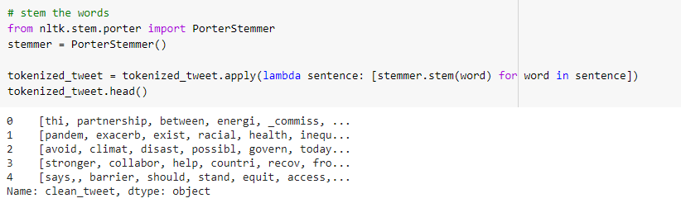
Go, change the world
RV College of
Engineering
Implementation
*
Department of ECE
19

Slide 20
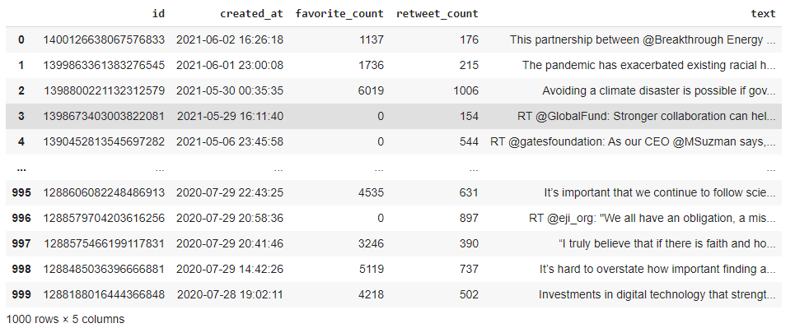
Go, change the world
RV College of
Engineering
Results
Raw tweets
*
Department of ECE
20

Slide 21
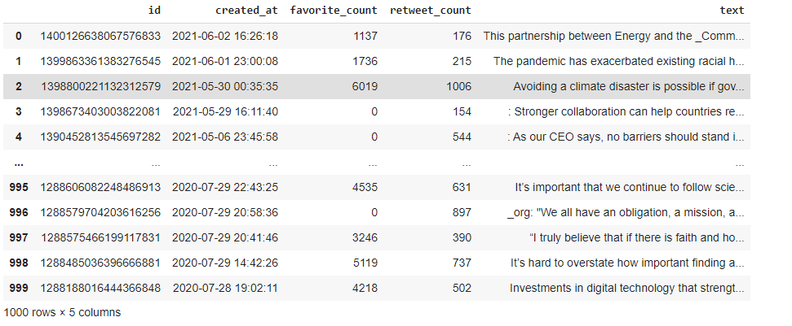
Go, change the world
RV College of
Engineering
Results
Tweets after cleaning i.e, removing mentions. Hashtags etc..
*
Department of ECE
21

Slide 22
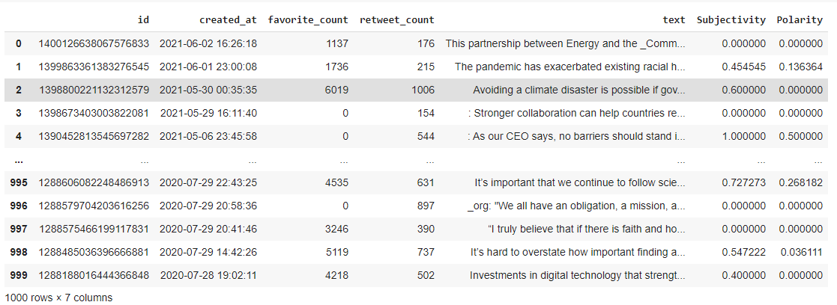
Go, change the world
RV College of
Engineering
Results
Subjectivity and Polarity Scores of each tweet
*
Department of ECE
22

Slide 23
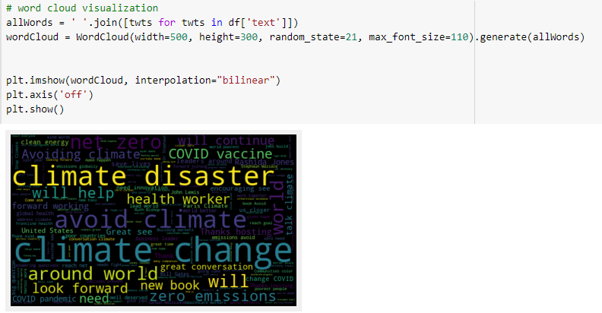
Go, change the world
RV College of
Engineering
Results
*
Department of ECE
23

Slide 24
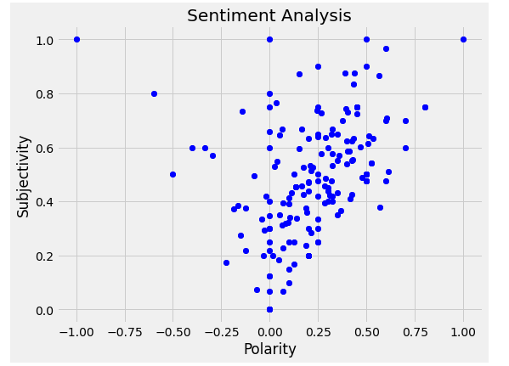
Go, change the world
RV College of
Engineering
Results
Graph Indicating Polarity and Subjectivity of Each Tweet
*
Department of ECE
24

Slide 25
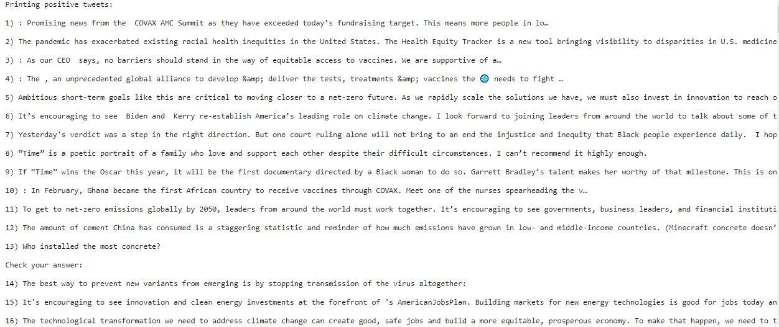
Go, change the world
RV College of
Engineering
Results
*
Department of ECE
25

Slide 26
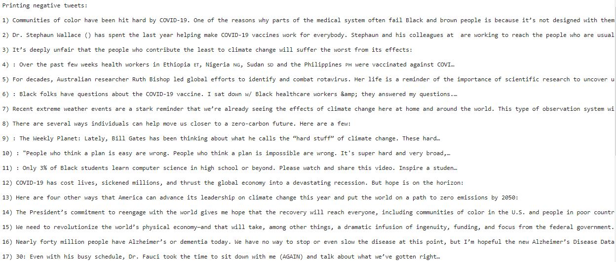
Go, change the world
RV College of
Engineering
Results
*
Department of ECE
26

Slide 27
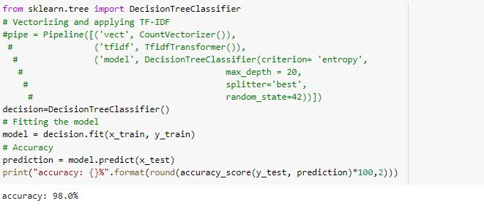
Go, change the world
RV College of
Engineering
Results
*
Department of ECE
27

Slide 28
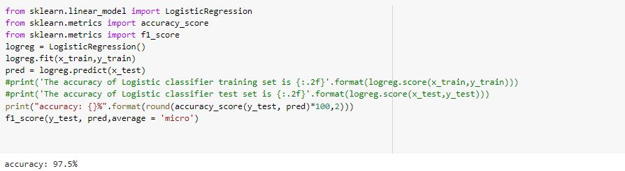
Go, change the world
RV College of
Engineering
Results
*
Department of ECE
28

Slide 29
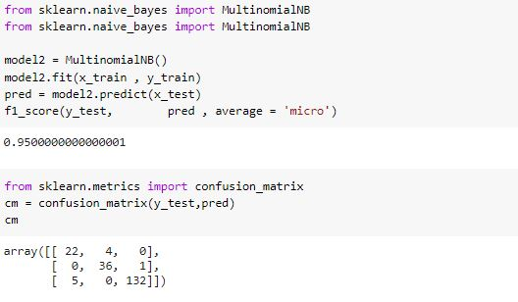
Go, change the world
RV College of
Engineering
Results
*
Department of ECE
29

Slide 30
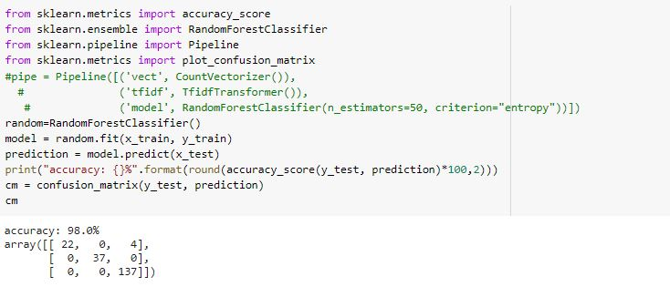
Go, change the world
RV College of
Engineering
Results
*
Department of ECE
30

Slide 31
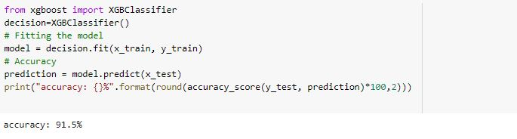
Go, change the world
RV College of
Engineering
Results
*
Department of ECE
31

Slide 32
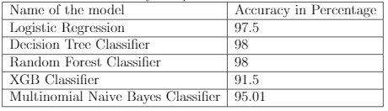
Go, change the world
RV College of
Engineering
Results
*
Department of ECE
32

Slide 33
Go, change the world
RV College of
Engineering
Conclusion
Discussed the creation of dataset by collecting the tweets by parsing them using the Twitter APIs.
Then found the sentiment of the tweet as either Positive or Negative .
Discussed the methodology of pre-processing the text that should be fed as input for the various algorithms .to a model.
Fed the data obtained after pre-processing to various ML algorithms.
The classification accuracy of algorithms were compared and the sentiment were found out .
*
Department of ECE
33

Slide 34
Go, change the world
RV College of
Engineering
References
Sl No | Author, Title of paper, Journal | Year
1 | S. E. Saad and J. Yang, "Twitter Sentiment Analysis Based on Ordinal Regression," in IEEE Systems Journal, vol. 7, pp. 163677-163685 | 2020
2 | Z. Jianqiang, G. Xiaolin and Z. Xuejun, "Deep Convolution Neural Networks for Twitter Sentiment Analysis," in IEEE Access, vol. 6, pp. 23253-23260 . | 2020
3 | H. Rehioui and A. Idrissi, "New Clustering Algorithms for Twitter Sentiment Analysis," in IEEE Systems Journal, vol. 14, no. 1, pp. 530-537 | 2019
4 | Z. Jianqiang and G. Xiaolin, "Comparison Research on Text Pre-processing Methods on Twitter Sentiment Analysis," in IEEE Access, vol. 5, pp. 2870-2879 . | 2019
5 | L. Mandloi and R. Patel, "Twitter Sentiments Analysis Using Machine Learninig Methods," 2020 International Conference for Emerging Technology (INCET), Belgaum, India | 2018
6 | Sentiment Analysis of Twitter Data: A Survey of Techniques - International Journal of Computer Applications (0975 – 8887) Volume 139 – No.11 . | 2016
*
Department of ECE
34

Slide 35
Go, change the world
RV College of
Engineering
Thank You
*
Department of ECE
35

