Slide 1
R
Lists, factors, matrices, arrays
Pradyumna J

Slide 2
Lists
A list is a collection of objects
Components can be of different types and lengths
Used to pass a structured argument to a function and to return a multi-valued object from a function
> list1 = list(name="john",age=28,married=F)
> list1$name
[1] "john"
> doe$age
[1] 28

Slide 3
Factors
A good deal of statistical data is of a form which indicates which one of several possible categories that an observation falls into.
Examples
Eye colour: brown, hazel, green, blue.
Location: North Island, South Island, other.
Pain level: low, medium, high.
R provides a facility for creating this kind of data through the functions factor() and ordered().
The function factor creates data objects which represent variables containing unordered categorical data. It takes a character or numeric vector as an argument and returns a factor.

Slide 4
Factors
> eyes <- c(“hazel”, “blue”, “brown”, “green”, “blue”, “brown”)
> eyecol <- factor(eyes)
> eyes
[1] "hazel" "blue" "brown" "green" "blue“ "brown“
> eyecol
[1] hazel blue brown green blue brown
Levels: blue brown green hazel
Factor Levels:
The set of all possible categories for a set of categorical variable is called the levels of the corresponding factor. By default, R takes the levels to be the set of values occuring in the input data vector, sorted into ascending order (either numerically or alphabetically). When a factor is printed, the levels of the factor are displayed after the variable.
> eyecol
[1] hazel blue brown green blue brown
Levels: blue brown green hazel

Slide 5
Specifying Factor Levels
The default set of factor levels and the order they appear in can be specified with a second argument to factor.
> eyecol = factor(eyes,levels = c("blue", "green", "hazel", "brown"))
> eyecol
[1] hazel blue brown green blue brown
Levels: blue green hazel brown
The levels of a factor can be obtained with the levels function.
> levels(eyecol)
[1] "blue" "green" "hazel" "brown“
Function gl() can be used to generate factors by specifying the pattern of their levels
> gl(2,8, labels=c(“Control”, “Treated”))

Slide 6
Ordered factors
Sometimes there is a natural order to a factor’s levels. In this case factors are described as ordered factors.
Ordered factors are created with the R function ordered().
It is important to specify the levels when creating an ordered factor to ensure that they are in the correct relationship to each other.
> pain = ordered(c("low", "medium", "medium“,"high", "medium", "low"),levels = c("low", "medium", "high"))

Slide 7
Factors and vectors
Factors look very much like vectors, and for many purposes they can be treated as vectors. In fact, they are special kinds of objects which are created from vectors in a similar way to which matrices are created from vectors.
To tell whether a value is a factor, use the functions, is.factor and is.ordered.
> is.factor(eyecol)
[1] TRUE
> is.factor(pain)
[1] TRUE
> is.ordered(eyecol)
[1] FALSE
> is.ordered(pain)
[1] TRUE

Slide 8
Operations on Factors
About the only operation which makes sense with an unordered vector is to compare the values with a particular value using == or !=. For ordered factors, comparisons using <, <=, > and >= also make sense.
> eyecol == "blue"
[1] FALSE TRUE FALSE FALSE TRUE FALSE
> eyecol < "blue"
[1] NA NA NA NA NA NA
Warning message:
In Ops.factor(eyecol, "blue") : < not meaningful for factors

Slide 9
Tabulation with factors
One of the few things that can be done with factors is to count the number of times each level occurs. This can be done with the function table.
> table(eyecol)
eyecol
blue green hazel brown
2 1 1 2
> table(pain)
pain
low medium high
3 1
> table(eyecol, pain)
pain
eyecol low medium high
blue 0 2 0
green 0 0 1
hazel 1 0 0
brown 1 1 0
The resulting matrix (or more general array) is called a contingency table.

Slide 10
Matrices and Arrays
Matrix: A matrix refers to a numeric array of rows and columns. One of the easiest ways to create a matrix is to combine vectors of equal length using cbind(), meaning "column bind":
Example: the expression values for 10000 genes for 30 tissue biopsies: a matrix with 10000 rows and 30 columns.
Array: 3-,4-,..dimensional matrix
Example: the red and green foreground and background values for 20000 spots on 120 chips: a 4 x 20000 x 120 (3D) array.

Slide 11
Creating and operating matrices
> x <- c(1,3,2,10,5)
> Y <- c(1,2,3,4,5)
> m1<-cbind(x,y);m1
x y
[1,] 1 1
[2,] 3 2
[3,] 2 3
[4,] 10 4
[5,] 5 5
To transpose the matrix
> t(m1) # transpose of m1
[,1] [,2] [,3] [,4] [,5]
x 1 3 2 10 5
y 1 2 3 4 5

Slide 12
Operating with matrices
To find the dimension of the matrix
> dim(m1) # 2 by 5 matrix
[1] 2 5
Use rbind() to bind the rows
> m1<-rbind(x,y) # rbind() is for row bind and equivalent to t(cbind()).
Of course you can directly list the elements and specify the matrix using matrix() function:
> m2<-matrix(c(1,3,2,5,-1,2,2,3,9),nrow=3);m2
[,1] [,2] [,3]
[1,] 1 5 2
[2,] 3 -1 3
[3,] 2 2 9
Note that the elements are used to fill the first column, then the second column and so on. To fill row-wise, we specify byrow=T option.

Slide 13
Indexing matrices
Extracting the component of a matrix involves one or two indices.
> m2[2,3] #element of m2 at the second row, third column
[1] 3
> m2[2,] #second row
[1] 5 -1 2
> m2[,3] #third column
[1] 2 2 9
> m2[-1,] #submatrix of m2 without the first row
[,1] [,2] [,3]
[1,] 5 -1 2
[2,] 2 3 9
> m2[-1,-1] #submatrix of m2 with the first row and column removed
[,1] [,2]
[1,] -1 2
[2,] 3 9

Slide 14
Matrix calculation
Matrix computation is usually done component-wise.
> m1<-matrix(1:4, ncol=2); m2<-matrix(c(10,20,30,40),ncol=2)
> 2*m1 # scalar multiplication
> m1+m2 # matrix addition
> m1*m2 # component-wise multiplication
Note that m1*m2 is NOT the usual matrix multiplication. To do the matrix multiplication, you should use %*% operator instead.
> m1 %*% m2
[,1] [,2]
[1,] 70 150
[2,] 100 220
> solve(m1) #inverse matrix of m1
[,1] [,2]
[1,] -2 1.5
[2,] 1 -0.5
> solve(m1)%*%m1 #check if it is so

Slide 15
Matrix calculation
> diag(3) #diag() is used to construct a k by k identity matrix
[,1] [,2] [,3]
[1,] 1 0 0
[2,] 0 1 0
[3,] 0 0 1
> diag(c(2,3,3)) #as well as other diagonal matrices
[,1] [,2] [,3]
[1,] 2 0 0
[2,] 0 3 0
[3,] 0 0 3
Eigenvalues and eigenvectors of a matrix is handled by eigen() function:
> eigen(m2)
$values
[1] 53.722813 -3.722813
$vectors
[,1] [,2]
[1,] -0.5657675 -0.9093767
[2,] -0.8245648 0.4159736

Slide 16
Arrays
Arrays can be constructed from vectors by the arrays() function, which has following form
> Z <- array(data_vector, dim_vector)
For example:
> h <- c(1:20)
> Z <- array(h, dim=c(3,4,2))
However if h is shorter than 24, its value are recycled from the beginning again to make it up to size 24.
At this point dim(Z) stands for the dimension of the vector c(3,4,2), and Z[1:24] (as.vector(Z)or c(Z)) stands for the entire array as it was in h.

Slide 17
Data frames
Data frames provide a way of grouping a number of related variables into a single data object. The function data.frame takes a number of vectors and/or factors and returns a single object containing all the variables.
df = data.frame(var1, var2, ...)
Each of the var1, var2, . . . is either an expression specifying a vector or factor, or a named expression of the form
name = var
where name provides a name for the given variable in the data frame.
It is a rectangular table with rows and columns; data within each column has the same type (e.g. number, text, logical), but different columns may have different types.

Slide 18
Creating Data frame
A simple gender/height data set.
> sex = factor(rep(c("female", "male"), c(4, 4)))
> hgt = c(165, 176, 171, 177, 176, 193, 180, 193)
> classinfo = data.frame(sex, hgt)
> classinfo
sex hgt
1 female 165
2 female 176
3 female 171
4 female 177
5 male 176
6 male 193
7 male 180
8 male 193

Slide 19
Updating Data frame
The function transform can be used to produce new variables from those already present in a data frame or to add new variable and to combine all the variables into a new data frame.
> nclass = transform(classinfo, hgt2 = hgt^2)
> nclass
sex hgt hgt2
1 female 165 27225
2 female 176 30976
3 female 171 29241
4 female 177 31329
5 male 176 30976
6 male 193 37249
7 male 180 32400
8 male 193 37249

Slide 20
Subsetting Data frame
Individual elements of a vector, matrix, array or data frame are accessed with “[ ]” by specifying their index, or their name
> localisation <- c(‘proximal’, ’distal’, ’proximal’)
> tumorsize <- c(6.3,8.0,10.0); progress <- c(0,1,0)
> a <- data.frame(localisation, tumorsize, progress, row.names=c(“XX348”, “XX234”, “XX987”))
> a
localisation tumorsize progress
XX348 proximal 6.3 0
XX234 distal 8.0 1
XX987 proximal 10.0 0
> a[3, 2]
[1] 10
> a["XX987", "tumorsize"]
[1] 10
> a["XX987",]
localisation tumorsize progress
XX987 proximal 10 0

Slide 21
> a
localisation tumorsize progress
XX348 proximal 6.3 0
XX234 distal 8.0 1
XX987 proximal 10.0 0
> a[c(1,3),]
localisation tumorsize progress
XX348 proximal 6.3 0
XX987 proximal 10.0 0
> a[c(T,F,T),]
localisation tumorsize progress
XX348 proximal 6.3 0
XX987 proximal 10.0 0
> a$localisation
[1] "proximal" "distal" "proximal"
> a$localisation=="proximal"
[1] TRUE FALSE TRUE
> a[ a$localisation=="proximal", ]
localisation tumorsize progress
XX348 proximal 6.3 0
XX987 proximal 10.0 0
Subsetting
subset rows by a vector of indices
subset rows by a logical vector
subset a column
comparison resulting in logical vector
subset the selected rows

Slide 22
Graphical procedures
Graphical facilities are an important and extremely versatile component of the R environment.
Important plotting commands are as follows
> plot(x,y)
If x and y are vectors, plot(x,y) produces a scatter plot of y against x.
> plot(x)
If x is a time series, this produces a time-series plot. If x is a numeric vector, it produces a plot of the values against their index in the vector.

Slide 23
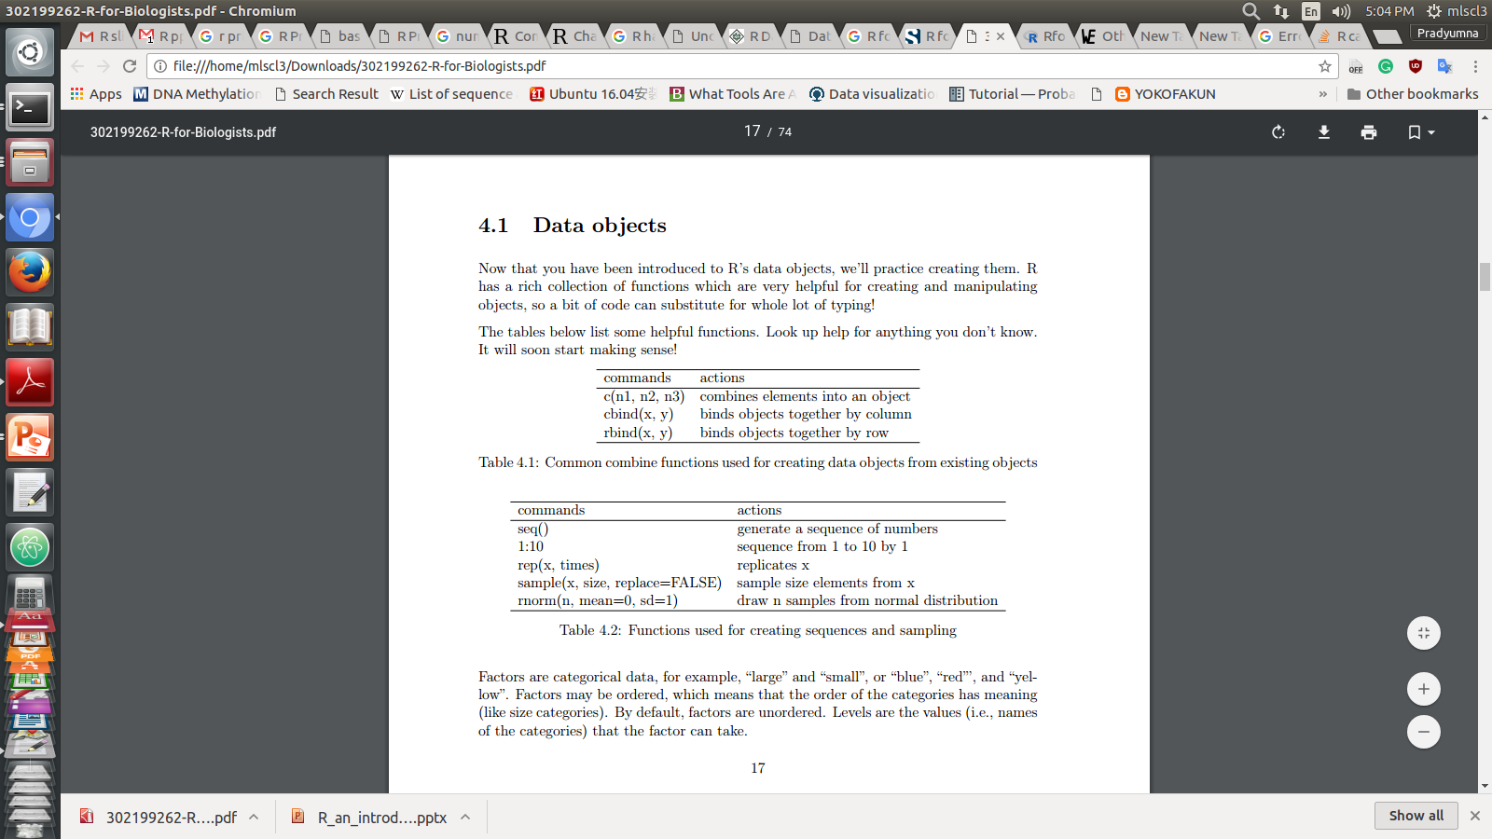
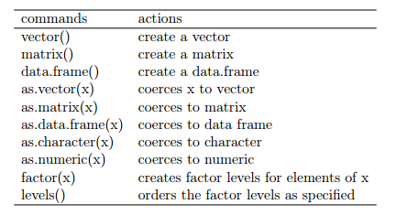

Slide 24
> x <- c( 1, 5, 7, 14)
> x
> x <- rep( x, times=2)
> x
y <- rnorm(8)
> species <- letters[1:4]
> Species
> treatment <- c("high", "med", "low")
> treat <- factor(treatment)
> xy <- cbind(x,y)
> dat <- data.frame(species, x, y)
> plot(y,x)
> plot(y)
> hist(y)
> barplot(y)
>?plot
>?barplot
Creates vector x
Print x
Repeat x 2 times
Print x
Create simulated normal distribution data (with 8 random points here)
Create char. Vector
Create char. Vector
Create a factor
Combine columns
Create data matrix
Bivariate plot(1st variable is x coordinate 2nd variable is y coordinate
Plots value of y
Plot histogram
Plot barplot
Help for plot
Help for barplot

Slide 25
Exercise
Create a dataset with simulated data using rnorm()
Simulate 25 random data points drawn from a normal distribution (create a numeric vector), and save it in the variable “t”. Create a second set of 25 points and save it as“t1”
Create a treatment vector with levels “low”, “med”, and “high”, save it as a factor.
Create a numeric vector with the values 2, 4, 8, save it as x
Create a species vector with seven names.
Create a matrix with y in the first column and x in the second column, save it as dat.matrix.

Slide 26
Exercise
Make a bivariate plot of the numeric value of the treatment (x) versus the response (t)
Make a plot on the treatment as factor versus the response
make two boxplots: treatment vs. t and treatment vs. t1

