Slide 1
Consumer Complaints Analysis
-A Data-Driven Report on Corporate Accountability & Geographical Trends
PRADYUMN SINGH
August 2, 2025

Slide 2
Project Overview
LOADING
CLEANING
ANALYSING
Project Objective:
To clean, analyze, and visualize a dataset of over 1 million consumer complaints to identify key trends, problem areas, and insights into the consumer grievance process.
Core Business Questions:
Geographical Hotspots: Which states generate the most complaints, and what are the primary issues in those regions?
Corporate Accountability: Which companies receive the most complaints, and how efficiently do they respond?

Slide 3
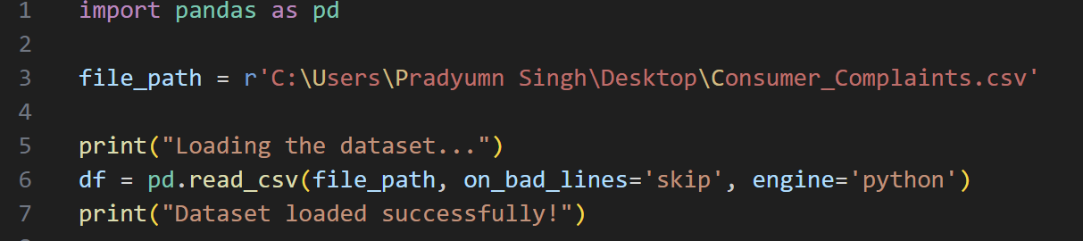
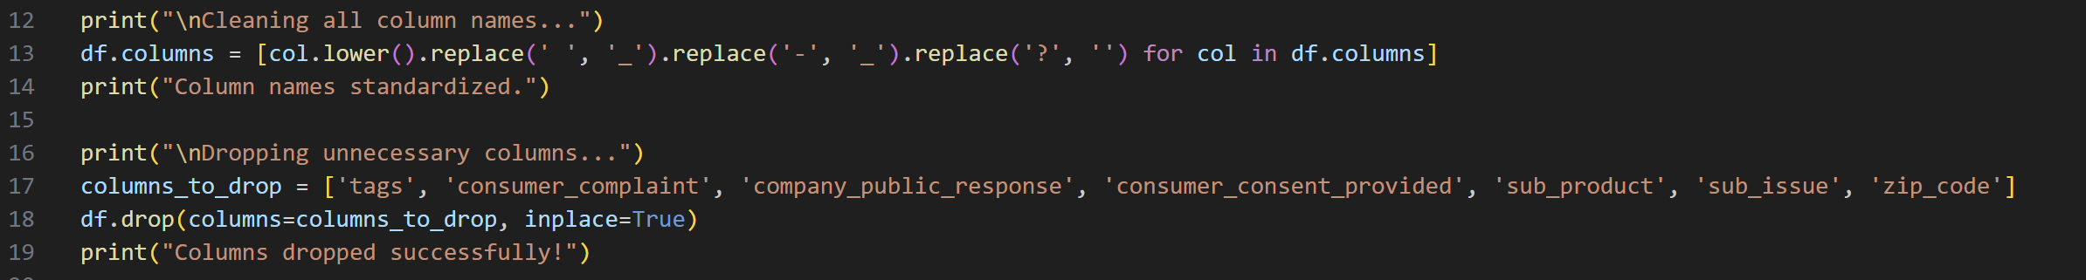

Data Preparation & Cleaning Process
Loaded & Inspected Data:
-Loaded a raw CSV file with over 1 million rows and identified significant issues, including messy column names, inconsistent date formats, and over 2.5 million missing data points.
2. Standardized Column Names:
-Converted all column names to a consistent "snake_case" format (e.g., date_received).

Slide 4
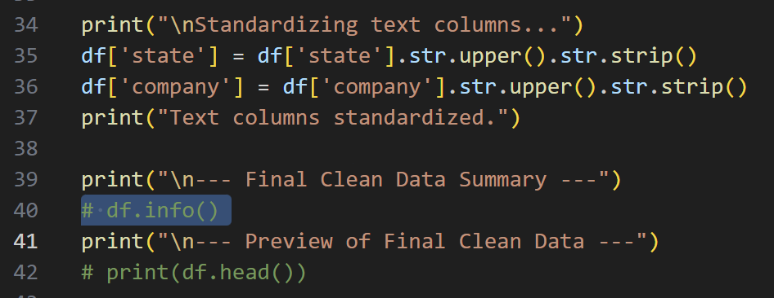


3. Cleaned Date Columns:
-Converted text-based dates into proper datetime objects using pd.to_datetime with format='mixed' and errors='coerce' to handle multiple formats and errors.
4. Feature Engineering:
-Created a new response_time column by calculating the number of days between date_received and date_sent_to_company.
5. Handled Missing Data:
-Dropped unusable columns with excessive missing values and filled key categorical columns (like state) with "Unknown".
6. Standardized Text:
-Used .str.upper() and .str.strip() to standardize the state and company columns, ensuring accurate grouping.

Slide 5
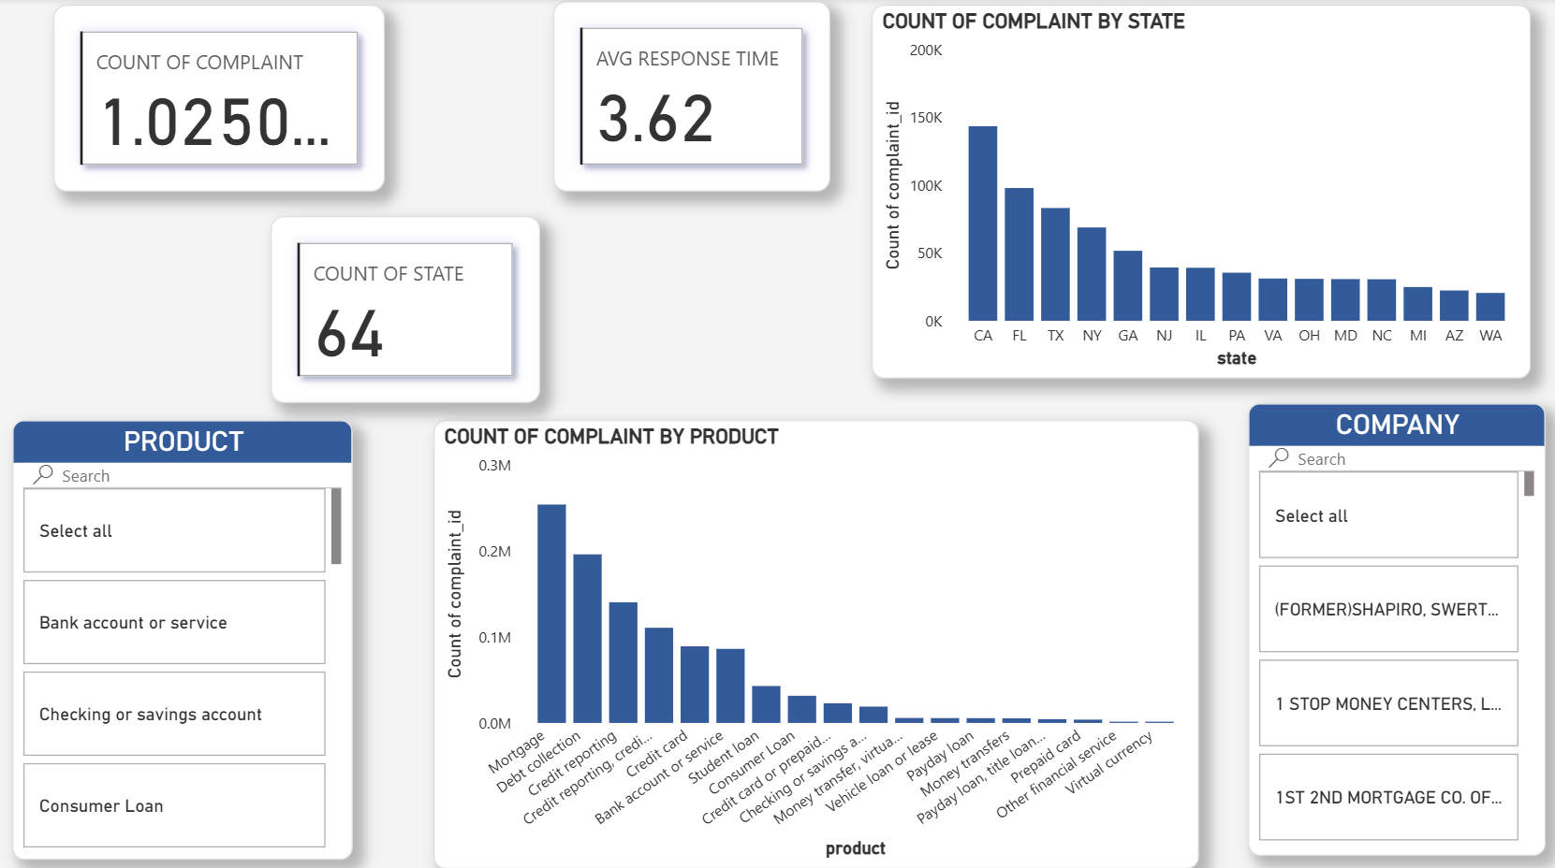
The Interactive Power BI Dashboard

Slide 6
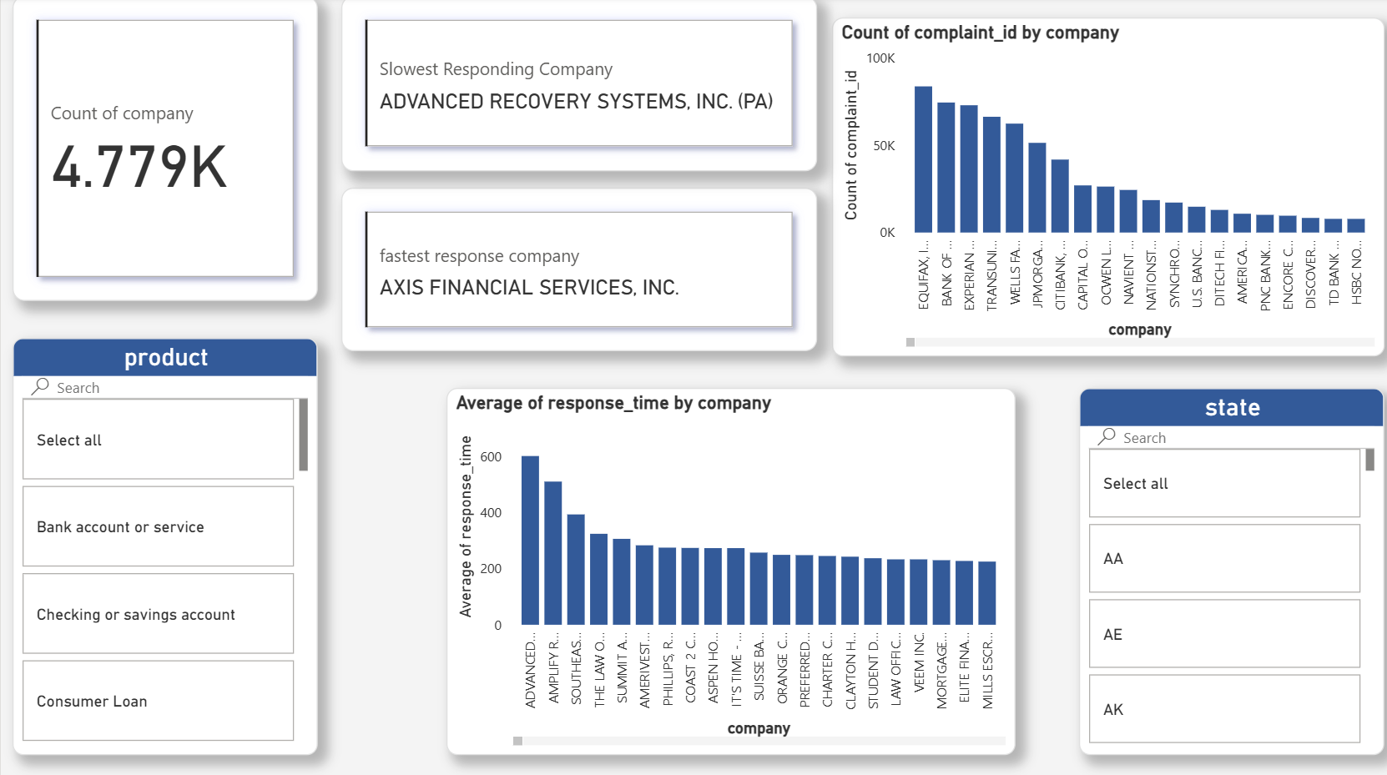

Slide 7
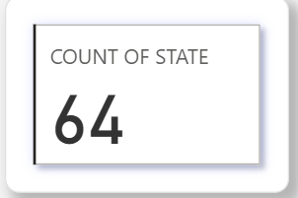
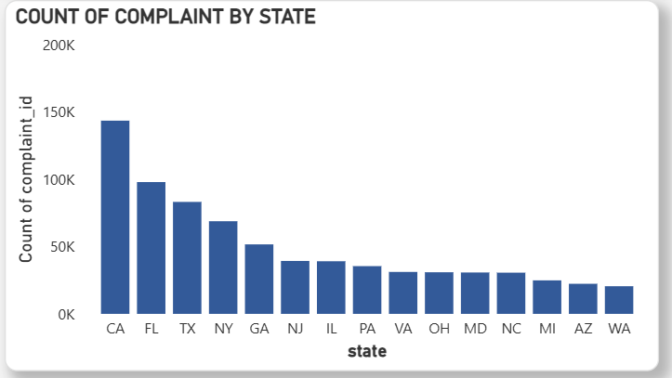
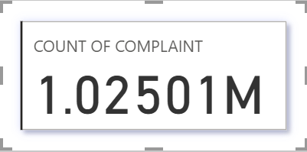
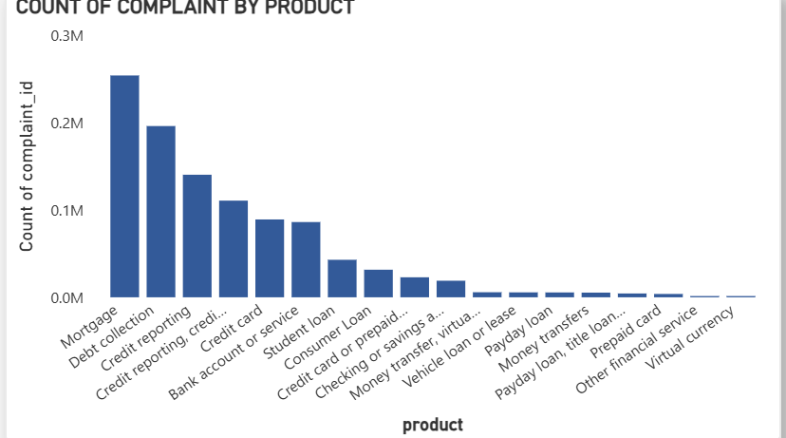
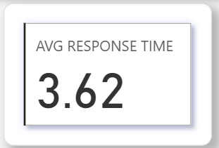
Analysis 1: Geographical Hotspots
Finding 1:
-Complaints are Concentrated in Populous States and the Financial Sector
Observations:
Complaint hotspots are the most populous states: California, Florida, Texas, and New York account for a significant portion of all complaints.
Within these key states, the issues are overwhelmingly related to the financial services industry.
Mortgage, Debt Collection, and Credit Reporting are the top three product categories driving complaints, indicating systemic issues in this sector.

Slide 8
Recommendations:
Consumer protection agencies in these top states should focus their resources on investigating practices within the financial services
industry.
Financial companies operating in these states need to review their mortgage and debt collection processes to address the root cause of these frequent complaints.

Slide 9
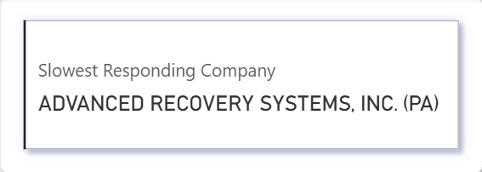
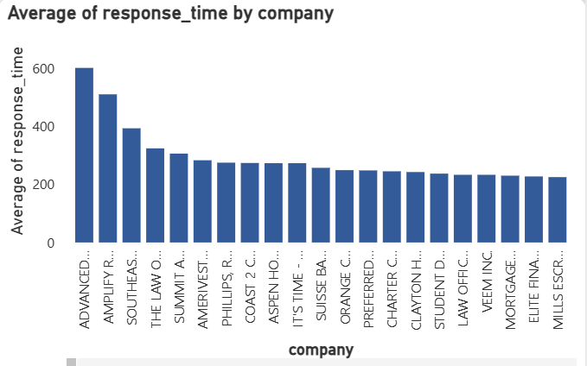
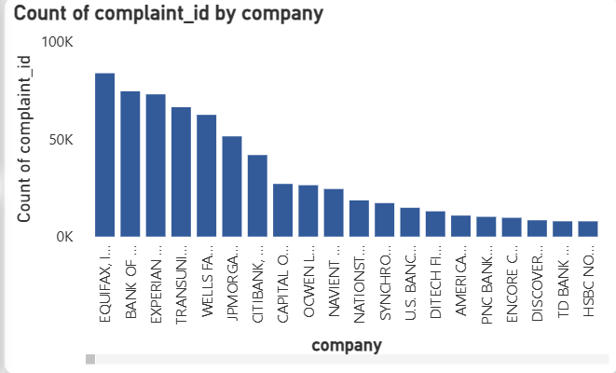
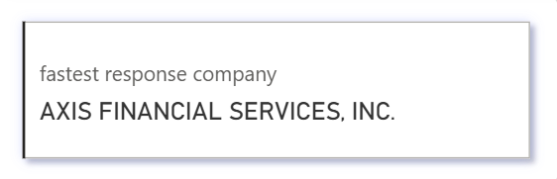
Analysis 2: Corporate Accountability & Performance
Finding 2:
Complaint Volume Does Not Correlate with Response Speed
Observations:
The companies receiving the most complaints are the major credit bureaus (Equifax, etc.) and national banks (Wells Fargo, etc.).
There is no clear correlation between the number of complaints a company receives and how quickly it responds.
Equifax, despite having the highest complaint volume, is one of the fastest responders (averaging under 2 days). In contrast, some companies with fewer complaints are the slowest, taking nearly 7 days on average.

Slide 10
Recommendations:
A new metric for corporate accountability should be established that considers both complaint volume and average response time.
Companies with high complaint volumes but fast response times (like Equifax) likely have efficient systems but may have underlying product or service issues.
Companies with slow response times, regardless of volume, have clear operational inefficiencies in their customer service process that need to be addressed.

Slide 11
Final Conclusion & Strategic Imperative
Central Finding:
-The consumer complaint landscape is dominated by the financial services industry, particularly in the most populous states. While some high-volume companies have developed efficient response systems, there is no consistent industry standard for timely complaint resolution.
Strategic Imperative:
The key to improving the consumer grievance process is twofold:
For Companies: Address the root causes of complaints in core financial products like mortgages and credit reporting, not just the symptoms.
For Regulators: Focus on establishing clear benchmarks for response time to hold all companies, regardless of size, to a higher standard of customer service.

Slide 12
Project Resources & Appendix
Download the Raw Dataset (.csv)
View the Python Cleaning Script
Download the Clean Dataset (.csv)
Download the Interactive Power BI Dashboard (.pbix)

Slide 13
Thank You

