Slide 1
FLIPKART
Sales Quality Analysis
PRADYUMN SINGH
23 JULY 2025

Slide 2

Introduction
Project Objective:
To conduct a comprehensive analysis of the Flipkart sales dataset to uncover actionable insights that can inform business strategy, improve customer satisfaction, and drive sustainable growth.
Dataset Overview:
The analysis is based on a dataset containing over 20,000 product listings. Key data points include product categories, pricing, discounts, customer ratings, and participation in the "FK Advantage" program.
Core Areas of Investigation:
This presentation will focus on three critical pillars of the business:
Category Performance: Identifying our most valuable and promising product categories.
Product Quality: Assessing the consistency of customer satisfaction across the platform.
Pricing Strategy: Evaluating the effectiveness of our current discount and pricing models.

Slide 3
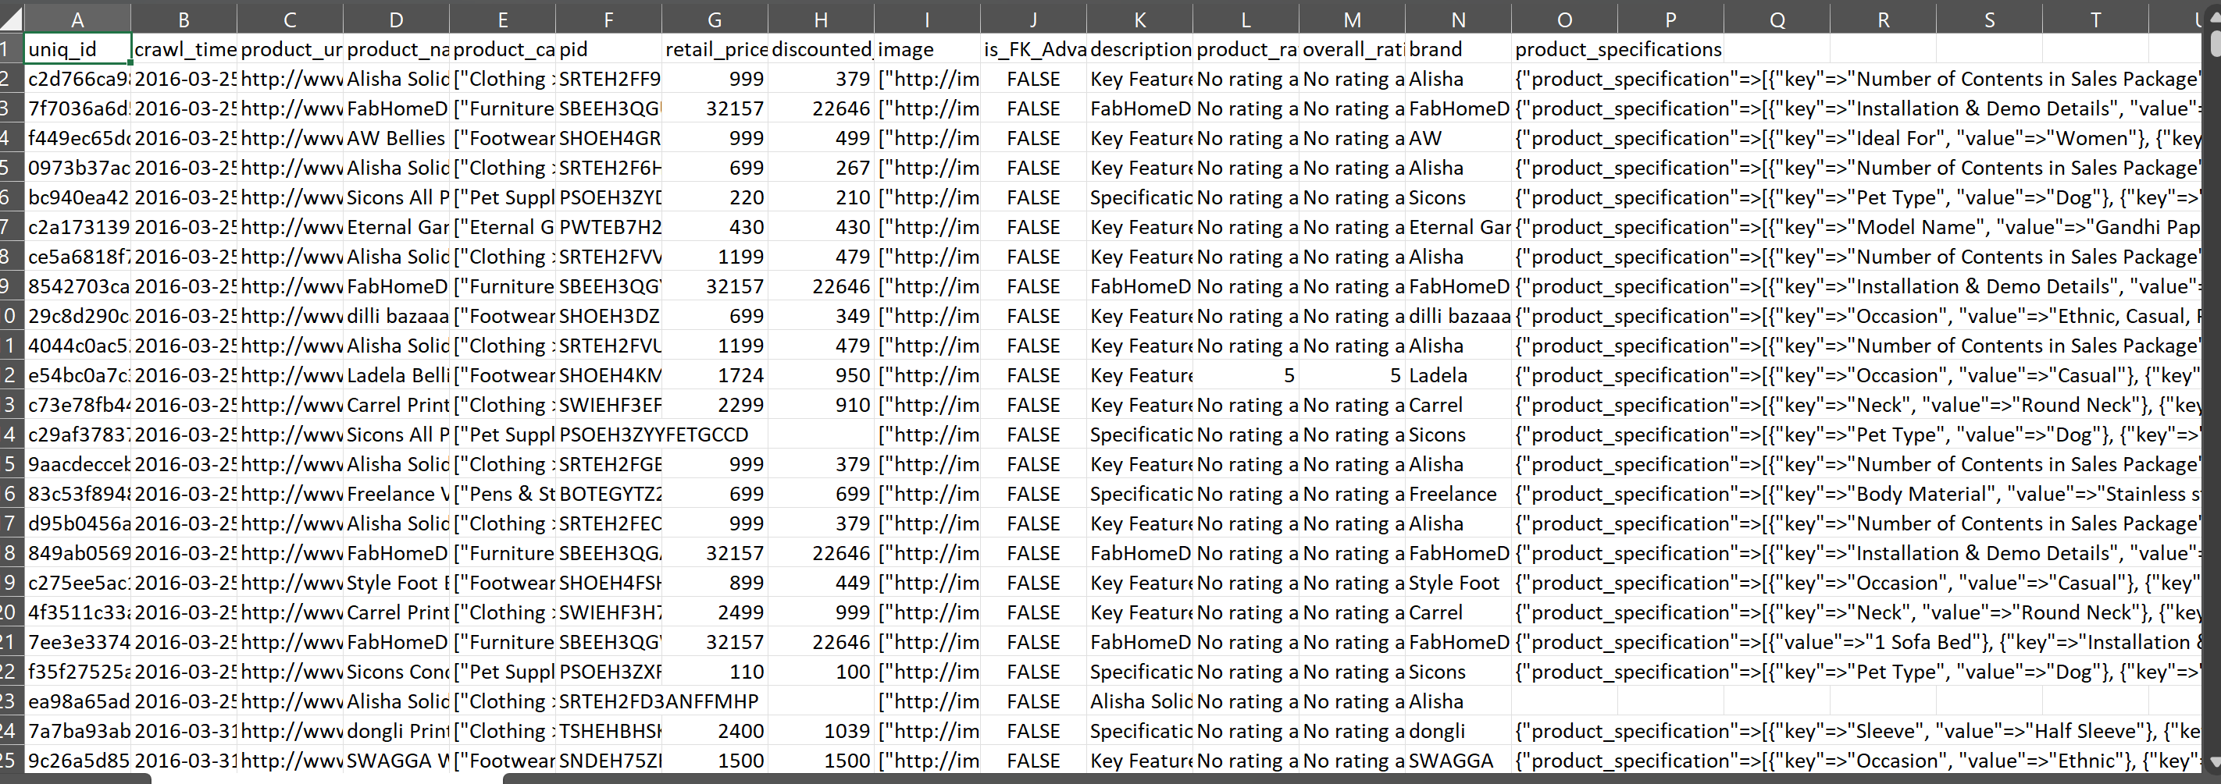
Data Acquisition & Cleaning Process
RAW DATA :
C:\Users\Pradyumn Singh\Desktop\flipkart_com-ecommerce_sample.csv

Slide 4
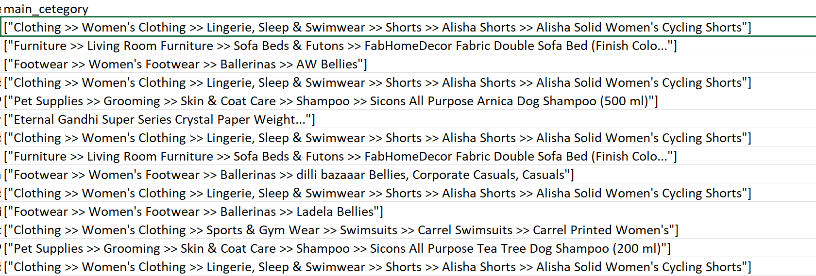
").
Initial Data Assessment:
The raw dataset, while comprehensive, required significant cleaning to ensure the accuracy of the analysis. The primary challenge was the Main_Category column, which contained inconsistent data formats.
Key Cleaning Challenge:
The Main_Category column contained two different types of data:
Structured Breadcrumbs
-Well-formatted text strings separated by a >> delimiter (e.g., "Clothing >> Men's Clothing >> ...").
2. Unstructured Product Names
-Simple product names with no category information (e.g., "Vishudh Printed Women's Straight Kurta")

Slide 5
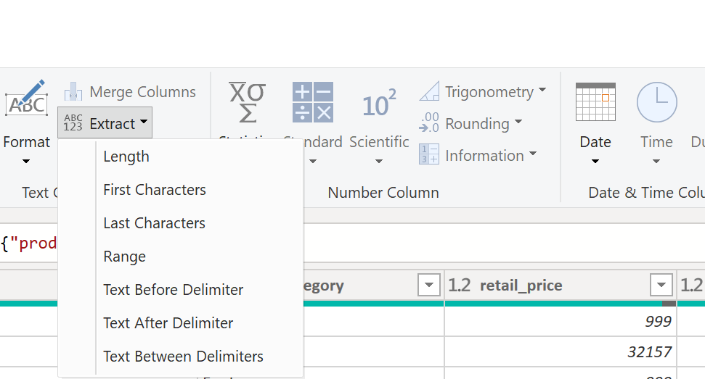
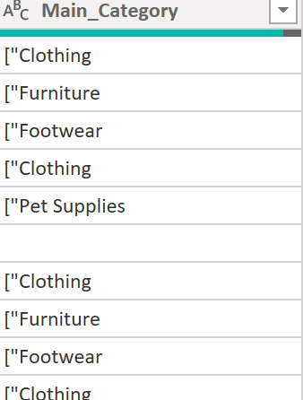
Data Transformation Steps in Power Query:
A multi-step process was used to create a new, clean category column:
Isolate Structured Data:
A conditional column was created to identify and separate the rows containing the >> delimiter
2. Extract Main Category:
The "Split Column by Delimiter" function was used on the structured data to extract the first item (the true main category).
3.Group Unstructured Data:
All remaining rows (the unstructured product names) were grouped into a single, consistent "Other" category.
Finalize Clean Column: This resulted in a new, 100% clean Clean Category column that was used for all subsequent analysis.

Slide 6
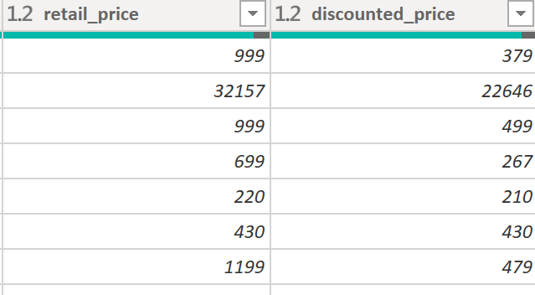
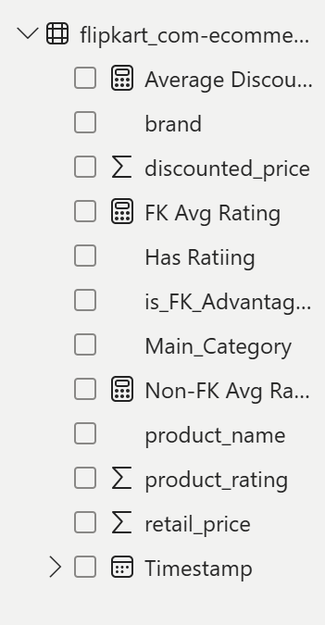
Additional Preparations:
Verified and corrected data types for all numeric columns (e.g., Retail_price, product_rating).
Created new DAX measures, such as Average Discount %, to enable deeper analysis.

Slide 7
Power BI Dashboard Design & Strategy
To analyze the business questions, a three-page interactive Power BI report was developed. Each page is designed to provide a different level of insight, from a high-level summary to a detailed analysis of specific strategies.
Page 1: Executive Summary
Purpose:
To provide a single-glance overview of the business's key performance indicators (KPIs).
Key Visuals:
Features KPI cards for Total Sales, Average Product Rating, and Total Product Count. It also includes summary charts showing the top categories by product volume and average price.

Slide 8
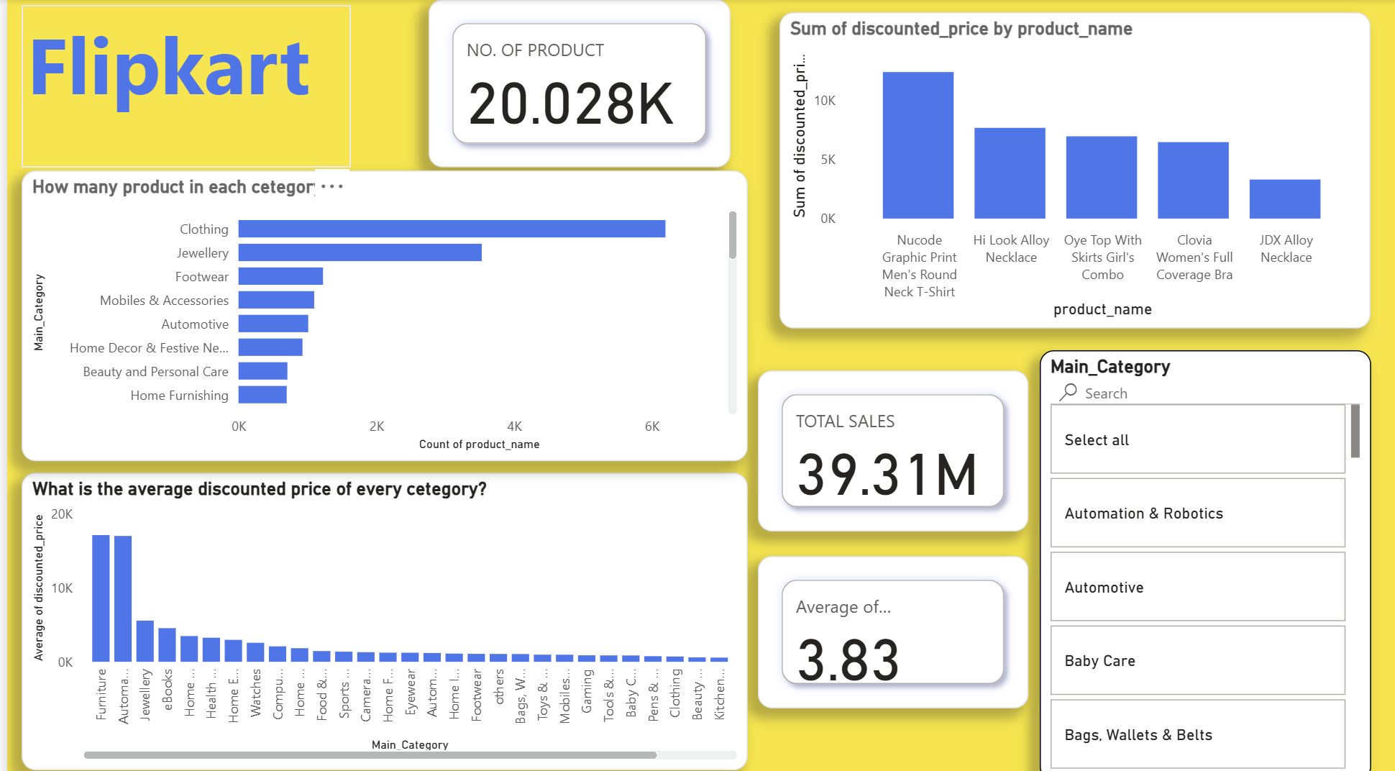

Slide 9
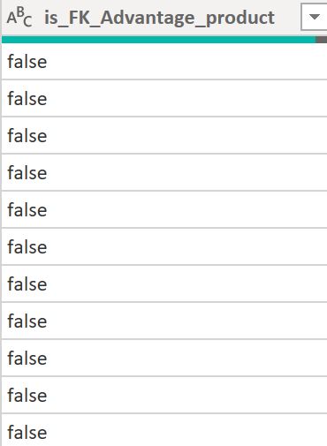
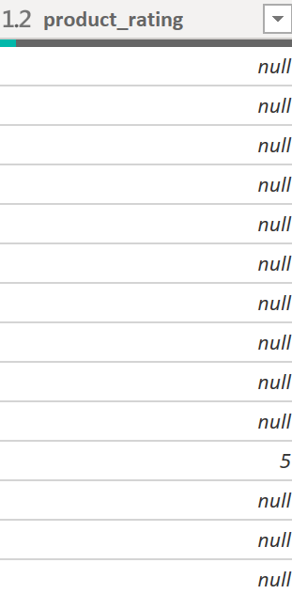
Page 2:
Quality & FK Advantage Analysis Purpose:
To perform a deep dive into customer satisfaction and analyze the effectiveness of the "FK Advantage" program.
Key Visuals:
Compares the average product rating across all main categories. A clustered column chart directly contrasts the ratings of "FK Advantage" products versus non-Advantage products to identify performance gaps.

Slide 10
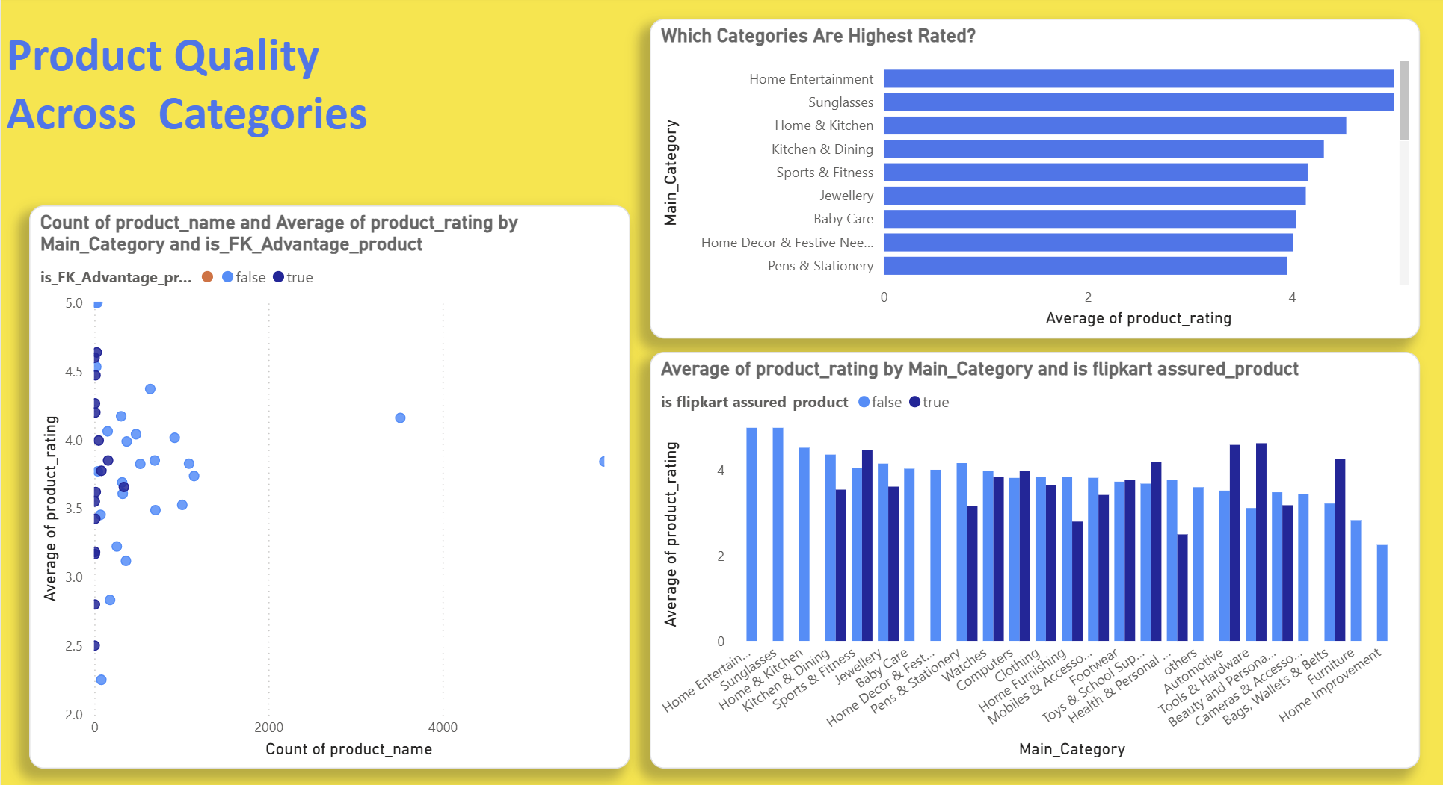

Slide 11
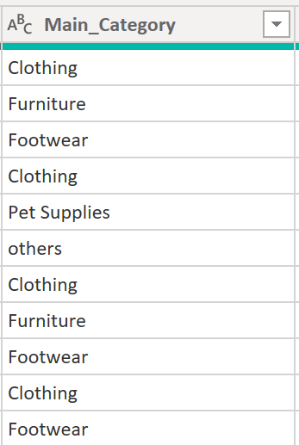
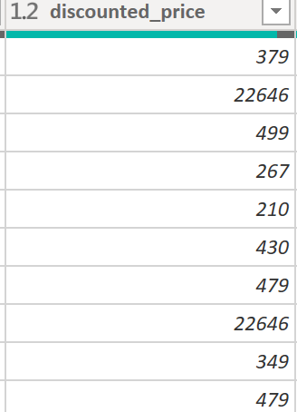
Page 3: Pricing & Discount Strategy
Purpose:
To evaluate the impact and effectiveness of the current discount models on sales and customer perception.
Key Visuals:
Utilizes a custom DAX measure for Average Discount %. Key charts show which categories are most heavily discounted and, crucially, compare the discount levels for products that have customer ratings versus those that do not.

Slide 12
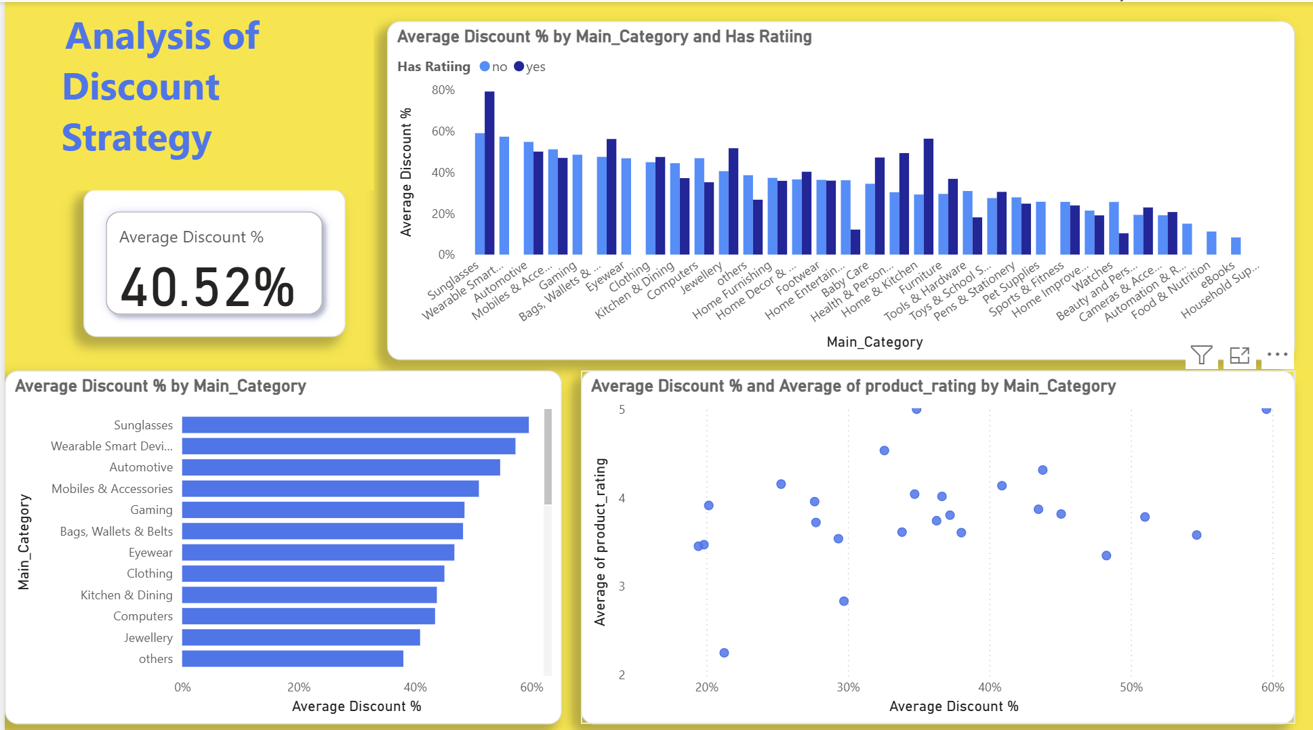

Slide 13
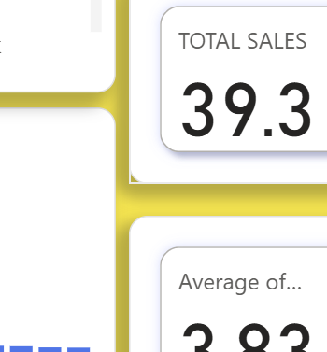
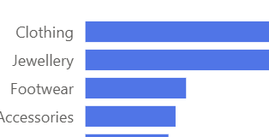
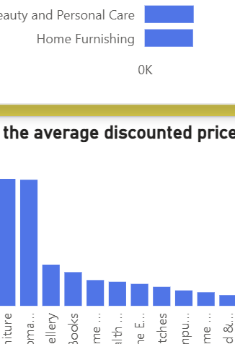
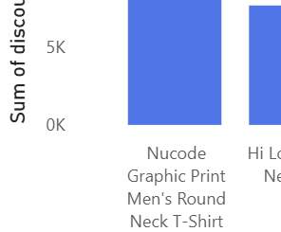
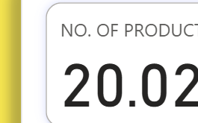
Key Findings & Analysis
Our analysis of the dataset has uncovered several critical findings that directly impact our business strategy. These insights reveal a clear picture of our current strengths, weaknesses, and opportunities for significant growth.
The Analytical Journey:
We will start with the Executive Summary to understand our most valuable categories.
Next, we will dive into the Quality Analysis page to investigate customer satisfaction and the "FK Advantage" program.
Finally, we will examine the Pricing Strategy page to understand the true impact of our discount models.

Slide 14
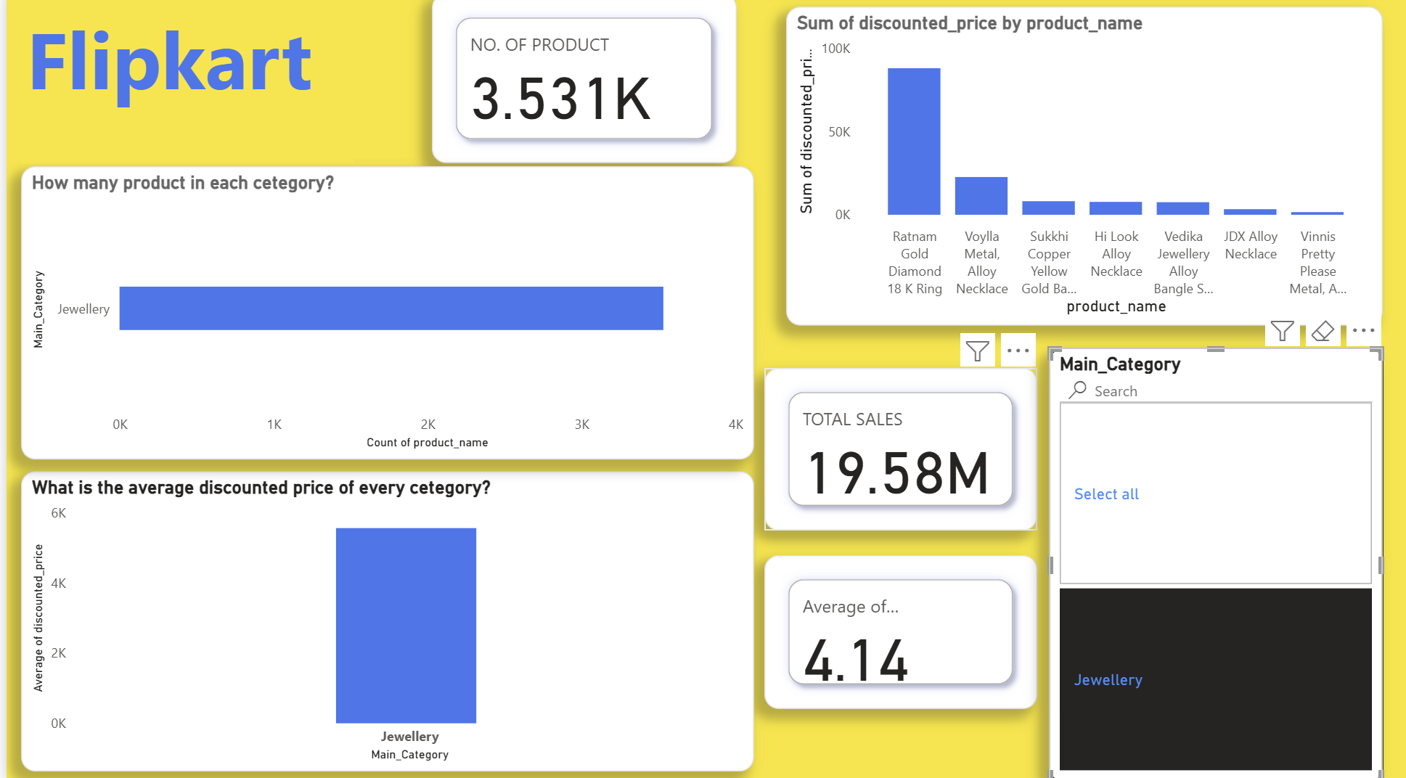
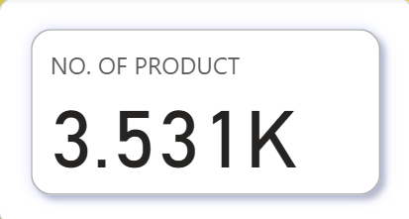
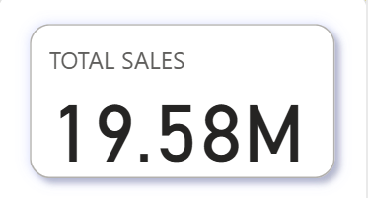
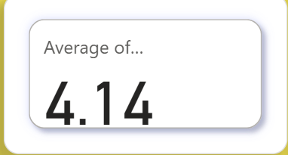
Our most valuable product categories
Observation
Based on a comprehensive analysis of sales revenue, product volume, and customer ratings, Jewellery stands out as the most valuable and well-rounded product category. It demonstrates a powerful combination of high sales, significant market demand, and strong customer satisfaction. However, a deeper analysis reveals distinct strategic roles for other key categories like Clothing and Furniture

Slide 15
Category Tiering & Strategic Recommendations
We can classify our main categories into three strategic tiers:
Tier 1: The Star Performer - JewelleryAnalysis:
Jewellery is the clear leader in overall value. It is the #2 category by product volume, indicating high demand, and our previous analysis showed it contributes significantly to total sales (~19.5M). Crucially, it maintains a high average customer rating of 4.14, demonstrating quality and customer trust.
Recommendation:
Protect & Grow. This category is a proven success. We should double down on our strategy here by actively promoting top-rated jewellery products, featuring trusted sellers, and ensuring a robust supply chain to meet demand.

Slide 16
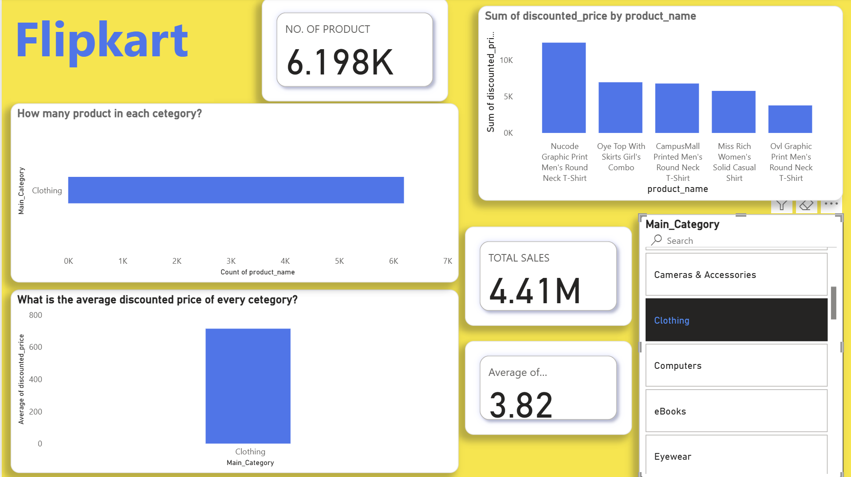
Tier 2: The Volume Engine - ClothingAnalysis:
Clothing is the undisputed leader in volume, dominating the platform with the highest number of product listings (~6,000). This drives enormous traffic and customer engagement. However, its average price point is low, and its contribution to the overall average rating of 3.83 suggests room for improvement in customer experience.
No. of products
TOTAL SALES
AVERAGE OF PRODUCT RATING

Slide 17
Deeper Insight (The "Hero Product" Effect):
While the average clothing item is low-cost, your "Sum of discounted_price by product_name" chart shows that one of the top-earning individual products is a T-shirt. This indicates that the Clothing category's value comes from identifying and promoting specific "hero products" that sell in massive quantities.
Recommendation:
Optimize the Customer Experience. Given the high volume, even small improvements will have a large impact. We must enforce stricter quality and fulfillment standards for sellers to boost the average rating. The focus should be on leveraging the high traffic from hero products to improve the reputation and sales of the entire category.
Tier 3: The Untapped Potential - Furniture & AutomotiveAnalysis:
These categories have the highest average retail prices on the platform, representing significant revenue potential per sale. However, they are currently underperforming with low total sales and poor customer ratings. This signals major friction in the customer journey, likely related to product quality, inaccurate descriptions, or delivery issues.

Slide 18
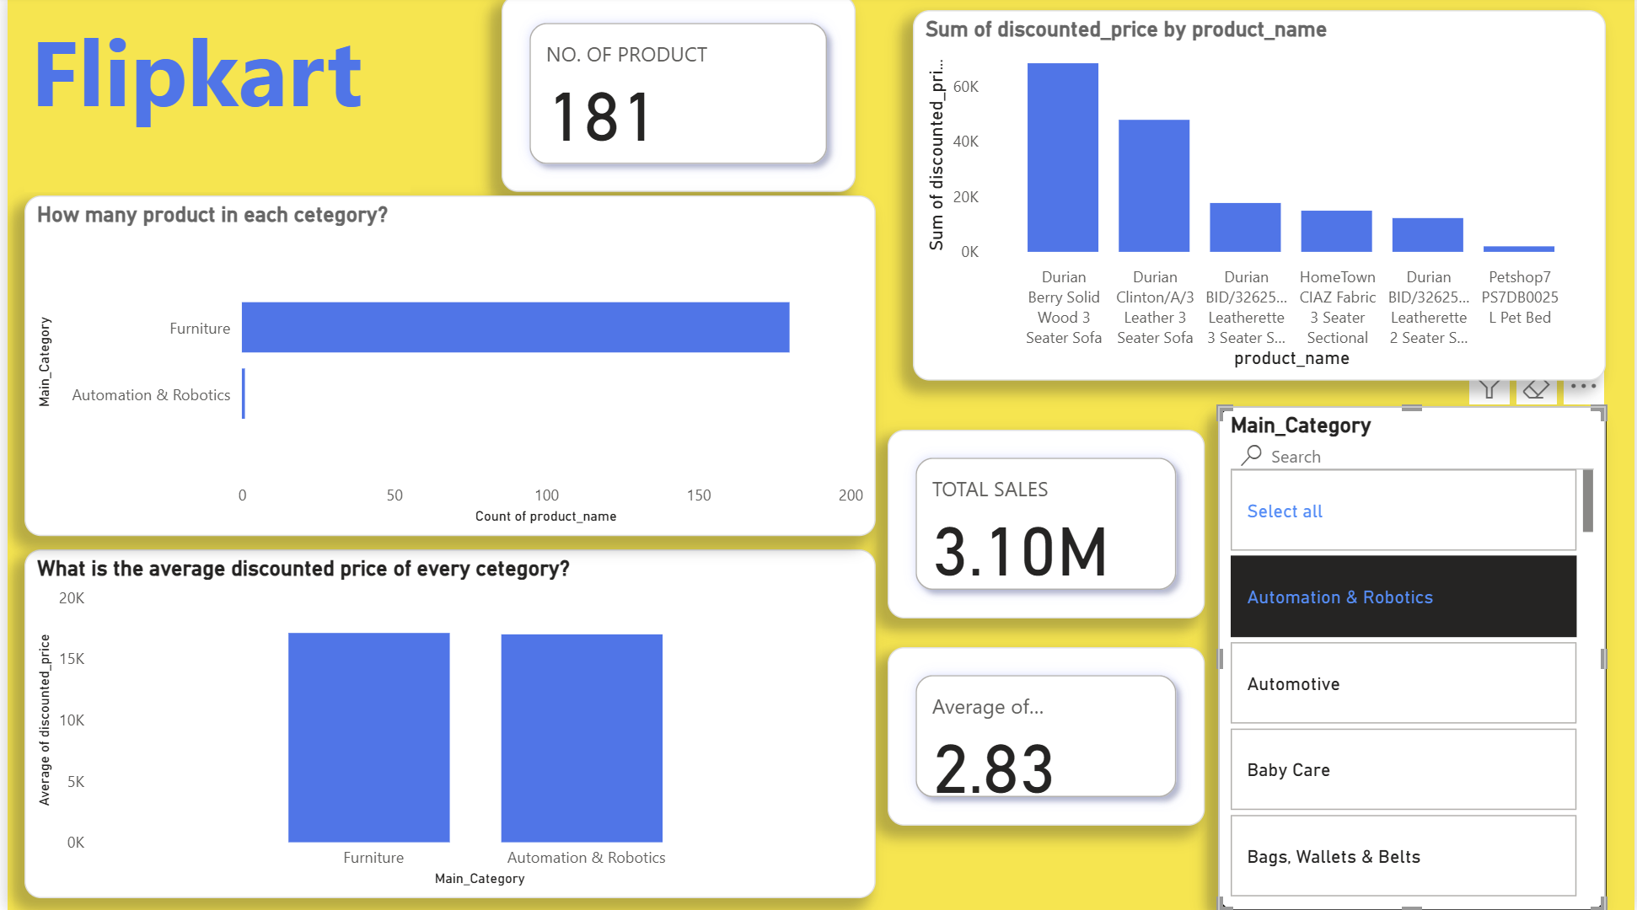
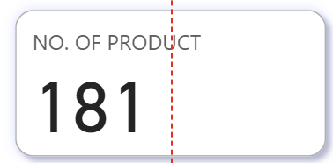
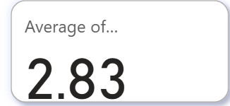
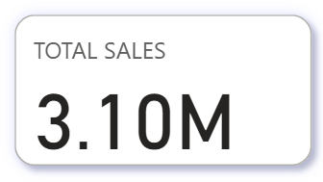
Recommendation:
Investigate & Rebuild Trust. It is critical to conduct a root cause analysis of the poor ratings in these categories. Unlocking the high-margin potential here requires a focused effort on improving product quality, vetting sellers, and ensuring a reliable and transparent delivery process.
Final Conclusion:
Our go-forward strategy should be three-pronged:Capitalize on the proven success and high trust in Jewellery.Optimize the high-traffic Clothing category by managing seller quality and promoting its "hero products".Fix the foundational issues (quality, logistics) in high-margin categories like Furniture to turn their potential into profit

Slide 19
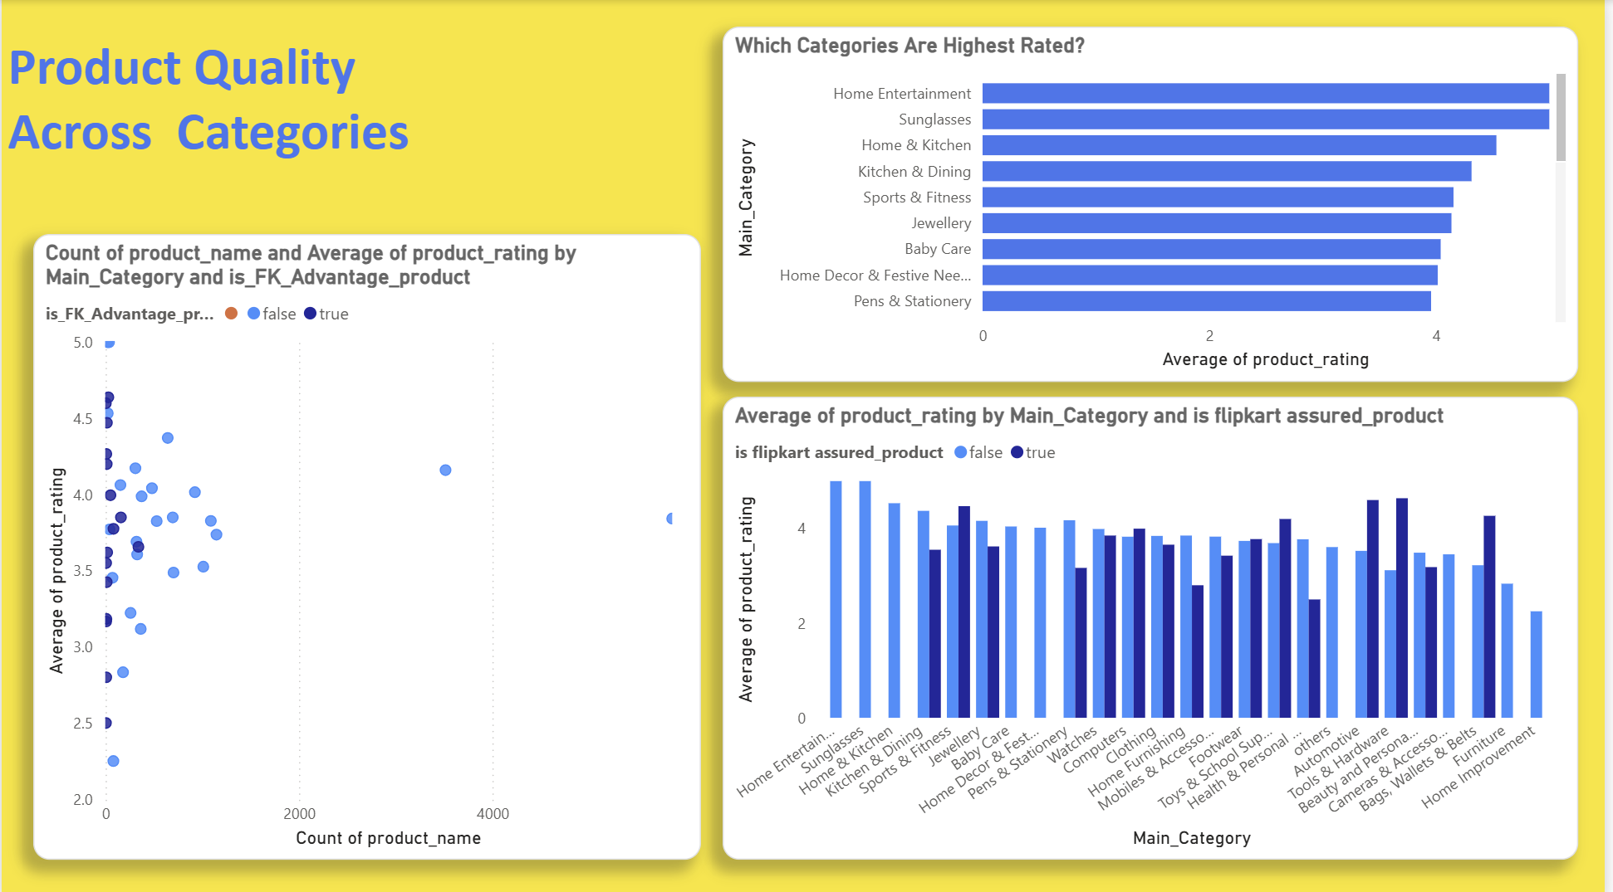
Product quality vary across categories
Observation
Product quality varies significantly by category and is not consistently improved by the "FK Advantage" program. The data indicates that quality issues likely stem from operational inconsistencies in seller and program management, rather than being tied to a single factor

Slide 20
Key Finding 1: Product Ratings are Highly Category-Dependent
There is a wide disparity in the average product ratings across different Main_Category values.
High-Performing Categories:
Home Entertainment and Sunglasses demonstrate exceptional quality, with average ratings approaching a perfect 5.0.Average-Performing Categories: Major segments like Jewellery, Footwear, and Clothing hover around the platform average of 3.8 to 4.2.
Under-Performing Categories:
Home Improvement and Furniture show notably lower average ratings, indicating potential areas of customer dissatisfaction.
Key Finding 2: The "FK Advantage" Program Shows Inconsistent Impact
The "FK Advantage" badge, which should signify higher quality and reliability, does not have a uniform positive effect on customer ratings.
Successful Implementation:
The program is highly effective in categories such as Automotive, Tools & Hardware, and Bags, Wallets & Belts, where "Advantage" products are rated significantly higher than their counterparts.
Counter-Intuitive Underperformance:
In many of the platform's largest categories, including Clothing, Jewellery, and Home & Kitchen, products with the "Advantage" badge have a lower average rating than non-Advantage products.

Slide 21
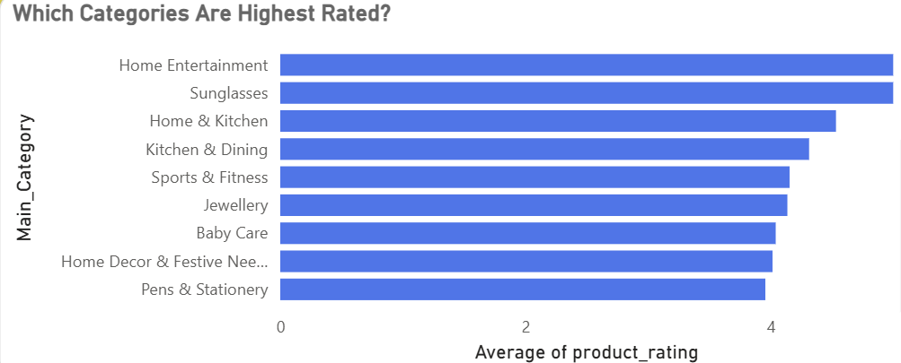
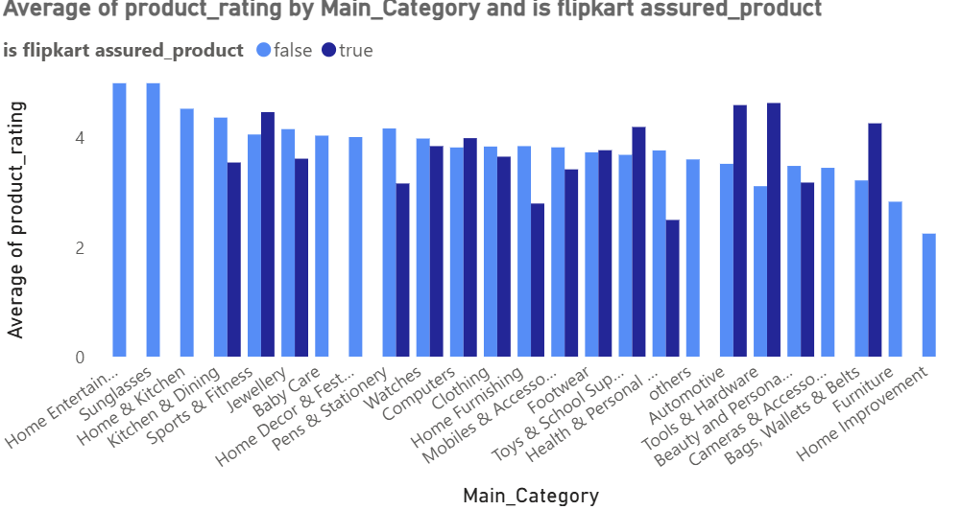
Conclusion & RecommendationsConclusion:
The primary driver of quality variation appears to be inconsistent execution. The "FK Advantage" program is not being applied with a uniform quality standard across all segments, leading to a confusing and unreliable experience for the customer.
Recommendations:
Conduct a Category-Level Program Review:
The criteria for granting the "FK Advantage" badge must be re-evaluated.For categories where the program is underperforming (e.g., Clothing), quality prerequisites for participating sellers should be significantly tightened.
For categories where the program is successful (e.g., Automotive), the best practices should be identified and scaled.
Enhance Seller Accountability: A more robust seller scoring and monitoring system is needed to ensure a consistent customer experience, regardless of whether a product has the "Advantage" badge or not.

Slide 22
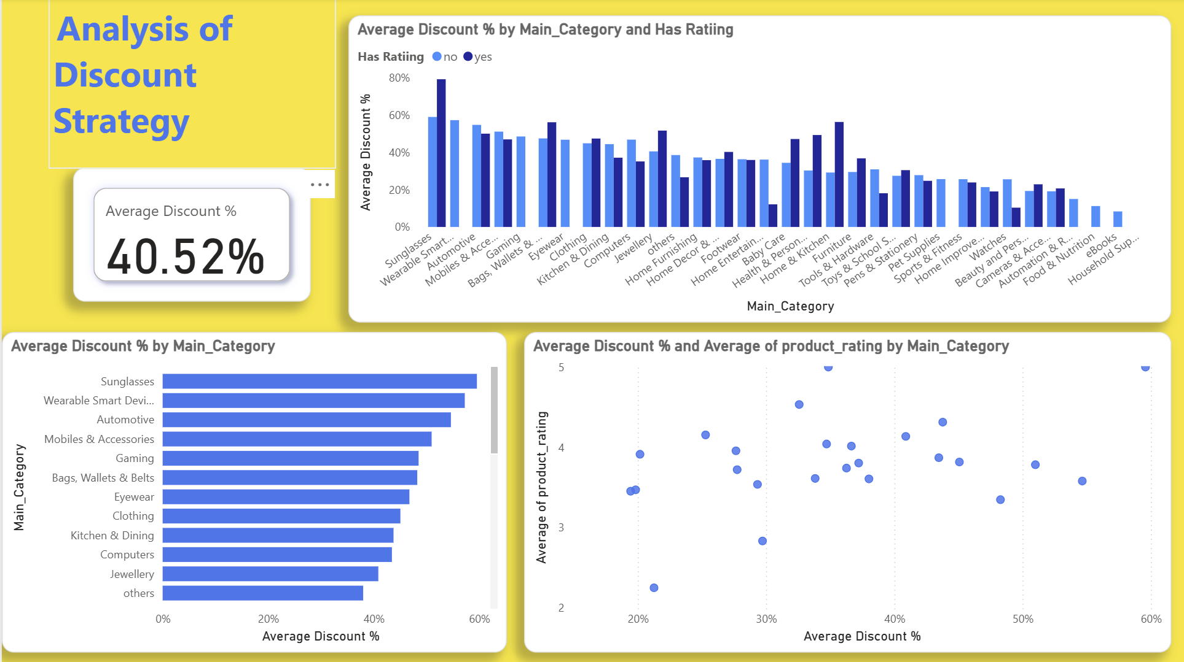
Pricing & Discount Strategy Effectiveness
Our discount strategy appears to have a generally positive impact on stimulating sales activity. However, its effectiveness is complex and should not be the sole lever for driving growth. There is compelling evidence that high discounts are often used on products that fail to achieve customer satisfaction, posing a potential risk to long-term brand perception.
Key Finding 1:
Discounts Show a Positive, but Complex, CorrelationWhile discounts seem to encourage sales, the relationship is not uniform across all categories.
Crucially, a high discount percentage does not guarantee positive customer engagement. There are numerous instances where heavily discounted products receive no ratings from the customer.

Slide 23
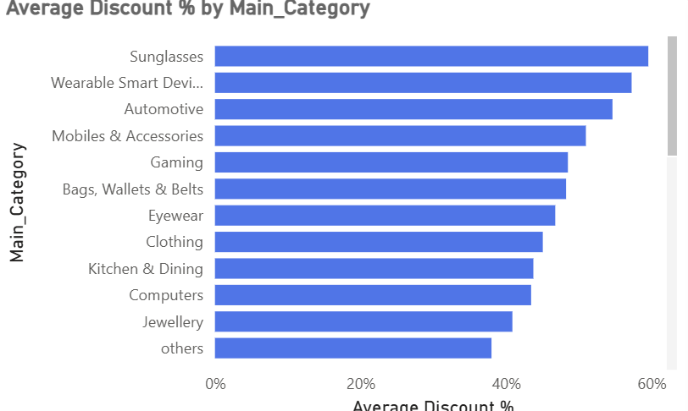
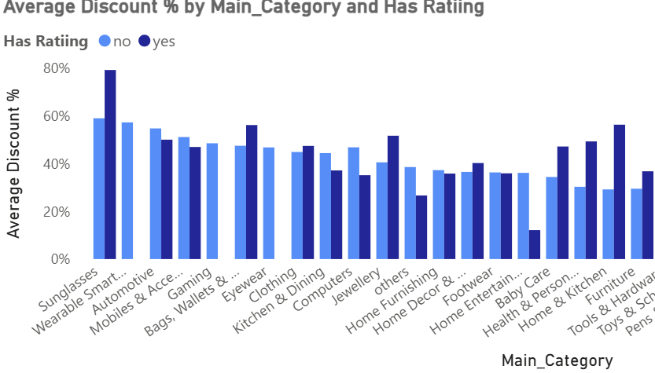
Key Finding 2:
High Discounts on Unrated Products - A Potential Red Flag
The data reveals a critical pattern: in several categories, the average discount for products without ratings is significantly higher than for products with ratings.

Slide 24
Hypothesis:
a lack of a rating can be a strong indicator of customer dissatisfaction. This suggests a strategy of using deep discounts to sell off unpopular or low-quality stock. While this may clear inventory in the short term, it risks associating the Flipkart brand with disappointing products.
Strategic Recommendations
Adopt a "Smart Discounting" Policy:
Instead of broad, reactive discounts, the strategy should be more targeted
2. Amplify Winners:
Use moderate discounts to further boost the sales of products that are already highly rated and popular.
3. Incentivize Reviews:
Use introductory discounts on new products specifically to encourage the first wave of customer reviews
4. Avoid Rewarding Poor Quality:
Do not apply deep discounts to products with historically poor performance or known quality issues.
5. Investigate "High-Discount, No-Rating" Products:
A specific action plan should be to identify the top products that fall into this quadrant. We need to analyze their return rates and review seller history to understand if they are causing long-term damage to customer trust.

Slide 25
Overall Conclusion & Strategic Imperative
Central Finding:
Our comprehensive analysis reveals that the key to unlocking future growth is not found in broad, platform-wide strategies like discounts or badging alone. Instead, success is determined by consistent, high-quality execution on a category-by-category basis.
Summary of Evidence:
We have seen that a category's value is a mix of its volume, price, and customer satisfaction (Jewellery excels at all three).
We have proven that even a premium program like "FK Advantage“(or flipkart assured) can fail to deliver higher quality if not managed with strict, consistent standards.\
We have identified that our current discount strategy creates a potential long-term risk by prioritizing the sale of unpopular products over building customer trust.
The Strategic Imperative:
The primary recommendation is to shift from a "one-size-fits-all" approach to a data-driven, category-focused operational model. This means implementing robust seller accountability, enforcing strict quality standards for all programs, and making strategic decisions based on the unique performance and potential of each individual product category.

Slide 26
THANK YOU

