Slide 1
FEDERATED HEALTHCARE USE CASE
Dagents for Federated Stroke Triage
Send a signed stroke-triage model to hospitals, train and evaluate locally, aggregate protected updates, and release only after cross-site review.
Seed model
Local LMAs
Protected updates
Global review
Signed release
Pradyun Devarakonda
Dagents Federated Healthcare / 01
Notes:
This proposal uses stroke triage as the concrete federated healthcare case.
Hospitals keep patient records and brain scans local. Dagents coordinates approved jobs, evidence, versions, and recoverable releases around a specialist federated-learning engine.
[Sources]
- https://www.cdc.gov/stroke/signs-symptoms/index.html
- https://www.fda.gov/news-events/press-announcements/fda-permits-marketing-clinical-decision-support-software-alerting-providers-potential-stroke
[/Sources]

Slide 2
THE PROBLEM
Pooling raw hospital records is not the only way to learn.
The system must handle data boundaries, site differences, update privacy, and safe operations—not just model accuracy.
Data cannot simply move
Hospitals do not match
Privacy, contracts, sovereignty, and breach risk make a central patient-data copy a poor default.
Populations, units, systems, labels, and workflows differ. One global setting may not fit every site.
Updates can still leak
Operations decide safety
Weights and gradients are not automatically anonymous. Aggregation and privacy controls still matter.
Identity, code approval, retries, versions, evidence, canaries, and rollback determine whether learning is controllable.
The use case is distributed learning plus governed operations / 02
Notes:
Federated learning reduces raw-data collection, but individual model updates may expose information. Secure aggregation and privacy analysis are separate requirements.
[Sources]
- https://research.google/pubs/practical-secure-aggregation-for-privacy-preserving-machine-learning/
- https://research.google/blog/distributed-differential-privacy-for-federated-learning/
[/Sources]

Slide 3
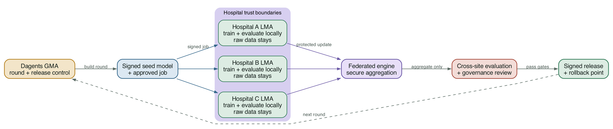
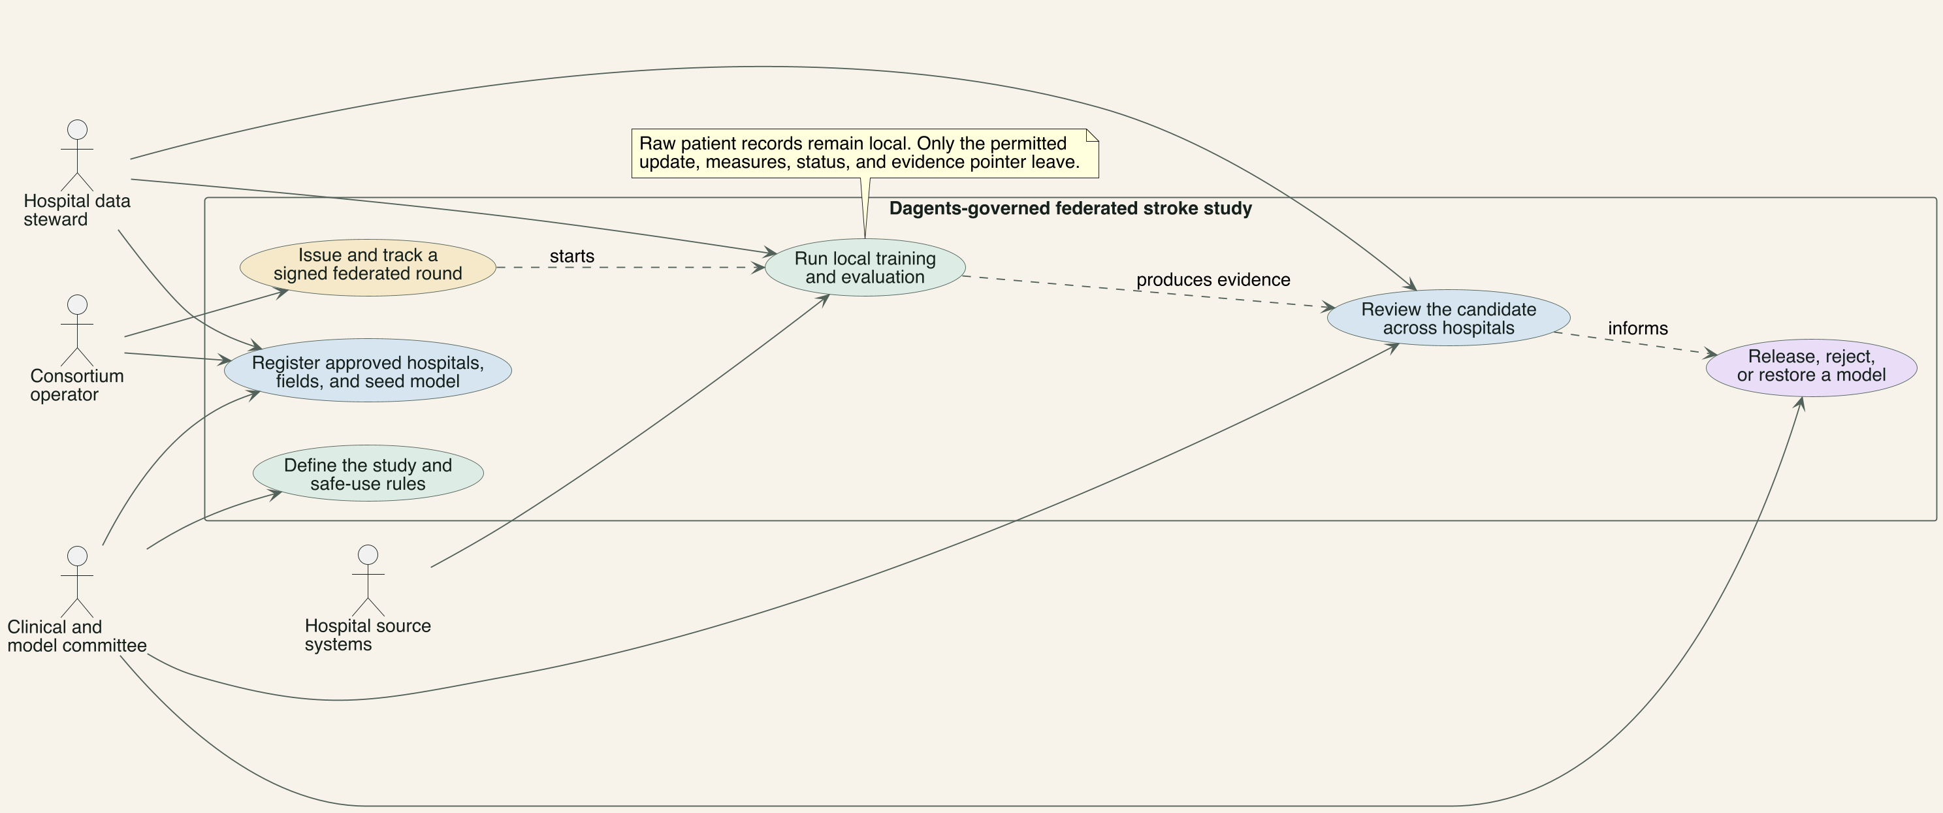
USE CASE
The system has clear actors, permissions, and outcomes.
The hospital keeps control of local data. Dagents governs the study and release. The federated runtime performs the distributed job.
Opening functional story / 03
Notes:
Start with responsibilities rather than components. The clinical committee defines the approved study and decides whether a candidate may be released. The consortium operator starts approved rounds and reviews evidence.
At each hospital, the LMA checks the signed job and approved local data view. The federated runtime performs the distributed training or evaluation. Clinicians remain the users of the approved workflow, not passive recipients of an automatic model decision.
[Sources]
- /Users/pradyundevarakonda/Developer/Dagents/docs/agents/lma-gma-architecture.md
- https://nvflare.readthedocs.io/en/main/system_architecture/system_architecture.html
[/Sources]

Slide 4
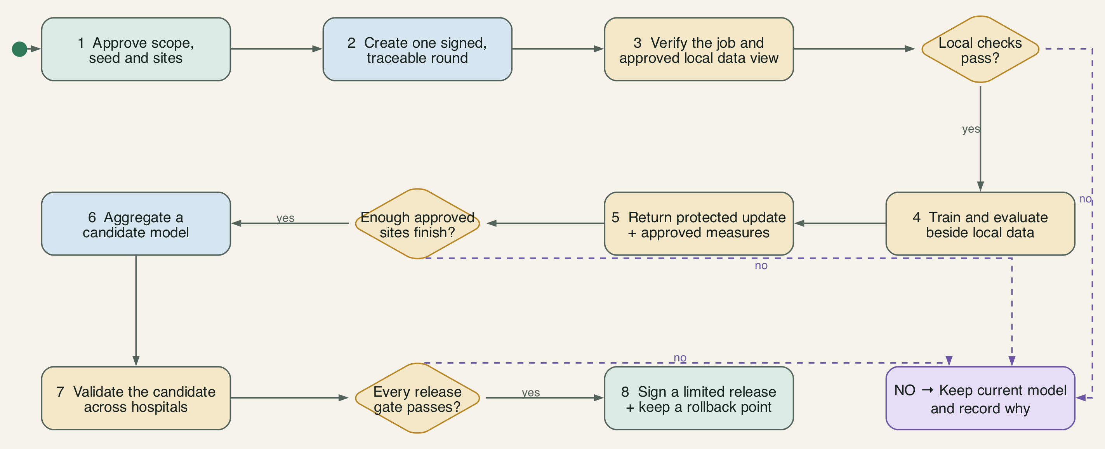
FUNCTIONAL FLOW
Every round follows one visible path with explicit stop points.
A failed local check, missing quorum, or failed release gate keeps the current approved model in service.
Opening functional story / 04
Notes:
This is the complete operating path. It begins with an approved question and ends with monitoring or rollback. A model candidate is only an intermediate result.
The important stop points are local approval, minimum participating hospitals, cross-site validation, and human release approval. If any stop point fails, the current approved model stays in service.
[Sources]
- /Users/pradyundevarakonda/Developer/Dagents/docs/agents/lma-gma-architecture.md
- https://nvflare.readthedocs.io/en/main/system_architecture/system_architecture.html
[/Sources]

Slide 5
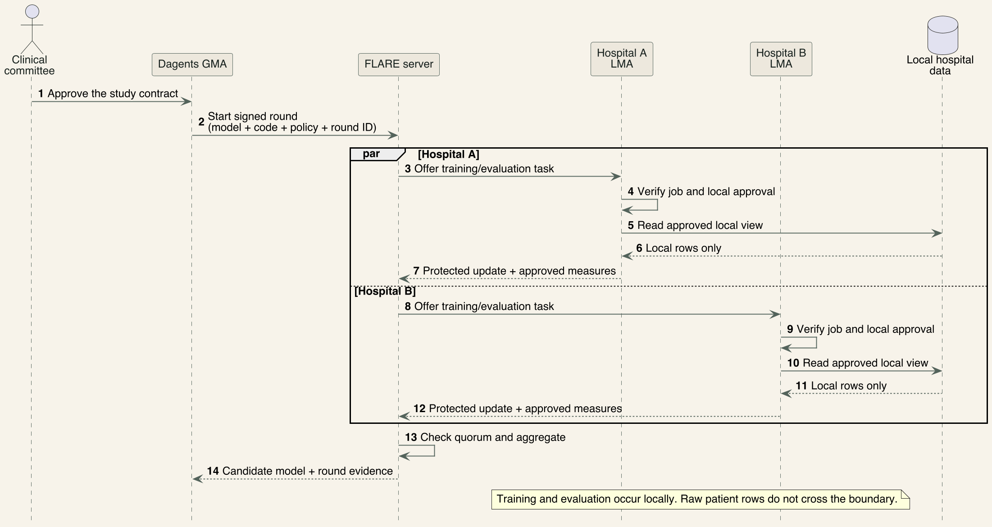
SEQUENCE 1 OF 2
A federated round creates a candidate without pooling patient records.
Dagents approves and tracks the round. FLARE coordinates the job. Each LMA checks and runs work beside local data.
Opening functional story / 05
Notes:
The GMA opens a round only after the study contract, eligible hospitals, model version, and stop rules are approved. FLARE then handles the federation protocol and task exchange.
Each LMA checks the signer, code, purpose, and local source view before any work runs. Raw patient records stay inside the hospital. Only the approved contribution and small measures leave the site.
[Sources]
- /Users/pradyundevarakonda/Developer/Dagents/docs/agents/lma-gma-architecture.md
- https://nvflare.readthedocs.io/en/main/system_architecture/system_architecture.html
[/Sources]

Slide 6
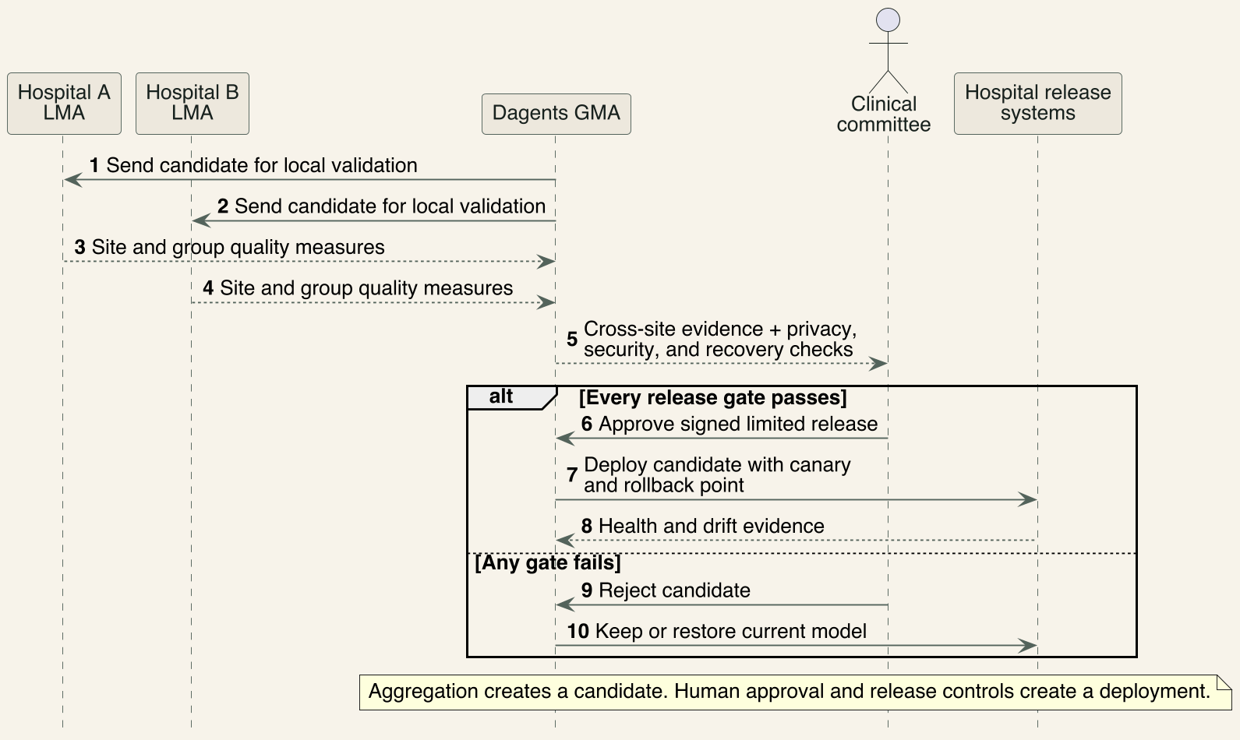
SEQUENCE 2 OF 2
A candidate becomes a release only after cross-site review.
Hospitals return local quality measures. The committee either approves a limited release or keeps the current model.
Opening functional story / 06
Notes:
The candidate is sent back to participating hospitals for local evaluation. Sites return approved quality and safety measures, not their patient records.
Dagents assembles the evidence package. The clinical committee approves a limited release only when the agreed gates pass. Otherwise, the candidate is rejected and the current model remains active.
[Sources]
- /Users/pradyundevarakonda/Developer/Dagents/docs/agents/lma-gma-architecture.md
- https://nvflare.readthedocs.io/en/main/system_architecture/system_architecture.html
[/Sources]

Slide 7
USE-CASE BOUNDARY
Start narrow enough to prove the whole system.
Illustrative research pilot: five hospitals, emergency and stroke pathways, past-scan testing followed by silent workflow evaluation.
One clinical question
Approved seed
Can a model help prioritize suspected-stroke scans for faster specialist review? A clinical committee defines inputs, output, exclusions, and safe use.
Start from public, de-identified, consented, synthetic, or otherwise permitted data—not a central copy of hospital records.
No automatic care
One condition
Past scans and silent mode first. No diagnosis, treatment, or queue removal without a separate approved study.
Later cases could cover heart attack, sudden kidney injury, breathing decline, or diabetic emergency. Each needs its own model, workflow, owner, and safety evidence.
Proposed research boundary—not a clinical or regulatory conclusion / 07
Notes:
Stroke is used because fast recognition and treatment matter, but the first study remains retrospective and silent.
FDA-cleared stroke triage software provides a useful boundary: workflow triage can run in parallel with standard care and does not replace full image review or clinical judgment.
[Sources]
- https://www.cdc.gov/stroke/signs-symptoms/index.html
- https://www.cdc.gov/stroke/treatment/index.html
- https://www.fda.gov/news-events/press-announcements/fda-permits-marketing-clinical-decision-support-software-alerting-providers-potential-stroke
- https://www.accessdata.fda.gov/cdrh_docs/pdf21/K211179.pdf
[/Sources]

Slide 8
FEDERATED ARCHITECTURE
Dagents controls the round; a federated engine aggregates.
Signed jobs go out, protected updates come back, and raw records plus patient-level traces stay at each hospital.
Federated control and data boundaries / 08
Notes:
The diagram is a proposed architecture. The GMA coordinates round and release state; a specialist engine performs secure aggregation; every hospital retains its raw data and detailed trace.
[Sources]
- /Users/pradyundevarakonda/Developer/Dagents/docs/agents/lma-gma-architecture.md
- https://developer.nvidia.com/blog/creating-robust-and-generalizable-ai-models-with-nvidia-flare/
- https://research.google/pubs/practical-secure-aggregation-for-privacy-preserving-machine-learning/
[/Sources]

Slide 9
RELEASE LIFECYCLE
Treat every model version as a recoverable release.
Federated training creates candidates; governance creates releases.
BASELINE
INCREMENT
VERIFY
RELEASE OR RESTORE
Record the seed model, code, features, dependencies, intended use, approved sites, and safe fallback.
Create a round manifest; collect bounded updates and approved aggregate results.
Re-evaluate at every site; check privacy, performance, subgroup, integrity, and operational gates.
Sign a candidate for a small rollout—or keep and restore the last known-good model and settings.
→
→
→
No candidate silently replaces the approved model.
Versioned release lifecycle / 09
Notes:
The lifecycle deliberately borrows baseline, catalog, integrity, and restore concepts from enterprise backup operations. A model update is not assumed trustworthy merely because it is incremental.
[Sources]
- https://helpcenter.veeam.com/docs/vdc/userguide/aws_backup_chain_ec2.html
- https://helpcenter.veeam.com/docs/vbr/userguide/backup_health_check.html
- https://www.cisa.gov/stopransomware/ransomware-guide
[/Sources]

Slide 10
LOCAL AGENT (LMA)
The LMA is the hospital’s enforcement point.
It accepts only approved jobs, touches only approved fields, and keeps the detailed trace under hospital control.
VERIFY JOB
PREPARE LOCALLY
TRAIN + EVALUATE
PUBLISH MINIMUM
Check signer, code hash, dependencies, condition, allowed fields, privacy settings, and local approval. The hospital may reject.
Build the approved feature view; validate units, time windows, missingness, cohort, and label availability.
Run an isolated workload, calculate local measures, and clip or bound the site contribution.
Send only the protected update, allowed measures, status, versions, and a local evidence pointer.
→
→
→
Detailed records, features, and patient-level predictions never belong in the GMA result.
Hospital-local execution boundary / 10
Notes:
NVIDIA FLARE documents client-side privacy policies and site-controlled execution. NVIDIA also demonstrates local code acceptance using hashes or digital signatures.
[Sources]
- /Users/pradyundevarakonda/Developer/Dagents/agents/lma/README.md
- https://developer.nvidia.com/blog/federated-learning-from-simulation-to-production-with-nvidia-flare/
- https://developer.nvidia.com/blog/?p=71033
[/Sources]

Slide 11
GLOBAL AGENT (GMA)
The GMA controls participation, rounds, and releases.
It coordinates the federation; it does not become a raw patient database.
REGISTER
PLAN ROUND
COORDINATE
RELEASE + ROLLBACK
Track each hospital, LMA, approved use, capability, schema version, certificate, and sharing rule.
Choose participants, minimum threshold, seed version, privacy profile, evaluation plan, and stop conditions.
Send signed jobs; track acknowledgements, timeouts, dropouts, retries, cancellation, and aggregate status.
Collect cross-site evidence, sign a canary release, watch health, or restore the known-good version.
→
→
→
When secure aggregation is required, the GMA should not read any hospital’s individual update.
Federated control plane / 11
Notes:
This extends the current GMA role. The repository has registration and model-run patterns, but not a production federated round controller or secure aggregator.
[Sources]
- /Users/pradyundevarakonda/Developer/Dagents/agents/gma/README.md
- /Users/pradyundevarakonda/Developer/Dagents/contracts/grpc/dagents/agents/v1/lma_gma.proto
- https://research.google/pubs/practical-secure-aggregation-for-privacy-preserving-machine-learning/
[/Sources]

Slide 12
METHOD BOUNDARIES
Four ‘federated’ ideas solve different problems.
Use them together, but do not treat the names as interchangeable.
Method
What it does
Dagents role / important limit
Federated learning
Trains a shared model from updates computed at each hospital
Use a specialist FL engine; Dagents coordinates jobs, evidence, releases, and rollback
Federated analytics
Computes local counts, statistics, and evaluation; reveals approved aggregates
Best first phase; small groups and repeated queries can still reveal sensitive facts
Federated database
Offers one query layer across remote sources and can push work to the source
Useful inside a hospital; unrestricted cross-site patient queries are out of scope
Central warehouse
Copies data into one place for central processing and analytics
Useful for some needs, but not a required dependency for this time-sensitive path
Backup patterns
Protect versions with baselines, increments, catalogs, checks, and recovery
Operations model only; backup software does not train or validate a clinical model
Federation is a design family—not a single product or guarantee / 12
Notes:
Federated analytics reveals approved aggregates rather than training updates. Database federation supplies logical access to remote sources and may still move or expose detailed results. Backup is an operations analogy.
[Sources]
- https://research.google/blog/federated-analytics-collaborative-data-science-without-data-collection/
- https://www.ibm.com/docs/en/db2/11.1.0?topic=federation-federated-systems
- https://helpcenter.veeam.com/docs/vbr/userguide/backup_architecture.html
[/Sources]

Slide 13
NVIDIA FLARE CASE STUDY
EXAM was a federated COVID-19 outcome study.
‘Electronic Medical Record Chest X-ray AI Model'. It predicted oxygen needs 24 and 72 hours after emergency-department presentation.
20 institutions, 16,148 cases
What the model used
Hospitals and research sites across several countries trained and tested one shared research model.
Each site used its first emergency-department chest X-ray plus 19 approved record features such as vital signs, laboratory values, and age.
How federation worked
What the paper reported
Sites trained locally. A central server combined model updates. Raw site datasets were not copied into one repository.
Average AUC was above 0.92. For the 24-hour task, the federated model improved average AUC by 16% and average generalizability by 38% versus site-only models.
Nature Medicine, 2021. COVID-19 research evidence, not a stroke result or regulatory approval.
Notes:
EXAM stands for Electronic Medical Record Chest X-ray AI Model. The researchers used a patient's first chest X-ray plus 19 structured record features to estimate whether oxygen support would be needed 24 or 72 hours after arrival at the emergency department.
AUC is a common measure of how well a model separates higher-risk from lower-risk cases. A value of 1.0 is perfect separation and 0.5 is close to chance. The paper reported average AUC above 0.92, but this was a COVID-19 research study. It does not prove stroke performance, clinical safety, or regulatory approval for Dagents.
[Sources]
- https://www.nature.com/articles/s41591-021-01506-3
[/Sources]

Slide 14
WHAT DAGENTS SHOULD LEARN
The lesson is the operating model, not the brand.
A real healthcare federation needs repeatable experiments, site workers, evaluation, privacy controls, and release governance.
Many traceable rounds
Local site capability
The EXAM study ran many experiments. Dagents needs durable round state, inputs, outputs, versions, and reasons.
Each hospital needs approved compute, data preparation, training, evaluation, and evidence storage.
Heterogeneity stays
Code + privacy approval
Shared features do not erase site differences. Every candidate needs site-level and group-level evaluation.
Hospitals should verify job code and data access; secure aggregation and privacy controls remain separate work.
Integrate NVIDIA FLARE or an equivalent runtime; keep Dagents as the reusable governance and orchestration layer / 14
Notes:
NVIDIA FLARE supports simulator-to-production workflows, federated statistics, client-side privacy policies, and customizable controllers. NVIDIA also documents site-side code acceptance using hashes or signatures.
[Sources]
- https://developer.nvidia.com/blog/federated-learning-from-simulation-to-production-with-nvidia-flare/
- https://developer.nvidia.com/blog/?p=71033
- https://www.nature.com/articles/s41591-021-01506-3
[/Sources]

Slide 15
ENTERPRISE BACKUP LESSONS
Backup patterns make model releases safer.
Borrow central policy, local workers, integrity checks, and recovery—not the idea that an update is automatically trustworthy.
Baseline + increments
Catalog + lineage
A full backup plus changed blocks maps to a signed seed package plus bounded round updates.
A backup catalog maps to model, code, feature-contract, round, participant, candidate, and release history.
Integrity checks
Restore drills
Checksums, signatures, reproducible evaluation, and locked releases detect corruption or silent change.
A rollback plan is incomplete until teams regularly prove that the known-good model can be restored.
Seed → bounded updates → verified candidate → immutable release → tested rollback / 15
Notes:
Veeam documents a central server, source-side data movers, incremental chains, restore points, and backup health checks. CISA and NIST emphasize protected backups and regularly tested recovery.
[Sources]
- https://helpcenter.veeam.com/docs/vbr/userguide/backup_architecture.html
- https://helpcenter.veeam.com/docs/vdc/userguide/aws_backup_chain_ec2.html
- https://helpcenter.veeam.com/docs/vbr/userguide/backup_health_check.html
- https://www.cisa.gov/stopransomware/ransomware-guide
- https://csrc.nist.gov/pubs/other/2020/04/24/protecting-data-from-ransomware-and-other-data-los/final
[/Sources]

Slide 16
DAGENTS MAPPING
Dagents supplies the control plane around specialist federation.
Five framework capabilities compose the use case; no single service is the whole solution.
LMA near the data
Pipeline plans
Federated engine
Model registry
GMA + core
Verify the job, build local features, train or evaluate, keep detailed evidence, and publish the minimum result.
Define repeatable readiness, training, evaluation, packaging, approval, rollout, and recovery steps.
Run FedAvg or another approved algorithm, secure aggregation, privacy mechanisms, and dropout handling.
Store signed seeds, candidates, releases, code digests, feature contracts, evidence pointers, and rollback targets.
Register sites, plan rounds, compile workloads, coordinate release, monitor health, pause, and restore.
Controls across every step: identity, least privilege, minimum messages, signatures, retention, evidence, and human approval.
Dagents federation component map / 16
Notes:
This slide distinguishes existing Dagents service boundaries from the proposed federated engine and signed registry extensions.
[Sources]
- /Users/pradyundevarakonda/Developer/Dagents/AGENTS.md
- /Users/pradyundevarakonda/Developer/Dagents/docs/agents/lma-gma-architecture.md
- /Users/pradyundevarakonda/Developer/Dagents/services/pipeline-service/README.md
- /Users/pradyundevarakonda/Developer/Dagents/services/model-service/README.md
[/Sources]

Slide 17
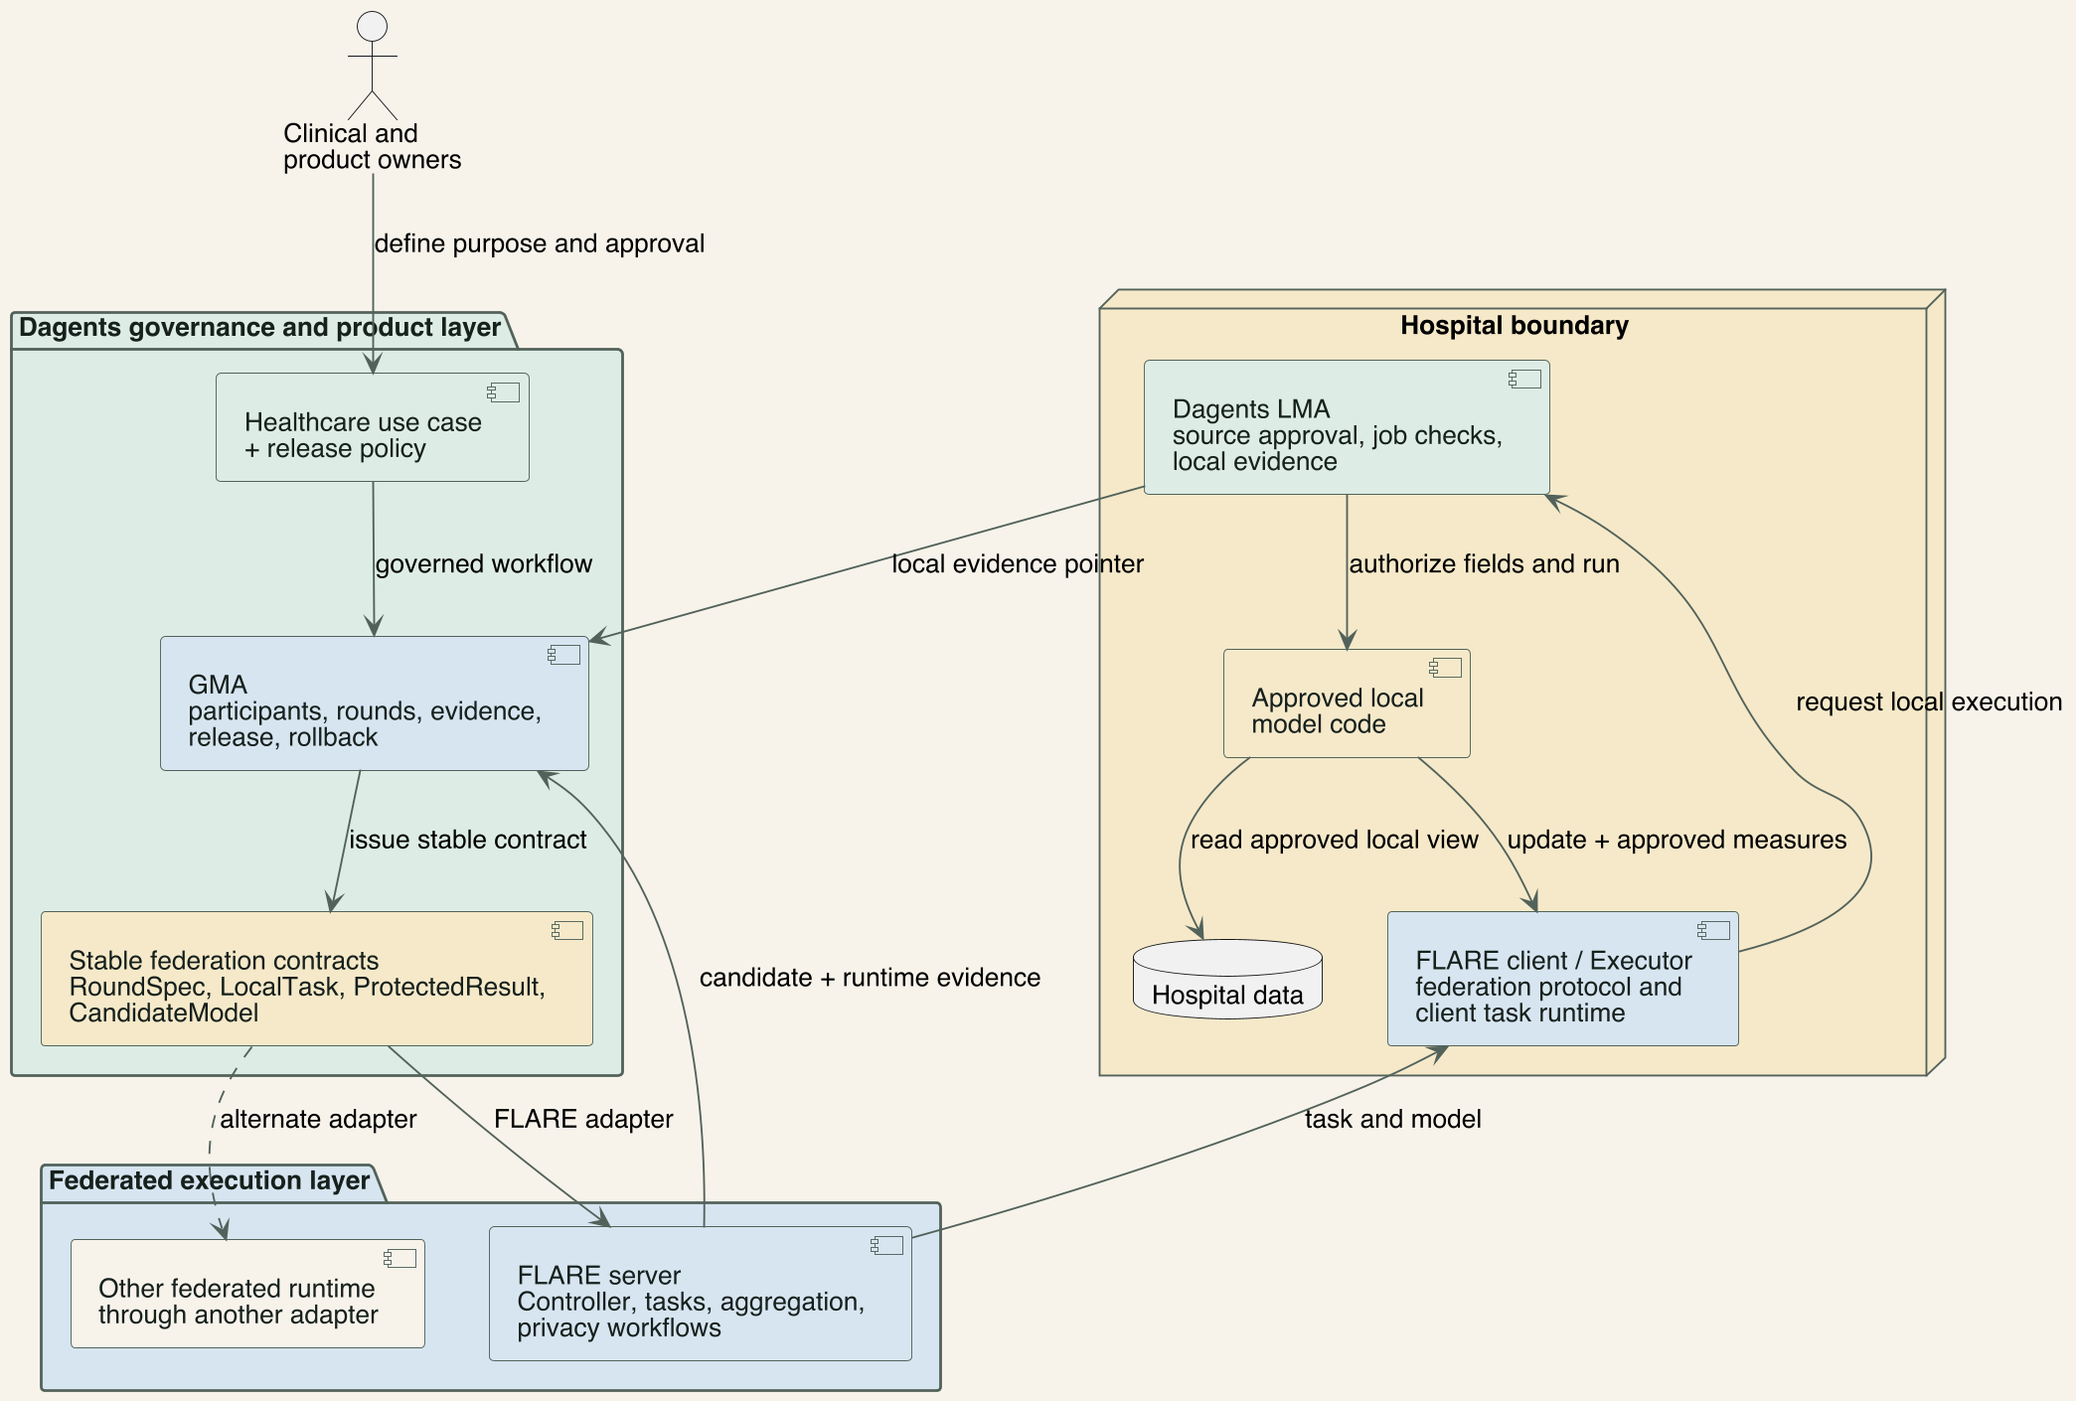
DAGENTS + FLARE BOUNDARY
Dagents can sit above FLARE and beside it at each hospital.
Above: Dagents keeps stable healthcare contracts and release policy. Beside: the LMA gates local access while the FLARE client runs the federation protocol.
Runtime abstraction and hospital boundary / 17
Notes:
Dagents can be an abstraction over FLARE because the clinical study, site eligibility, round contract, evidence package, and release decision do not need to expose every FLARE-specific detail. An adapter translates the stable Dagents contract into a FLARE job.
Dagents also runs in parallel with FLARE at the hospital. The LMA checks purpose, identity, code, and local source access. The FLARE client handles protocol tasks and returns the approved contribution. Neither component replaces the other.
[Sources]
- /Users/pradyundevarakonda/Developer/Dagents/docs/agents/lma-gma-architecture.md
- https://nvflare.readthedocs.io/en/main/system_architecture/system_architecture.html
[/Sources]

Slide 18
DAGENTS + FLARE
Dagents and FLARE work together at different layers.
Dagents keeps one healthcare contract. Adapters translate it to FLARE or another approved runtime.
Question
NVIDIA FLARE
Dagents
Primary job?
Run the federation protocol: controller, tasks, clients, aggregation, and supported privacy workflows
Define the use case, eligible sites, signed round contract, evidence, release, and rollback
Inside a hospital?
Client API or Executor connects the protocol to local model code
LMA approves the job and source view, then keeps detailed local evidence
Across hospitals?
Controller dispatches tasks, collects contributions, and builds a candidate
GMA sets quorum and stop rules, records the round, and governs the result contract
What is produced?
Candidate model plus runtime status and validation support
Governed candidate and evidence package; human approval remains separate
Can the runtime change?
Runtime-specific job, controller, and client APIs
Stable contracts can map to FLARE now or another approved runtime later
Design rule: do not rebuild FLARE inside GMA, and do not ask FLARE to replace Dagents governance. / 18
Notes:
FLARE is the specialist execution layer. Its server controller and client APIs run tasks, collect site contributions, aggregate them, and support cross-site validation and privacy workflows.
Dagents is the healthcare workflow and governance layer. Its GMA and LMA boundaries define which sites and source views are allowed, track evidence, and control release and rollback. A stable contract lets Dagents use FLARE today without making the healthcare workflow depend on one runtime forever.
[Sources]
- https://nvflare.readthedocs.io/en/main/system_architecture/system_architecture.html
- /Users/pradyundevarakonda/Developer/Dagents/docs/agents/lma-gma-architecture.md
[/Sources]

Slide 19
COMPLIANCE + SAFETY
Less data movement does not equal compliance.
Technical controls help, but hospitals and the consortium still own policy, operations, clinical evidence, and accountable decisions.
HIPAA
SOC 2
CLINICAL AI SAFETY
Keeping records local can reduce copies. Teams still need approved purpose, minimum-necessary decisions, access control, encryption, BAAs, retention, audit, risk analysis, and incident response.
Dagents can produce health, change, and recovery evidence. The organization still needs control owners, access reviews, change management, availability targets, vendor risk work, and an independent examination.
Each stroke-triage model needs a defined intended use, site and group validation, usability testing, clinician authority, monitoring, rollback, and regulatory analysis before care use.
Federated architecture is a control choice—not legal, audit, privacy, or medical approval / 15
Notes:
Keeping records local can reduce data movement, but it does not make a system HIPAA compliant, SOC 2 audited, or medically approved.
For the stroke pilot, each hospital still needs privacy, security, clinical-safety, human-factors, and regulatory work before any care use.
[Sources]
- https://www.hhs.gov/hipaa/for-professionals/security/index.html
- https://www.aicpa-cima.com/resources/download/2017-trust-services-criteria-with-revised-points-of-focus-2022
- https://www.fda.gov/news-events/press-announcements/fda-permits-marketing-clinical-decision-support-software-alerting-providers-potential-stroke
- https://www.accessdata.fda.gov/cdrh_docs/pdf21/K211179.pdf
[/Sources]

Slide 20
ROUND SAFETY GATES
Four gates must pass before a round changes the model.
Any failure cancels the candidate, records the reason, and keeps the current release in service.
1. SCOPE + SITE
2. CODE + DATA
3. PRIVACY
4. RELEASE
Is the hospital, condition, patient group, seed version, feature contract, and purpose approved?
Did the hospital verify the signer and code hash? Are units, cohort, labels, freshness, and quality acceptable?
Are contributions bounded, participant threshold met, egress allowed, and aggregation/privacy settings correct?
Did every site evaluation, subgroup, security, clinical, canary, and rollback check pass?
→
→
→
A successful aggregation is only a candidate—not permission to deploy.
Federated safety gates / 20
Notes:
The code-approval gate is supported by NVIDIA's example of hospital-side job acceptance based on code hashes or signatures. Secure aggregation requires a threshold and does not replace all privacy or security controls.
[Sources]
- https://developer.nvidia.com/blog/?p=71033
- https://research.google/pubs/practical-secure-aggregation-for-privacy-preserving-machine-learning/
- https://research.google/blog/distributed-differential-privacy-for-federated-learning/
[/Sources]

Slide 21
GRAILS
A published way to decide who may see what.
GRAILS keeps the ethics rules out of the normal application code, so a policy change does not become a code change.
Two parts
Three questions
The Rails work out what protection a request needs. The Guard applies it. Deciding and enforcing stay separate.
How sensitive is the data? How far do we trust who is asking? How much are they asking for?
Added, not rebuilt
Wider than privacy
It plugs into software that already exists. The stroke pathway is not redesigned to add ethics to it.
Privacy is the paper's worked example. The same shape extends to fairness, transparency, and security.
Access rules based on job titles alone cannot express “this person, this field, this purpose, today”. GRAILS can.
Kulkarni & Ramanathan, AIES 2025, IIIT Bangalore / 21

Slide 22
GRAILS + STROKE
The three dials, using stroke data.
The same request can get a different answer, depending on where the three dials sit.
HOW SENSITIVE
HOW TRUSTED
HOW MUCH
A ward name is low. The time symptoms started is medium. The brain scan and the final diagnosis are high.
A treating clinician on the stroke pathway, an internal audit reviewer, and an outside researcher are not the same requester.
One value for one patient, one patient's whole record, one field across every stroke case, or the entire table.
→
→
High sensitivity, asked for by low trust, across a whole column is the case that must never quietly default to allow.
Sensitivity, trust, and how much is asked for / 22

Slide 23
GRAILS + STROKE
The same field, three different answers.
What a requester gets back depends on who they are, not only on what they asked for.
Stroke field
Treating clinician
Audit reviewer
Outside researcher
When symptoms started
Exact time
Rounded to the hour
Time band only
Brain scan image
Full image
Report text, not the image
Not released
Stroke severity score
Exact score
Grouped into bands
Bands, small groups hidden
Final diagnosis
Full detail
Grouped category
Counts only, minimum group size
None of this is an if-statement inside the application. The row is looked up from the three dials.
Stroke fields under the three dials / 23

Slide 24
GRAILS + DAGENTS
GRAILS splits the same way Dagents already splits.
The Rails are planning. The Guard is runtime. That line is the one Dagents is built on.
Rails = planning
Guard = runtime
Work out the protection plan. Pure, typed, repeatable, and no input or output. This belongs in the OCaml layer, beside the dataset and model planners.
Apply the plan to real data and record what was decided. This belongs in the LMA and GMA, where the side effects already are.
GRAILS part
Where it goes in Dagents
Why there
Restriction Planner
OCaml planner module
The paper compares it to a database query planner. Dagents already has that layer.
Ethical Guard
LMA and GMA request path
Enforcement needs real data, a real requester, and an audit log.
Rules and regulations
Configuration, not code
Hospital policy changes far more often than the framework does.
Plan first, then enforce / 24

Slide 25
GRAILS + STROKE
The guard stands at the four gates you already have.
GRAILS does not add a fifth gate. It makes the existing ones concrete and reviewable.
1. SCOPE + SITE
2. CODE + DATA
3. PRIVACY
4. RELEASE
The trust score decides whether this hospital, this study, and this requester may run at all.
Only fields on the stroke feature contract can be read. Anything else is refused before a scan is ever opened.
The restriction plan sets the limit on the update and the counts before they leave the hospital network.
The GMA checks the plan was followed and the evidence exists before it signs anything as released.
→
→
→
Every decision writes down what it decided, why, and which round it belonged to.
Guard placement on the existing gates / 25

Slide 26
GRAILS + FEDERATION
GRAILS protects rows. A stroke round sends updates.
This is the one place the framework has to be extended, and it is the contribution this project can make.
What it covers today
What a stroke round adds
One value, one row, one column, or a whole table. All of them are data you can point at and read.
A model update is not a row, but it still carries patient signal. It has to become a fifth thing the rules cover.
Sensitivity becomes
Trust becomes
Action becomes
How much stroke-patient signal an update can carry out of the hospital.
The receiving site and the coordinator, not only a named person.
Limit the contribution, require enough sites, add noise, or refuse to send.
This is a real extension of the published framework, not a restatement of it.
Extending the rules to model updates / 26

Slide 27
CHOICE
Why Dagents over a framework or SaaS alone?
Best fit: Dagents supplies reusable control and release governance around a specialist federated-learning engine.
Option
Advantages
Tradeoffs
Dagents + FL engine
Source-local LMA boundary; reusable GMA orchestration; portable contracts; evidence and rollback in one design
More integration and operational ownership; privacy, identity, and clinical controls still need production work
FL framework alone
Mature algorithms, simulation, aggregation, and privacy extensions
Needs a surrounding control plane for orchestration, evidence, releases, and product integration
Managed FL SaaS
Fast onboarding, hosted services, and vendor support
Lock-in, recurring cost, deployment constraints, and less control over evidence or recovery
Central warehouse + ML
Familiar central analytics and model tools
Large and delayed data flows, duplicated sensitive records, and a larger governance boundary
One-off custom build
Can match one hospital network exactly
Slow to reuse and maintain; likely to create incompatible contracts for the next condition
Dagents wins on control, portability, and recoverability—not on lowest initial effort / 27
Notes:
This is an architectural pros-and-cons comparison, not a vendor benchmark. Dagents is strongest when paired with a specialist federated-learning engine; its main tradeoff is integration and operational ownership.
[Sources]
- /Users/pradyundevarakonda/Developer/Dagents/AGENTS.md
- /Users/pradyundevarakonda/Developer/Dagents/docs/agents/lma-gma-architecture.md
- https://developer.nvidia.com/blog/creating-robust-and-generalizable-ai-models-with-nvidia-flare/
- https://research.google/blog/federated-analytics-collaborative-data-science-without-data-collection/
[/Sources]

Slide 28
PILOT ROADMAP
Prove federation in stages.
Start with federated analytics; enable training only after the data, privacy, and recovery paths work.
Phase
What happens
Proof needed
1. Define
Approve the stroke-triage question, patient group, scan type, outcome, sources, site owners, and stop conditions
Signed clinical and data contract; named owners; no automatic care action
2. Federated analytics
Compute local counts, missingness, units, labels, and seed-model measures; reveal approved aggregates only
Same meaning at every site; minimum-message path; privacy threshold and audit trail
3. Simulate
Exercise complete rounds with approved test data, including site rejection, dropout, retry, bad update, and rollback
Deterministic recovery, signatures, round state, and no individual-update exposure
4. Retrospective train
Train on historical local data; evaluate every candidate locally and compare with local-only and current baselines
Cross-site and subgroup evidence; privacy report; candidate rejected when any gate fails
5. Silent live
Run the approved model on current data without displaying warnings to clinicians
Reliability, drift, alert volume, security, recovery, and separate clinical approval for any next stage
Evidence—not calendar dates—advances the federation / 28
Notes:
The roadmap starts with a precise stroke-triage question and federated analytics. Training is enabled only after common meaning, small-message exchange, privacy thresholds, and recovery are proven.
[Sources]
- https://www.cdc.gov/stroke/treatment/index.html
- https://www.accessdata.fda.gov/cdrh_docs/pdf21/K211179.pdf
[/Sources]

Slide 29
SUCCESS MEASURES
Success means quality, privacy, and recovery.
No single accuracy number proves that the federated system is safe or useful.
Cross-site model evidence
Minimal data movement
Calibration and discrimination at every hospital; approved group results; comparison with local-only and current baselines.
Zero raw patient rows in the GMA path; measured message size; blocked fields; cohort and privacy-threshold compliance.
Reliable rounds
Proof of recovery
Completion, timeout, dropout, retry, cancellation, signature verification, and time to stop a bad round.
Complete seed-to-release lineage; immutable approved versions; successful scheduled rollback and evidence-recovery drills.
Set measured baselines before targets; do not borrow NVIDIA study results as project goals / 29
Notes:
The four evaluation groups combine clinical-model evidence, data minimization, distributed-operations reliability, and backup-inspired recovery assurance.
[Sources]
- https://www.nature.com/articles/s41591-021-01506-3
- https://research.google/blog/distributed-differential-privacy-for-federated-learning/
- https://www.cisa.gov/stopransomware/ransomware-guide
[/Sources]

Slide 30
RECOMMENDATION
Start with federated analytics; earn the right to train.
Use Dagents as the governed orchestration and release layer around a specialist federated-learning engine.
Define one stroke-triage research use, feature contract, participant policy, site owner, and safe fallback.
Run data-readiness and seed-model evaluation locally; share only protected aggregate measures.
Integrate NVIDIA FLARE or an equivalent engine behind Dagents round and result contracts.
Require local code approval, secure aggregation where needed, signed releases, and complete lineage.
Practice cancellation and rollback before retrospective training—and again before any clinician-facing study.
Dagents Federated Healthcare / 30
Notes:
Recommendation: use Dagents as the governed orchestration and release layer around a specialist federated-learning engine.
Begin with federated analytics and a silent stroke-triage workflow study. Require local approval, protected aggregation where justified, signed releases, and tested rollback before training or clinician-facing use.
[Sources]
- https://www.accessdata.fda.gov/cdrh_docs/pdf21/K211179.pdf
- /Users/pradyundevarakonda/Developer/Dagents/docs/agents/lma-gma-architecture.md
[/Sources]

Slide 31
GLOSSARY
Federated-system terms
The terms describe different jobs; none is automatic proof of privacy, security, safety, or compliance.
Term
Plain meaning
Why it matters here
Federated learning
Hospitals train locally and send protected model updates instead of records
Improves one shared model; requires a specialist engine and privacy controls
Federated analytics
Hospitals calculate approved measures locally and reveal combined results
The safest first cross-hospital workload for readiness and evaluation
Federated database
One query layer can reach several remote data sources
Useful for local feature views; can still expose or move detailed results
Secure aggregation
The coordinator learns a combined update without reading each site’s update
Reduces exposure; does not solve poisoning, memorization, or governance alone
Restore point / rollback
A locked known-good release / return to that release after a problem
Backup-inspired control that makes model changes reversible
Federated healthcare glossary / 31
Notes:
Use these as working definitions for the presentation. Federated database behavior is based on IBM Db2 federation; backup language is used only as an operations analogy.
[Sources]
- https://research.google/pubs/communication-efficient-learning-of-deep-networks-from-decentralized-data/
- https://research.google/blog/federated-analytics-collaborative-data-science-without-data-collection/
- https://www.ibm.com/docs/en/db2/11.1.0?topic=federation-federated-systems
- https://research.google/pubs/practical-secure-aggregation-for-privacy-preserving-machine-learning/
- https://helpcenter.veeam.com/docs/vdc/userguide/aws_backup_chain_ec2.html
[/Sources]

Slide 32
FEDERATED AI APPENDIX
Federated AI
A self-contained guide to NVIDIA FLARE, federated rounds, FedAvg, privacy layers, deployment modes, and the Dagents boundary.
Big picture
NVIDIA FLARE
One round
Privacy layers
Dagents fit
Pradyun Devarakonda
Dagents Federated Healthcare / A1
Notes:
This appendix is designed to replace a separate introductory course for this presentation. It explains the few concepts needed to understand the proposed architecture and to answer basic questions.
The main distinction is simple: NVIDIA FLARE is a specialist runtime for distributed or federated computing. Dagents is the reusable control, policy, evidence, deployment, and recovery layer around that runtime.
[Sources]
- https://github.com/NVIDIA/NVFlare
- https://nvflare.readthedocs.io/en/main/system_architecture/system_architecture.html
- /Users/pradyundevarakonda/Developer/Dagents/docs/agents/lma-gma-architecture.md
[/Sources]

Slide 33
APPENDIX · BIG PICTURE
Federated AI is an umbrella, not one algorithm.
The common idea is to move approved computation or small results instead of pooling every raw record.
Term
Plain meaning
What crosses the boundary
Federated AI
Broad family of distributed AI and analytics methods
Tasks, models, updates, or aggregates
Federated learning
Sites improve one shared model by training locally
Protected model updates and approved measures
Federated analytics
Sites calculate approved statistics locally
Counts, statistics, and evaluation summaries
Federated database
One query layer reaches several remote sources
Queries and results—possibly detailed rows
Privacy techniques
Extra protection for messages and released results
Masked values, encryption, limits, and noise
Use the precise term: federation is a design family, not an automatic privacy guarantee / A2
Notes:
Federated AI is the umbrella. Federated learning is one member of that family and specifically improves a shared model from locally computed updates.
Federated analytics produces shared counts or measures without training a model. A federated database offers remote query access and can still move detailed results. Secure aggregation and differential privacy are protection techniques, not synonyms for federated learning.
Ask two questions whenever someone says federated: what is computed locally, and exactly what is allowed to leave each site?
[Sources]
- https://github.com/NVIDIA/NVFlare
- https://research.google/pubs/communication-efficient-learning-of-deep-networks-from-decentralized-data/
- https://research.google/pubs/practical-secure-aggregation-for-privacy-preserving-machine-learning/
[/Sources]

Slide 34
APPENDIX · NVIDIA FLARE
NVIDIA FLARE is a runtime for multi-site computing.
It is an open-source Python SDK for federated jobs—not a hospital data lake, stroke model, or compliance certificate.
Job definition
Server workflow
Client runtime
Algorithms
Security + operations
Packages the model, client code, sites, rounds, aggregation method, and validation plan.
A controller creates tasks, selects clients, tracks rounds, and processes returned results.
An executor or Client API connects FLARE to local training or evaluation beside the data.
Supports FedAvg, FedProx, FedOpt, other workflows, and cross-site validation patterns.
Provisioning, mTLS, site policies, filters, audit, simulation, POC, and production modes.
FLARE runs the specialist distributed workflow; Dagents still governs purpose, evidence, release, and recovery.
NVIDIA FLARE orientation / A3
Notes:
FLARE stands for NVIDIA Federated Learning Application Runtime Environment. NVIDIA describes it as an open-source, extensible Python SDK for adapting machine-learning and other collaborative-computing workflows to a federated setting.
Its component architecture supports server-side workflows, client-side execution, several machine-learning frameworks, federated statistics, multiple aggregation algorithms, privacy mechanisms, and deployment from simulation to production.
What FLARE does not supply is just as important: the validated stroke model, the clinical intended use, hospital governance, HIPAA compliance, or the Dagents product-level release contract.
[Sources]
- https://github.com/NVIDIA/NVFlare
- https://nvflare.readthedocs.io/en/main/system_architecture/system_architecture.html
- https://nvflare.readthedocs.io/en/main/system_architecture/security_overview.html
[/Sources]

Slide 35
APPENDIX · FLARE VOCABULARY
A FLARE job has four names worth knowing.
Read them as a simple request-and-return system; the lower-level software details can wait.
JOB / RECIPE
CONTROLLER
TASK
EXECUTOR / CLIENT API
The packaged plan: model, training code, clients, rounds, aggregation, and validation.
Server-side logic that creates tasks, chooses clients, and decides what happens next.
One unit of client work, such as train this model or evaluate this candidate.
The client-side bridge that calls local code and returns only the permitted result.
→
→
→
The task payload may use FLModel or the lower-level Shareable type; neither should contain the hospital's patient database.
FLARE job vocabulary / A4
Notes:
A Job Recipe is FLARE's higher-level way to describe a complete job. At runtime, a server-side Controller creates tasks and processes results.
On each client, an Executor or the higher-level Client API connects the FLARE runtime to local training or evaluation code. Recent FLARE APIs commonly exchange model state and lightweight metadata through FLModel; lower-level applications may use Shareable and FLContext concepts.
For a professor-level discussion, the four bold terms are enough: job, controller, task, and executor. The rest is implementation detail until the project is built.
[Sources]
- https://nvflare.readthedocs.io/en/main/programming_guide/flare_api_evolution.html
- https://nvflare.readthedocs.io/en/main/system_architecture/system_architecture.html
- https://github.com/NVIDIA/NVFlare/blob/main/examples/hello-world/README.md
[/Sources]

Slide 36
APPENDIX OVERVIEW · ONE ROUND
One round is a controlled request-and-return loop.
A round repeats; it is not one long data transfer or a database synchronization.
1. PREPARE
2. DISTRIBUTE
3. RUN LOCALLY
4. COMBINE + CHECK
Choose eligible sites, the approved starting model, code version, privacy profile, and round ID.
The controller offers each selected client a task carrying the model and approved instructions.
Each executor trains or evaluates beside local data and returns only its permitted contribution.
The server aggregates results, creates a candidate, and sends it back for site-level evaluation.
→
→
→
Another round or release begins only after participant, privacy, quality, and governance gates pass.
Federated round walkthrough / A5
Notes:
FLARE uses a task-based interaction model. The Controller creates work; clients request tasks, execute them locally, and return results. The Controller processes those results to advance or stop the workflow.
A well-governed round records the input model, code, selected sites, completed sites, privacy settings, aggregate result, evaluation status, and reason for stopping. Dagents can wrap these details in a reusable round and evidence contract.
If too few sites complete, a privacy threshold is missed, or validation fails, the round should stop without producing a release.
[Sources]
- https://nvflare.readthedocs.io/en/main/system_architecture/system_architecture.html
- https://nvflare.readthedocs.io/en/main/programming_guide/flare_api_evolution.html
- /Users/pradyundevarakonda/Developer/Dagents/docs/agents/lma-gma-architecture.md
[/Sources]

Slide 37
APPENDIX · FEDAVG
FedAvg combines local updates into a new candidate.
It averages model changes: often weighted by local training size, not patient rows.
Same starting model
Train locally
Every selected hospital begins the round from the same approved global-model version.
Each site adjusts the model using only its approved local examples and training rules.
Weight + average
Evaluate candidate
The server combines updates, commonly giving more weight to sites with more approved examples.
The average becomes a candidate only; every site still checks quality and safety before release.
Simple example: 300 approved examples may receive 3× the weight of 100; real policies can differ / A6
Notes:
Federated Averaging, or FedAvg, is the most useful first mental model for aggregation. Each participant trains the same starting model locally and sends a model update. The server computes a weighted average of those updates.
The weighting is often based on the amount of local training data, but production systems may add caps, clipping, reliability checks, fairness constraints, or choose a different algorithm entirely.
FedAvg explains how a candidate can be created without centralizing training rows. It does not, by itself, guarantee privacy, security, fairness, or clinical usefulness.
[Sources]
- https://research.google/pubs/communication-efficient-learning-of-deep-networks-from-decentralized-data/
- https://github.com/NVIDIA/NVFlare/blob/main/examples/hello-world/README.md
[/Sources]

Slide 38
APPENDIX · PRIVACY LAYERS
Federated learning still needs separate privacy layers.
Keeping raw data local reduces movement, but model updates and infrastructure can still leak or be attacked.
SECURE AGGREGATION
DIFFERENTIAL PRIVACY
IDENTITY + SECURE TRANSPORT
Reveals only a combined update when enough sites participate. It hides individual updates from the coordinator, but does not stop poisoning or final-model memorization.
Clips contributions and adds calibrated noise. A privacy budget tracks protection across rounds; stronger privacy can reduce model usefulness.
mTLS authenticates participants and encrypts the connection. Signatures and digests detect changed jobs or models; local authorization may still reject them.
Use layers together: no single control makes a federation private, secure, compliant, or clinically safe / A7
Notes:
Secure aggregation lets a server recover an aggregate without reading each participant's individual contribution, provided the protocol's threshold and assumptions are satisfied.
Differential privacy limits how strongly an individual sample or participant can affect a released result. FLARE documents client-side filters and training-time DP-SGD approaches with clipping, noise, and privacy accounting.
Mutual TLS, signatures, authorization, audit, secure aggregation, and differential privacy protect different parts of the system. A healthcare deployment usually needs several of them plus the hospital's existing security program.
[Sources]
- https://research.google/pubs/practical-secure-aggregation-for-privacy-preserving-machine-learning/
- https://nvflare.readthedocs.io/en/main/system_architecture/security_overview.html
- https://nvflare.readthedocs.io/en/main/user_guide/admin_guide/security/differential_privacy.html
[/Sources]

Slide 39
APPENDIX · RUN MODES
FLARE grows from laptop test to distributed production.
Each mode proves something different; a successful simulation is only the first piece of evidence.
SIMULATOR
PROOF OF CONCEPT
PRODUCTION
Runs a lightweight multi-client experiment on one machine. Best for learning the API, testing algorithms, and checking basic job logic quickly.
Runs separate local server and client processes. Tests task flow, configuration, operators, failures, and a closer version of the real runtime.
Runs provisioned participants across real machines or organizations with PKI, mTLS, authorization, deployment, monitoring, and recovery.
Progression: algorithm evidence → system evidence → real organizational and security evidence / A8
Notes:
Simulator mode is the fastest environment and runs a federation locally for algorithm and job development. POC mode uses separate local processes to exercise more realistic behavior.
Production mode distributes provisioned server and client systems across real machines and uses production identity and communication controls. It also introduces real firewalls, certificates, administrators, availability requirements, and recovery work.
The same job succeeding in all three modes is useful, but production deployment still needs hospital approval, security testing, privacy review, operational monitoring, and clinical validation.
[Sources]
- https://nvflare.readthedocs.io/en/main/run_mode.html
- https://nvflare.readthedocs.io/en/main/system_architecture/system_architecture.html
[/Sources]

Slide 40
APPENDIX · OPERATIONAL TERMS
Five terms complete the federated-round picture.
These are the terms most likely to appear in a project review or professor's question.
Term
Plain meaning
Why it matters here
Seed / global model
The approved shared model before a round begins
Every eligible site must receive the intended version
Round
One distribute, local-work, aggregate, and evaluate loop
Needs one ID, participant list, versions, status, and stop reason
Local model update
A mathematical change computed by one site
Not raw rows, but still potentially sensitive or malicious
Candidate model
A newly combined model waiting for every check
It is not a release and must not silently replace the current model
Dropout / quorum
A missing site / the minimum completed sites required
Cancel safely when too few approved sites complete
Canary and rollback occur only after a candidate passes the release gates / A10
Notes:
The seed or global model is the model state entering a round. A local model update is the mathematical change produced by one site. Aggregation creates a candidate global model.
A candidate is not a release. It needs cross-site validation, privacy and security checks, clinical review, a signed version, and a recovery plan.
Dropout is normal in distributed systems. The round definition should state how many sites must complete and what happens when the quorum or minimum participant threshold is missed.
[Sources]
- https://nvflare.readthedocs.io/en/main/system_architecture/system_architecture.html
- https://research.google/pubs/communication-efficient-learning-of-deep-networks-from-decentralized-data/
- https://research.google/pubs/practical-secure-aggregation-for-privacy-preserving-machine-learning/
[/Sources]

Slide 41
APPENDIX TAKEAWAY
You only need five ideas to explain the design.
FLARE runs the federation; Dagents governs how it becomes a controlled healthcare workflow.
Raw data stays local, but model updates still need protection and review.
A controller assigns tasks; client executors or client code run them locally.
Repeated rounds create candidate models—not automatic clinical releases.
Secure aggregation, differential privacy, mTLS, signatures, and authorization solve different risks.
Move from simulator to POC to production only when each stage supplies the required evidence.
Dagents Federated Healthcare / A11
Notes:
If asked to summarize NVIDIA FLARE in one sentence: it is an open-source runtime that coordinates server-side workflows and client-side local computation for federated jobs.
If asked why Dagents is still needed: FLARE executes the federation, while Dagents supplies reusable hospital boundaries, product contracts, deployment planning, policy, evidence, release governance, and rollback across use cases.
If asked whether federated learning is automatically private or compliant: no. Keeping raw data local is useful, but updates, code, identities, infrastructure, and final models still need layered controls and proof.
[Sources]
- https://github.com/NVIDIA/NVFlare
- https://nvflare.readthedocs.io/en/main/system_architecture/security_overview.html
- https://nvflare.readthedocs.io/en/main/run_mode.html
- /Users/pradyundevarakonda/Developer/Dagents/docs/agents/lma-gma-architecture.md
[/Sources]

