Slide 1
DAGENTS
The DAgents Framework
A reusable framework for deploying one computation agent per source, combining their outputs through a global agent, and producing workload plans for real backend systems.
Source data
LMA
GMA
Framework services
Workloads
Pradyun Devarakonda
Rajanala Dheeraj (Previously)
Dagents / 01

Slide 2
DEFINITION
Dagents deploys computation agents near data sources, then combines their work globally.
In the codebase, the per-source agent is called LMA ( Local Monitoring Agent) or the CMA (Constraint Monitoring Agent). The outputs produced by them are combined and computations on the combined data are then done by the GMA ( Global Monitoring Agent).
One LMA is attached to each source boundary: tenant, database, service, event stream, or environment.
CMA / LMA
per source
Each local agent profiles data, partitions work, runs source-level models, and publishes summaries or artifacts.
The GMA registers local agents and combines their outputs for multi-source computation.
send results
Core services turn those plans into workflows, model jobs, and Kubernetes workload manifests.
GMA
multi-source view
Dagents / 02

Slide 3
TASK 01 / DATA
Some tasks you can do...
Understand a source before choosing partitions, models, or pipelines.
Source profiling: Turn raw source metadata into a structured DatasetProfile.
1 / INPUT ↓
POSTGRES
ORDERS
TRY IT
"Profile the Postgres orders table before anomaly detection."
WHAT DAGENTS DOES
Read the schema and source statistics.
Find field types, gaps, and cardinality.
Suggest partitions and suitable model tasks.
RESULT
DatasetProfile plus a data-quality summary
2 / PROFILE ↓
3 / RESULT
DATASET
PROFILE
WHY IT MATTERS Better model choices start with a clear picture of the data.
DAgents / Task 01

Slide 4
TASK 02 / WORKFLOW
Some tasks you can do...
Turn a workflow description into a checked and ordered execution plan.
Pipeline orchestration: Validate steps and dependencies before runtime execution.
1 / INPUT ↓
JSON
PIPELINE
TRY IT
"Run: load orders, filter paid, profile, then detect anomalies."
WHAT DAGENTS DOES
Check step IDs and input references.
Reject missing dependencies and cycles.
Produce a safe topological execution order.
RESULT
Validated pipeline plan plus execution order
2 / COMPILE ↓
3 / RESULT
PIPELINE
PLAN
WHY IT MATTERS The runtime receives a valid plan instead of guessing step order.
DAgents / Task 02

Slide 5
TASK 03 / MODELS
Some tasks you can do...
Select a model from task needs, dataset traits, and available adapters.
Model routing: Centralize model selection and keep fallback choices visible.
1 / INPUT ↓
PROFILE +
TASK
TRY IT
"Choose a model for tabular anomaly detection on transaction data."
WHAT DAGENTS DOES
Match the requested task and dataset profile.
Check registered model capabilities.
Rank candidates and choose a packaging mode.
RESULT
Selected model route plus fallback candidates
2 / ROUTE ↓
3 / RESULT
MODEL
PLAN
WHY IT MATTERS Apps ask for a task; the framework owns the model-choice policy.
DAgents / Task 03

Slide 6
TASK 04 / DEPLOY
Some tasks you can do...
Convert a typed workload request into deployment-ready Kubernetes YAML.
Manifest generation: Render repeatable deployment material from a WorkloadSpec.
1 / INPUT ↓
WORKLOAD
SPEC
TRY IT
"Deploy lma-orders with two replicas in the dev environment."
WHAT DAGENTS DOES
Validate image, resources, environment, and ports.
Apply deterministic naming and labels.
Render the required Kubernetes resources.
RESULT
KubernetesManifestBundle ready for review or apply
2 / RENDER ↓
3 / RESULT
K8S YAML
BUNDLE
WHY IT MATTERS One workload contract can produce consistent deployment files.
DAgents / Task 04

Slide 7
TASK 05 / AGENTS
Some tasks you can do...
Give the GMA a live catalog of local agents, scopes, and capabilities.
Agent registration and discovery: Track which LMA can perform each source-level task.
1 / INPUT ↓
LMA
METADATA
TRY IT
"Register orders for Postgres profiling and forecasting."
WHAT DAGENTS DOES
Validate identity, scope, version, and capabilities.
Store the current agent registration.
Expose the capability through fleet discovery.
RESULT
Discoverable LMA registration and capability record
2 / REGISTER ↓
3 / RESULT
FLEET
CATALOG
WHY IT MATTERS The GMA can route work only after it knows what each LMA can do.
DAgents / Task 05

Slide 8
TASK 06 / LOCAL
Some tasks you can do...
Run source-scoped work near a tenant, database, service, or event stream.
Local source execution: Keep each computation inside a clear source boundary.
1 / INPUT ↓
TENANT-A
SOURCE
TRY IT
"Run anomaly detection for tenant-a orders."
WHAT DAGENTS DOES
Resolve the source scope and current bundle.
Profile, partition, and invoke the selected model.
Publish a summary and artifact pointer.
RESULT
Source-level run with output metadata
2 / EXECUTE ↓
3 / RESULT
LOCAL
RESULT
WHY IT MATTERS Local work remains isolated, traceable, and close to its data.
DAgents / Task 06

Slide 9
TASK 07 / GLOBAL
Some tasks you can do...
Combine local results when the question spans several sources or tenants.
Multi-source assimilation: Use the GMA for aggregate profiling, correlation, and models.
1 / INPUT ↓
LMA
OUTPUTS
TRY IT
"Combine three sales summaries and find cross-region anomalies."
WHAT DAGENTS DOES
Collect compatible outputs from registered LMAs.
Normalize and profile the assimilated data.
Run aggregate models or correlation rules.
RESULT
Multi-source insight with correlated events
2 / ASSIMILATE ↓
3 / RESULT
GMA
INSIGHT
WHY IT MATTERS The GMA turns separate local results into one combined view.
DAgents / Task 07

Slide 10
TASK 08 / PLANNING
Some tasks you can do...
Translate computation intent into a typed plan the runtime can execute.
Workload compilation: Resolve task, model, resources, partitions, and outputs early.
1 / INPUT ↓
JOB
INTENT
TRY IT
"Compile this profiling and anomaly-detection job for runtime."
WHAT DAGENTS DOES
Validate input, task, model, resources, and output.
Resolve model routing and partition strategy.
Emit an explicit execution-ready workload plan.
RESULT
Typed WorkloadPlan with no hidden runtime decisions
2 / COMPILE ↓
3 / RESULT
WORKLOAD
PLAN
WHY IT MATTERS Compilation makes runtime behavior inspectable before execution.
DAgents / Task 08

Slide 11
TASK 09 / CONTRACTS
Some tasks you can do...
Plan safe extraction and transformation from a typed source contract.
Schema and extraction planning: Catch missing fields and invalid transforms before data moves.
1 / INPUT ↓
SOURCE
SPEC
TRY IT
"Extract order_id, amount, region, and created_at from Postgres."
WHAT DAGENTS DOES
Validate fields, types, and required values.
Plan projections, renames, and transforms.
Return the expected output schema and checks.
RESULT
ExtractionPlan plus output schema and validation report
2 / PLAN ↓
3 / RESULT
EXTRACTION
PLAN
WHY IT MATTERS A shared data contract removes repeated defensive checks.
DAgents / Task 09

Slide 12
TASK 10 / ML
Some tasks you can do...
Coordinate dataset preparation, training, evaluation, and saved artifacts.
Model training and inference: Run the model lifecycle through one service boundary.
1 / INPUT ↓
PROFILED
DATA
TRY IT
"Train and evaluate an autoencoder on profiled transaction records."
WHAT DAGENTS DOES
Load and preprocess the selected dataset.
Train with validation or cross-validation.
Persist metrics, status, and the model artifact.
RESULT
Model artifact, evaluation metrics, and run status
2 / TRAIN + TEST ↓
3 / RESULT
MODEL
ARTIFACT
WHY IT MATTERS DAgents coordinates the lifecycle while Python handles numerical work.
DAgents / Task 10

Slide 13
TASK 11 / REUSE
Some tasks you can do...
Register common JSON steps once and reuse them across products and runs.
Reusable pipeline steps: Compose filtering, projection, profiling, and model execution.
1 / INPUT ↓
JSON
STEPS
TRY IT
"Build: filter, project, profile, then run a model job."
WHAT DAGENTS DOES
Resolve built-in step implementations.
Check compatible inputs and outputs.
Register the named pipeline and run it on JSON.
RESULT
Reusable pipeline with inspectable run history
2 / REGISTER ↓
3 / RESULT
REUSABLE
PIPELINE
WHY IT MATTERS Products share workflow behavior without copying orchestration code.
DAgents / Task 11

Slide 14
TASK 12 / TRACE
Some tasks you can do...
Keep execution status, summaries, and artifact locations easy to inspect.
Run tracking and artifact publishing: Make every computation auditable after it leaves the caller.
1 / INPUT ↓
RUN
REQUEST
TRY IT
"Show the status and artifacts for run-204."
WHAT DAGENTS DOES
Create a stable run identifier.
Record state transitions and summary metadata.
Publish artifact pointers for later inspection.
RESULT
Auditable run record with status and artifacts
2 / TRACK ↓
3 / RESULT
STATUS +
ARTIFACTS
WHY IT MATTERS Every run leaves evidence that another service can inspect.
DAgents / Task 12

Slide 15
TASK 13 / OPS
Some tasks you can do...
Connect typed plans to service discovery and deployable workloads.
Deployment and service operations: Inspect topology and generate deployment material for services.
1 / INPUT ↓
SERVICE
INTENT
TRY IT
"Prepare LMA, GMA, and pipeline-service for deployment."
WHAT DAGENTS DOES
Read the service catalog and runtime topology.
Compile workload settings and environment values.
Return manifests for the required services.
RESULT
Deployable manifest bundle plus topology information
2 / COMPILE ↓
3 / RESULT
DEPLOY
BUNDLE
WHY IT MATTERS The framework links typed plans to the services that run them.
DAgents / Task 13

Slide 16
TASK 14 / APPS
Some tasks you can do...
Let a product backend consume DAgents without importing its internals.
Consumer app integration: Use stable APIs and contracts from any backend stack.
1 / INPUT ↓
APP
BACKEND
TRY IT
"Add DAgents planning to NL2SQL without moving domain logic."
WHAT DAGENTS DOES
Call REST, gRPC, or the internal process boundary.
Send shared source, model, pipeline, or workload contracts.
Consume plans, run status, SQL, or trace output.
RESULT
A stable integration with a visible DAgents trace
2 / CALL API ↓
3 / RESULT
PLAN +
TRACE
WHY IT MATTERS The product keeps its domain logic while DAgents supplies computation services.
DAgents / Task 14

Slide 17
TASK 15 / EXTEND
Some tasks you can do...
Add new infrastructure behind contracts without changing the framework core.
New adapters and integrations: Grow from local demos into cloud and broker-backed deployments.
1 / INPUT ↓
CLOUD
ADAPTER
TRY IT
"Add an S3 source adapter and a broker-backed run publisher."
WHAT DAGENTS DOES
Implement the existing adapter contract.
Register the new source or publisher capability.
Verify conformance and deploy independently.
RESULT
Portable capability with no domain-layer rewrite
2 / PLUG IN ↓
3 / RESULT
NEW
CAPABILITY
WHY IT MATTERS The same contracts can grow into GCP, AWS, Supabase, and broker integrations.
DAgents / Task 15

Slide 18
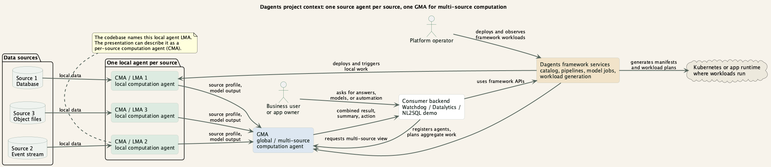
CONTEXT
Non-technical view: local computation first, combined computation second.
The framework sits between consumer apps, data sources, operators, and the runtime where workloads are deployed.
Dagents / 03

Slide 19
FRAMEWORK
Dagents is not one product backend. It is a reusable service framework.
Consumer apps plug into it when they need agent orchestration, ML workflow services, or workload generation.
Core service
Pipeline service
Model service
LMA / CMA
GMA
Catalog, topology, workload compilation, and Kubernetes manifest generation.
Register JSON workflows, validate them, and run them against payloads.
Python-first training, checks, benchmark data, and reusable ML jobs.
Source-scoped dataset profiling and local model execution.
Agent registration, aggregation, dispatch tracking, and multi-source profiles.
The important idea: backend teams call stable service APIs instead of rebuilding source profiling, pipeline orchestration, model routing, and manifest generation in every app.
Dagents / 04

Slide 20
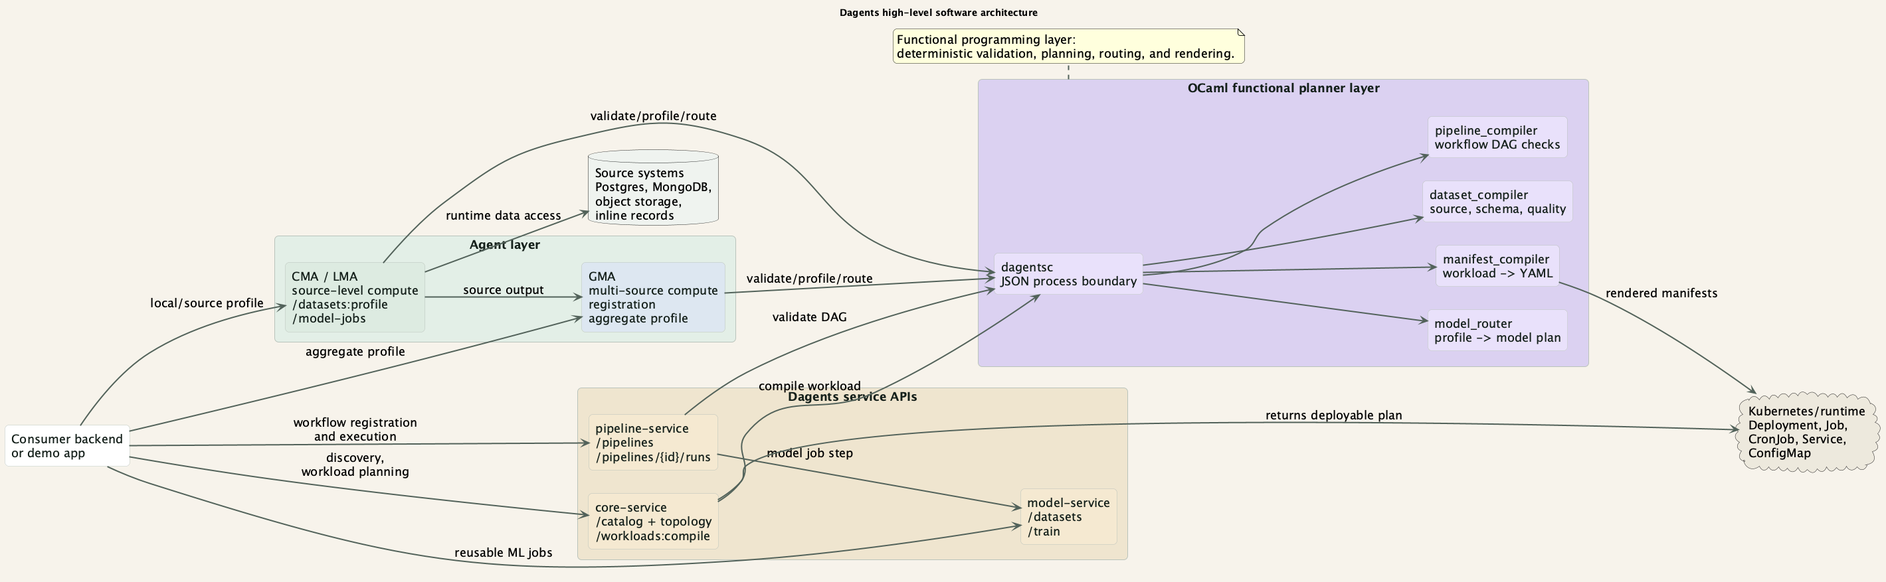
SOFTWARE ARCHITECTURE
High-level software view: runtime services outside, functional planners inside.
The purple block is the OCaml functional programming layer. Services call it through dagentsc.
Dagents / 05

Slide 21
INTEGRATION
A backend integrates by calling Dagents APIs at the points where it needs planning or execution.
The system is useful because integration is service-based, not a codebase fork.
Architectural points
How to integrate
LMA owns local/source execution.
Call /api/v1/services or /topology to discover framework services.
GMA owns aggregate coordination.
Register a source or pipeline definition.
Core service is the deployment facade.
Use LMA/GMA /datasets:profile for local or aggregate profiles.
Pipeline service executes reusable workflows.
Use /workloads:compile to turn app components into deployable manifests.
OCaml planners keep validation deterministic.
Read returned plans and traces in your own backend/UI.
Dagents / 06

Slide 22
ARCHITECTURE TRADEOFFS
Why Dagents is split this way
The framework is intentionally polyglot: each layer owns a clear responsibility.
OCaml for plans
Python for runtime
Best for closed choices: source kinds, step kinds, model families.
Pure functions make validation repeatable and easy to test.
Best for FastAPI, ML libraries, source adapters, and quick experiments.
Training and inference stay close to the Python ecosystem.
Java / Spring for control APIs
Service boundaries between layers
Best for typed controllers, validation, configuration, and backend integration.
It provides stable orchestration entrypoints without owning ML execution.
Spring and Python services call dagentsc through JSON process contracts.
Consumer backends use stable REST or gRPC APIs; failures stay isolated.
“DAgents is not OCaml-first, Python-first, or Java-first. OCaml makes plans precise, Python executes data and models, and Java exposes stable control and integration APIs.”
Dagents / 06A

Slide 23
SERVICE API SCOPE
Core service scope includes workload compilation.
The current FastAPI route shows the intended service contract.
current API example
consumer call
@router.post("/workloads:compile", response_model=WorkloadPlanResponse)
def compile_workloads(
request: WorkloadCompileRequest,
service: ManifestService = Depends(get_manifest_service),
) -> WorkloadPlanResponse:
return service.compile(request)
curl -X POST http://127.0.0.1:8040/api/v1/workloads:compile \
-H "Content-Type: application/json" \
-d @docs/demo/inputs/core-workload-compile.json
# returns a stored workload plan plus Kubernetes YAML
# for Deployment, Service, and ConfigMap resources
The same pattern exists across the framework: register a workflow, validate a source, profile a dataset, route a model, or compile a workload.
Dagents / 07

Slide 24
WORK IN PROGRESS
Current implementation scope
The repository contains working slices across agents, services, planners, deployment, and documentation. These boundaries are still being hardened.
Agents
Services
Functional planners
Current: source and aggregate APIs with in-memory state. Next: durable state and broker messaging.
Current: core, pipeline, and model APIs. Next: hardened contracts, authentication, and operations.
Current: typed OCaml planners behind dagentsc. Next: wider contracts and service packaging.
Consumer validation
Deployment
Documentation
Current: one demo validates the consumer boundary. Next: Watchdog and Datalytics adapters.
Current: Docker Compose and demo scripts. Next: Kubernetes apply and CI/CD.
Current: architecture, reports, debug notes, and demo output. Next: operator guides.
Implementation scope, not a production-readiness claim

Slide 25
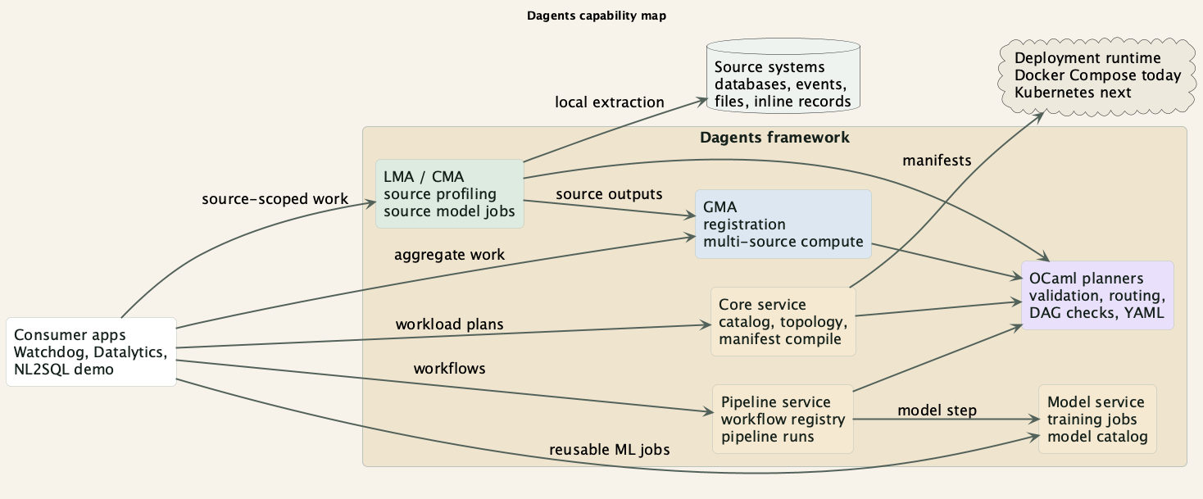
SCOPE MAP
Current framework scope
This map separates the current implementation boundaries from extension points for future consumer backends.
PlantUML: docs/presentation/puml/dagents_capability_map.puml

Slide 26
AGENT SCOPE
Agent control plane: current work in progress
The current implementation establishes the local-versus-global boundary with in-memory control flows.
Register
Profile
Run models
Sync
GMA records LMA identity, scope, version, and capabilities.
LMA profiles source records; GMA profiles assimilated records.
Both agents can accept model-job requests and produce run metadata.
GMA can plan desired deployments and receive LMA heartbeat/sync state.
→
→
→
This is the first control-plane slice. Persistent state, broker-backed dispatch, and production telemetry remain work in progress.
Current agent API scope: LMA + GMA

Slide 27
SERVICE SCOPE
Service suite: current integration scope
Each service owns a narrow job; contracts and operational hardening remain work in progress.
Service
What it does
Next hardening step
core-service
Catalog, topology, workload compile, Kubernetes YAML
Auth, durable plans, deployment apply
pipeline-service
Registers JSON workflows and runs ordered steps
Persistence, retries, scheduling
model-service
Dataset catalog, training jobs, model-job visibility
Artifact registry and worker queues
LMA / GMA
Source-level and aggregate agent computation
Broker dispatch and durable state
dagentsc
OCaml process boundary for deterministic planning
Versioned contracts and packaging
Integration stays API-based while the contracts mature

Slide 28
POTENTIAL
Where this project can grow
Dagents can become the shared agent layer for data-heavy applications.
Reusable agent layer
Traceable decisions
Apps can reuse LMA/GMA behavior instead of writing one-off orchestration code.
Every request can show checks, plans, routes, and service calls.
Deployment bridge
Safer AI workflows
Typed workload specs can become Docker, Kubernetes, or cloud deployment artifacts.
Policy checks can run before data access, model calls, and generated actions.
Potential: shared infra for future consumers

Slide 29
PYTHON / RUNTIME
Python: why we chose it and what it does
Python runs the parts of DAgents that talk to data, services, files, models, and external systems.
Why we chose it: FastAPI makes APIs quick to build, Pydantic checks JSON requests, and PyTorch and data libraries support ML work.
Python's job
APIs + I/O
pipelines
ML execution
state
FastAPI
PyTorch
What it does: Python runs LMA and GMA APIs, pipeline execution, model training and inference, source adapters, and the core service.
How it is used: A request enters a Python service. The service performs I/O or ML work and calls dagentsc when it needs a typed plan.
What stays outside: Deterministic compiler rules stay in OCaml. Spring provides a separate control API and integration surface.
DAgents / Python layer

Slide 30
PYTHON MODULES
Python services execute the framework's live workloads
Each service owns an API or runtime concern; shared contracts keep them connected.
Area
What it owns
Why Python fits
LMA / GMA
Source and aggregate agent APIs, runs, state
Fast local and global orchestration
core-service
Catalog, topology, workload facade
HTTP integration and deployment I/O
pipeline-service
Workflow registry and stateful runs
Flexible JSON execution
model-service
Preprocessing, training, evaluation, artifacts
PyTorch and data libraries
NL2SQL backend
Schema, model adapters, DAgents trace
Consumer-specific orchestration
DAgents / Python modules

Slide 31
PYTHON REQUEST FLOW
Python turns valid requests into runtime work
The runtime layer coordinates side effects while typed planner boundaries stay explicit.
RECEIVE
PLAN
EXECUTE
RETURN
FastAPI parses and validates a Pydantic request.
The service calls dagentsc or another typed planning boundary.
It reads data and runs an agent, pipeline, or model action.
It stores status and returns output with an execution trace.
→
→
→
Python is the live execution layer; planning remains deterministic and replaceable.
Python flow

Slide 32
PYTHON TESTING
Pytest checks Python runtime behavior
FastAPI clients and dependency boundaries keep most tests quick and focused.
WHAT WE VERIFY
1. Typed fixtures
pytest -q
pytest agents/tests
pytest services/core-service/tests
pytest services/nl2sql-demo/tests
Datasets, sources, workloads
LMA and GMA control flow
Manifest endpoints
Pipeline step ordering
Model preprocessing
NL2SQL model and trace behavior
PostgreSQL adapters
dagentsc process calls
2. Pytest starts app
FastAPI test clients
3. Service flow runs
Repositories and adapters
4. Integration checked
PostgreSQL or Docker when needed
Two kinds of confidence
Python tests prove API and runtime behavior. OCaml tests prove deterministic planner behavior.
DAgents / Python verification

Slide 33
JAVA / SPRING
Java / Spring: control APIs and integration
Java provides a strongly typed service layer for control APIs, validation, configuration, and backend integration.
Why we chose it: Spring Boot provides mature controllers, dependency injection, configuration, validation, testing, and integration tools.
Java's job
validate
coordinate
control APIs
integration
Spring Boot
Java 21
What it does: Java exposes agent registration, heartbeat, source, deployment, telemetry, catalog, topology, and workload APIs.
How it is used: Controllers receive requests, application services run the use case, repositories keep state, and gateways call dagentsc.
What stays outside: Java does not train ML models or replace OCaml planners. Python handles ML; OCaml handles deterministic planning.
DAgents / Java layer

Slide 34
JAVA MODULES
Spring services provide a second runtime surface
Controllers stay thin while application services and gateways own coordination.
Area
What it owns
Why it matters
spring-common
Shared request and response records
Keeps service contracts aligned
control API
Registration, heartbeat, source, deployment, telemetry
Stable orchestration entrypoints
control application
Coordination and in-memory repositories
Separates HTTP from state
core API
Catalog, topology, workload compile
Deployment-facing facade
compiler gateway
dagentsc process call and Java fallback
Typed planner without direct FFI
DAgents / Java modules

Slide 35
JAVA REQUEST FLOW
Spring keeps request boundaries clear
The control layer keeps transport, coordination, state, and compilation separate.
RECEIVE
COORDINATE
PERSIST
COMPILE + RETURN
A Spring controller validates the incoming request.
An application service selects and runs the use case.
Repositories update agents, sources, deployments, or runs.
The OCaml gateway or Java fallback produces the response.
→
→
→
Spring adds an enterprise integration surface without moving ML execution into Java.
Java flow

Slide 36
JAVA TESTING
JUnit and MockMvc verify Spring services
Maven runs controller, application, repository, and compiler-gateway tests together.
WHAT WE VERIFY
1. Request fixture
cd services/spring-services
mvn test
mvn package
Typed Java records
Controller validation
Agent registration
Heartbeat and source catalog
Deployment planning and sync
Core catalog and topology
Java manifest compiler
Process gateway fallback
2. MockMvc calls API
Validation and status codes
3. Service runs
Use cases and repositories
4. Compiler checked
Process call and fallback
Why the fallback is tested
The service can still return a valid manifest plan when the OCaml executable is unavailable.
DAgents / Java verification

Slide 37
OCAML / PLANNING
OCaml: why we chose it and what it does
OCaml handles small planning kernels where invalid states should be rejected before runtime work begins.
Why we chose it: Variant types, pattern matching, immutable data, and pure functions make rules explicit and easy to test.
OCaml's job
typed input
validate
compile plans
route models
manifests
dagentsc
Dune
What it does: OCaml validates source schemas, compiles pipeline DAGs, routes model choices, plans workloads, and renders manifests.
How it is used: Services send JSON to dagentsc and receive a validation report, execution plan, model route, or manifest bundle.
What stays outside: OCaml is not the API server, database layer, or ML runtime. It plans and validates; Python and Java run services.
DAgents / OCaml layer

Slide 38
HIGHLIGHTED LAYER
In the high-level architecture, the OCaml modules are the purple planning layer.
They are called by services when a request needs deterministic validation or planning.
OCaml modules
common_ir gives one typed language for all planners.
dataset_compiler checks sources and schema work.
pipeline_compiler validates workflow graphs.
model_router standardizes model selection policy.
manifest_compiler renders Kubernetes workload plans.
Dagents / 11

Slide 39
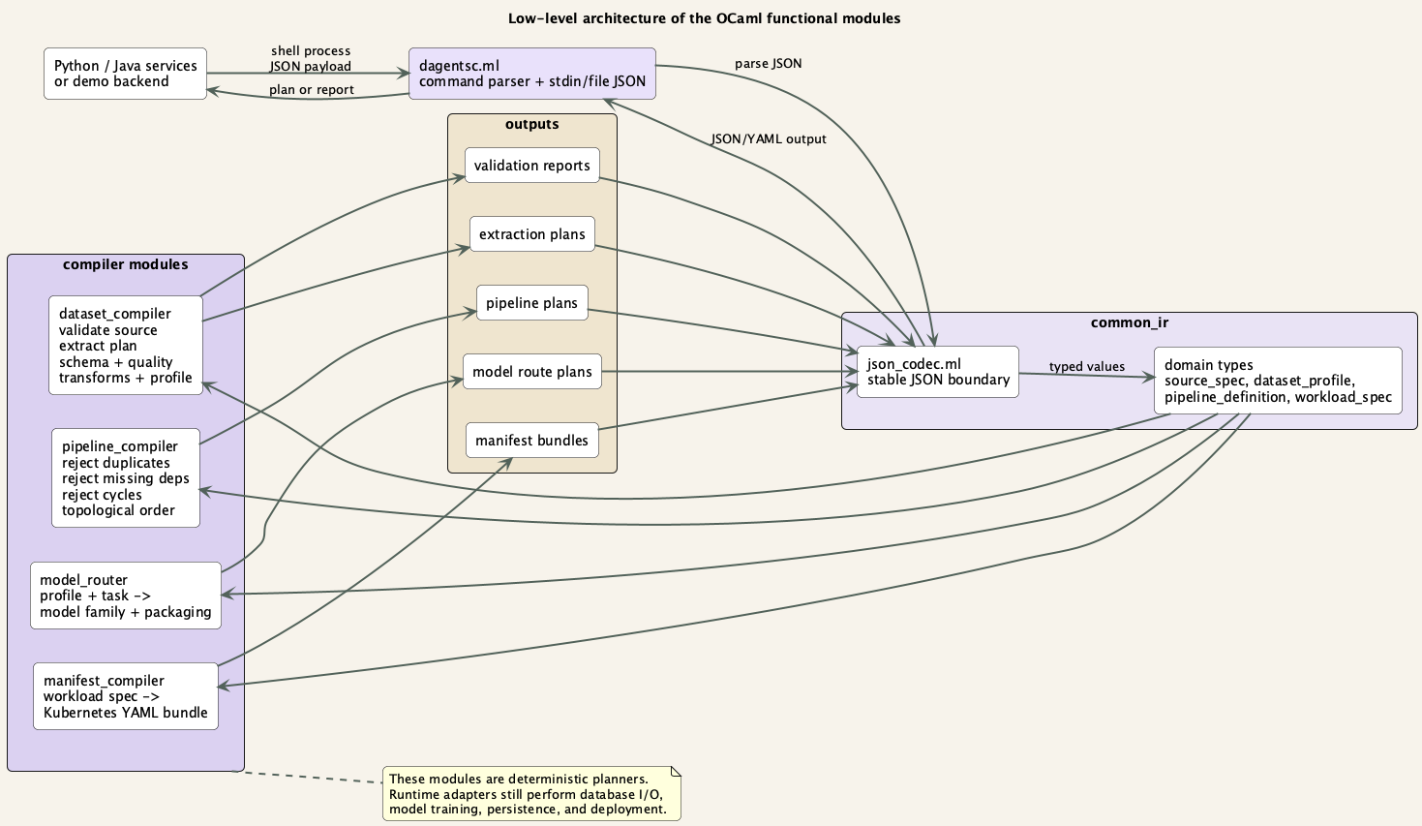
LOW-LEVEL OCAML
The OCaml layer is a compiler stack over shared typed contracts.
The diagram shows how services enter through dagentsc and leave with reports, plans, routes, or manifests.
common_ir owns the domain shapes and JSON codecs.
Each compiler module is a pure planning kernel.
Outputs are explicit artifacts that runtime services can execute.
Invalid inputs fail before the runtime does expensive work.
Dagents / 12

Slide 40
LOW-LEVEL OCAML ROLES
What each planner module does
Each module has a narrow contract: typed input in, explicit artifact out.
Module
Input it understands
Output it returns
Used when
dagentsc.ml
CLI args + JSON
JSON report, plan, route, or YAML
Python/Java services need a planner call
common_ir + json_codec
Source, pipeline, profile, workload JSON
Typed records and variants
Every planner needs the same domain language
dataset_compiler
Sources, records, schema rules, transforms
Profiles, extraction plans, quality reports
Before LMA/GMA/model/pipeline data work
pipeline_compiler
Workflow DAG with dependencies
Ordered steps or validation failure
Before pipeline registration or execution
model_router
Dataset profile + task type
Candidate models + packaging mode
Before model job selection
manifest_compiler
Workload spec
Kubernetes YAML bundle
Core-service workload compilation
These are not long-running ML services. They are deterministic planning kernels that runtime services call when needed.
Dagents / 12A

Slide 41
TESTING + VERIFICATION
Dune runs the OCaml workspace tests
Dune is the OCaml build and test tool: it compiles libraries, builds dagentsc, and runs test executables.
What the tests cover
Typed test data
cd bindings/ocaml
opam exec -- dune test
opam exec -- dune build
./bin/dagentsc.exe
records, sources, pipelines
• source validation + invalid source rejection
• time-window and hash partition planning
• schema contracts and quality reports
• record transforms and output schema checks
• pipeline duplicate, missing dependency, and cycle checks
• model routing and packaging modes
• manifest rendering and JSON codec round trips
Dune builds modules
common_ir + compilers
Test executable runs
assertions fail fast
CLI build checked
dagentsc.exe for services
Why this matters for the presentation
Most OCaml tests do not need Docker, databases, or GPUs because the modules are pure planners. That makes the functional layer easy to prove live.
Dagents / 12B

Slide 42
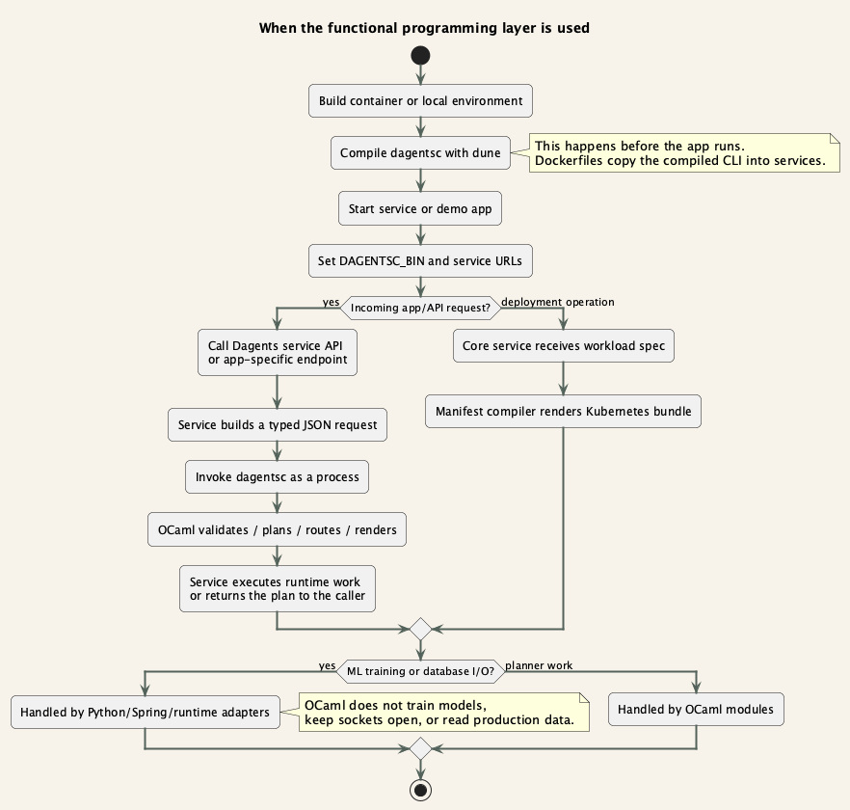
WHEN IT RUNS
The OCaml modules are not project ML APIs. They are planner calls used before and during runtime.
They can run before the app starts as a build artifact, and during app requests when a service needs a plan.
Before running: Dockerfiles and scripts build dagentsc with dune.
At startup: services receive DAGENTSC_BIN and service URLs.
During requests: services invoke dagentsc for validation, routing, DAG planning, or manifest rendering.
Runtime work still belongs to Python/Spring: reading data, training models, serving APIs, and storing results.
Dagents / 13

Slide 43
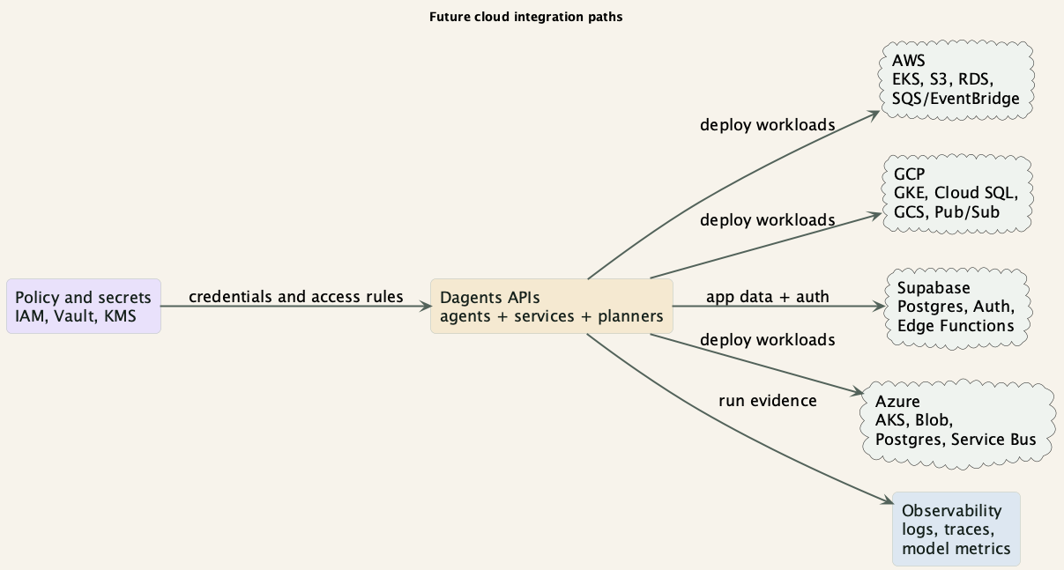
FUTURE
Cloud and backend integrations
The framework is service-based, so it can connect to cloud services without changing the core agent model.
Examples: GCP, AWS, Supabase, Azure

Slide 44
FUTURE
Concrete integration backlog
These are practical next steps after the current local/demo stack.
GCP
AWS
Supabase
GKE for workloads, Cloud SQL for sources, GCS for artifacts, Pub/Sub for events.
EKS for workloads, S3 for artifacts, RDS for sources, SQS/EventBridge for messaging.
Postgres and Auth for quick product integrations; Edge Functions for lightweight hooks.
Observability
Secrets
Persistence
OpenTelemetry traces, run metrics, model-job metrics, and audit logs.
Vault/KMS/IAM integration so source credentials are never hard-coded.
Move in-memory registries to Postgres or a managed store.
Future integrations should keep the same LMA/GMA contracts

Slide 45
FUTURE
Ethical firewalls for AI-era systems
A GRAILS-style layer can be treated as a policy firewall around agent actions.
What it checks
Where it runs
What it records
Should this request access this data? Should this model be called? Should this output be released?
Before source extraction, before model routing, before workload deployment, and before returning generated output.
The policy decision, reason, request id, agent id, data scope, and final action.
This would make Dagents useful not only for computation, but also for responsible control of computation.
The idea fits the LMA/GMA model because local and global decisions can have different policy rules.

Slide 46
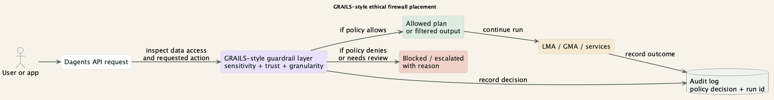
FUTURE
Where a GRAILS-style guardrail fits
The guardrail should be a first-class service boundary, not a UI-only warning.
Policy can stop a run, narrow the data scope, or require human review.
Audit logs should connect policy decisions with Dagents run ids and deployment plans.
This can support college research around ethical firewalls while staying practical for backend teams.

Slide 47
ROADMAP
Next build steps
The path forward is incremental: harden the current stack, then add cloud and policy boundaries.
Phase
Goal
Output
1. Stabilize
Persist registrations and runs; improve error reporting.
Reliable local demo and repeatable tests.
2. Deploy
Move workloads from Compose to Kubernetes.
Core-service manifests applied to a real cluster.
3. Integrate
Connect GCP/AWS/Supabase data and auth services.
Reusable adapters and secret handling.
4. Govern
Add GRAILS-style policy checks and audit logs.
Ethical firewall for data, models, and outputs.
5. Scale
Broker-backed messaging and distributed agent execution.
Production-ready multi-source computation.
Future work: move from demo stack to production platform

Slide 48
CLOSE
Dagents gives consumer backends reusable agent orchestration plus deterministic planning.
The project story is simple: compute locally, combine globally, plan with typed functional modules, and deploy through services.
CMA / LMA per source keeps local computation close to the data.
GMA combines many local outputs into multi-source computation.
Framework services expose catalog, pipeline, model, agent, and workload APIs.
OCaml planners make validation and planning predictable.
NL2SQL proves a real app can plug into the framework without becoming the framework.
Dagents / 16

Slide 49
Appendix
NL2SQL demo and TypeScript UI
Architecture, integration flow, frontend layer, and demo runbook

Slide 50
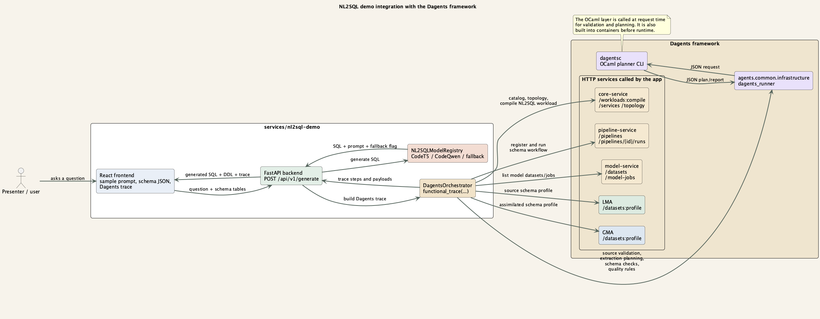
NL2SQL INTEGRATION
The demo app plugs into Dagents through a thin backend orchestration layer.
The app still owns the UI and SQL generation. Dagents owns traceable planning, validation, service checks, and workload compilation.
Dagents / 08

Slide 51
BACKEND WIRING
NL2SQL calls Dagents while handling a normal /generate request.
The trace returned to the UI is built from actual planner and service calls.
services/nl2sql-demo/backend/app/services/dagents_orchestrator.py
The schema is converted into records for validation and profiling.
self._append_trace(trace, "Dagents SourceSpec validation",
lambda: validate_dataset_source(inline_source))
self._append_trace(trace, "Dagents extraction planning",
lambda: compile_dataset_extraction(inline_source))
self._append_trace(trace, "Dagents pipeline DAG planning",
lambda: self._pipeline_plan_payload())
self._append_trace(trace, "core-service workload compile",
lambda: self._compile_demo_workload())
dagentsc plans the schema and pipeline parts through JSON.
Core, pipeline, model, LMA, and GMA services are touched in the trace.
The SQL model adapter remains app-specific.
Dagents / 09

Slide 52
MODEL ADAPTERS + APIS
NL2SQL uses app adapters plus Dagents service calls
The app owns SQL generation; Dagents owns traceable planning, validation, and orchestration.
/api/v1/models
/api/v1/generate
adapter selected
SQL + trace
list adapters
schema + question
CodeT5 / CodeQwen / fallback
prompt, DDL, fallback detail
Adapter
What it loads
Demo behavior
CodeT5 seq2seq
Zip artifact with config and weights
Uses question/context DDL prompt for compact text-to-SQL inference.
CodeQwen LoRA
PEFT adapter over CodeQwen chat model
Uses system + user chat prompt; needs heavier runtime resources.
heuristic_demo
No model artifact
Deterministic fallback; response includes fallback_detail for clarity.
Dagents APIs touched during generation
core /services + /topology + /workloads:compile | pipeline /pipelines + /runs | LMA/GMA /datasets:profile + /model-jobs | GMA registration + heartbeat
Dagents / 08A

Slide 53
NL2SQL APPENDIX
NL2SQL integration: current demo scope
The demo exercises the current planning and service path around SQL generation.
Dagents trace
Model adapter
Demo scripts
The backend returns planner checks, service calls, LMA/GMA actions, and workload compilation evidence.
CodeT5 model artifacts are discovered from models/*.zip and loaded by the adapter when dependencies are present.
run_compose_demo.sh, probe_api.sh, and stop_compose_demo.sh make the presentation path repeatable.
The current probe checks 22 DAgents trace steps.
The model adapter can use the packaged artifact when dependencies are available.
The deterministic fallback remains available for low-resource machines.
Current demo evidence: docs/demo/expected/nl2sql-generate.json

Slide 54
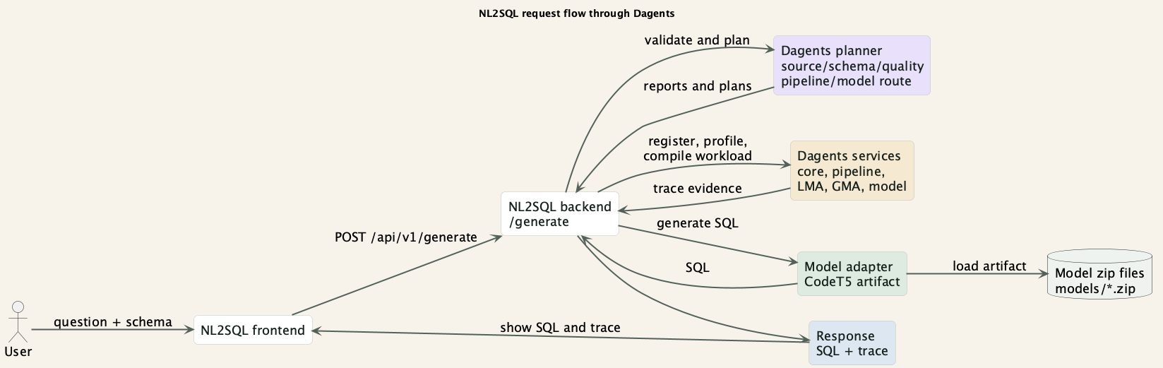
DEMO FLOW
What happens during /generate
The app request becomes a traceable sequence of planner calls, service calls, and model generation.
PlantUML: docs/presentation/puml/dagents_request_flow.puml

Slide 55
TYPESCRIPT / UI
TypeScript / React: the NL2SQL interface
TypeScript owns the NL2SQL browser experience and keeps user-interface state and API responses typed.
Why we chose it: TypeScript catches UI mistakes during builds, React fits interactive forms, and Vite provides a fast build loop.
TypeScript's job
input
backend calls
render SQL
show trace
UI state
React 19
Vite
What it does: The UI captures the question, schema, and sample data, calls the backend, and displays SQL with the DAgents trace.
How it is used: React stores input and response state, sends a typed request to /api/v1/generate, and renders the returned result.
What stays outside: The browser does not run agents, planners, models, or database queries. Sensitive work stays in backend services.
DAgents / TypeScript layer

Slide 56
TYPESCRIPT MODULES
The frontend makes framework results usable
The UI is deliberately small and keeps the backend contract visible.
Area
What it owns
Why it matters
App.tsx
Prompt, schema, sample, response state
Main demo experience
main.tsx
React application bootstrap
Small composition root
API request
POST /api/v1/generate
Explicit UI and backend contract
Trace view
Planner steps, calls, fallback details
Makes DAgents explainable
Vite + Docker
Dev server and production build
Repeatable local demo
DAgents / TypeScript modules

Slide 57
TYPESCRIPT USER FLOW
NL2SQL keeps the demo path short
One screen shows the user input, generated SQL, and the framework trace.
EDIT INPUT
SUBMIT
RECEIVE
RENDER
The user enters a question, schema, and optional sample.
The browser posts a generate request to the backend.
The API returns SQL, trace steps, and model status.
React displays the SQL and explains how DAgents produced it.
→
→
→
The frontend demonstrates framework use without duplicating backend intelligence.
TypeScript flow

Slide 58
TYPESCRIPT BUILD
TypeScript builds catch UI errors early
The frontend is checked through TypeScript compilation, Vite bundling, and browser smoke tests.
WHAT WE VERIFY
1. Install
cd services/nl2sql-demo/frontend
npm ci
npm run build
npm run dev
npm ci
React entrypoint compiles
Prompt and schema state is typed
API responses are handled
Production assets are emitted
Frontend reaches the backend
SQL and trace remain readable
2. Type-check
tsc -b
3. Bundle
vite build
4. Demo
Vite or Docker
A clear responsibility boundary
The UI proves the framework is consumable. It does not duplicate planner or model logic.
DAgents / TypeScript verification

Slide 59
DEMO VALUE
In NL2SQL, the functional layer makes the demo safer and easier to explain.
The UI can show exactly what Dagents checked and planned before returning SQL.
Useful for schema input
Useful for workflow safety
Useful for deployment
Useful for traceability
Source validation, extraction planning, schema contract checks, and quality rules run over the table metadata.
Pipeline DAG planning rejects invalid graph structure before a workflow is executed.
Core service compiles the NL2SQL backend into a workload plan and manifest bundle.
The response includes planner and service trace steps, so the demo can show what happened.
Short answer for Q&A: OCaml is called as needed by the app/services. It is not the SQL model and not a separate ML server.
Dagents / 14

Slide 60
DEVELOPMENT
Challenges and steering decisions
We used the AI assistant as an implementation partner, but kept decisions grounded in test results and logs.
Challenge
How we steered it
State change
Docker model deps
Use logs, identify CUDA wheel blow-up, pin CPU-friendly Torch line.
Backend image now builds with model deps.
Fallback SQL
Trace the exception instead of hiding it.
Model adapter now loads CodeT5 artifact.
JSON key casing
Compare trace payloads and find false schema failures.
Record field names are preserved.
OCaml readability
Ask for modular common_ir without changing behavior.
Types are grouped while old API remains.
Demo reliability
Make scripts executable and probe real service behavior.
Probe validates trace and model path.
This slide also answers the development-challenges report request

Slide 61
DEMO RUNBOOK
Run the demo with one terminal for the app and one terminal for the probe.
Use local mode for speed. Use compose mode when you want to show the whole Dagents stack.
local mode
compose and functional demo
# Fast local demo
services/nl2sql-demo/scripts/run_local_demo.sh
# Probe the backend and save the response
services/nl2sql-demo/scripts/probe_api.sh
# Full Dagents stack with NL2SQL
services/nl2sql-demo/scripts/run_compose_demo.sh
# Stop containers
services/nl2sql-demo/scripts/stop_compose_demo.sh
# Functional layer output screenshots
docs/demo/run_functional_layer_demo.sh
Open http://127.0.0.1:5173
Dagents / 15

