Slide 1
HEALTHCARE CASE STUDY
Dagents for Sepsis
A multi-hospital decision-support case: keep patient-level computation local, coordinate learning globally, and make every rollout traceable.
Hospital data
LMA
GMA
Clinical workflow
Governed rollout
Pradyun Devarakonda
Professor presentation
Dagents Healthcare / 01
Notes:
Open with the central thesis: the useful unit is not one model, but a governed system spanning multiple hospital data boundaries.
[Sources]
- /Users/pradyundevarakonda/Developer/Dagents/docs/presentation/dagents-project-presentation.pptx
- /Users/pradyundevarakonda/Developer/Dagents/docs/agents/lma-gma-architecture.md
[/Sources]

Slide 2
DOMAIN OPPORTUNITIES
Regulated domains need local execution and global coordination.
Healthcare and finance share fragmented data, strict access boundaries, drifting models, and audit-heavy operations. The proposed deep dive is multi-hospital sepsis decision support.
Healthcare: sepsis/deterioration, readmission, chronic monitoring, claims quality, and imaging-model drift.
SELECTED
SEPSIS
Finance: payment fraud, AML pattern detection, credit-risk drift, liquidity, and transaction-operations anomalies.
Why sepsis: bedside decisions must stay local while evidence and model governance improve across hospitals.
local evidence
Scope: retrospective and shadow-mode research first—no autonomous diagnosis or treatment.
GMA
consortium view
Dagents Healthcare / 02
Notes:
The finance list is included to show that the local/global pattern is reusable beyond healthcare.
The rest of the deck focuses on sepsis because it stresses privacy, safety, heterogeneous sources, and cross-site governance at once.
[Sources]
- /Users/pradyundevarakonda/Developer/Dagents/docs/agents/lma-gma-architecture.md
[/Sources]

Slide 3
WHY SEPSIS
Sepsis makes coordination a high-stakes problem.
The disease burden is large; the operational challenge is turning scattered, time-sensitive signals into governed clinical support.
48.9 million cases
11 million deaths
Published 2020 global estimate summarized by WHO.
WHO reports roughly 20% of global deaths in the cited estimate.
15 per 1,000
Why it is hard
Estimated hospitalized patients developing sepsis as a complication of care.
Signals span EHRs, labs, devices, and workflows that vary by hospital.
Evidence: WHO Sepsis fact sheet, 3 May 2024
Notes:
Treat these as global burden estimates, not expected outcomes for the proposed pilot.
The case study does not claim that an early-warning system will reduce mortality; that requires prospective clinical evidence.
[Sources]
- https://www.who.int/news-room/fact-sheets/detail/sepsis
[/Sources]

Slide 4
THE CORE PROBLEM
Dagents makes the missing coordination layer explicit.
The problem is not only predicting sepsis; it is governing the path from local data to repeated multi-site action.
Fragmented signals
Site-specific reality
Different schemas, units, clocks, and quality rules. Dagents: SourceSpec plus LMA validation and profiling.
Patient mix, workflows, resources, and alert tolerance vary. Dagents: site-scoped LMAs plus GMA comparison.
Control-plane sprawl
Evidence debt
Sites rebuild registration, scheduling, artifacts, deployment, and rollback. Dagents: shared contracts and services.
Lineage, approvals, overrides, and audit evidence arrive late. Dagents: versioned plans, runs, artifacts, and rollback records.
Consequence: duplicated engineering, slower rollout, uneven behavior—and no reliable cross-site learning loop / 04
Notes:
Separate the prediction task from the coordination system around it. A good model does not solve schema drift, hospital-specific policy, deployment ownership, rollback, or audit evidence.
Dagents addresses this as a control-plane problem: LMA owns the hospital boundary; GMA owns approved cross-site coordination; typed contracts make plans and outcomes inspectable.
[Sources]
- /Users/pradyundevarakonda/Developer/Dagents/AGENTS.md
- /Users/pradyundevarakonda/Developer/Dagents/docs/agents/lma-gma-architecture.md
- /Users/pradyundevarakonda/Developer/Dagents/contracts/grpc/dagents/agents/v1/lma_gma.proto
[/Sources]

Slide 5
FUNCTIONAL SCOPE
The case needs a reusable system—not only a prediction model.
Five capability groups turn a candidate model into governed, multi-hospital clinical decision support.
Ingest + quality
Local execution
Clinical workflow
Global coordination
Deploy + govern
FHIR/HL7 adapters, source validation, canonical features, provenance, units, freshness, and missingness.
LMA profiles approved data, scores locally, suppresses unsafe runs, and records patient-level traces.
Show recommendation basis, uncertainty, and limitations; capture acknowledgement, override, and outcome.
GMA registers sites, compares drift and calibration, and selects site-appropriate policies or bundles.
Pipelines, artifacts, typed plans, signed rollouts, canaries, monitoring, rollback, and audit evidence.
Cross-cutting controls: security, privacy, lineage, versioning, policy gates, retention, and clinician accountability.
Dagents Healthcare / 05
Notes:
Call out that the current model-service provides generic ML infrastructure and anomaly-model examples; a clinically valid sepsis model is new work.
[Sources]
- /Users/pradyundevarakonda/Developer/Dagents/docs/agents/lma-gma-architecture.md
- /Users/pradyundevarakonda/Developer/Dagents/services/pipeline-service/README.md
- /Users/pradyundevarakonda/Developer/Dagents/services/model-service/README.md
- /Users/pradyundevarakonda/Developer/Dagents/services/core-service/README.md
[/Sources]

Slide 6
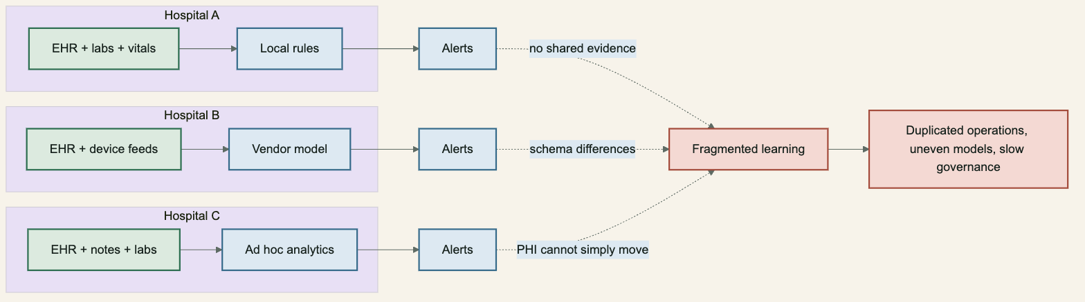
CURRENT STATE
Hospitals solve the same risk problem in isolated stacks.
Site-specific rules and vendors limit shared learning; raw protected health information cannot simply be centralized.
Dagents Healthcare / 06
Notes:
The diagram is a proposed operating pattern, not a claim about every hospital.
The engineering problem is duplicated local stacks plus weak cross-site evidence and governance.
[Sources]
- https://www.hhs.gov/hipaa/for-professionals/security/index.html
- https://hl7.org/fhir/R4/observation.html
- /Users/pradyundevarakonda/Developer/Dagents/docs/presentation/healthcare-case-study/diagrams/01-current-fragmentation.mmd
[/Sources]

Slide 7
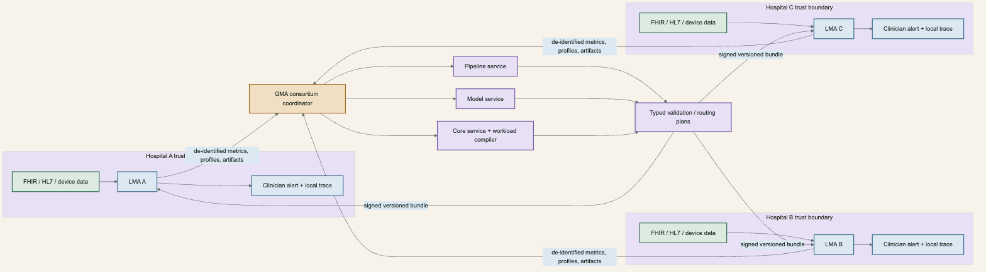
TARGET ARCHITECTURE
Dagents scores locally and coordinates evidence globally.
LMAs run inside hospital trust boundaries; the GMA receives approved summaries and returns governed, versioned bundles.
Dagents Healthcare / 07
Notes:
The architecture does not require a central raw-PHI lake.
The precise aggregation technique remains a design choice; the case study requires an approved minimum-data interface rather than promising a specific federated-learning algorithm.
[Sources]
- /Users/pradyundevarakonda/Developer/Dagents/docs/agents/lma-gma-architecture.md
- /Users/pradyundevarakonda/Developer/Dagents/contracts/grpc/dagents/agents/v1/lma_gma.proto
- /Users/pradyundevarakonda/Developer/Dagents/docs/presentation/healthcare-case-study/diagrams/02-dagents-target-architecture.mmd
[/Sources]

Slide 8
LMA FLOW
The LMA owns the patient-level decision-support loop.
A local run validates scope and quality before scoring; the clinician retains decision authority.
INGEST
VALIDATE
SCORE
SUPPORT
Receive approved FHIR, HL7, database, or event-stream data inside the hospital boundary.
Check schema, units, provenance, freshness, cohort, consent or purpose scope, and missingness.
Run the approved local model; return risk, uncertainty, model version, and input basis.
Present evidence to a clinician; capture acknowledgement, deferral, override, action, and outcome.
→
→
→
Only approved de-identified metrics and artifact pointers leave the hospital trust boundary.
Local execution / 08
Notes:
Emphasize clinician control and explainability. The LMA is an execution boundary, not an autonomous doctor.
[Sources]
- /Users/pradyundevarakonda/Developer/Dagents/docs/agents/lma-gma-architecture.md
- https://www.fda.gov/regulatory-information/search-fda-guidance-documents/clinical-decision-support-software
- /Users/pradyundevarakonda/Developer/Dagents/docs/presentation/healthcare-case-study/diagrams/03-lma-functional-flow.mmd
[/Sources]

Slide 9
GMA FLOW
The GMA governs cross-hospital learning.
Aggregate coordination improves consistency without erasing hospital-specific populations, workflows, or risk tolerances.
REGISTER
ASSIMILATE
COMPARE
PLAN + ROLLOUT
Track each LMA identity, hospital scope, version, capability, and approved data-sharing policy.
Accept approved profiles, performance metrics, run summaries, and artifact pointers with provenance.
Measure drift, calibration, subgroup behavior, alert burden, reliability, and configuration variance.
Select site-appropriate bundles; compile plans, canary, monitor, pause, and roll back.
→
→
→
The GMA coordinates the fleet; it does not make bedside decisions or ingest unrestricted raw PHI.
Global coordination / 09
Notes:
The current GMA has registration, assimilated profiling, aggregate model execution, and deployment-planning concepts; durable production infrastructure remains future work.
[Sources]
- /Users/pradyundevarakonda/Developer/Dagents/docs/agents/lma-gma-architecture.md
- /Users/pradyundevarakonda/Developer/Dagents/contracts/grpc/dagents/agents/v1/lma_gma.proto
- /Users/pradyundevarakonda/Developer/Dagents/docs/presentation/healthcare-case-study/diagrams/04-gma-functional-flow.mmd
[/Sources]

Slide 10
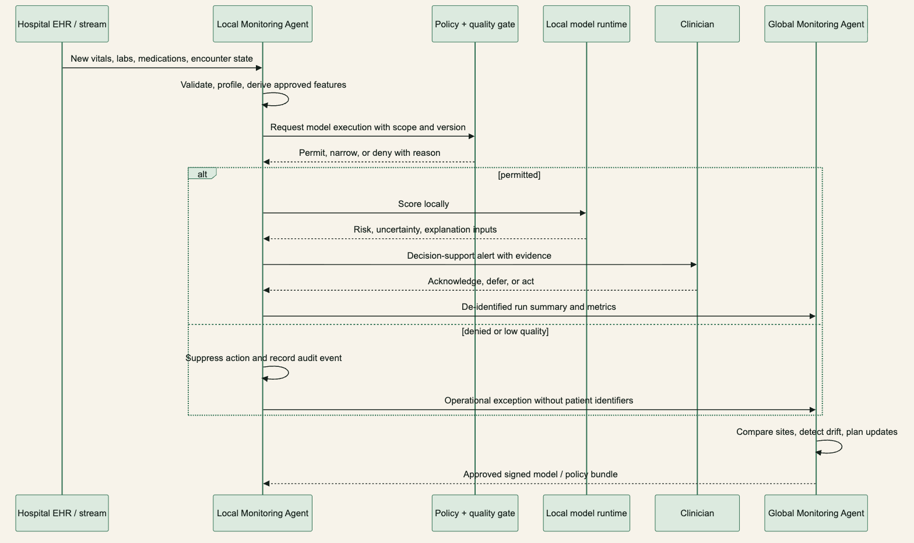
RUN SEQUENCE
A local decision becomes a global learning signal.
Policy and data-quality checks precede scoring; a clinician reviews the basis before any clinical workflow action.
Clinician-in-the-loop execution / 10
Notes:
Walk from left to right and call out the denied or low-quality branch: it suppresses the output and still creates operational evidence.
[Sources]
- https://www.fda.gov/regulatory-information/search-fda-guidance-documents/clinical-decision-support-software
- /Users/pradyundevarakonda/Developer/Dagents/docs/presentation/healthcare-case-study/diagrams/05-end-to-end-sequence.mmd
[/Sources]

Slide 11
CONTROL PLANE
Dagents already has the required control-plane shape.
Current contracts cover registration, profiling, model jobs, bundle synchronization, telemetry, and workload compilation.
REGISTER
PROFILE
RUN
SYNC
GMA records hospital/LMA identity, scope, version, capability, and desired deployment state.
LMA profiles source-scoped records; GMA profiles approved assimilated evidence across sites.
Typed model-job requests identify task, model family, features, version, scope, and artifact prefix.
Versioned bundles and plans coordinate desired state, deployment resources, health, and rollback.
→
→
→
Production work: durable state, broker-backed delivery, signed bundles, idempotency, and immutable audit evidence.
Existing Dagents contracts / 11
Notes:
This slide is the bridge between the proposed case and the actual repository: the control-plane verbs already exist even though their production hardening is incomplete.
[Sources]
- /Users/pradyundevarakonda/Developer/Dagents/contracts/grpc/dagents/agents/v1/lma_gma.proto
- /Users/pradyundevarakonda/Developer/Dagents/docs/agents/lma-gma-architecture.md
[/Sources]

Slide 12
GOVERNANCE
Compliance requires shared controls.
Dagents can supply reusable technical enforcement and evidence; hospitals still own organizational, security, privacy, and clinical controls.
HIPAA
SOC 2
CLINICAL AI
Dagents support: local PHI boundary, scoped sources, run IDs. Still needed: IAM/MFA, encryption and keys, retention, risk analysis, incident response, BAAs.
Dagents support: deterministic plans, health checks, change/run evidence. Still needed: control owners, access reviews, vendor risk, incident evidence, CPA examination.
Dagents support: model/version trace, explanation inputs, policy gates, rollback. Still needed: intended use, clinical validation, human factors, regulatory and safety governance.
A production claim depends on implemented and operating controls—not architecture alone. SOC 2 is an attestation; HIPAA also includes administrative and physical safeguards.
Notes:
Avoid saying Dagents is HIPAA compliant or SOC 2 compliant. The accurate claim is that its architecture creates reusable control and evidence points.
[Sources]
- https://www.hhs.gov/hipaa/for-professionals/security/index.html
- https://www.hhs.gov/hipaa/for-professionals/security/laws-regulations/index.html
- https://www.aicpa-cima.com/resources/download/2017-trust-services-criteria-with-revised-points-of-focus-2022
- https://www.fda.gov/regulatory-information/search-fda-guidance-documents/clinical-decision-support-software
[/Sources]

Slide 13
RESPONSIBILITY MATRIX
Dagents enables evidence, not compliance.
The implementation backlog should map each external obligation to a reusable Dagents mechanism and an accountable owner.
Framework
Dagents-aligned support
Production controls still required
HIPAA Security
Local boundary, scoped sources, versioned runs and plans
IAM/MFA, encryption and keys, audit controls, integrity, DR, incident response
HIPAA Privacy
Approved feature contracts; aggregate-only GMA interface
Purpose/minimum-necessary policy, consent or authorization, retention and deletion
SOC 2
Repeatable deployments, service health, evidence and lineage
Control ownership, access/change/vendor reviews, operating evidence, CPA report
Clinical CDS
Human decision point, model/input basis, validation metadata, rollback
Intended use, clinical validation, human factors, regulatory assessment
FHIR / USCDI
SourceSpec and canonical dataset boundaries fit adapter-based exchange
Profiles, terminology, conformance, provenance, patient matching
Control design aid—not a legal, audit, or regulatory conclusion / 13
Notes:
The matrix is deliberately split between framework mechanisms and residual responsibilities.
HIPAA minimum necessary has context-specific exceptions, including certain treatment disclosures; the deploying organization must make the legal determination.
[Sources]
- https://www.hhs.gov/hipaa/for-professionals/privacy/guidance/minimum-necessary-requirement/index.html
- https://www.hhs.gov/hipaa/for-professionals/security/laws-regulations/index.html
- https://www.aicpa-cima.com/resources/download/2017-trust-services-criteria-with-revised-points-of-focus-2022
- https://www.fda.gov/regulatory-information/search-fda-guidance-documents/clinical-decision-support-software
- https://hl7.org/fhir/R4/observation.html
- https://healthit.gov/standards-and-technology/
[/Sources]

Slide 14
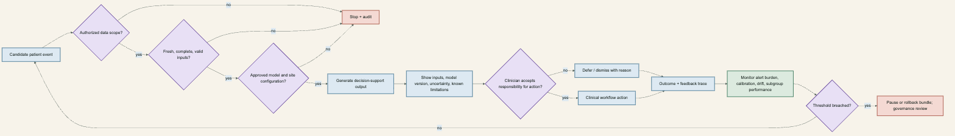
CLINICAL SAFETY
Clinical action requires four explicit gates.
Authorization, data quality, model approval, and human review are explicit; monitoring can pause or roll back a bundle.
Start retrospectively, then shadow mode. Fail closed, record the reason, keep the clinician accountable, and link monitoring thresholds to a tested pause/rollback plan.
Notes:
The diagram is a proposed safety control flow, not a substitute for a clinical safety case or quality system.
[Sources]
- https://www.fda.gov/regulatory-information/search-fda-guidance-documents/clinical-decision-support-software
- https://airc.nist.gov/airmf-resources/airmf/
- /Users/pradyundevarakonda/Developer/Dagents/docs/presentation/healthcare-case-study/diagrams/06-clinical-safety-gates.mmd
[/Sources]

Slide 15
EFFORT
Dagents moves effort toward clinical validation.
The framework adds discipline; the payoff grows with hospitals, models, deployments, and regulated consumers.
Concern
Reusable Dagents leverage
Case-specific or production work
Source boundary
Reuse SourceSpec, validation, profiling, and local/global scope contracts
Build FHIR/HL7 mappings, terminology, cohort, provenance, and patient matching
Orchestration
Reuse pipelines, runs, agent registration, telemetry, and workload plans
Add durable queues, retries, idempotency, replay, scheduling, and persistence
ML lifecycle
Reuse model-job, artifact, evaluation, and versioning patterns
Develop and clinically validate the sepsis model, thresholds, and monitoring
Deployment
Reuse Docker/Kubernetes compilation and desired-state concepts
Harden secrets, signing, isolation, canaries, rollback, and disaster recovery
Assurance
Reuse typed plans, run IDs, policy gates, and lineage points
Implement IAM, immutable logs, policies, training, audits, and clinical governance
For one static model at one site, Dagents may be more infrastructure than necessary / 15
Notes:
This is the balanced effort argument: Dagents does not remove the hard clinical or compliance work; it prevents platform plumbing from being rebuilt for every site and use case.
[Sources]
- /Users/pradyundevarakonda/Developer/Dagents/docs/agents/lma-gma-architecture.md
- /Users/pradyundevarakonda/Developer/Dagents/services/core-service/README.md
- /Users/pradyundevarakonda/Developer/Dagents/services/pipeline-service/README.md
- /Users/pradyundevarakonda/Developer/Dagents/services/model-service/README.md
[/Sources]

Slide 16
DECISION GUIDE
Where Dagents fits—and where other tools lead.
Choose it when one control plane must span multiple data boundaries, model families, and deployment targets.
Option
Why teams choose it
Limit / Dagents fit
Dagents
LMA/GMA boundary plus pipelines, model jobs, typed plans, and workload compilation
Broad reusable control plane; less mature; hardening and clinical adapters required
Federated-learning toolkits
Flower / NVIDIA FLARE: distributed training, evaluation, privacy, and federation mechanics
Deeper FL, narrower lifecycle; use inside Dagents when collaborative training is needed
Managed MLOps SaaS
SageMaker AI / Azure ML: managed training, registries, endpoints, and monitoring
Fast cloud path; cloud coupling and hospital-boundary integration remain
Workflow platforms
Airflow / Kubeflow: DAGs, retries, caching, and Kubernetes execution
Mature workflows; no native LMA/GMA scope, capability registry, or clinical governance contract
Clinical point SaaS
Fastest when a validated product already fits the exact workflow
Narrow product/vendor boundary; Dagents fits multi-model, multi-site ownership
Dagents can complement these tools: it is the domain control plane around specialized runtimes / 16
Notes:
This is a capability-fit comparison, not a benchmark. The strongest argument is composability: Dagents can call a federated-learning runtime, cloud MLOps service, or workflow engine rather than pretending to replace every component.
The trade-off is candid: Dagents has broader domain orchestration but less production maturity and requires healthcare-specific adapters, controls, and validation.
[Sources]
- https://flower.ai/docs/framework/index.html
- https://nvidia.github.io/NVFlare/
- https://docs.aws.amazon.com/sagemaker/latest/dg/whatis.html
- https://learn.microsoft.com/en-us/azure/machine-learning/overview-what-is-azure-machine-learning
- https://www.kubeflow.org/docs/components/pipelines/concepts/pipeline/
- https://airflow.apache.org/docs/apache-airflow/stable/core-concepts/overview.html
[/Sources]

Slide 17
PILOT ROADMAP
A safe pilot proves value in five controlled phases.
Evidence gates—not calendar dates—determine when the work advances from contracts to clinical use.
Phase
Goal
Evidence required
1. Define
Intended use, cohort, outcome label, exclusions, sources, and governance owners
Approved case specification and canonical data contract
2. Validate
Run retrospective LMAs separately at each hospital
Data-quality, calibration, subgroup, and baseline alert evidence
3. Shadow
Execute prospectively without showing recommendations to clinicians
Latency, reliability, alert volume, trace completeness, recovery results
4. Pilot
Show evidence to clinicians under an approved protocol
Workflow fit, burden, overrides, human factors, safety review
5. Scale
Let GMA compare sites; canary signed bundles and test rollback
Consortium results plus security, privacy, regulatory, and audit readiness
No autonomous clinical action in the initial case study / 17
Notes:
Do not promise a clinical go-live. The requested case is strongest as a research and shadow-mode pilot with explicit evidence gates.
[Sources]
- https://www.fda.gov/regulatory-information/search-fda-guidance-documents/clinical-decision-support-software
- https://airc.nist.gov/airmf-resources/airmf/
[/Sources]

Slide 18
EVALUATION
Judge the pilot on four kinds of evidence.
Clinical performance alone is insufficient; safety, operations, and governance determine whether the system is usable and controllable.
Clinical usefulness
Safety + equity
Discrimination and calibration; sensitivity and PPV at a fixed alert budget; lead time.
Subgroup performance, alert burden, duplicates, acknowledgement, and override reasons.
Operational reliability
Governance evidence
Freshness, missingness, run success, inference latency, recovery, and rollback time.
Trace completeness, model/version coverage, access exceptions, and site-to-site variance.
Targets follow measured baselines; this deck does not invent clinical outcomes / 18
Notes:
A fixed alert budget connects technical performance to clinician capacity and prevents a high-sensitivity result from hiding unusable alert volume.
[Sources]
- https://www.fda.gov/regulatory-information/search-fda-guidance-documents/clinical-decision-support-software
- https://airc.nist.gov/airmf-resources/airmf/
[/Sources]

Slide 19
RECOMMENDATION
Use Dagents as the execution plane for a shadow-mode sepsis pilot.
The project is valuable because it separates local patient computation from global coordination—and makes every plan, model, run, and rollout traceable.
LMAs keep patient-level processing close to hospital-controlled data.
GMA coordinates approved evidence without becoming a central raw-PHI lake.
Pipeline, model, core, and typed planner boundaries reduce duplicated platform work.
HIPAA and SOC 2 readiness becomes a concrete control backlog with reusable evidence points.
Clinical validation, security operations, regulatory analysis, and human oversight remain essential.
Dagents Healthcare / 19
Notes:
Close by resolving the opening: Dagents is compelling here because multiple regulated local boundaries need one coordinated, auditable execution model.
[Sources]
- /Users/pradyundevarakonda/Developer/Dagents/docs/agents/lma-gma-architecture.md
- https://www.hhs.gov/hipaa/for-professionals/security/index.html
- https://www.aicpa-cima.com/resources/download/2017-trust-services-criteria-with-revised-points-of-focus-2022
- https://www.fda.gov/regulatory-information/search-fda-guidance-documents/clinical-decision-support-software
[/Sources]

