Slide 1

Gemini RAG Pipeline
A Focused, Readable & Reproducible Retrieval-Augmented Generation System
Team: SWAT_Genies
Members:
Manish Chatla
Siddharth Jain
Pradyut Parida
Pardheev Krishna Tammineni

Slide 2
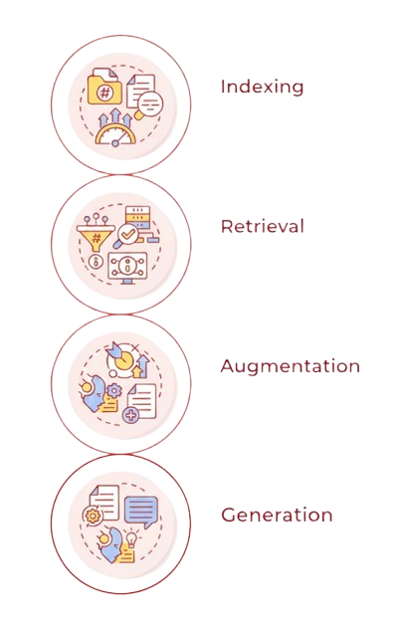
What is RAG?
Transform raw content into a structured catalog. Segment information into coherent units, capture descriptive signals (topic, entities, timestamps), and persist them in a form optimized for fast, high-quality lookup.
Interpret the request and locate the most pertinent units from the catalog. Apply relevance scoring, lightweight filtering (e.g., scope, recency), and ordering so only the strongest evidence is returned.
Curate the retrieved material for consumption: deduplicate, sanitize, and compress while preserving attribution. Assemble a concise, well-framed context that aligns with the task and stays within operational limits.
Produce the final output using the curated context and explicit instructions. The response prioritizes factual grounding, clarity, and required structure (e.g., citations or schema), minimizing speculation and drift.

Slide 3



Project Overview
A Modular and Production grade RAG System Powered by:
Google Gemini
ChromaDB
Streamlit
Google Gemini produces dense embeddings and grounded answers, with query expansion, batching, caching, and deterministic runs to reduce hallucinations.
ChromaDB is a fast, persistent vector store with HNSW retrieval, storing vectors and metadata for hybrid, filterable search.
Streamlit UI lets you query, tweak settings, inspect retrieved context and scores, and export reports with metrics.
Notes:
exchange gemini and chroma

Slide 4
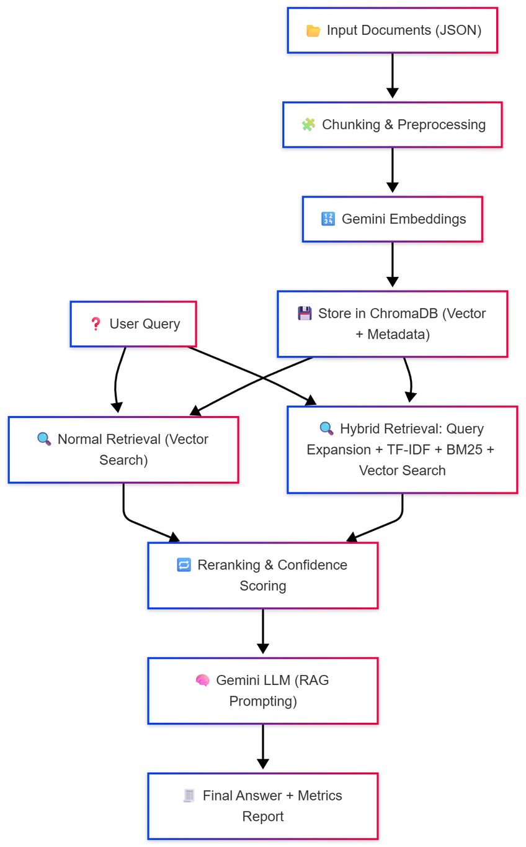
Workflow Overview
Ingestion pipeline
Input Documents (JSON)
Chunking & Preprocessing
Gemini Embeddings
Store in ChromaDB (Vector + Metadata)
Query pipeline
User Query
Query Embedding
Retrieval paths
Normal Retrieval (Vector Search)
Hybrid Retrieval: Query Expansion + TF-IDF + BM25 + Vector Search
Ranking & reasoning
Reranking & Confidence Scoring
Gemini LLM (RAG Prompting)
Output
Final Answer + Metrics Report

Slide 5


Step 1 — Chunking & Context Preservation
We used a hybrid fixed-size + overlap strategy for better context preservation.
Sentence boundary detection
Token-based windowing (e.g., 512–1024 tokens)
Overlap context preservation (typically 10–20%)
Step 2 — Embedding Logic
Gemini’s embedding model (models/embedding-001) creates high-dimensional vector representations of text.
These embeddings capture the semantic meaning of the content for better retrieval accuracy
Deterministic behavior by seed control.
Batching for API efficiency and Metadata binding for traceability

Slide 6
Step 3 — Vector Storage (ChromaDB)
ChromaDB provides persistent, local storage with HNSW indexing for fast approximate nearest-neighbor search. It co-stores vectors and metadata, enabling explainable retrieval, efficient filtering by attributes, and reproducible runs ideal for experimentation and production hardening.
Hybrid Retrieval Strategy
Query Expansion – For reformulating user queries to enhance recall
TF-IDF (for fast keyword relevance scoring) + BM25 (for improved term weighting and ranking) - Used for lexical matching to capture exact term overlaps and key word relevance
ChromaDB (Vector-based) – For semantic retrieval using cosine similarity
This hybrid fusion ensures that both exact keyword matches and semantic meaning contribute to retrieval ranking, leading to richer and accurate context sets
Reranking Strategy
LLM-based Reranker – Uses Gemini to analyze contextual match with the query.
Cohere Reranker – Leverages Cohere’s rerank-english-v2.0 model for relevance scoring.
CrossEncoder Reranker – Uses transformer-based pair scoring (query, document) similarity.

Slide 7
Step 4 — Confidence Scoring
Retrieval Confidence: avg(top-K cosine scores) / 1.0
Answer Confidence: Combines retrieval, coherence, and diversity
Also tracks: Retrieval latency, Tokens used and Answer length
Step 5 —Explainability & Reporting
Context used for the final answer
Confidence breakdown
Top retrieved passages
Latency & token stats
JSON report for auditing

Slide 8



Trade-offs & Optimization
Speed
Achieved through batch embedding, caching, and HNSW indexing.
Accuracy
Cost
Improved by multi-stage reranking and overlap chunking.
Minimized via checkpointing and caching embeddings locally.

Slide 9
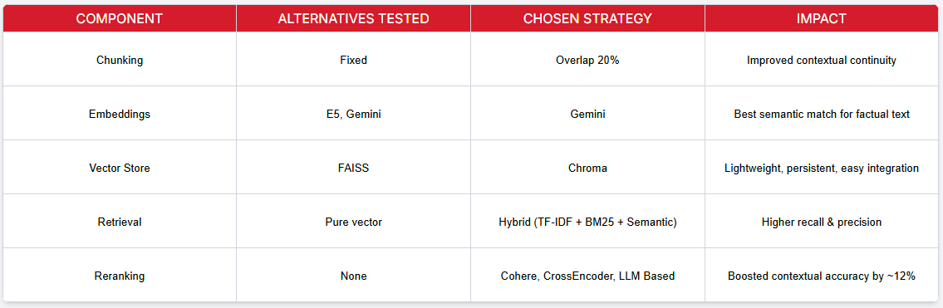
Experimental Rigger and Impact

Slide 10
Testing & Engineering Discipline
✅ Unit tests for all major modules (tests/)
🪵 Structured logging for debugging and observability
💾 Checkpointing and error handling for long runs
💡 Deterministic results (seeded randomness)
🔐 Secure API key loading via .env
Future Enhancements
🔄 Dynamic chunking based on sentence or semantic boundaries
⚡ FAISS or HNSW backend for large-scale corpora
🧾 Automated threshold tuning for confidence calibration
📚 Multi-lingual embeddings for cross-language KB search
🔍 Context-aware query expansion using user interaction history
🛠️ Explainable retrieval with highlighted matched terms or sections
🧮 Adaptive top-K selection based on query complexity
📊 Retrieval analytics dashboard for precision, recall, and coverage
🤖 Integration with multiple LLM providers for fallback and ensemble reasoning
🔒 Secure handling of sensitive data in embeddings and metadata
🌐 Cloud-based scaling for distributed retrieval and embedding pipelines

Slide 11

Thank
You

