Slide 1
Change

Slide 2
Change
PRINCE2® manual page 91
Workbook page 155

Slide 3
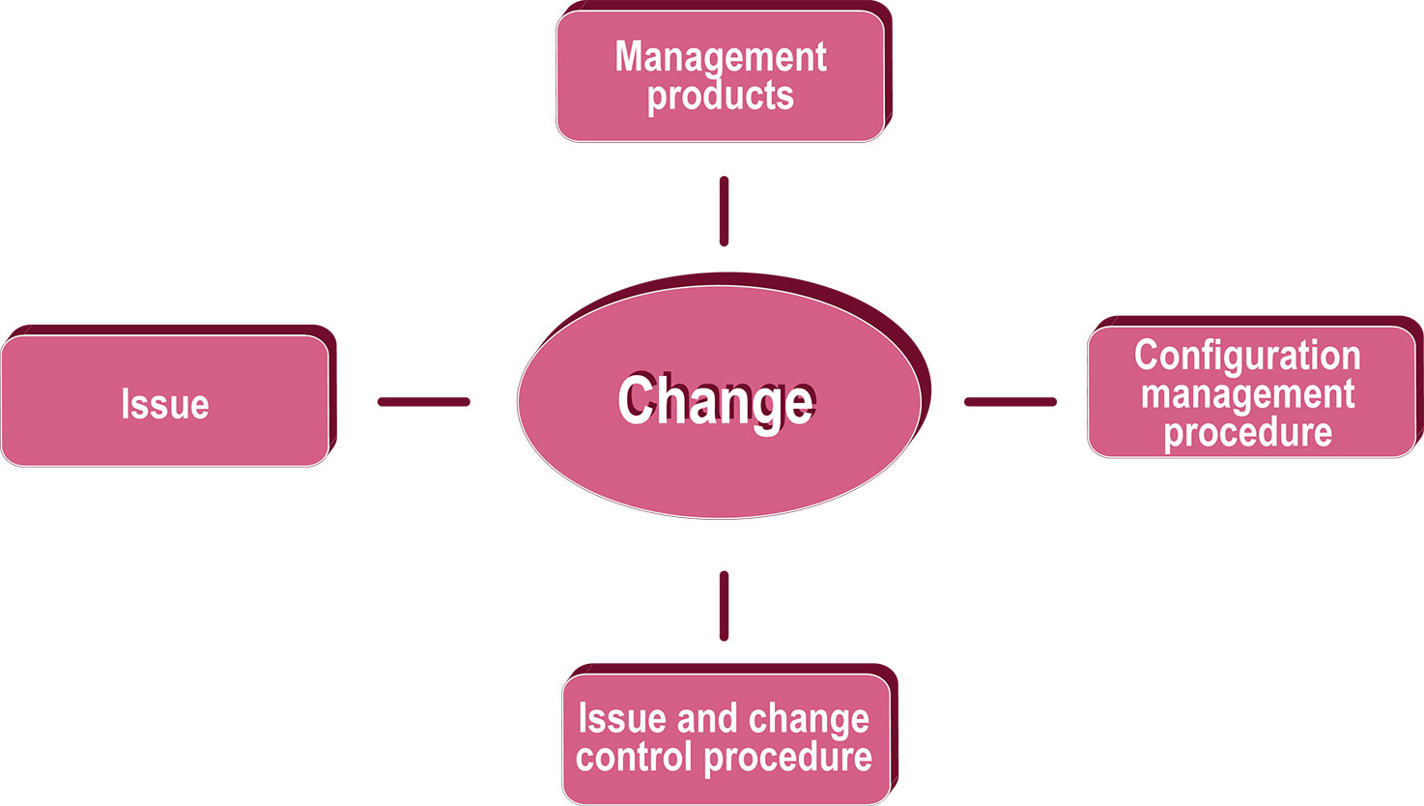
Change
Information hierarchy

Slide 4

Change
Introduction
What is change control
What is configuration management?
What is an issue?
  Request for change: a proposal to change a baseline
  Off-specification: should be provided but is currently
  forecast not to
  Problem/concern: any other issue that the Project Manager needs to resolve or escalate.

Slide 5


Manual 240
Workbook 162
Manual 241
Workbook 160
Manual 242
Workbook 106
Change
Management products
Configuration Item Record
  Describes the status and version of each item
Configuration Management Strategy
  Describes how change will be handled
Daily Log
  Informal progress, issues and risks
More....

Slide 6
Manual 246
Workbook 164
Manual 247
Workbook 165
Manual 253
Workbook 163
Change
Management products
Issue Register
  Formal management of issues
Issue Report
  Assessment and recommendations for an issue
Product Status Account
  Information about the current state of products

Slide 7

Change
Configuration management procedure

Slide 8
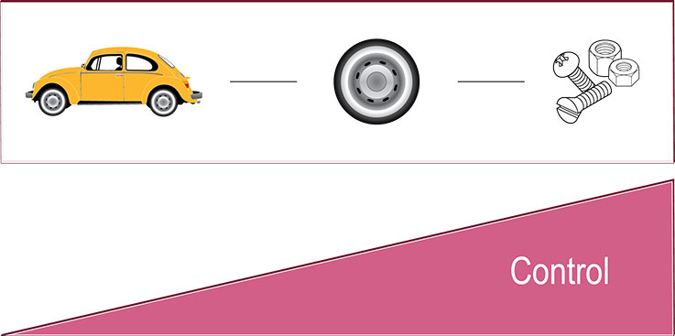
Change
Configuration management control

Slide 9
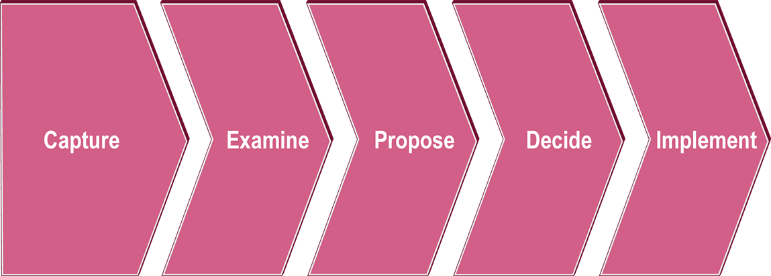
Change
Issue and change control procedure

Slide 10



Change
Issue and change control procedure
Capture
  Is this a Request for change, off-specification or problem/concern?
  Formal (Issue Register) or informal (Daily Log) management
Examine
  Detailed or quick analysis?
  Impact: time, cost, quality and scope, business case, risk exposure
Propose
  Effect of each option on performance targets
  What are the options' costs, level of risk (operational and project)

Slide 11


Change
Issue and change control procedure
Decide
  Permission to approve minor changes or escalation required?
  Is an Issue Report or Exception Report required?
Implement
  Take necessary corrective action or (with approval) an Exception Plan

Slide 12
Change
Change Authority & change budget
Change Authority
  By default is the Project Board
  Primarily involved in 'decide' step of change control procedure
  Makes decisions on request for change, off-specifications and problems/concerns
Change budget
  Allocated money that funds requests for change
  If no change budget allocated use the stage budget
  Separate budget given to Change Authority

Slide 13
Change
Principles
Continued business justification
Learn from experience
Defined roles and responsibilities
Manage by stages
Manage by exception
Focus on products
Tailor to suit project environment

