Slide 1
Introduction

Slide 2
Introduction
Principles
Themes
Processes
Tailoring
PRINCE2® manual pages 3, 11, 17, 113, 215
Workbook page 7

Slide 3
Organisations involved with PRINCE2
Cabinet Office
  The UK government organisation that owns the intellectual property rights of PRINCE2, MSP, P3O and ITIL.
AXELOS
  The sole entity contracted by the Cabinet Office to manage the accreditation framework and examination administration. They check trainers, training material and procedures adhere to required standards.

Slide 4
Exam rules (Foundation and Practitioner)
Please provide photographic ID for the exam
You must silence electronic devices
Your bags and personal belongings must be out of reach.
All posters, charts and group work will be removed
Only one candidate at a time can leave the room and cannot take anything out or bring anything back

Slide 5
Introduction
What is a project?
A project is a temporary organisation that is created for the purpose of delivering one or more business products according to an agreed Business Case.
Projects differ from business as usual:
  They instigate change
  They are temporary
  They involve cross-functional teams
  Every project is unique
  There is uncertainty in every project delivery

Slide 6
Introduction
Difference between projects & programmes
Projects | Programmes
Driven by deliverables | Driven by vision of ‘end state’
Finite | No pre-defined path
Bounded and scoped deliverables | Changes to the business capability
Delivery of product | Coordinated outputs delivery, includes projects not directly delivering benefits
Benefits usually realised after project closure | Benefits realised during the programme and afterwards
Shorter timescale | Longer timescale

Slide 7
Introduction
Aspects of project performance
Costs
Timescales
Quality
Scope
Risk
Benefits
Each has tolerances, each must be reviewed when analysing risks & undertaking issue analysis

Slide 8
Introduction
Four integrated elements
Principles
  Obligations and good practices which determine if the project is genuinely being managed using PRINCE2
Themes
  Aspects of project management that must be addressed continually and in parallel throughout the project
Processes
  A step-wise progression through the project lifecycle, from getting started to project closure.
Tailoring
  The need to tailor PRINCE2 to the specific context of the project

Slide 9
Introduction
Principles
Continued business justification
Learn from experience
Defined roles and responsibilities
Manage by stages
Manage by exception
Focus on products
Tailor to suit the project environment.

Slide 10
Introduction
Themes
Business Case – defines the business benefits
Organisation – roles & responsibilities on a project
Quality – of products
Plans – product-based planning
Risk – positive opportunities & negative threats
Change – modifications to products
Progress – reports and exception management

Slide 11


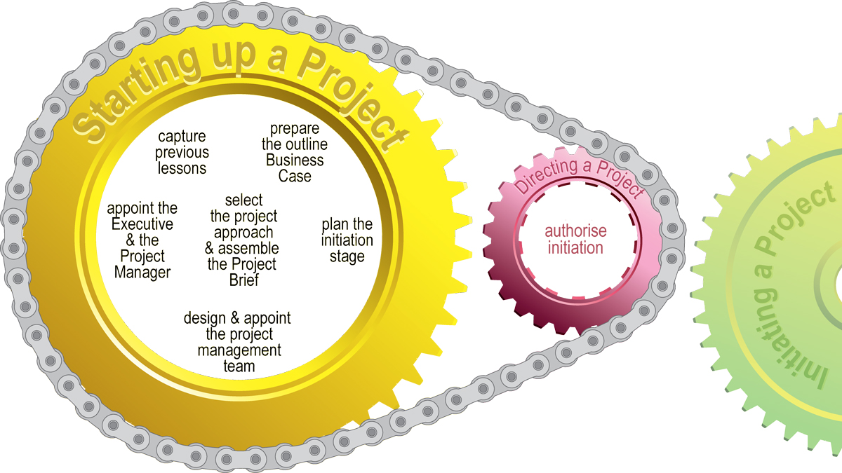
Introduction
Starting up a Project
Manual 121
Workbook 217

Slide 12
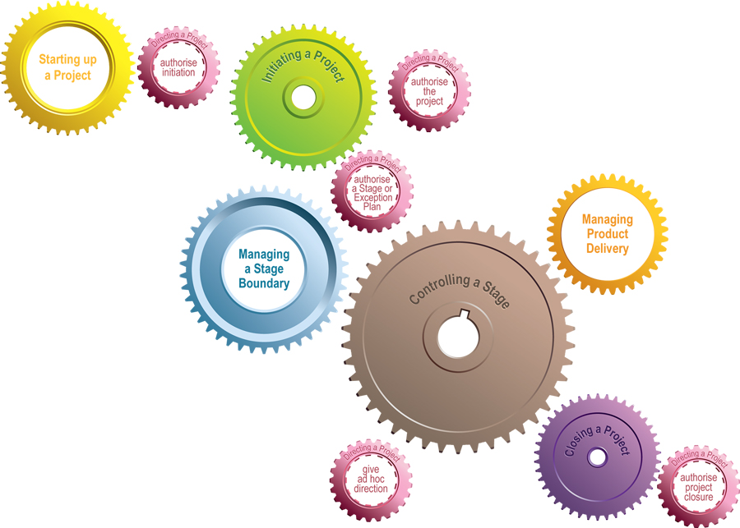
Introduction
Directing a Project
Manual 135
Workbook 227

Slide 13
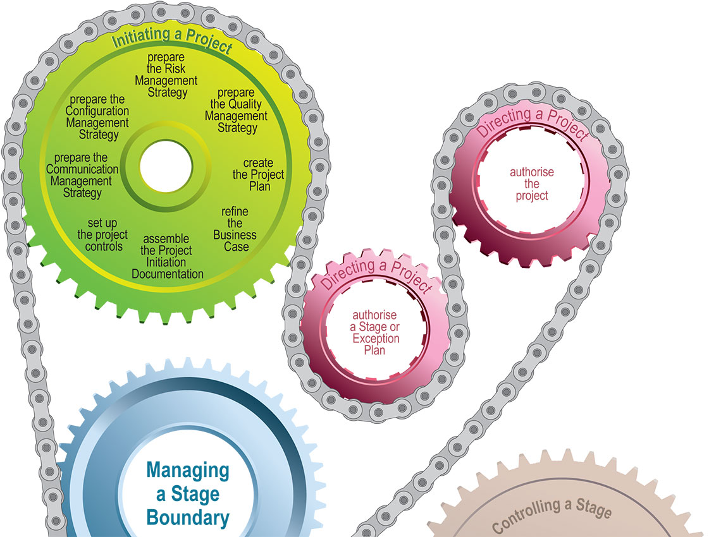
Introduction
Initiating a Project
Manual 149
Workbook 237

Slide 14
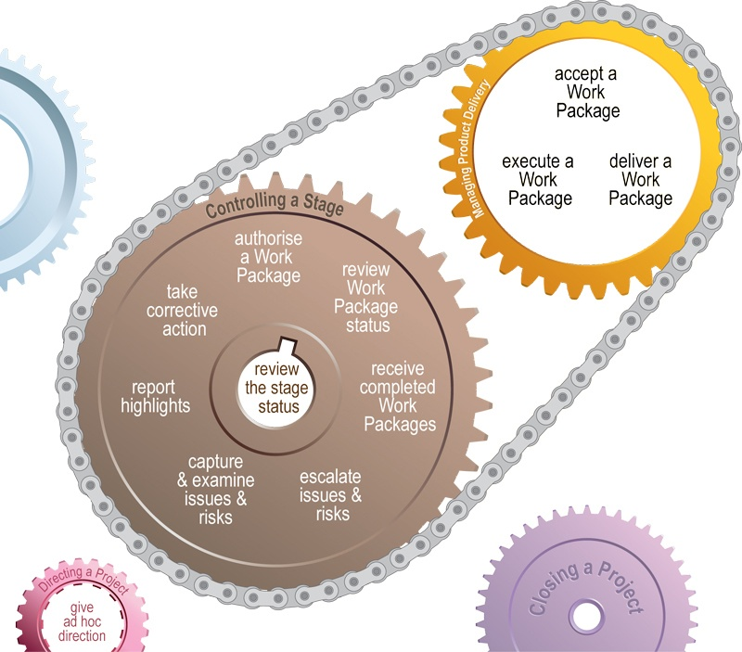
Manual 167
Workbook 247
Introduction
Controlling a Stage & Managing
Product Delivery
Manual 185
Workbook 257

Slide 15
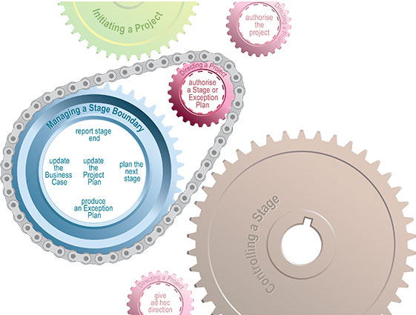
Introduction
Managing a Stage Boundary
Manual 193
Workbook 267

Slide 16
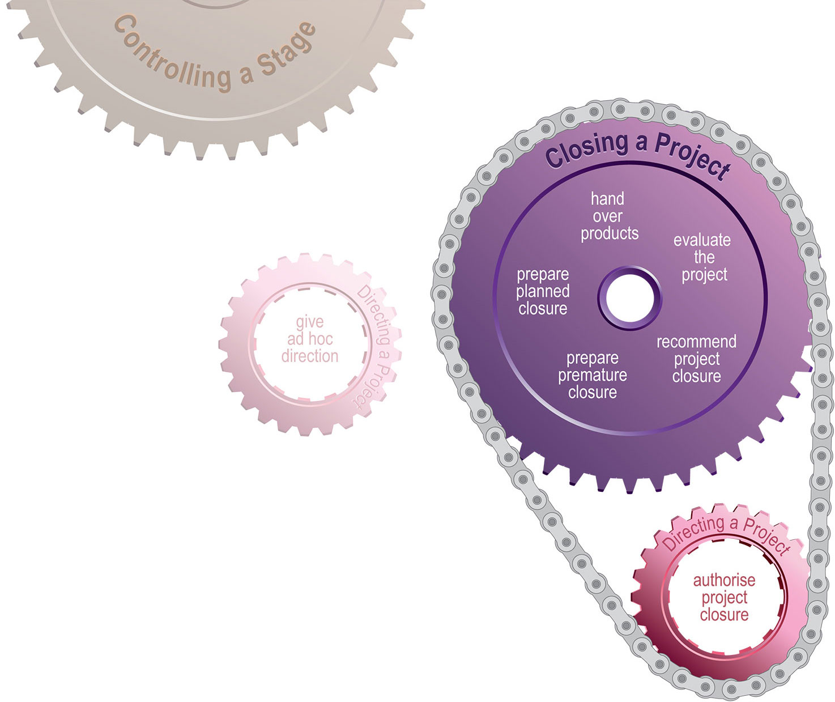
Introduction
Closing a Project
Manual 205
Workbook 277

Slide 17
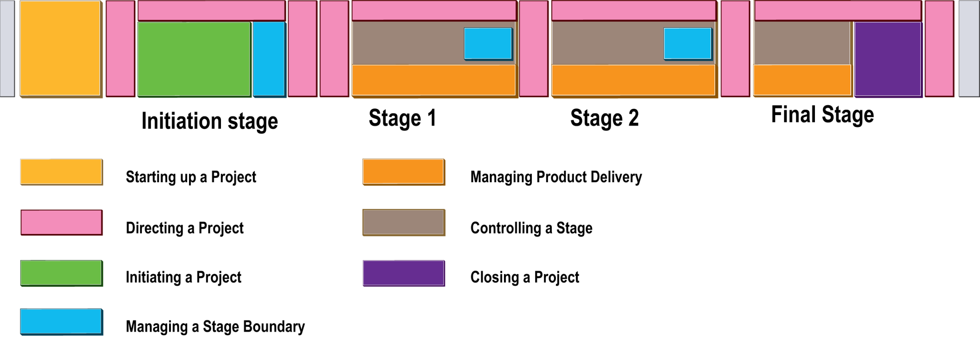
Introduction
Process time line

Slide 18
Introduction
Tailoring PRINCE2
Customer:supplier environment
Embedding
  Adoption across the organisation
  Responsibilities, scaling, training, standards
Tailoring
  Performed by the project management team
  Adapt themes, incorporate terms, revise product descriptions
  Consider size, complexity, risk and importance

Slide 19
Introduction
Summary
Project is temporary to deliver a Business Case
Principles – can you remember them?
Themes – aspects to be addressed continually
Processes – step-wise progression
Projects vs programmes
Customer:supplier environment

